Slide 1
Systems Analysis & Design CS183 Spring Semester 2008
Dr. Jonathan Y. Clark
Email: j.y.clark@surrey.ac.uk
Course Website: www.computing.surrey.ac.uk/personal
/st/J.Y.Clark/teaching/sad/cs183.html
Reference Book: Systems Analysis and Design with UML Version 2.0: An Object-Oriented Approach [Second Edition], by Alan Dennis, Barbara Haley Wixom and David Tegarden.
Notes:
This is the main course text, essentially defining the course. You will find it of great help to have access to a copy of this book. Each lecture is based on one or more chapters of the book

Slide 2
Course Textbook: Systems Analysis and Design With UML 2.0 An Object-Oriented Approach, Second Edition
Chapter 1:
Introduction to Systems Analysis and Design
Alan Dennis, Barbara Wixom, and David Tegarden
© 2005
John Wiley & Sons, Inc.

Slide 3
Adapted from slides Copyright © 2005 John Wiley & Sons, Inc.

Slide 4
INTRODUCTION
Chapter 1

Slide 5
Key Ideas
Many failed systems were abandoned because analysts tried to build wonderful systems without understanding the organization.
The primarily goal is to create value for the organization.
Quality is satisfaction of requirements, not ‘goodness’. Take note of this!

Slide 6
Key Ideas
The systems analyst is a key person analyzing the business, identifying opportunities for improvement, and designing information systems to implement these ideas.
It is important to understand and develop through practice the skills needed to successfully design and implement new information systems.

Slide 7
THE SYSTEMS DEVELOPMENT LIFE CYCLE (SDLC)

Slide 8
Major Attributes of the Lifecycle
The project
Moves systematically through phases where each phase has a standard set of outputs
Produces project deliverables
Uses deliverables in implementation
Results in actual information system
Uses gradual refinement

Slide 9
4 Main Project Phases
Planning
Why build the system?
Analysis
What, when, where will the system be?
Design
How will the system work?
Implementation
System construction & delivery

Slide 10
Planning
Identifying business value (is it worth doing?)
Analyze feasibility (is it possible?)
Develop work plan (when?)
Staff the project (who?)
Control and direct project

Slide 11
Analysis
Analysis (what do we want? Who will use the system?)
Information gathering
Process modelling (what happens?)
Data modelling (… and to what?)

Slide 12
Design
Design strategy
Architectural design
Interface design (HCI)
Database and file design
Program design (what will the programs do?)

Slide 13
Implementation
Construction (Programming, testing, validation etc)
Installation (including migration, change management)

Slide 14
Processes and Deliverables
Process
Product
Project Plan
System Proposal
System
Specification
New System and
Maintenance Plan
Planning
Analysis
Design
Implementation

Slide 15
SYSTEM DEVELOPMENT Methodologies

Slide 16
What Is a Methodology?
A formalized approach or series of steps
Writing code without a well-thought-out system request may work for small programs, but rarely works for large ones.

Slide 17
System Development Methodologies
Structured Design
Rapid Application Development
Agile Development

Slide 18
1. STRUCTURED DESIGN
Projects move methodically from one to the next step
Generally, a step is finished before the next one begins

Slide 19
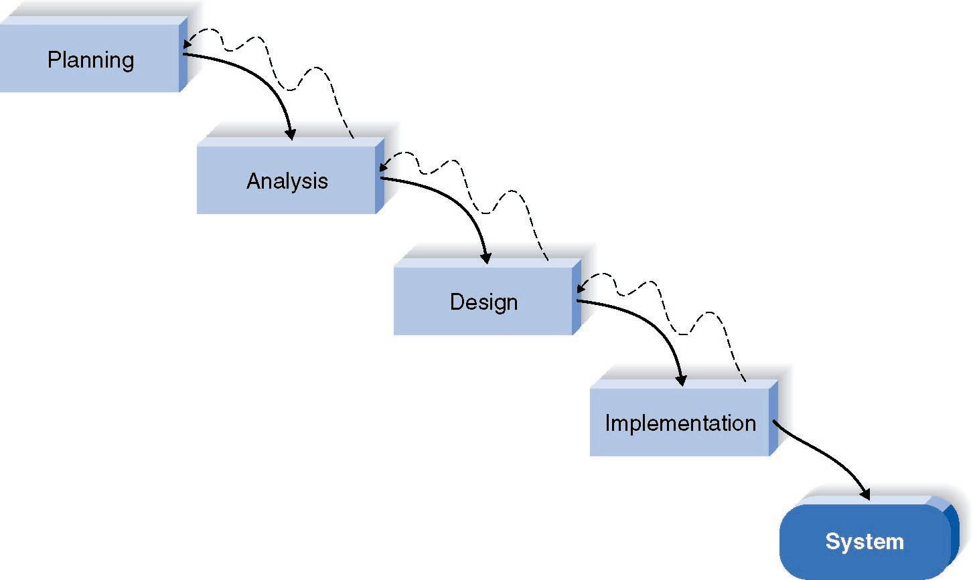
Waterfall Development Method

Slide 20
Pros and Cons of the Waterfall Method
Pros
Cons
Identifies systems
requirements long
before programming
begins
Design must be
specified on paper
before programming
begins
Long time between
system proposal and
delivery of new
system

Slide 21
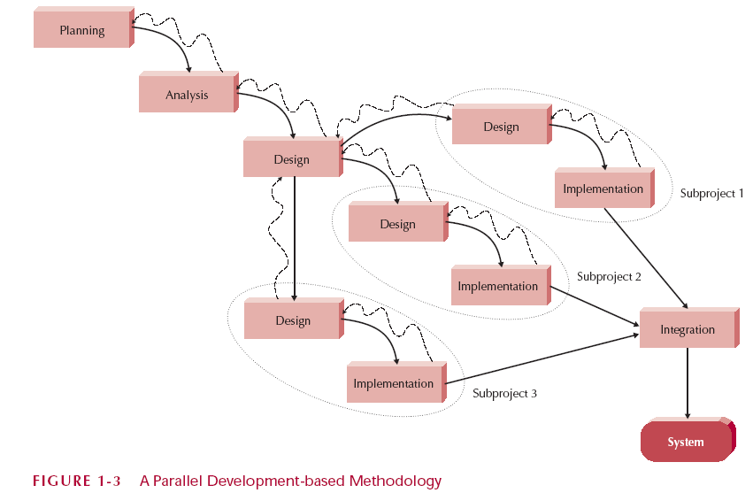
Parallel Development

Slide 22
2. RAPID APPLICATION DEVELOPMENT (RAD)
Critical elements
CASE tools
JAD sessions
Fourth generation/visualization programming languages
Code generators

Slide 23
Rapid Application Development Categories
Phased development
a series of versions, later combined
Prototyping
System prototyping
Throw-away prototyping
Design prototyping

Slide 24
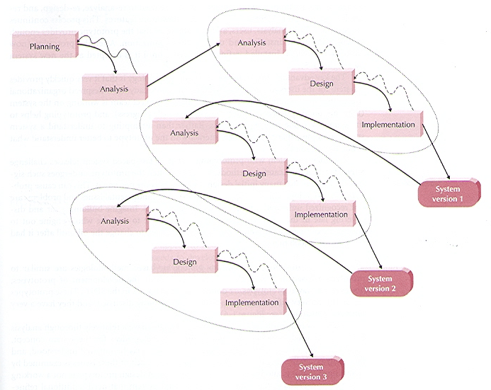
Phased Development

Slide 25
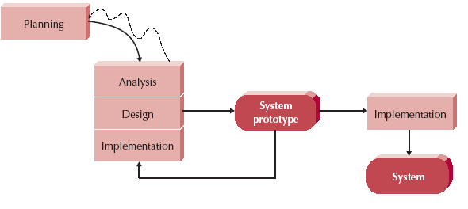
How Prototyping Works

Slide 26
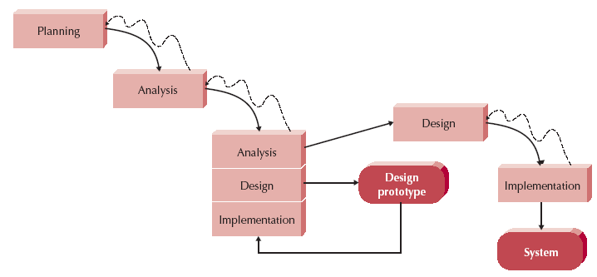
Throwaway Prototyping

Slide 27
3. AGILE DEVELOPMENT
Simple iterative application development
Extreme programming (XP)

Slide 28
Extreme Programming (XP)
Key principles
Continuous testing
Simple coding by pairs of developers
Close interactions with end users
Testing & Efficient Coding Practices
Integrative testing environment
Requires…
Stable and experienced teams
Small groups of developers (<=10)

Slide 29
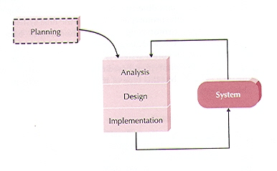
Extreme Programming (XP)

Slide 30
Selecting the Appropriate Methodology
Clarity of User Requirements
Familiarity with the Technology
System Complexity
System Reliability
Length of Time Schedules
Time Schedule Visibility

Slide 31
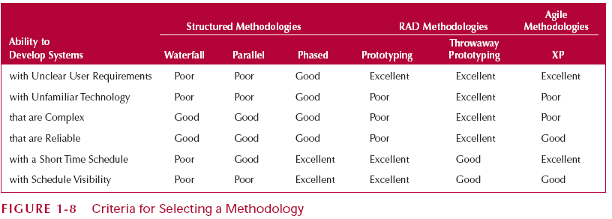
Criteria for Selecting a Methodology

Slide 32
Project Team Roles and Skills

Slide 33
Project Team Roles
Business analyst (business value)
Systems analyst (IS issues)
Infrastructure analyst (technical issues – how the system will interact with the organization’s hardware, software, networks, databases)
Change management analyst (people and management issues)
Project manager (budget, time, planning, managing)

Slide 34
Summary
The Systems Development Life Cycle (SDLC) consists of four stages: Planning, Analysis, Design, and Implementation
The Major Development Methodologies:
Structured Design
Waterfall Method
Parallel Development
Rapid Application Development (RAD)
Phased Development
Prototyping (system prototyping)
Throwaway Prototyping (design prototyping)
Agile development
eXtreme Programming
Project Team Roles

Slide 35
Summary -- Part 2
There are five major team roles: business analyst
systems analyst
infrastructure analyst
change management analyst
project manager.

