Slide 1
Blackwell Electronics’ General Business Analysis based on Data Keyla Méndez and Jonathan Ayala G. 04-07-2019

Slide 2
Points to review
Customer Brand Preferences
Predicting products sales
Market basket analysis

Slide 3
Process to transform Data into Information.
first
second
third
last
Analyze Data
Determine Profitability
Final Decisions
Analyze preferences customers

Slide 4

Customer brand preferences
The data that was given to us for this analysis was performed with stratified sampling,
The strata or groups are formed based on members’ shared attributes, for example, the salary.

Slide 5
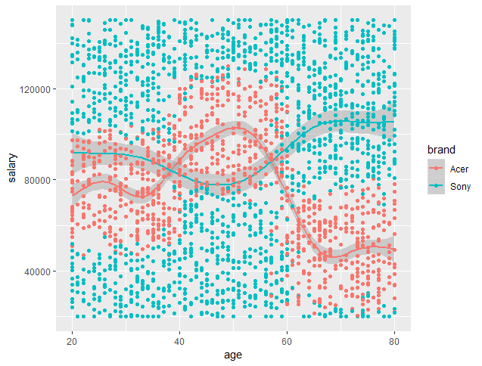
Customer brand preferences
The elderly customers with a low salary tend to choose Acer over Sony as their preferred brand.
Regardless the age, all these customers with a salary higher than 120k USD per year tend to chose Sony Over Acer.

Slide 6
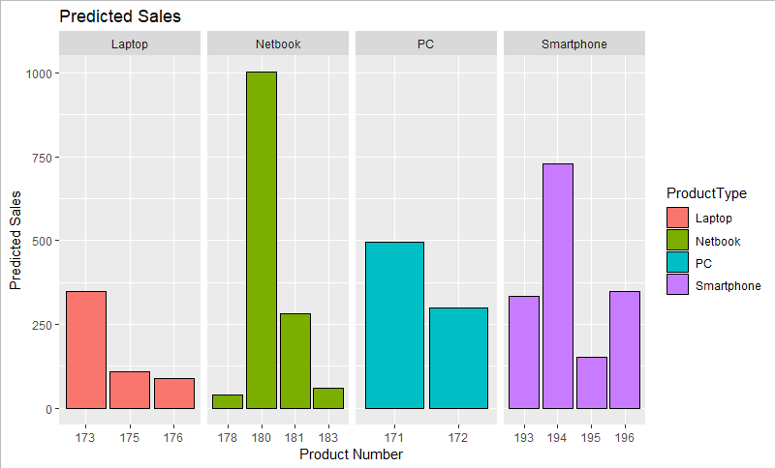
Predicting products sales

Slide 7

Market basket analysis
Electronidex
Blackwell Electronics

Slide 8
Blackwell - Electronidex

Slide 9
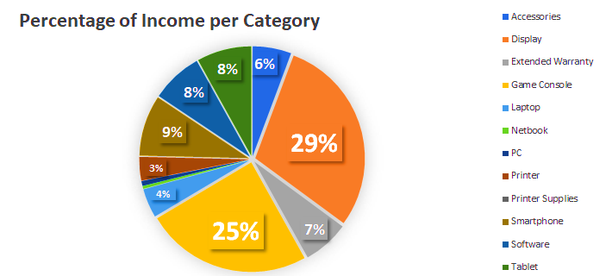
Blackwell - Electronidex

Slide 10
Apple
Laptops
A very high percentage of Electronidex’s customers tend to purchase Monitors from the LG brand when they purchase brand new or second hand Apple Laptops.
Blackwell also has these Monitors from the LG brand in its portfolio.
So it could be very profitable to incorporate Laptops from Apple in Blackwell’s portfolio.

Slide 11
Apple Warranty
The Smartphone category represents around the 10% of Blackwell’s income, however the Apple Smartphones only accounts for less than the 0,5 % out of this 10%
Around the 30% of those who buys an Extended Warranty tend also to buy an Smartphone from Apple.

Slide 12
Apple
Tablets
It was also detected that those customers who buy Apple Tablets also tend to buy some accessories during the same transaction.
The acquisition of Apple Tablets to be offered to Blackwell’s clients would boost the sales of a category that provides a high margin of profit .
Accounts by a 8% of the total income of Blackwell Electronics.

Slide 13
Conclusions and Recommendations
Increase the details in the Blackwell’s Data-warehouse (subcategories)
Know Electronidex’s margin of profit for each product.
Work with a bigger sample of Completed Transactions (20%)
More sales on high profitable products -> Increase on NET INCOME

Slide 14
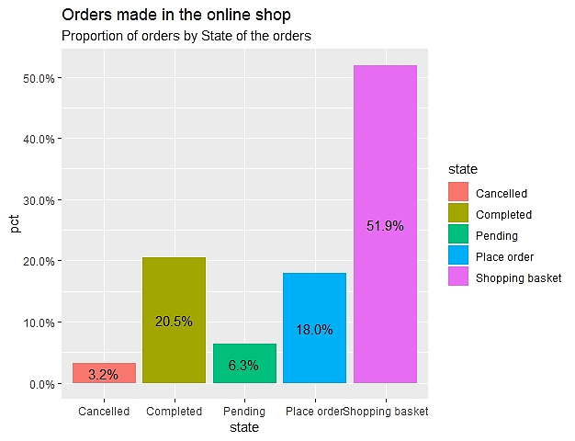
Total percentage for each order’s state.

Slide 15
Conclusions and Recommendations
Increase the details in the Blackwell’s Data-warehouse (subcategories)
Know Electronidex’s margin of profit for each product.
Work with a bigger sample of Completed Transactions (20%)
More sales on high profitable products -> Increase on NET INCOME

Slide 16
Thanks!

Slide 17
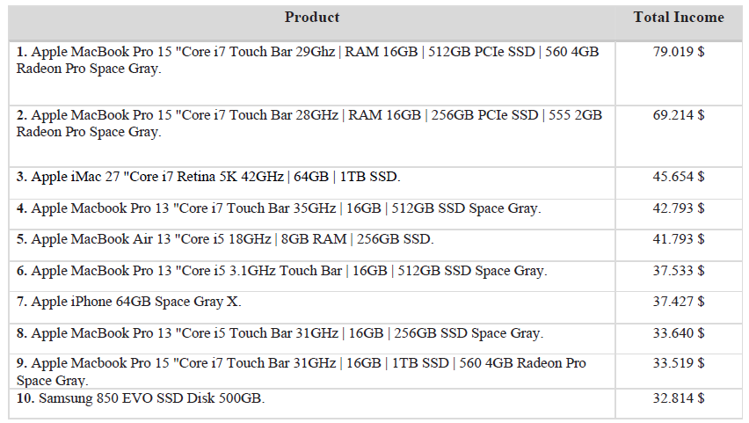

Slide 18
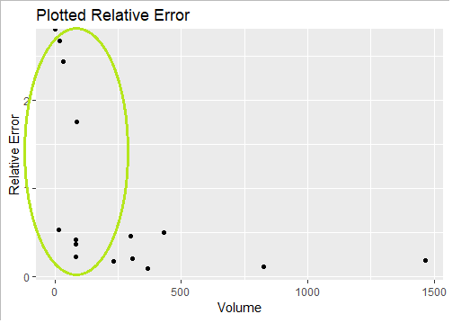
As can be seen in the chart above, as the sales volume increases, the relative errors tend to be lower. which means that the model created performs better with product types which present a very high volume. However, as can be seen in the chart, most of the products analysed (76 % of the product types studied) are located within the green circle zone, which is a zone where the model created perform poorly.

Slide 19
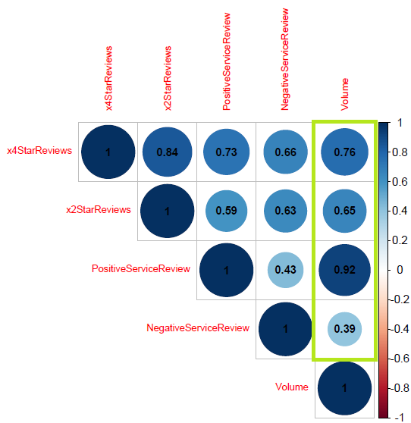

Slide 20

As can be seen in the results above, the SMV-Linear and the Random Forest algorithms were the best performers. The SMV-Linear was chosen to make the sales prediction per category even though it had worst Mean Absolute Error than the Random Forest (meaning that the average error on the predictions was higher) because we considered that the gain on how well the model explained the data (R-squared) was worth the trade-off as we got an acceptable level of confidence and a tolerable level of error.

Slide 21
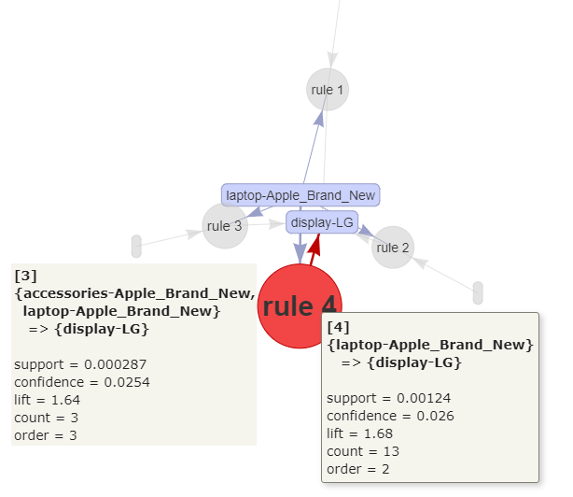

Slide 22
