Slide 1
RAG system evaluation

Slide 2
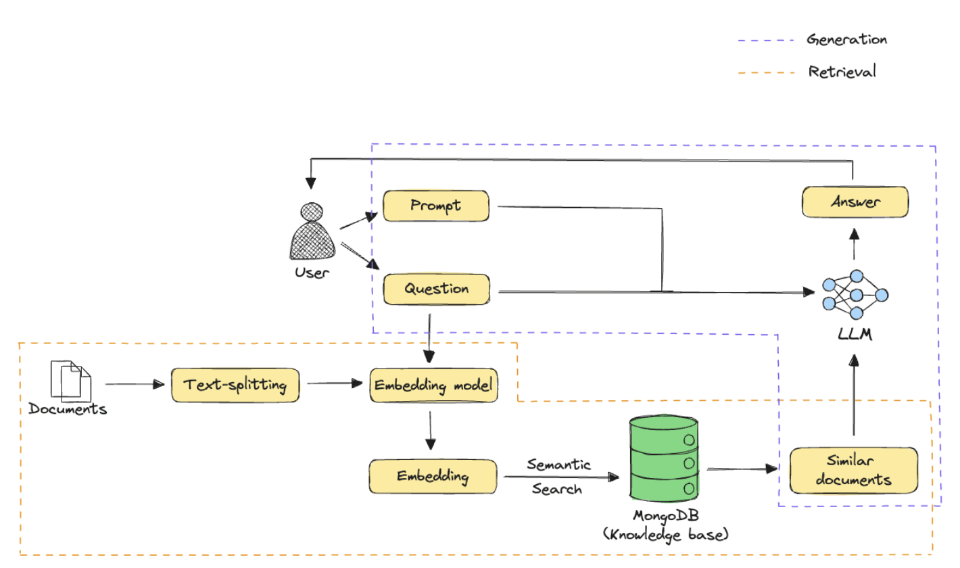
Retrieval Augmentation Generation (RAG)
The main elements to evaluate in a RAG application are as follows:
Retrieval: This involves experimenting with different data processing strategies, embedding models, etc., and evaluating how they impact retrieval.
Generation: Once you decide on the best settings for the retriever, this step involves experimenting with different LLMs to find the best completion model for the task.

Slide 3
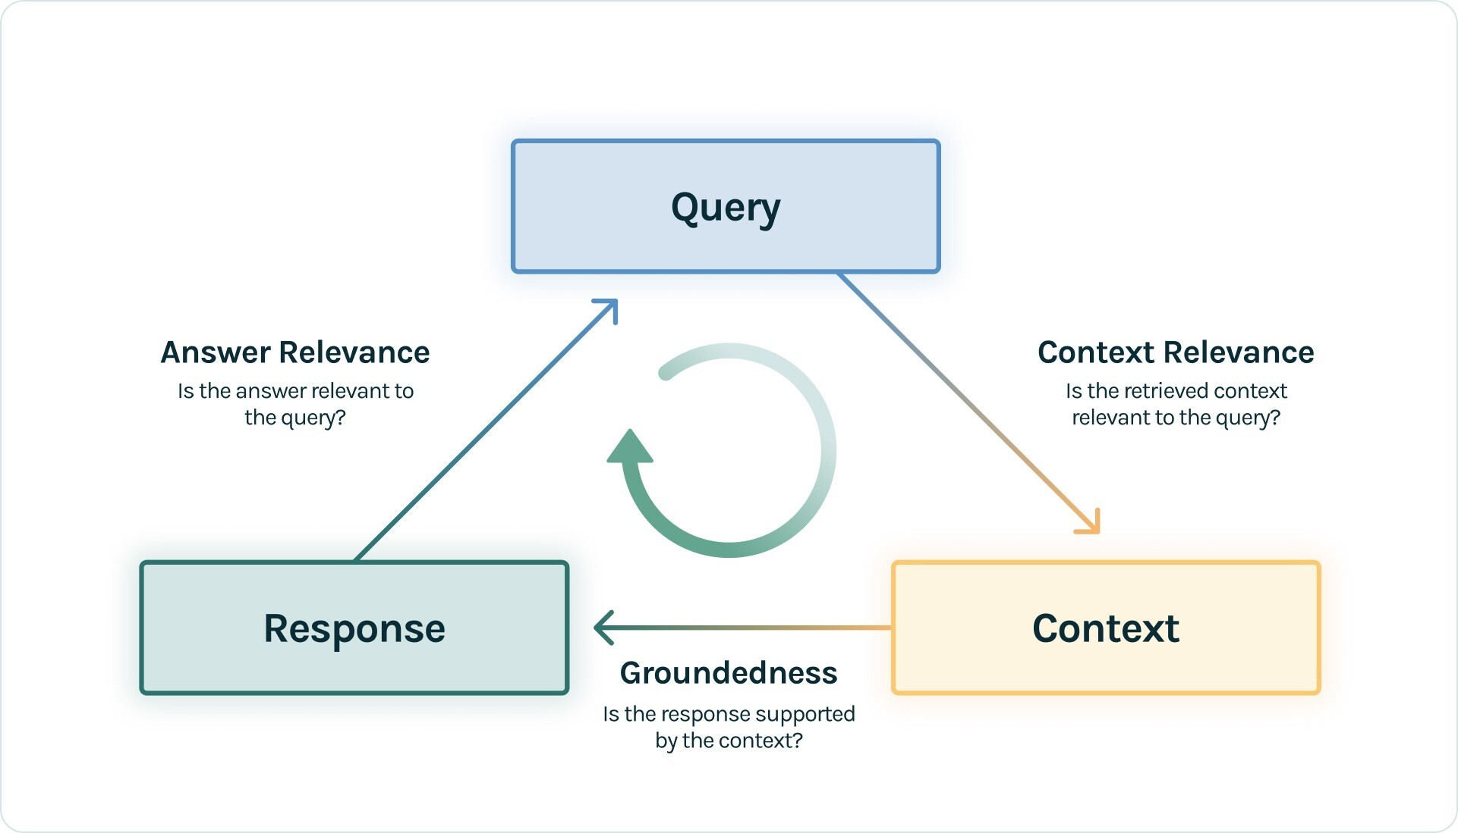
RAG TRIAD framework
Context Relevance: This component evaluates the retrieval part of the RAG system. It evaluates how accurately the documents were retrieved from the large dataset. Metrics like precision, recall, MRR, and MAP are used here.
Faithfulness (Groundedness): This component falls under the Response evaluation. It checks if the generated response is factually accurate and grounded in the retrieved documents. Methods such as human evaluation, automated fact-checking tools, and consistency checks are used to assess faithfulness.
Answer Relevance: This is also part of the Response Evaluation. It measures how well the generated response addresses the user's query and provides useful information. Metrics like BLEU, ROUGE, METEOR, and embedding-based evaluations are used.
https://www.trulens.org/trulens_eval/getting_started/core_concepts/rag_triad/

Slide 4
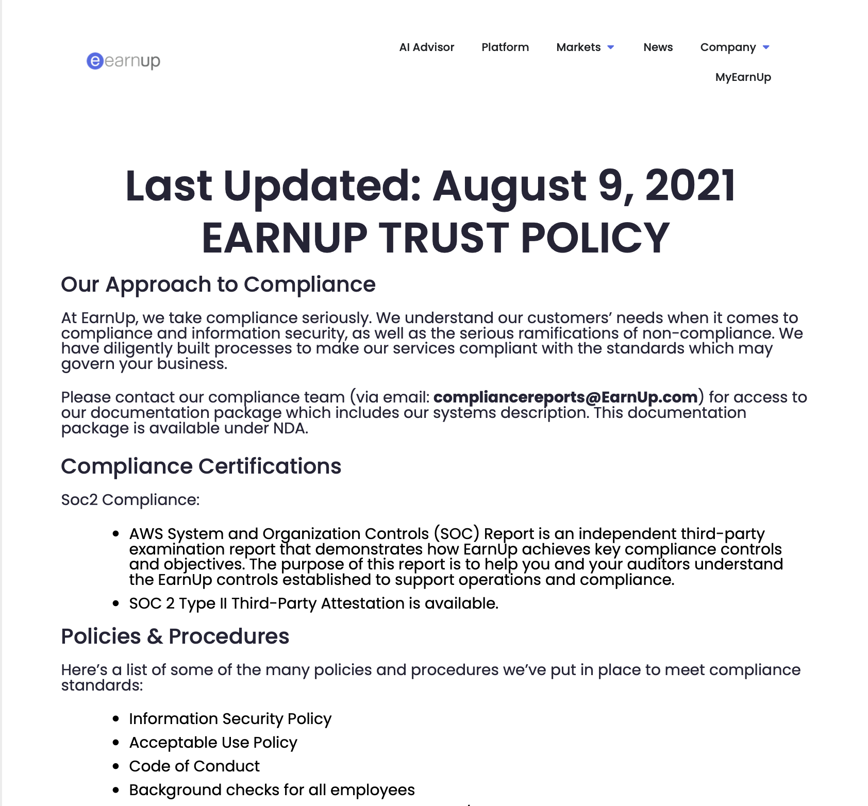

Document used
To reproduce the process of ingesting documents, EarnUp Trust policy and Privacy Policy were converted to PDF files
RAG system:
Used ChromaDB
openAI embedding (text-embedding-3-small)
12 pages split in chunks of size 100 with overlap (10)

Slide 5
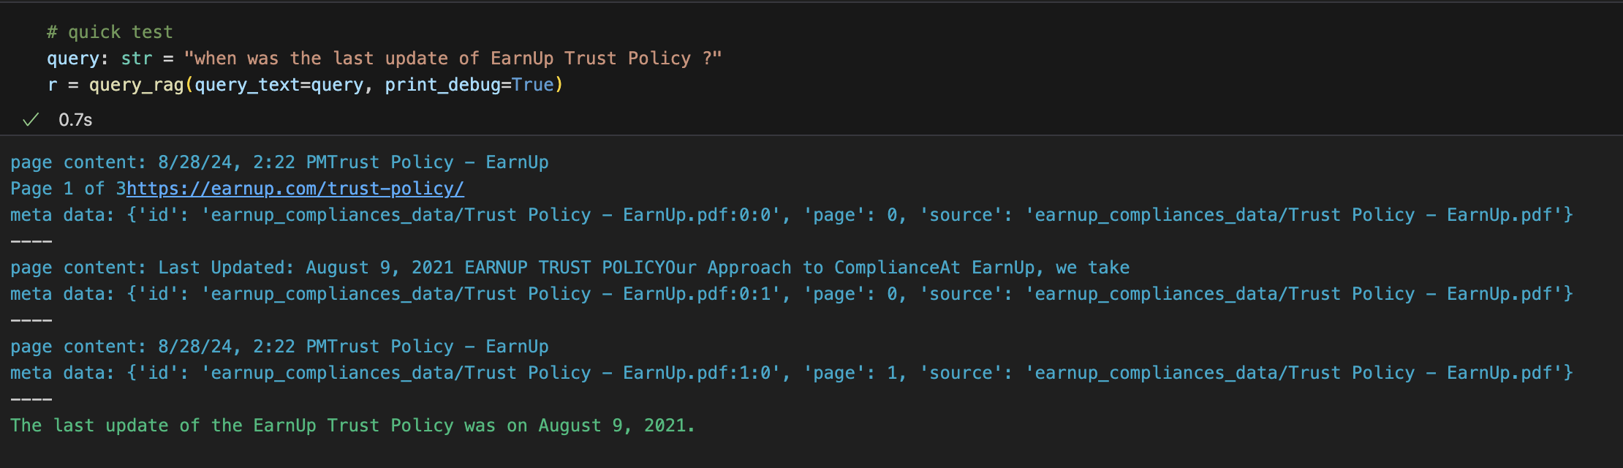
Quick Test
User query
Documents retrieved
Documents ingested by the LLM then answer formatted by the LLM

Slide 6
RAGAS
https://docs.ragas.io/en/stable/

Slide 7
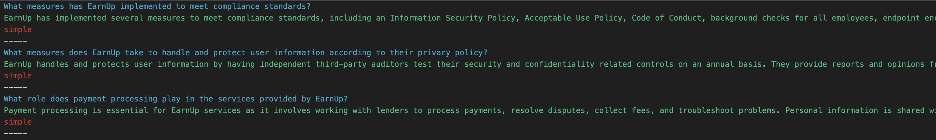
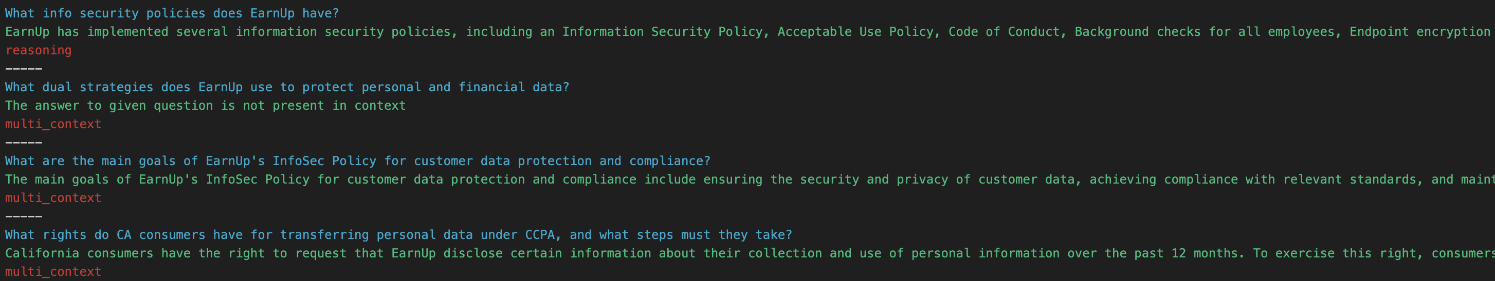
Generation of questions / answers
Creation of questions and answers (“ground truth”) based on the original pdf files
Level of complexity in the questions

Slide 8
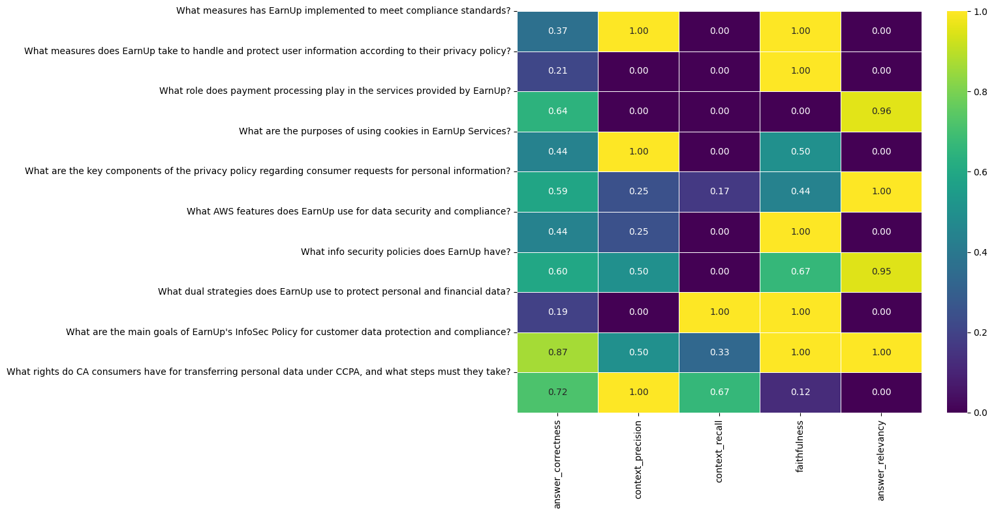
Evaluation of the RAG

Slide 9
TruLens
https://www.trulens.org

Slide 10
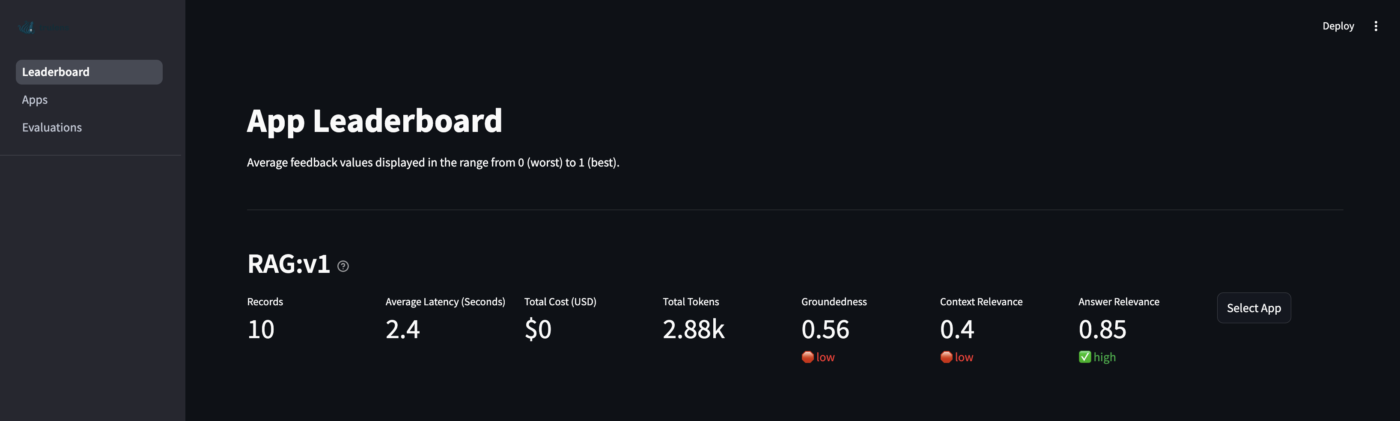

Slide 11
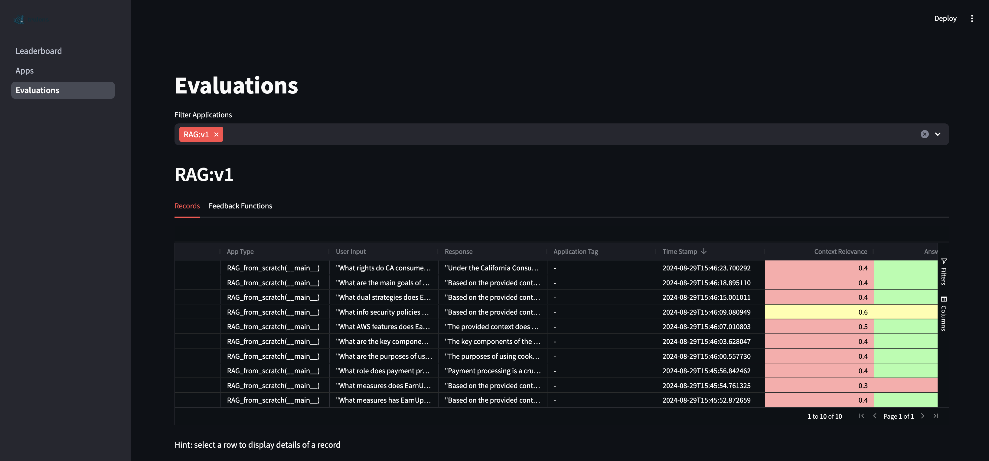

Slide 12
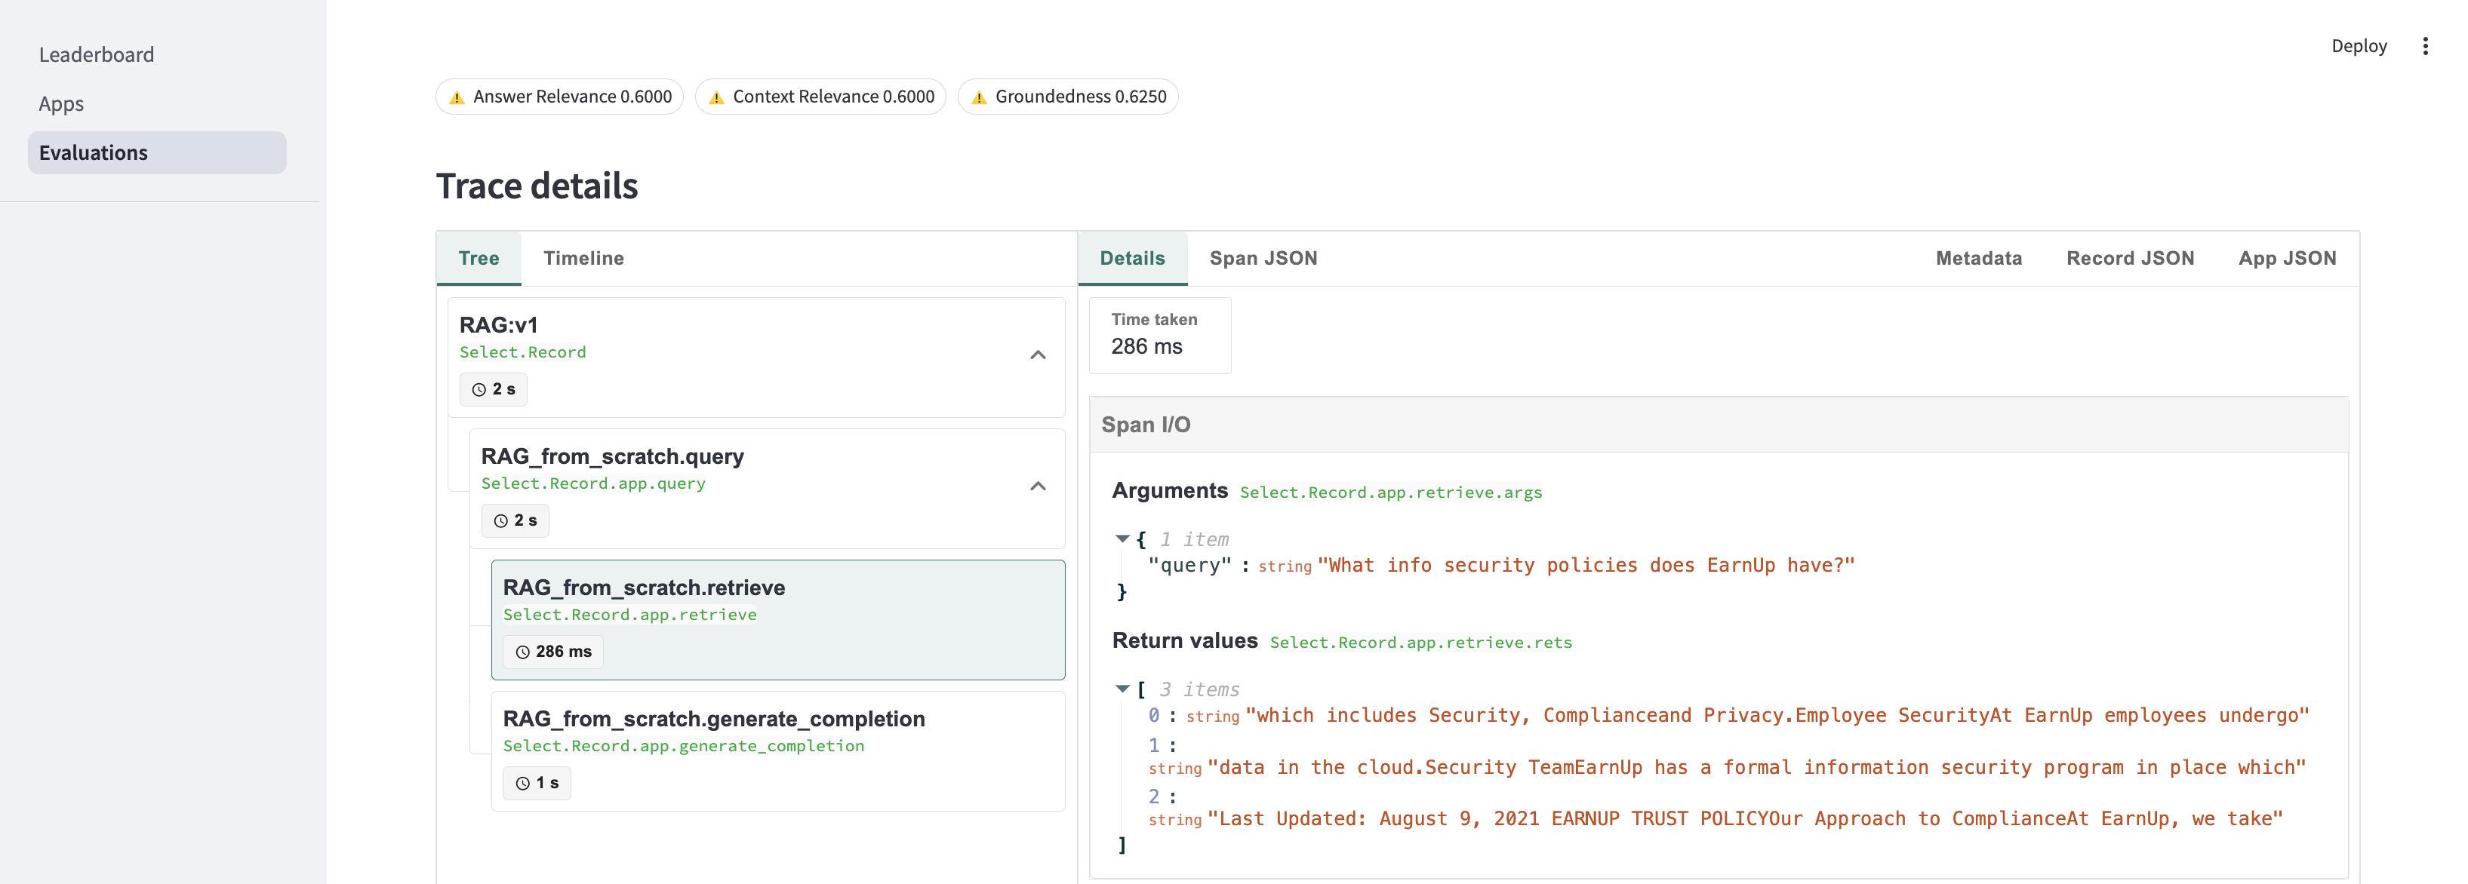
Trace details for retrieval part

Slide 13
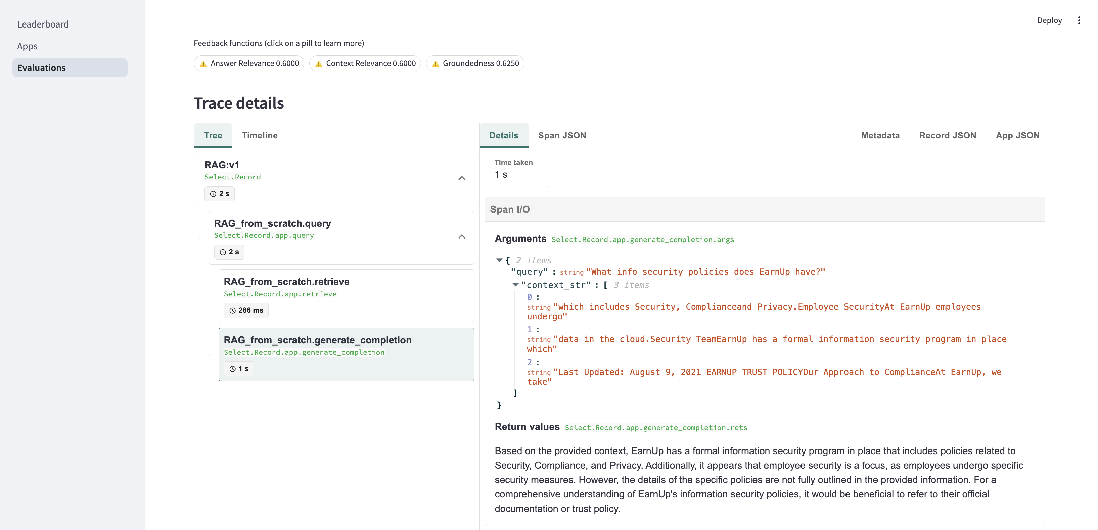
Trace details for generation part

Slide 14
Ragas: type of questions
Ragas employs a sophisticated approach to generate a diverse set of questions for evaluating Retrieval-Augmented Generation (RAG) systems. Here are the types of questions that can be generated:
Simple Questions: These are straightforward questions that require direct answers and minimal reasoning.
Reasoning Questions: These questions are designed to enhance the need for reasoning to answer them effectively. They require the synthesis of information and logical deduction.
Conditional Questions: These questions introduce a conditional element, adding complexity and requiring the understanding of specific conditions to provide the correct answer.
Multi-Context Questions: These questions necessitate information from multiple related sections or chunks of the provided documents, demanding a broader understanding and correlation of information.
Conversational Questions: Following the evolution process, some questions are transformed into conversational samples. These simulate a chat-based question-and-follow-up interaction, mimicking a chat-Q&A pipeline.

