Slide 1
Final Project of Bioinmormatics
Expression Divergence of Chemosensory Genes
between Drosophila sechellia and Its Sibling Species
and Its Implications for Host Shift
111753156 - 陳羽暉
111753166 - 邱鉅樺
111753170 - 山本遙人
2023/01/12

Slide 2
Intoroduction and Purpose of the paper
Main Purpose ; Figure out how chemosensory genes have contributed to Drosophila sechellia’s host shift.
Drosophila sechellia relies exclusively on the fruits of Morinda citrifolia, which are toxic to most insects, including its sibling species Drosophila melanogaster and Drosophila simulans.
In previous work, odorant binding protein (Obp) genes and olfactory receptor (Or) genes have been suggested to associated to the host shift
Study the transcriptomes of antennae to know whether gene expression, particularly chemosensory genes, has diverged between D. sechellia and its two sibling species.

Slide 3
Original Method of the paper
Sample Collection of antennae and RNA Isolation
Paired-End mRNA-seq using the TruSeq v2 kits from Illumina
For RNA-seq analysis, the 100-bp paired-end sequencing reads were mapped to the reference genome using TopHat 2.0.6 (Trapnell et al. 2009), with allowance of twomismatches in read mapping to the reference genome.
Generating Orthologous Gene Set and Identifying DEGs
Gene annotation tables of the three species were retrieved from FlyBase. The potential bias from sequencing between different samples was normalized by upper quartile implemented in NOISeq. also Computes FPKM.
Quantitative Reverse Transcription Polymerase Chain Reaction
Using NanoString quantitative reverse transcription polymerase chain reaction (qRT-PCR) technology to verify the gene expression levels estimated with RNA-seq.
Analize FPKM data of its 3 species.

Slide 4
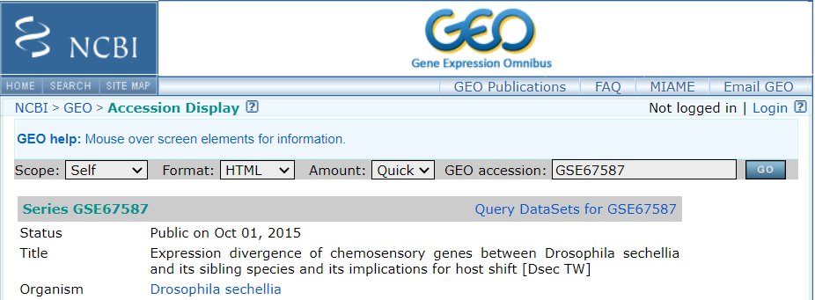

Sequencing data
Where to download it?
The raw sequencing data reported in this work have been deposited in the NCBI GEO with accession numbers GSE67587, GSE67861 and GSE67862 for D. sechellia (Taiwan), D. sechellia (Japan) and D. simulans (Japan), respectively.
How big in terms of GB? in terms of reads?
GSE67587: 24.9GB 6 samples (3 males and 3 females)
GSE67861: 26.13GB 6 samples (3 males and 3 females)
GSE67862: 24.5GB 6 samples (3 males and 3 females)
In addition to raw dara, There is a Supplementary file which contain FPKM on NCBI

Slide 5
Where all Sequencing Data that the paper used comes from
D. sechellia_Male_TW , D. sechellia_Female_TW
→ GSE67587 on NCBI
D. sechellia_Male_JP, D. sechellia_Female_JP
→ GSE67861 on NCBI
D. melanogaster_Male, D. melanogaster_Female
→ from Shiao et al. (2013) were included for analysis
D. simulans_Male_JP, D. simulans_Female_JP
→ GSE67862 on NCBI

Slide 6
Introduction of tools that we used
In this paper:
Flybase: Using FlyBase ID to search the corresponding Symbol ID.
TopHat 2.0.6: To analysis the RNA-seq.
NanoString: To verify the gene expression levels estimated with RNA-seq.
NOISeq: Statistical methods for analyzing RNA-seq data.
pvclust: Bootstrap.
Professor’s suggestion:
STAR: RNA-seq alignment.
DEseq2: Statistical methods for analyzing RNA-seq data.
We use:
pvclust: Bootstrap.
limma: Caculate the DEG.

Slide 7
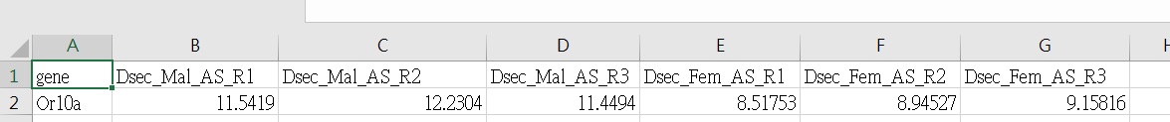
How to reproduct the result of the paper with the tools
Download Supplementary file which contains FPKM from NCBI
Compute TPM from FPKM implemented in the limma (R package)
Compute Degs from TPM
Creating heatmaps with each species’s FPKMs average value
heatmap(heat_or_scale)
Do multiscale bootstrap resampling implemented in the pvclust (R package)
plot(or_bp)
Demo
Notes:
How do we calculate expression levels? -->mapping => count => NOrmarized —FPKM Fragments Per Kilobase of exon per Million mapped reads

Slide 8
Result
What do you find?
There were ten genes consistently expressed at FPKM> 1,000 in all three species:Obp19a, Obp19d, Obp28a, Obp56d, Obp69a, Obp83a, Obp83b, and lush.
Among the Or genes, Orco was expressed at the highest level in all samples, at FPKM> 1,000 in both D. melanogaster and D. simulans and >500 in D. sechellia.
Higher FPKMs value mean those genes are more developed.
We find match result is same species but not same area will classify by sex and not same species just classify by itself.
Does your finding match the results published?
Heatmaps classify is match with our result.
About DEGs:
The analysis showed that chemosensory genes were enriched in the DEGs in the antennae of both D. sechellia and D. simulans, but there was a higher percentage of chemosensory genes differentially expressed in D. sechellia.

Slide 9
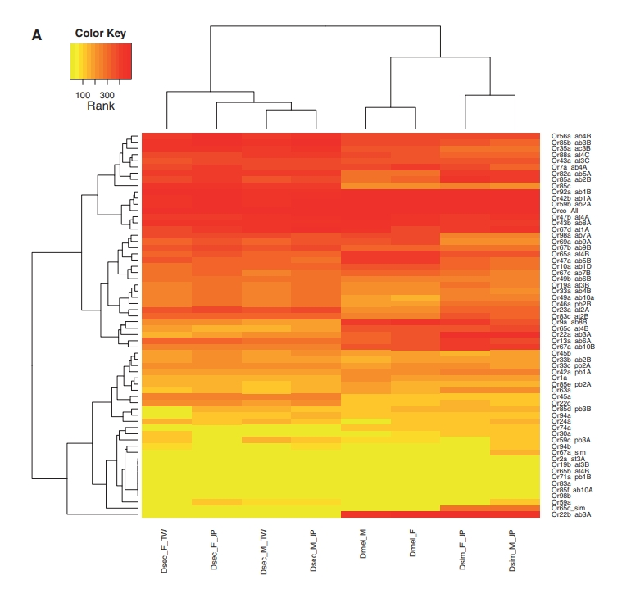
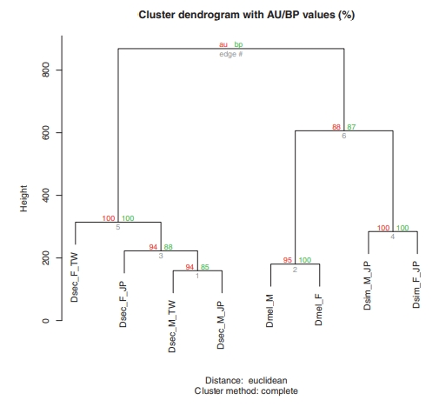
heatmap_or_paper
pvclust_or_paper

Slide 10
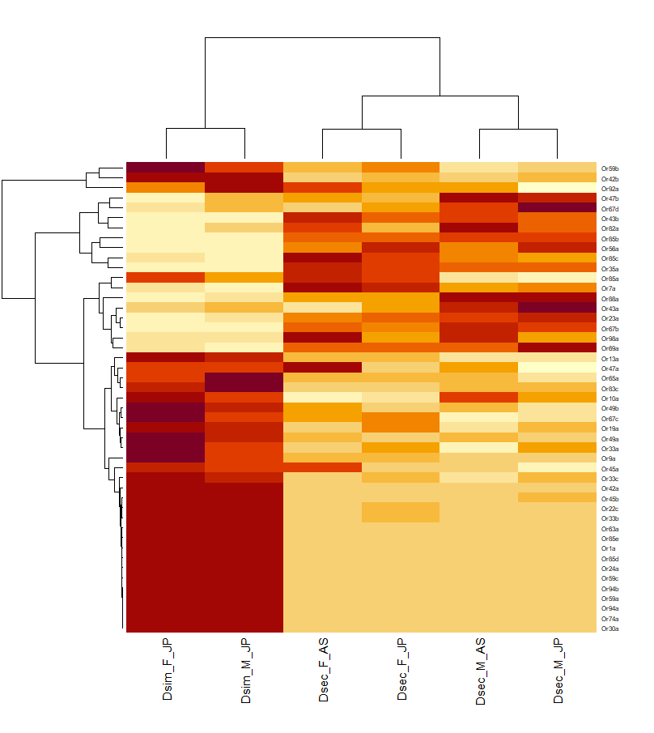
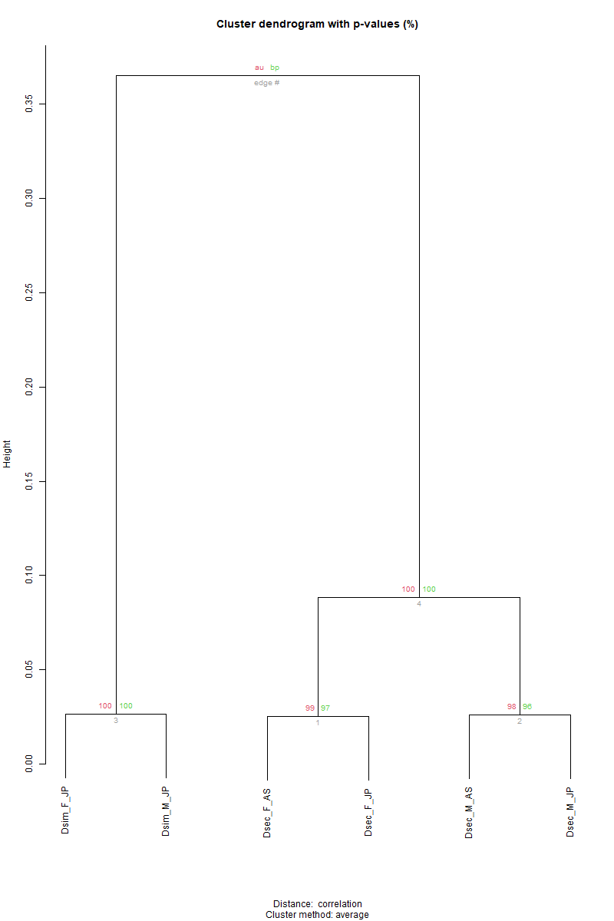
heatmap_or_our_result
pvclust_or_our_result

Slide 11
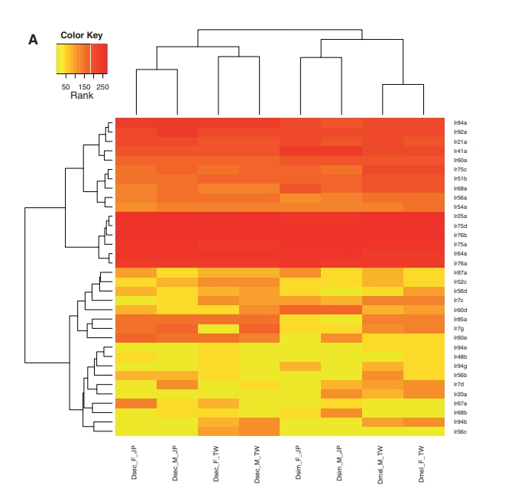
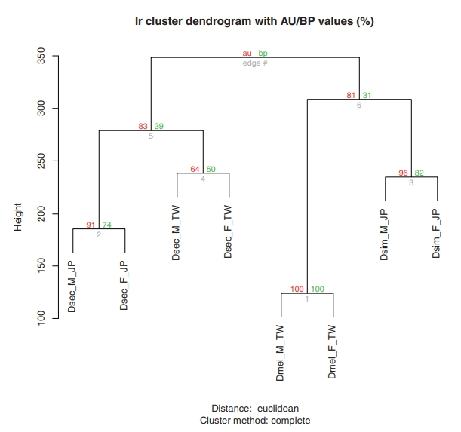
heatmap_ir_paper
pvclust_ir_paper

Slide 12
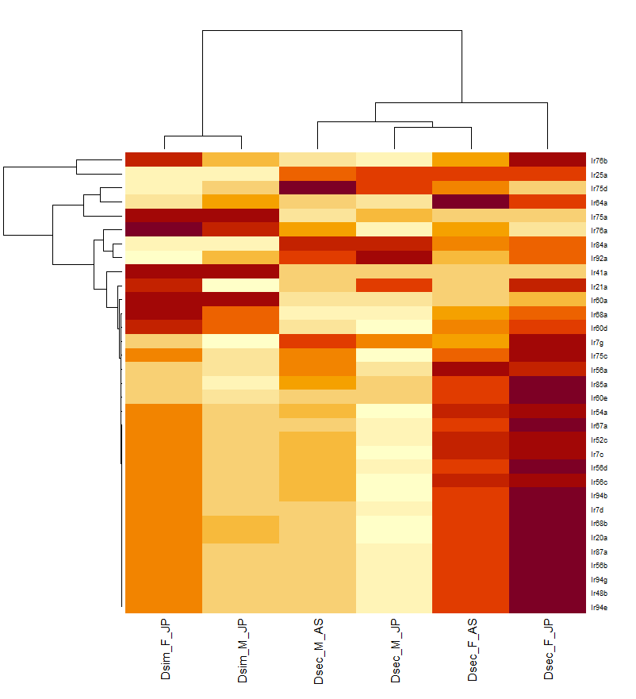
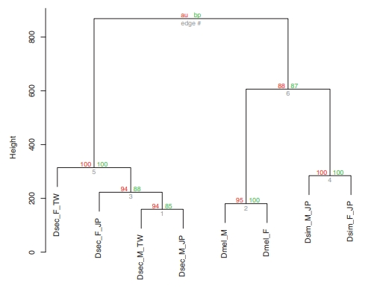
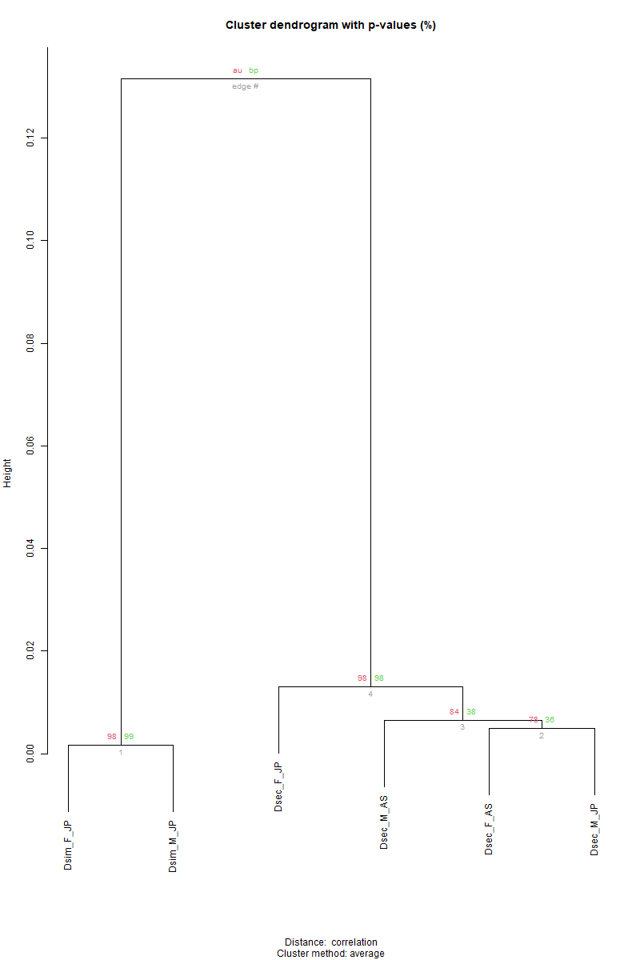
heatmap_ir_our_result
pvclust_ir_our_result

Slide 13
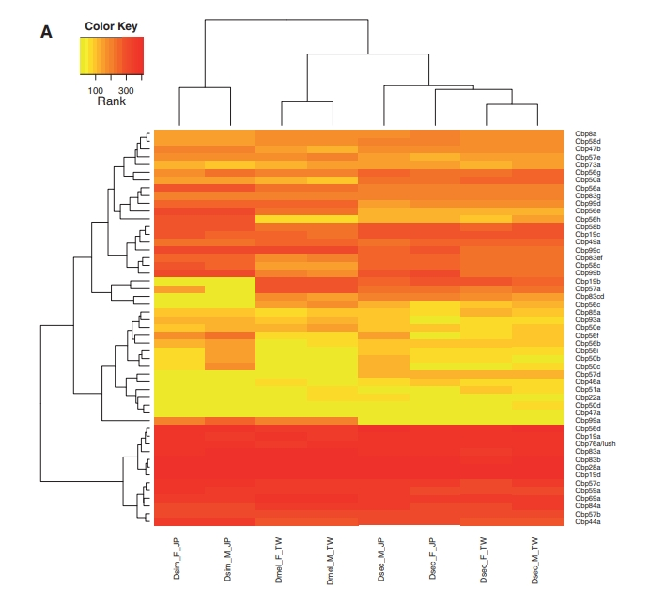
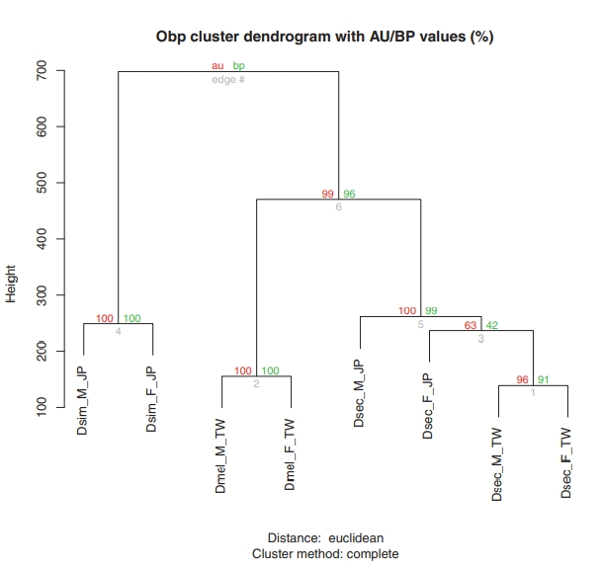
heatmap_obp_paper
pvclust_obp_paper

Slide 14
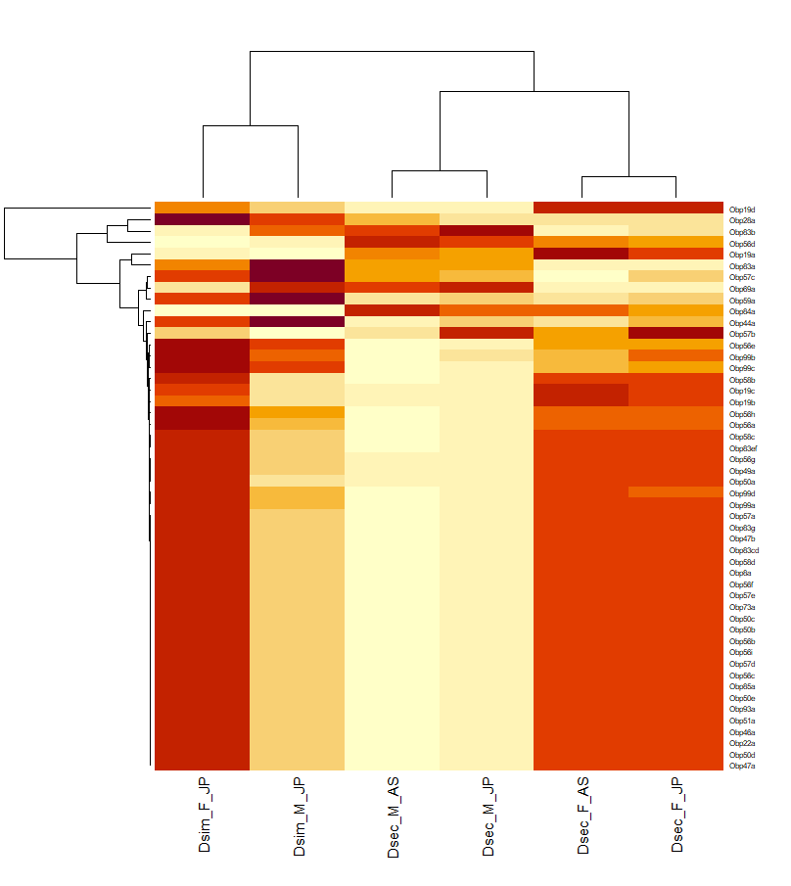
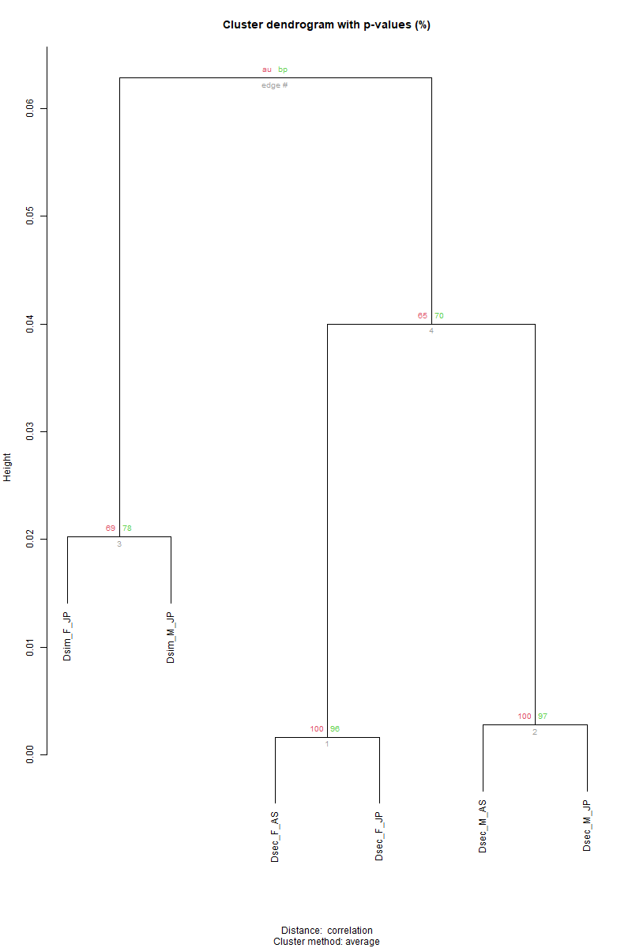
heatmap_obp_our_result
pvclust_obp_our_result

Slide 15
Reproducibility
How to document our project and maintain our code?
Check our final project repository on github,
all information about our project are shown on github
Our code is perfectly written by R, and maintain our code on studio well.
How to reproduce our result?
Download all csv files from our github.
Install packages (limma and pvclust)
Running our code from guithub on R
finally using command to get heat map and tree (boostrap) and get same result as ours

Slide 16
How did we coorpolate (team work)
Understood the detail of main Materials, Methods and Results well together.
Understood how to use tool and setup helping each other.
and also found a useful tool.
Discussed many times to obtain results that we expect.
Recreated the Heat maps and Cluster dendrogram together.
陳羽暉: Created Main program and prepared our results
邱鉅樺: Found useful tool (limma) and organized datasets
山本遙人: Made outline of slides and supported to implement

