Slide 1
Programmation C# && PHP/HTML
Un peu de théorie…

Slide 2
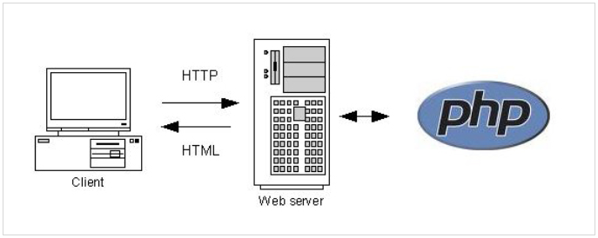

Slide 3
Syntaxe générale
C# | HTML | PHP
instruction; | <balise>contenu<balise> | instruction;
répétition, condition,… | uniquement descriptif | répétition, condition,…
Particularités
C# | HTML | PHP
compilé en avance ou en live | attributs de balise <x attr1=""> | compilé en live
compilation pointilleuse et précise | syntaxe permissive / tolérante | types (int, float, …) dynamiques

Slide 4
Affichage
C# | PHP/HTML
Console.WriteLine("Hello"); | echo "Hello<br />";
Console.Write("Hello") | echo "Hello";
Console.ForeColor = Color.Red; Console.Write("red"); | echo "<font color=red>Hello</font>";

Slide 5
Présentation
C# | HTML
//Colonne 1 Console.SetCursorPosition(0*1/3*Console.WindowWidth,0); Console.Write("Colonne 1"); //Colonne 2 Console.SetCursorPosition(1*1/3*Console.WindowWidth,0); Console.Write("Colonne 2"); //Colonne 3 Console.SetCursorPosition(2*1/3*Console.WindowWidth,0); Console.Write("Colonne 3"); | <!-- Librairie CSS --> <script src="https://cdn.tailwindcss.com"></script> <!-- Colonnes --> <div class=grid grid-cols-3> <div>Colonne 1</div> <div>Colonne 2</div> <div>Colonne 3</div> </div>

Slide 6
Saisie
C# | PHP/HTML
int x = Convert.ToInt32(Console.ReadLine()); | <form action=input.php> <input name=x> <input type=submit> </form> $x = $_GET["x"];
string text = Console.ReadLine(); | <form action=input.php> <input name=text> <input type=submit> </form> $text = $_GET["text"];

Slide 7
Calculs
C# | PHP/HTML
float average = (5+5+5) / 3 | $average = (5+5+5) / 3;
int min = Math.Min(1,2); | $min = min(1,2);
bool odd = 1 % 2; | $odd = 1 % 2;

Slide 8
Listes
C# | PHP
List<string> students = new List<string>(); | $students = [];
students.Add("bob"); | $students[] = "bob";
students.Remove("bob"); | unset(students[array_search("bob",$students)]);
students.RemoveAt(0); | unset(students[0]);

Slide 9
Autres
Syntax Comparison: PHP and C# (technologyimprov.com)
PHP: PHP Manual – Manual
DevDocs API Documentation

