Slide 1
Jonathan
Pouyan
Abstract Trader
+ Portfolio : (Shares / Money)
+ Artificial Market
+ max_buy & max_sell
Life Market
order::runStrategy()
Share::buyShareFromTrader (Money,shares)
Money::sellShareToTrader(Money,shares)
sendFinalOrderToMarket()
+ Database Connector
+
getLastLifePrice()
getPrice()
getLastLifePrice()
YahooConnector
Market Maker << Abstract Trader
+
Order
+ Portfolio : Portfolio
+ Artificial Market
+ Life Market
loadDataFromYahooFinance()
getPrice()
+ Type (Buy / Sell) : int
+ TypeII (Market / Limit) : int
+ Volume : int
+ Price : int
+ Owner : Abstract Trader
order::runStrategy()
Share::buyShareFromTrader (Money,shares)
Money::sellShareToTrader(Money,shares)
getLastNPrices()
Intelligent Trader << Abstract Trader
Artificial Market
DatabaseConnector
+ Portfolio : Portfolio
+ Artificial Market
+ OrderList :Orders
+ Money
+ LastPricces : Array(int)
+ Database Connector
+ DataBaseConnector : SQL
Portfolio
order::runStrategy()
Share::buyShareFromTrader (Money,shares)
Money::sellShareToTrader(Money,shares)
getLastNPrices()
reciveOrder(Order)
querry()
connectDB()
+ Shares : int
+ Money : int
- reciveOrder(Order)
querry(„INSERT Order“)
shares::getShares()
setShares(int shares)
money::getMoney()
setMoney(int money )
Runs intelligent strategy
Intelligent orders
buyShareFromTrader()
sellShareToTrader()
clearMarket()
getLastNPrices(N)
querry(„INSERT Price“)
addShare()
takeShare
Intelligent Trader << Abstract Trader
+ Portfolio : Portfolio
+ Artificial Market
getLastNPrices()
order::runStrategy()
Share::buyShareFromTrader (Money,shares)
Money::sellShareToTrader(Money,shares)
Runs intelligent strategy
Cater for volatility/volume in market

Slide 2
JAS Observer
JAS Model
Statistics
Controller
Graphical output
Controlls the model
Calculates basic financial statistics
Data storage and export
Market
Agent
Behavioral control and output
Life Market
Bank
Artificial Market
Random Trader
Provides real prices
Gets Prices from Yahoo finance
Price
Stabelized the market
Drags price to real price
Order
Calculates price based on orders of participants
Order
Brings volume in the market
Buy and sel randomly
Two types: risk averse and risk affine
Order
Order
Order
Order
Order
Tian Strategy
Basic SMA Strategy
Bollinger Band Strategy
Poujan Strategy
William Strategy
Strategy based on highes price in the last few days
Strategy based on simple moving average
Strategy based on bollinger bands
Strategy based on risk parameter
Counter strategy

Slide 3
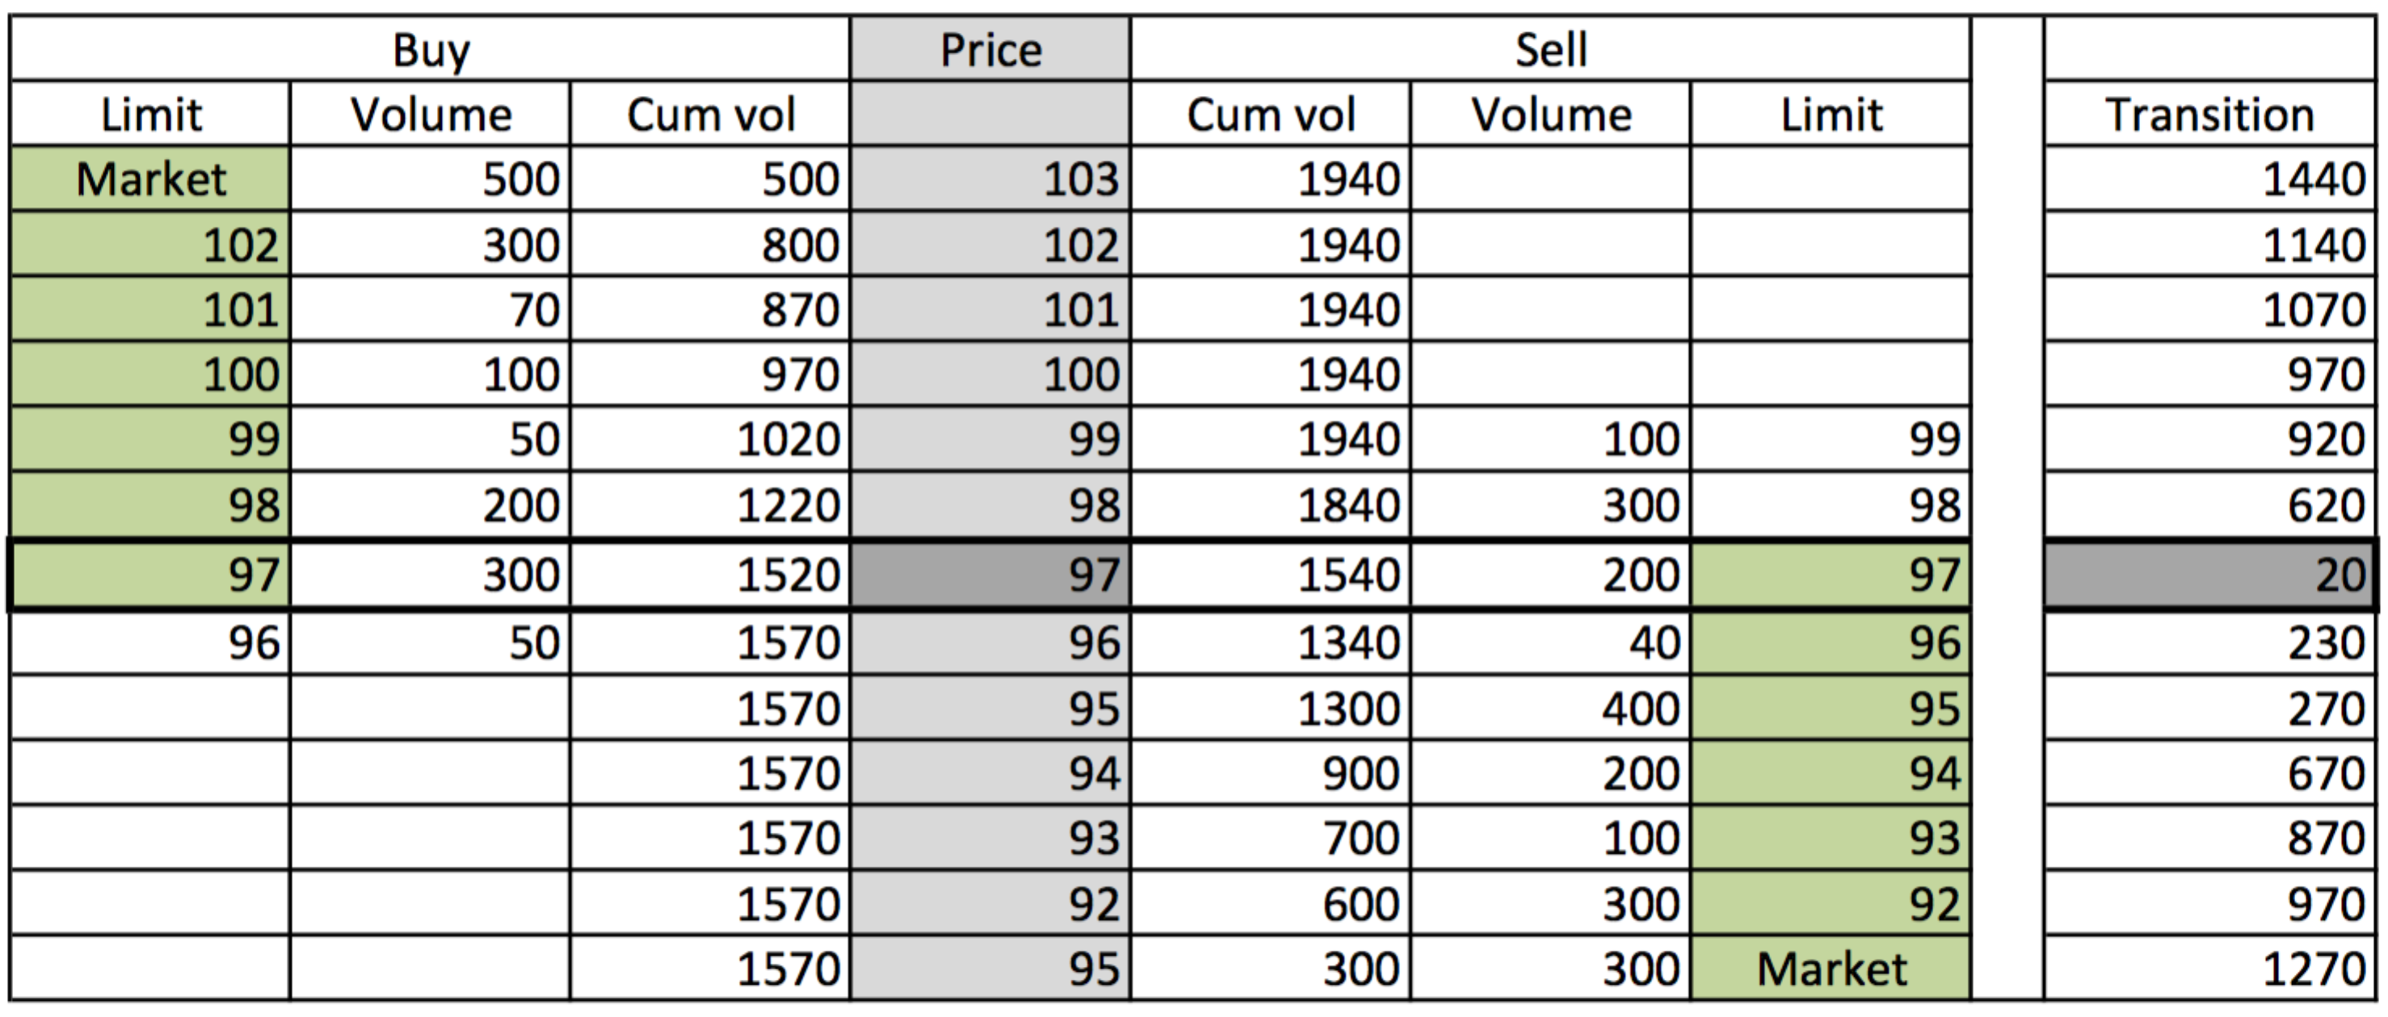
Execution voume maximisation
Used in auction phase in stock markets like XETRA or SETS

Slide 4
Morning phase
Bank places random orders close to life price
Morning phase
Bank places random orders close to life price

