Slide 1
CSE 2102: Introduction to Software Engineering
Software Specification
Use Case Diagrams

Slide 2
Use Case Diagrams
Written descriptions of user’s interaction with the software product to accomplish a goal
  Show all the possible functionality
  Top-down/user perspective
Used during requirements analysis
Qualities of a good use case:
  Starts with a request from an actor to the system.
  Ends after all the answers to the request are produced.
  Defines the interaction between the system and the actors.
  Written from actors’ not the system’s point of view.
  3-9 clearly written steps in main success scenario

Slide 3
Use cases vs. Internal features
Consider a banking web application
Use Cases
Pay bills
Check balance
Transfer funds
Set up automatic payment
Point of view: user
Internal Functions
Transmit / receive data
Update balances
User I/O (display, keys, ...)
Point of view: developer / designer

Slide 4
Components of Use Case diagrams
Actors
External entities which interact with the system.
Humans and/or other systems (external databases, servers, legacy systems)
Entities whose behavior cannot be controlled or changed by the system.
Stimulates the system with events or receives something from the
system.
While determining actors, be concerned about not the individual
titles but the roles.
Symbol:

Slide 5
Components of Use Case Diagrams (contd..)
Use Cases
Discrete goal for the user.
Request a service provided by a single use case in one session.
Horizontal description of the functionality
Top level services offered to the user.
Symbol:

Slide 6
Components of Use Case Diagrams (contd..)
Association
Indicates which actors are involved in which use cases.
A use case may involve multiple actors.
A single actor may be involved with multiple use cases.
Represented by a line:

Slide 7
Components of Use Case Diagrams (contd..)
Generalization
Relationship between one general use case and one specific use case
Represented by a line with a triangular arrowhead toward the parent,
the more general modeling element.
Cashier
Employee

Slide 8

Components of a use case diagram (contd..)
Extends
“Extends” relationship is typically used to document important specific variants of a more general use case.
Extending use case may add behavior to the base use case.
Extends denotes exceptional or out-of-the-norm situations.
Extends is represented by a line with an arrow pointing towards the base use case.

Slide 9

Relationships Between Use Cases
Include
In the “Include” relationship, one use case must include another use case to perform its function.
A use case may be included by one or more use cases to avoid duplication of functionality.
Represented by a dotted line labeled <<include>> beginning at the base use case and ending with an arrow pointing to the include use case.

Slide 10
Relationship Between Use Cases
Extends vs. Include
Extends and Include have opposite labeling convention.
In extends, the arrow points towards the base use case (A extends B, arrow points towards B, which is the base use case).
In include, arrow points away from the base use case towards the included use case (A includes B, arrow points towards the included use case B).

Slide 11
Uses of use case diagrams
Determining features (requirements):
  New use cases often generate new requirements as the system is analyzed and design takes shape.
  Provides executives a skeleton for planning project priorities
Communicating with clients:
  Notational simplicity makes use case diagrams a good way for developers to communicate with clients..
  Agreement as to the system's responsibilities.
Generating test cases:
  Collection of scenarios for a use case may suggest a suite of test cases for those scenarios.
  Extension conditions provide a list of things to test for.

Slide 12
Suggestions for designing good use cases
Choose a good name:
  E.g. Add appointment rather than make time.
Show a complete and completable behavior:
  E.g. Add appointment rather than Add appointment location.
  E.g. Add appointment rather than Adding appointment.
Show inverse use cases if applicable:
  E.g. Add appointment and delete appointment.
Limit a use case to one behavior/function:
  E.g. Add appointment, Update appointment, and Delete appointment rather than Manage appointments.
Write the use cases from the actor’s point of view:
  E.g. Sell stock rather than delete stock.

Slide 13
Use Case Diagram – Reservation System
Use case
Security
Personnel
Reservation System
CreditCard System
Compile
List
Communication
Actor
Make
Reservation
External Flight Database
TicketClerk
Cancel
Reservation

Slide 14
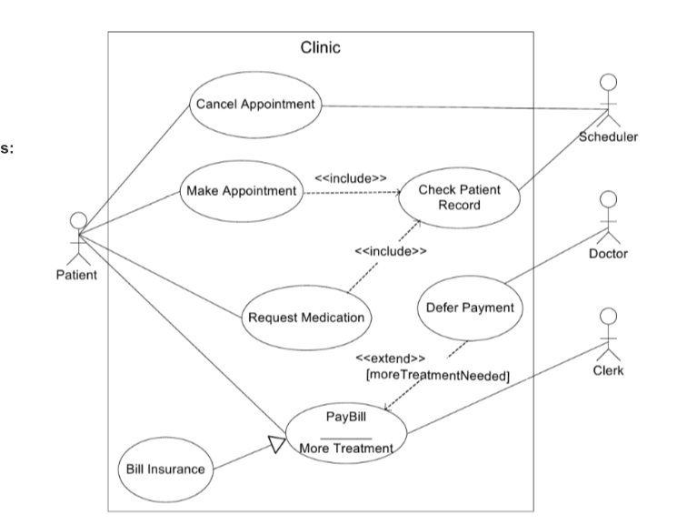
Use Case Diagram – Medical Information System
System that manages appointments and payments.

Slide 15
Use Case Diagram – Medical Information System
Defer Payment extends Pay Bill:
  Pay Bill use case can have Defer Payment as an alternative or an extension.
  Pay Bill is a base use case, defer payment is an extension.
  Arrow pointing from Defer payment to Pay Bill use case.
Request Medication and Make Appointment use cases include to Check Patient Records:
  When a patient requests medication or wishes to make an appointment, the patient’s medical records must be checked.
  Cancel Appointment may also include Check Patient Record – sometimes prior to cancelling an appointment a Scheduler may remind a patient that he/she is due for a particular test or a screening.

