Slide 1
CSE 2102: Introduction to Software Engineering
Software Specification
Petri Nets

Slide 2
Petri Nets
Introduced by C. Adams Petri in 1960.
Widely used in the modeling and analysis of computer systems.
  Used to model systems with multiple independent activities simultaneously.
  Any one or all of the activities may occur in parallel changing the state of the system.
Basic elements:
  Places
  Transitions
  Directed arcs
  Tokens

Slide 3
Basic elements
P1
t1
P3
P2
Legend:
Place
Transition
Directed arc
Token

Slide 4
Basic elements (contd…)
P1
t1
P3
P2
Input place: Directed arc from a place to a transition
Place is an input place to the transition
P1 is an input place to transition t1
Output place: Directed arc from a transition to a place
Place is an output place of the transition
P3 is an output place of transition t1

Slide 5
Basic elements (contd..)
P1
2
t1
P3
P2
Weighted connection:
- Multiple arcs between a place and a transition.
- Represented as a single arc, labeled with a natural number called
weight.
Weight of the connection between P1 and t1 is 2.
Default weight is 1.

Slide 6
Static structure
Net structure:
  Static part of the system.
Marking:
  Overall state on the structure.
  Distribution of tokens among the places
  Marked place: Place with one or more tokens
  Umarked place: Place with no tokens
  Local state: Number of tokens in a place
  Overall state: Number of tokens in each place.

Slide 7
State of PN
P1
t1
P3
P2
Local State:
P1 – 1
P2 – 0
P3 – 0
Overall State: <1,0,0>

Slide 8
Dynamic evolution
Dynamic behavior:
  Firing of transitions
  Flow of tokens
Transition firing:
  Tokens from input place are moved to output place
Evolution of the net
Steps involved in firing of a transition

Slide 9
Dynamic evolution (contd..)
P1
2
t1
P3
P2
Step #1
Transition must be enabled.
Each input place has at least many tokens as the weight of the arcs.
Transition t1 is enabled if P1 has 2 and P2 has 1 token respectively

Slide 10
Dynamic evolution (contd..)
P1
2
t1
P3
P2
Step 2
Enabled transition may fire.
Remove from each input place the number of tokens equal to the weight
of the arc.
t1 fires, removes 2 tokens from P1 and 1 token from P2.

Slide 11
Dynamic evolution (contd..)
P1
2
t1
P3
P2
Step 3:
Add tokens to the output place
Number of tokens added is equal to the weight of the arc connecting
the transition to the output place
t1 fires, 1 token is added to place P3

Slide 12
Dynamic evolution (contd..)
Enabled transitions not forced to fire
Can be subject to external conditions
Ordinary Petri net, firing of transitions occurs instantly

Slide 13
Example of dynamic evolution
User & Candy
User has
coin
Machine
ready
Dispense
candy
eat
reset
User has
candy
Machine busy

Slide 14
Modeling constructs
Sequence
Synchronization
Concurrency

Slide 15
Modeling constructs (contd..)
Conflict
Shared Resource

Slide 16
Summary of main concepts
Place
  Represent distributed states
State:
  Given by marking places
Marking:
  Assigning non-negative integers to places
  Inserting tokens in places in the net
Transitions:
  Represent actions or events that may occur when system is in a certain state
  Occur as certain conditions hold on the states

Slide 17
Summary of main concepts (contd…)
Enabled:
  Transition with at least one token in each of one of its input places
Fire:
  One token removed from each input place and one token inserted into each output place
Petri nets are non-deterministic
  Any of the enabled transitions may fire.
  Model does not specify which fires, nor when it fires
Firing sequence:
  Sequence of transition firings denoted as string of transitions enabled.

Slide 18
Modeling concurrent systems
Petri nets may be used to model concurrent systems
Concurrent transitions:
  Two or more transitions that are both enabled and do not prevent each other from firing
  See t₁ and t₂ in case (a)

Slide 19
Modeling concurrent systems (contd..)
P
1
P
2
t
1
P
3
t
2
P
4
P
5
t
t
4
P
3
6
P
t
7
5
t
6
Transitions t1 and t2 are both enabled.
Any one of t1 and t2 can fire.

Slide 20

Modeling concurrent systems (contd..)
P
1
P
2
P
1
P
2
t
1
t
1
P
3
t
2
P
t
2
3
P
4
P
P
P
5
4
5
t
t
4
t
4
P
3
t
3
6
P
P
6
P
t
7
t
7
5
5
t
6
t
6
Before t1 fires
After t1 fires
Which transitions are enabled?

Slide 21
Modeling concurrent systems (contd..)
P
1
P
2
P
1
P
2
t
1
t
1
P
3
t
2
P
t
2
3
P
4
P
P
P
5
4
5
t
t
4
t
4
P
3
t
3
6
P
P
6
P
t
7
t
7
5
5
t
6
t
6
Before t2 fires
After t2 fires
Which transitions are enabled?

Slide 22
Modeling concurrent systems (contd..)
P
1
P
2
P
1
P
2
t
1
t
1
P
3
t
2
P
t
2
3
P
4
P
P
P
5
4
5
t
t
4
t
4
P
3
t
3
6
P
P
6
P
t
7
t
7
5
5
t
6
t
6
Before t1 & t2 fire
Firing sequence t1,t2
t2,t1

Slide 23

Modeling concurrent systems (contd..)
P
1
P
2
P
1
P
2
t
1
t
1
P
t
2
P
3
t
2
3
P
4
P
P
4
P
5
5
t
t
4
t
t
4
P
3
P
3
6
P
6
P
t
7
t
7
5
5
t
6
t
6
Before t3 fires
After t3 fires

Slide 24
Modeling concurrent systems (contd..)
P
1
P
2
P
1
P
2
t
1
t
1
P
t
2
P
3
t
2
3
P
P
P
4
P
4
5
5
t
t
4
t
t
4
P
3
P
3
6
P
6
P
t
7
t
7
5
5
t
6
t
6
Before t4 fires
After t4 fires

Slide 25
Modeling concurrent systems (contd..)
Transitions t3 and t4 were both enabled:
  Firing of t3 prevented the firing of t4 and vice versa.
  Place P3 models a shared resource.
Conflict
  Two transitions are enabled to fire in a given state, but the firing of one prevents the other from firing
  No policy exists to resolve conflicts (known as unfair scheduling)
A process may never get a resource (starvation)

Slide 26
Modeling concurrent systems (contd..)
Conflict
  Two transitions are enabled to fire in a given state, but the firing of one prevents the other from firing
    see t₃ and t₄ in case (d)
    place P₃ models a shared resource between two processes
  No policy exists to resolve conflicts (known as unfair scheduling)
  A process may never get a resource (starvation)

Slide 27
Deadlocks
Deadlock:
  A marking where no transition may be enabled
Live:
  PN where no deadlock can occur from a given marking

Slide 28
Deadlocks (contd..)
P
1
P
2
Transition t1 fires
t
1
t
2
R
t'
3
t'
4
t"
3
t"
4
2
2
t
6
t
5

Slide 29
Deadlocks (contd..)
P
1
P
2
Transition t3’ fires
t
1
t
2
R
t'
3
t'
4
t"
3
t"
4
2
2
t
6
t
5

Slide 30
Deadlocks (contd..)
P
1
P
2
Transition t2 fires
t
1
t
2
R
t'
3
t'
4
t"
3
t"
4
2
2
t
6
t
5

Slide 31
Deadlocks (contd..)
P
1
P
2
Transition t4’ fires
t
1
t
No transition is enabled.
The net is deadlocked.
2
R
t'
3
t'
4
t"
3
t"
4
2
2
t
6
t
5
Notes:
Deadlocks lead to a state where the system is stuck and nothing happens. Try to avoid deadlock as much as possible. Detecting deadlocks from informal descriptions is difficult. Formal notations such as PNs can help us analyze whether the system reaches a deadlock state.

Slide 32
Deadlocks (contd..)
P
1
P
2
A deadlock free net
t
1
t
2
R
t'
3
2
2
t'
4
t"
3
t"
4
t
6
t
5
2
2

Slide 33
Is Deadlock Possible in this Net?
P1
T1
T3
P2
T2
No deadlock is possible. If place P1 is marked, either T1 or T3 can fire. If place P2 is marked, T2 can fire. There is no transition that requires markings in 2 places.

Slide 34
Petri nets: Limitations
Tokens are anonymous:
  Don’t know a token’s value
  Firing of transition may depend on the value of the token
Cannot compute the value of a token
No selection policy to decide between different enabled transitions
  Can’t avoid starvation
Lack exact timing constraints

Slide 35
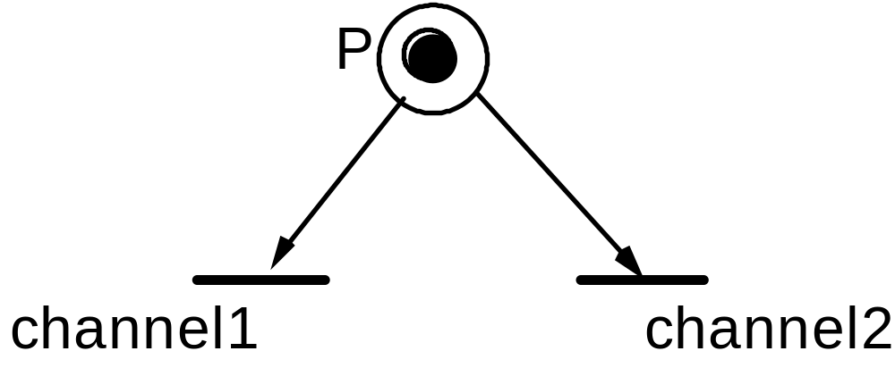
Petri nets: Limitations (contd..)
Token represents a message.
You wish to say that the delivery channel depends
on contents. How?
Petri nets cannot specify selection policies.

Slide 36
Petri nets: Extensions
Assign values to tokens
Predicates and functions can be associated with transitions
  Transition with k input places and h output places is enabled if there exists a k-tuple of tokens whose values satisfy predicate.
  Functions define values of tokens produced in output places.
Firing of a transition implies:
  Ready tokens consumed from input places
  h new tokens produced by the function associated with the transition go to output places.

Slide 37
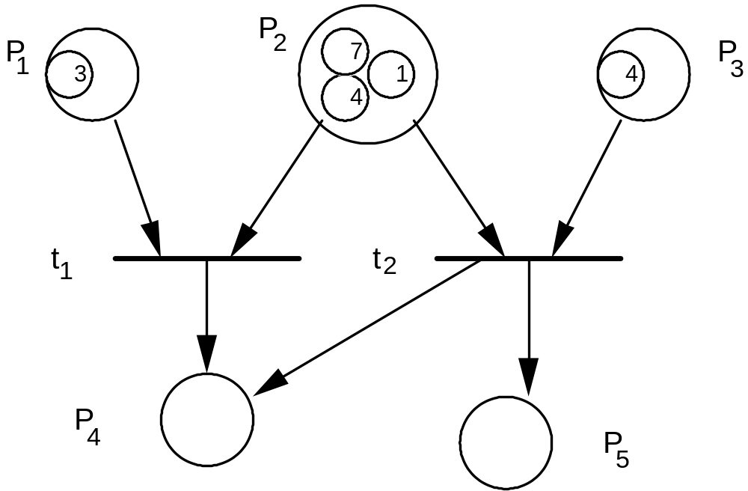
Petri nets: Extensions (contd..)
Predicate P2 > P1
and function
P4 := P2 + P1
associated with t1
Predicate P3 = P2
and functions
P4 := P3 ⁻ P2 and
P5 := P2 + P3 are
associated with t2
The firing of t1 by using <3,7> would produce the value 10 in P4. t2 can then fire using <4, 4>

