Slide 1
CSE 2102: Introduction to Software Engineering
Software Specification
Interaction Diagrams

Slide 2
UML Models
A system can be represented from multiple points of view.
  UML has many diagrams for these representations
UML diagrams can be classified into – static and dynamic diagrams.
Static diagrams -- class and use case diagrams
Dynamic diagrams – Sequence, collaboration, state and activity diagrams.
  We will study only sequence and collaboration diagrams.
  Activity diagrams

Slide 3
Interaction Diagrams
Sequence and collaboration diagrams are called interaction diagrams.
  Show an interaction, consisting of a set of objects and their relationships, including the messages that may be dispatched/exchanged among them.
Sequence diagrams
  Emphasizes the time ordering of messages
Collaboration diagrams
  Emphasizes the structural organization of the objects that send and receive messages

Slide 4
Uses of Interaction Diagrams
To visualize, specify, construct and document the dynamics of a particular set of objects.
To represent the logic of a usage scenario

Slide 5
Notation for Sequence Diagrams
Classifiers
Objects (instances of classes) and classes.
Arranged horizontally.
Objects respond to messages by invocation of methods, while
Classes respond to messages by invocation of static methods.
Represented by a rectangle
Objects have labels name: ClassName, where name is optional
Objects with no name are called anonymous objects
Classes have labels in the form ClassName
aStudent:Student
:Seminar

Slide 6
Notation for Sequence Diagrams (contd..)
Actors:
Communicate with objects
Modeled using the stick figure
Actors initiate, take active part in usage scenarios
Labeled by ActorName

Slide 7
Notation for Sequence Diagrams
Lifeline
Denotes the life of an object during a sequence.
Contains an X at the point at which the object is removed from the memory.
In languages such as C++, where memory needs to be managed by the programmer a destroy method needs to be called
Dotted vertical line below the class/object.

Slide 8
Notation for Sequence Diagrams
Focus of control:
Long narrow rectangle placed on top of a lifeline
Denotes an object performing an action to fulfill a message

Slide 9
Notation for Sequence Diagrams
Message:
Conveys information from one object to another, or from an actor to
an object, or from object to an actor.
Represented by a horizontal arrow.
Source and the target of the method are objects, message label is
the signature of the method invoked in response to the message.
If either the source or target is human actor, then the message is
labeled with a brief text describing the information being communicated.
Wish to enroll
isEligible(aStudent)

Slide 10
Drawing Sequence Diagrams
Place actors, objects, and classes that participate in the interaction at the top of the diagram, across the X-axis.
  Place the actors or objects that initiate the interaction at the left, and increasingly more subordinate objects to the right.
Place messages the objects send and receive along the Y-axis, in order of increasing time from top to bottom.

Slide 11
Basic Sequence Diagrams
Object1:Class1
Object2:Class2
Messages
Activations
Lifelines

Slide 12
Basic Sequence Diagrams (contd..)
Object1:Class1
Object2:Class2
Destroy

Slide 13
Basic Sequence Diagrams
Object1:Class1
Object2:Class2
Return values (optional)

Slide 14
Basic Sequence Diagrams
Object1:Class1
Object2:Class2
[Condition to exit]
Repetition or a loop is depicted as a rectangle.
Condition to exit is placed at the bottom of the rectangle.

Slide 15
Basic Sequence Diagrams
Object1:Class1
Object2:Class2
loop(x, y)
loop(x..y)/loop(x,y) – x is the minimum, and y is the maximum number
of times the loop is executed. Any number of executions between
x & y are possible.
loop – default, no minimum and maximum number of iterations.

Slide 16
Basic Sequence Diagrams
Object1:Class1
Object2:Class2
Self Call

Slide 17
Basic Sequence Diagrams
Object1:Class1
Object2:Class2
[Condition true]
[Condition false]
Messages can be sent conditionally
Conditions can also be depicted on the sequence diagrams

Slide 18
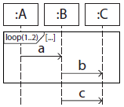
Sequence Diagrams: Traces
Tracing involves determining the sequence and number of message
exchanges.
The loop can be executed once or twice.
If the loop is executed once, trace is:
a -> b -> c
If the loop is executed twice, trace is:
a -> b -> a -> b -> c

Slide 19
Collaboration Diagrams
Displays object interactions organized around objects and their links to one another.
Do not explicitly show the lifeline of an object
  Can show both create and destroy messages
Do not show the focus of control explicitly
  Each message’s sequence number can be an indicator
Show how one object is linked to another

Slide 20
Collaboration Diagrams (contd..)
Objects:
  Rectangles containing object signature
  Object signature consists of object name: object class
    Object name optional, starts with a lower case letter
    Class name (mandatory), starts with an upper case letter
    Objects connected by lines
    Actor symbol may appear
Messages:
  Labeled like C and Java function calls
    Followed by round brackets, and can have parameters and return values
  Are followed by an arrow to show direction
  Messages may be numbered, starting from 1

Slide 21
Sequence vs. Collaboration Diagrams
Collaboration diagrams do not have any specific concepts that are unique to them, but sequence diagrams involve two specific concepts that are unique.
These are:
  Object lifeline & Focus of control.

Slide 22
Common Uses
Use sequence diagrams to model flows of control by time ordering
  Good for visualizing simple iteration and branching.
Use collaboration diagrams to model flows of control by organization
  Good for visualizing complex interactions and branching.
Both represent the same information, and are both needed?
  Yes, they show different perspectives.
  Sequence diagram shows the length of an interaction, which can be important from a performance standpoint.
  Collaboration diagram shows “coupling” between the objects. -- the higher the number of messages exchanged between a pair of objects, the stronger is the coupling.

Slide 23
Example
Draw a sequence and collaboration diagram for the following scenario: A computer sends a file to be printed to a printer server. The printer server prints the file using the printer if the printer is free. If the printer is not free, the printer server queues the file onto a queue.

Slide 24
How to Draw Sequence Diagrams
Start from the left to the right.
Place objects from the left to the right, in the order in which they appear in the interaction.
  Object computer appears before any other object and is placed on the leftmost edge.
  Following the computer, the printserver participates in the interaction, which is placed after the computer, followed by the other two objects.
No specific guidelines for the placement of objects in a collaboration diagram.
  Placed in such a way that the exchange of messages should not appear as a “spaghetti” (recall spaghetti code!!)

Slide 25
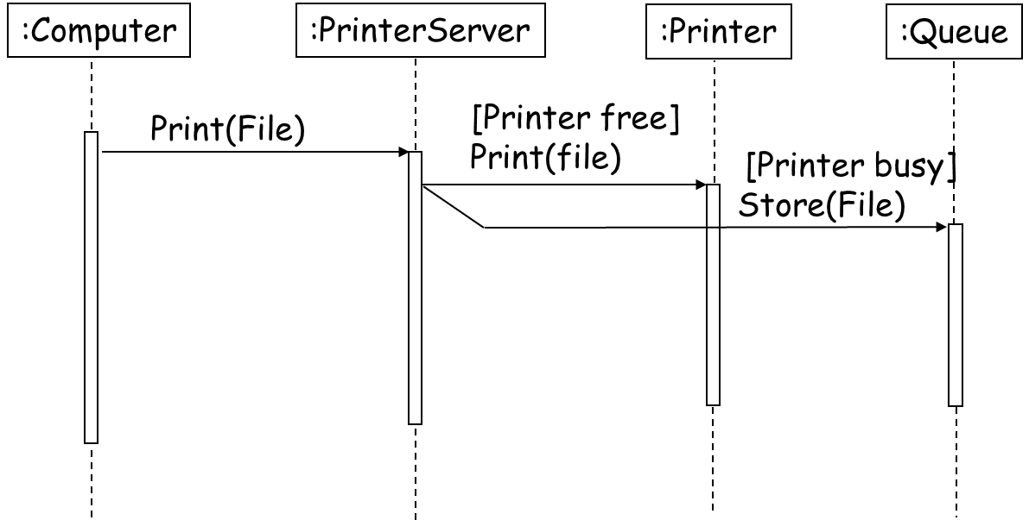
Sequence Diagram: Example

Slide 26
How to Draw Collaboration Diagrams
Place objects that participate in the interaction as vertices in a graph.
Render the links that connect these objects as the arcs of this graph.
Adorn these links with the messages that objects send and receive

Slide 27
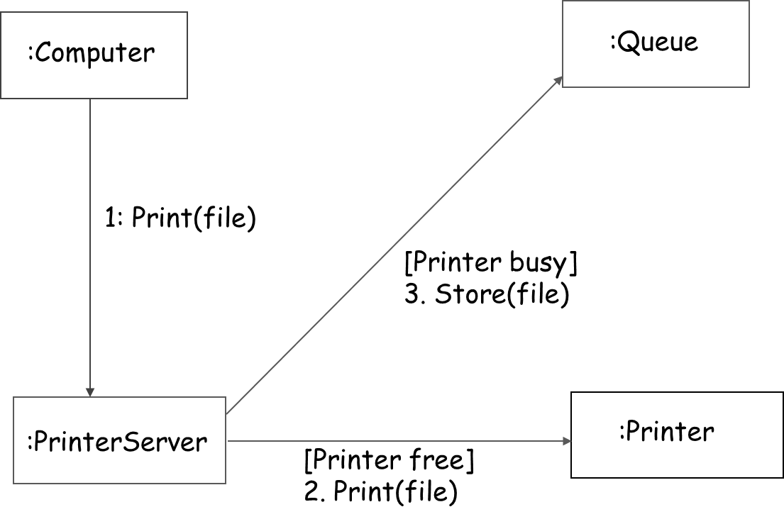
Collaboration Diagram: Example

