Slide 1
CSE 2102: Introduction to Software Engineering
Software Verification
White-box Testing

Slide 2
White-box testing
Also called structural testing
Uses internal structure/code of the software to generate test cases.
(In)adequacy criteria
  If significant parts of program structure are not tested, testing is inadequate
Control flow coverage criteria
  Statement coverage
  Edge coverage
  Condition coverage
  Path coverage

Slide 3
Statement coverage criterion
Informally, test the software in such a way that all of its statements are executed at least once.
Formally, select a test set T such that every elementary statement in P is executed at least once by some d in T
  An input datum executes many statements.
  Try to minimize the number of test cases still preserving the desired coverage
Difficult to minimize the number of test cases and still ensure the execution of all statements

Slide 4
Statement coverage criterion (contd..)
Example
read (x); read (y);
if x > 0 then (I1)
write ("1"); (W1)
else
write ("2"); (W2)
end if;
if y > 0 then (I2)
write ("3"); (W3)
else
write ("4"); (W4)
end if;

Slide 5
Statement Coverage Criterion -- Drawbacks
if x < 0 then
x := -x;
end if;
z := x;

Slide 6
Edge/Branch coverage criterion
Represent a program using its control flow graph.
A control flow graph is constructed using the following rules:
  Each I/O assignment or a procedure call is represented by an edge.
  Edge connects two nodes representing an entry or an exit into the statement.

Slide 7
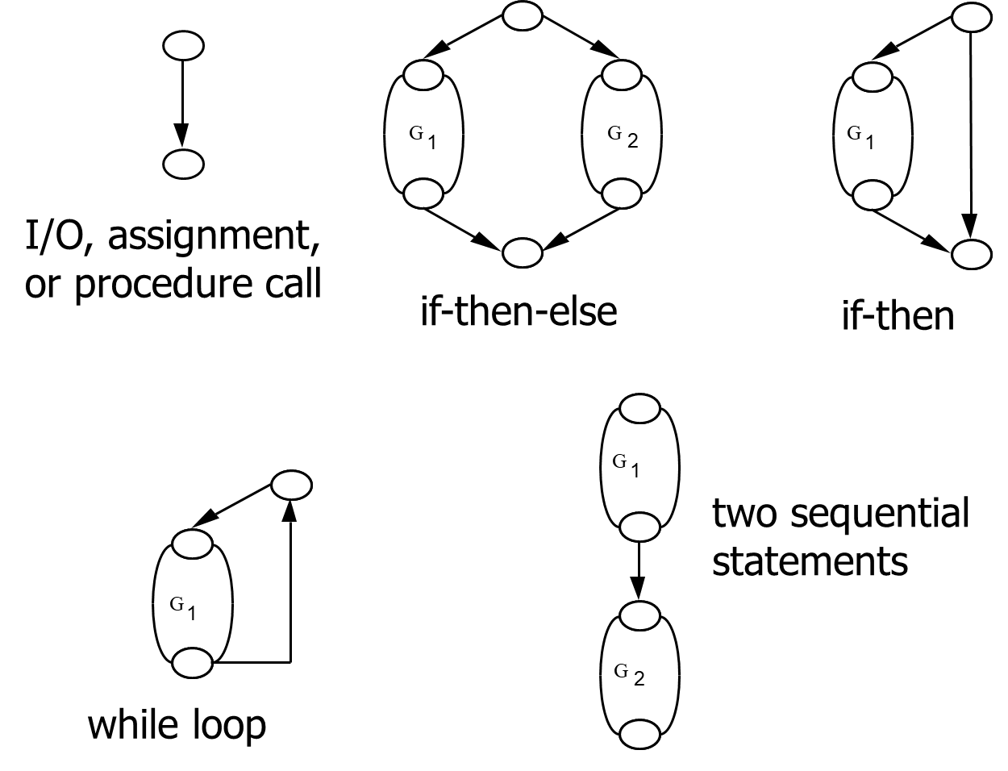
Control Graphs – Common Constructs

Slide 8
Example: Euclid’s algorithm
begin
read (x); read (y);
while x ≠ y loop
if x > y then
x := x - y;
else
y := y - x;
end if;
end loop;
gcd : = x;
end;

Slide 9
Edge Coverage
Select test cases so that all the edges of the control flow graph are executed at least once.

Slide 10
Weakness of edge coverage criterion
found := false; counter := 1;
while (not found) and counter < number_of_items loop
if table (counter) = desired_element then
found := true;
end if;
counter := counter + 1;
end loop;
if found then
write ("the desired element is in the table");
else
write ("the desired element is not in the table");
end if;
test cases: (1) empty table, (2) table with 3 items, second of
which is the item to look for. Does not discover the error < instead
of <= in counter < number_of_items

Slide 11
Weakness of condition coverage criterion
if x ≠ 0 then
y := 5;
else
z := z - x;
end if;
if z > 1 then
z := z / x;
else
z := 0;
end if;
{<x = 0, z = 1>, <x = 1, z = 3>}
causes the execution of all edges,
but fails to expose the risk of a
division by zero

Slide 12
Path-coverage criterion
Select a test set T which traverses all paths from the initial to the final node of P’s control flow
Finer than previous kinds of coverage
Number of paths may be too large, or even infinite (see while loops)
    Additional constraints must be provided
Path coverage criterion may be used as a guide to determining a few critical paths.

Slide 13
White-box Testing – Programming Constructs
Guidelines for testing loops:
  Execute the loop zero times.
  Execute the loop maximum number of times
  Execute the loop average number of times
Guidelines for IF and CASE statements
  Try to combine paths as much as possible

Slide 14
White-box Testing -- Drawbacks
Once a criterion has been chosen, actual input values may be chosen.
  How do you decide which criterion to use?
  Can (and should) different criterion be applied to different modules in the same system?
The presence of unreachable statements may mean that 100% coverage is not achieved.
  May not be able to decide if a statement is reachable or not.
  Manual justification for omitting each test case.
In summary, whatever coverage criterion we decide, human intervention is needed to solve problems (reachability, etc.)

Slide 15
White-box Testing -- Drawbacks
What if the code omits the implementation of some part of the specification?
White box test cases derived from the code will ignore that part of the specification!

