Slide 1
CSE 2102: Introduction to Software Engineering
Software Design
Design Strategies & Notation

Slide 2
Modules: Interface Design Considerations
What goes in the public interface vs. hidden implementation?
Considerations in interface design:
  Interface must convey to the client the services that it provides
  Too much information in the interface increases overall system complexity. Knowledge of the internal implementation details leaked in the interface may impact the interface if there are subsequent changes in the implementation
  If there is not enough information in the interface, module may not provide required services, e.g. undisclosed pre-conditions.
Interface design depends on what information is needed for the client to use the services and the information the clients will not use.
  Identification of likely changes is necessary, since that must go in the implementation, hidden from the client

Slide 3
Modules: Interface Design Considerations
Clear distinction of interface and implementation supports prototyping.
  In prototyping, an initial version may be built to represent a “quick and dirty” implementation of the service provided by the module.
As long the interface remains the same, this initial “quick and dirty” version may be replaced by a more efficient one, without affecting the clients of the modules.
  Easy to evolve the initial prototype into a final product.

Slide 4
Modules: Interface Design Considerations
Module supports information hiding by making a clear distinction between the interface and the implementation.
Information hiding is a global design principle, which states:
  Encapsulate changeable design decisions as implementation secrets within module implementations.
Clients or users of modules are not exposed to the implementation secrets
  Secrets can be changed freely without affecting the clients and the system structure.
Information hiding principle is a basis for decomposing a system into modules.

Slide 5
Modules: Interface Design Considerations
Policies are used to implement high-level design decisions:
  They should also be hidden in the implementation.
Policies may be separated from the mechanism:
Mechanism:
  Ability to suspend and resume tasks in a concurrent system
Policy
  How do we select the next task to resume?
    Different scheduling policies are available
    They may be hidden to the clients
    They may be encapsulated as module secretsts

Slide 6
Top-down Design Strategy
Large modules are decomposed into smaller modules which are said to implement the large modules
General Specific

Slide 7
Bottom-up Design Strategy
Start with primary or basic low-level functions, and then compose these functions into subsystems, and then finally the entire system.
Pieces
Compose

Slide 8
Top-down vs. Bottom-up Design Strategy
Information hiding proceeds “bottom-up”, while iterative application of IS_COMPOSED_OF relation to modules proceeds “top-down”
Top-down vs. bottom-up:
  In practice, a combination of both the approaches is followed. This is known as the “yo-yo” design.
  A single approach is not followed exclusively. followed.

Slide 9
Top-down vs. Bottom-up Design Strategy
No matter what design process is followed, documentation should always be organized in a top-down manner. Why?
  Level of detail should increase as one proceeds top-down.
  Top-down approach /provides the big picture first and then subsequently refines the big picture by providing additional details.
  If someone wants to simply understand a high-level 10,000 feet view of the system, then they should be able to do so, without getting bogged down by the details.

Slide 10
Advantages of Modular Designs
Reduces complexity, by providing a systematic approach to breaking problems into sub-problems.
Facilitates change – critical aspect of software maintainability.
Results in faster implementation by encouraging parallel developments of different parts of a system.
Supports reuse of existing modules in new systems.

Slide 11
Properties of Modular Designs
Each module should be functionally independent:
  Addresses a specific sub-function of requirements and has a simple interface when viewed from the other parts of the system structure
Independence of modules is measured using two metrics:
  Cohesion - Indication of the degree to which a module focuses on just one thing
  Coupling - Indication of the degree to which a module is connected to other modules and to the outside world
A good design has modules which show high cohesion and low coupling

Slide 12
Design Notation
Designs can be specified in natural language, but that is is too ambiguous to precisely and accurately describe software designs.
Remember Software Engineering is young – so no standardized notation for software currently in use.
Two types of notations:
  TDN – Textual design notation
    Resembles a programming language
  GDN – Graphical design notation

Slide 13
Graphical Design Notation (GDN)
In general, graphical notations are easier to read and understand.
A module is represented graphically as a box
Incoming arrows represent an interface
- Represent access to the module
Module
X
Module
Y
Module
Module
R
T
B
C
Module
Z
A
B

Slide 14
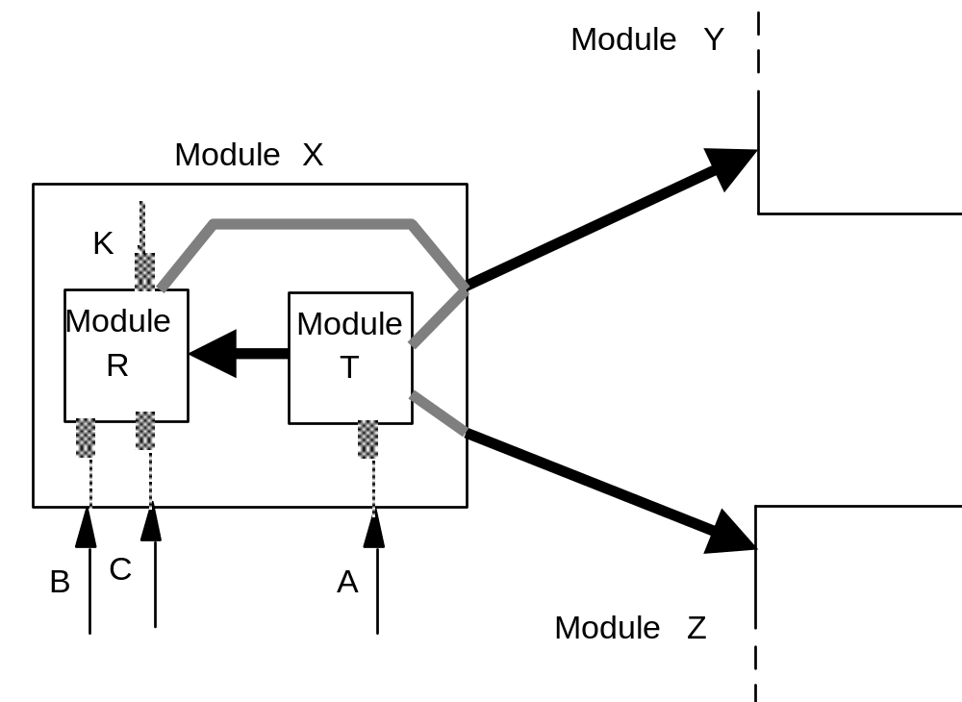
Graphical Design Notation (contd..)
X's decomposition

Slide 15
Graphical Design Notation (contd..)
Resources exported by module X:
  B and C are exported by module R, A is exported by module T.
Modules used by module X:
  Module R uses module Y.
  Module T uses module Y
  Module T uses module Z

Slide 16
Graphical Design Notation (contd..)
Notation helps describe a design precisely
Design can be assessed for consistency and completeness
  Having defined module X, modules R and T must be defined eventually
    If not the design is incomplete.
  R, T replace X
    Either one or both must use Y, Z, else the design is inconsistent.

Slide 17
Graphical Design Notation – Example
Consider the following relationship among the modules of a system. Module M1 IS_COMPOSED of M2 and M3. Module M2 IS_COMPOSED_OF M4 and M5. Module M3 USES M6. Depict the above relationship among the modules using Graphical Design Notation (GDN). Which modules have a physical existence in this system?

Slide 18
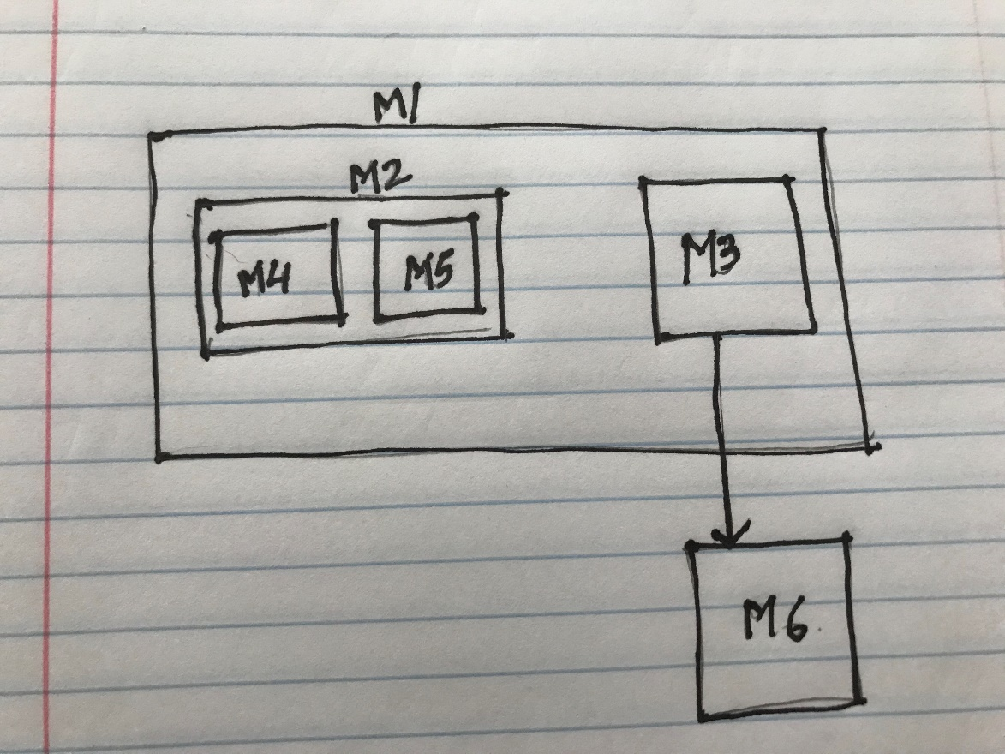
GDN -- Example
Modules M3, M4,
M5 and M6 are
implemented or
have a physical
existence.

Slide 19
Handling Anomalies
Defensive design
  Try to shield an application from errors
A module is anomalous if it fails to provide the service as expected and as specified in its interface
Defensive design requires an exception to be raised when an anomalous state is recognized.

Slide 20
Handling Anomalies (contd..)
A module M should fail and raise an exception if
  one of its clients does not satisfy the required protocol for invoking one of M’s services
  M does not satisfy the required protocol when using one of its servers, and the server fails
  hardware generated exception (e.g., division by zero)

Slide 21
Handling Anomalies (contd..)
Before failing, modules may try to recover from the anomaly by executing some exception handler (EH).
Exception Handler (EH) is a piece of code that may:
  Try to recover from the anomaly (if successful, module does not fail)
  Or simply do some cleanup of the module’s state and then let the module fail, signaling an exception to its client.

