Slide 1
CSE 2102: Introduction to Software Engineering
Object-Oriented Paradigm
Core Object-Oriented Concepts

Slide 2
Object-Oriented Paradigm
Object-oriented decomposition:
  Decompose the problem into Agents which perform operations.
  Emphasize Agents that cause actions.
Agents comprised of two parts:
  Hidden implementation: Data and operations only available to Agent.
  Public interface: Operations available to the clients of agent.
An Agent can only be modified by operations defined in either the hidden implementation or public interface.

Slide 3
Core Object-Oriented Concepts
Class
  The Type of an Agent
  Describes the behavior
Object
  The Instance of a class
  Represents actual data manipulated by Agents
  Maintains the state of the object
Method
  Operation defined on a class
  Operates on all instances of the class
Message
  Indicates that the object’s method is invoked.

Slide 4
Class
occurrences
roles
things
organizational units
places
external entities
structures
class name
A class is a generalized description of
a collection of similar objects.
Object is an instance of a class.
Class exports:
-Operations used to manipulate instances
-May export attributes.
attributes:
operations:

Slide 5
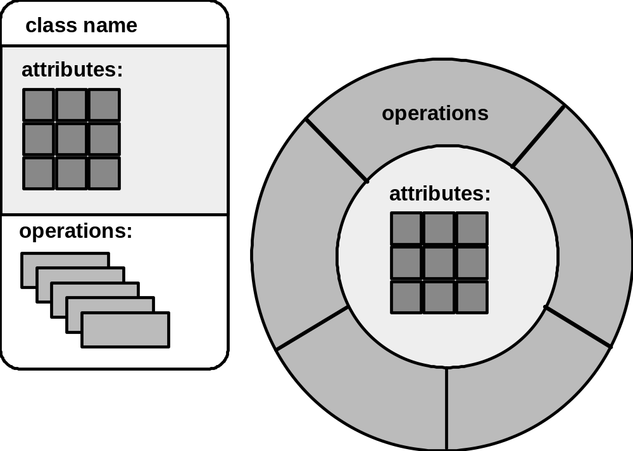
Two Representations of a Class
A class can be viewed from two perspectives.
Collection of attributes and operations.
Operations encapsulating the attributes, and preventing direct access

Slide 6
Operations (or Methods or Services)
An executable procedure that is a part of a
class and operates on the data attributes
defined as part of the class.
A method operates on all instances of a class
A method is invoked via message passing.

Slide 7
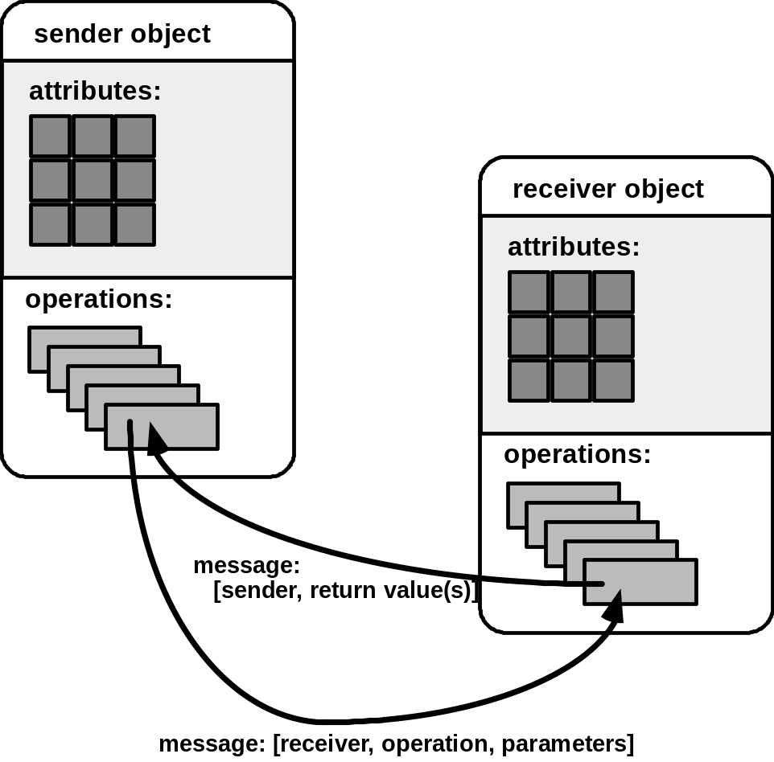
Messages
Messages - the means by which objects invoke each other’s methods.

Slide 8
An example Employee class
Class Employee
{
}
Main()
{
//Declare Objects
Employee emp1(Steve,100.0);
Employee emp2(Lois, 120.0);
//Pass Messages
//Invoke Methods
emp1.print_name();
emp1.print_salary();
emp2.update_salary(10);
emp2.print_name();
emp2.print_salary();
}
//Hidden Implementation
Private: //Instance Vars
char[30] name;
float salary;
//Public Interface
Public:
void print_name();
void print_salary();
void update_salary(float i);
Employee(char *n, float s);
What’s Output of Main()?
Conclusion:
Each Object (emp1,emp2) has
Own Independent State that
is Accessible via Shared
Public Interface of Class
Steve
100.0
Lois
130.0

Slide 9
Heuristic Approach to OO Design
First step in building a software application using the object-oriented paradigm is to find classes in the problem domain.
Usually, presented with an informal description of the features of a system written in natural language.
  No “proven” method to map this description to a set of classes.

Slide 10
Heuristic Approach to OO Design
Heuristic approach to map a natural language description to a set of classes:
  First cut, classes correspond to nouns in the description of the problem.
  Problem description will have different types of nouns, but not all nouns should correspond to classes.
  Some nouns represent concepts outside the system boundary.
  Some nouns are just attributes instead of classes in their own right.
  Multiple nouns may be used to represent the same concept.
Different types of nouns and corresponding classes for an information system that automates the operations of a medical practice.

Slide 11
Heuristic Approach – Example
Tangible -- Physical objects or groups of objects :
  Medication, prescription, receipt, x-rays, lab reports.
Roles -- A person who carries out some action, duty, role:
  Doctor, nurse, administrative assistant.
Events – things that can happen, usually at a given place or time, especially historical events that must be recorded.
  Office visits, lab work.
Interactions between roles:
  Exam, immunizations.
Other systems – external systems or events with which the application interacts:
  Pulse monitor, insurance system, credit card system.

Slide 12
High Tech Super Market System
The High-Tech Supermarket System, HTSS is a modern supermarket system that uses the newest and most up-to-date technology to support inventory control and to assist customers in their shopping experiences. The inventory control aspect of the proposed system would maintain all inventory for the store and alert the appropriate store personnel whenever the amount of an item drops to its reorder limit. The system should also have extensive query capabilities that allow store personnel to investigate the status of the inventory and to track sales for the store over varying time periods and other restrictions. To facilitate the shopping experience, the system should have a variety of user interfaces to locate, check out, and pay for various items.

Slide 13
Categories of Classes
Data Managers: Maintain data/state information
Contain functionality for application
class Item {
private: // Private Data
int UPC;
char* Name;
int InStock, OnShelf, ROLimit;
float RetailCost;
public: // Public Methods
Item(int code, char* str, int st1,
int st2, int st3, float cost);
void CreateNewItem();
int GetUPC();
char* GetName();
int GetQuantity();
int CheckReorderStatus();
void PrintItem();
void UpdatePrice(float new_value);
};

Slide 14
Categories of Classes (contd..)
Data Container class – stores objects of other (data manager) classes
class ItemDB
{private:
int Num_Items;
int Curr_Item;
Item* AllItems[Max_Items];
int FindFirstItem();
int FindNextItem();
int FindItemUPC(int code);
int FindItemName(char* name);
public:
ItemDB(); // Constructor
void InsertNewItem(Item* new_one);
void DeleteExistingItem(int code);
void FindDisplayItemUPC(int code);
void FindDisplayItemName(char* name);
void PrintAllItems();
};

Slide 15
Categories of Classes (contd..)
Data Manager class
Item class contains the state of a
single object
Item I1, I2, I3;
Data Container class
ItemDB is a collection or set of items
Item ItemDB[100];
I1
“milk”
I2
“peas”
I3
“soda”
ItemDB

Slide 16
Categories of Classes (contd..)
Viewer/Observer: Provide an interface for user
- Often collects information via public interface of multiple classes
- InvControlGUI utilizes Item ItemDB etc.
class InvControlGUI
{ private:
int Curr_Option; // Current menu option
public:
InvControl(); // Constructor
void PrintMenuSetOption();
void ActivateController();
void EnterNewItem();
void RemoveExistingItem();
void FindItem();
void InvSearchQuantity();
void InvSearchReorder();
void GenerateAnOrder();
};

Slide 17
Categories of Classes (contd..)
Data sink class:
  Classes that consume data – output file, port
Data source class:
  Classes that generate data – random number generators, Fibonacci sequence.
Facilitator/Helper – Used to support complex tasks
  E.g. GUI libs, Strings, I/O Handler etc.
  Data structures classes.
  Standard, well-known algorithms/functions such as sorters, parsers.

