Slide 1
CSE 2102: Introduction to Software Engineering
Midterm Review

Slide 2
Question #1
Software maintenance could consume what percentage of total software costs:
Two-thirds or more (x)
Up to half (about 50%)
Up to 25%
Less than 1%

Slide 3
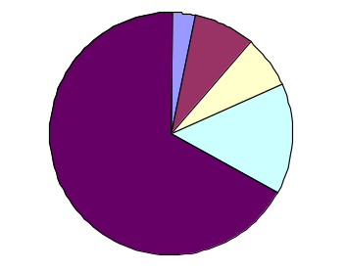
Question #1 (Explanation)
Software development times are getting longer and longer and
maintenance costs are getting higher and higher
3%
8%
7%
Requirements -- 3%
Design -- 8%
Implementation -- 7%
Testing -- 15%
Maintenance -- 67%
15%
67%
Most of the money and effort spent in testing and maintenance.
85% of errors are introduced during requirements analysis and design.

Slide 4
Question #2
Consider a system to manage the inventory in a car dealership. A “Car” class in this system is an example of
  Data Manager class (x)
  Data Container class
  Viewer/Interface class
  Facilitator/Helper class

Slide 5
Question #2 -- Explanation
The class car represents a physical object or a concept in the real world. Hence it is a data manager class. A data container class contains multiple instances of data manager classes. It is like a database. A viewer/interface class consists of GUIs, and facilitator/helper classes contain generic functions such as file I/O, string manipulation routines, and math libraries.

Slide 6
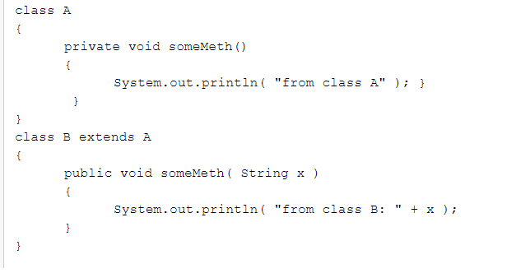
Question #3
What type of relationship exists between someMeth in class A and someMeth in class B?

Slide 7
Question #3 (Explanation)
This is neither overloading nor overriding. Overloading occurs in
the same class with same method name, and different
signatures. Overriding occurs in different classes but method
signatures are same. In this case, the methods have different
signatures but they belong to different classes. So its neither
overloading nor overriding.

Slide 8
Question #4
Which of the following does not pertain to software engineering as a discipline as compared to traditional engineering disciplines?
It is younger than the traditional engineering disciplines.
It has standard specification and analysis tools. (x)
It does not have established processes.
It is a collection of best practices

Slide 9
Question #4 (Explanation)
SE is a young discipline compared to other disciplines. In the case of other engineering disciplines, sufficient experience has been gained with how scientific techniques may be scaled up, and these scientific techniques have been encapsulated in the form of tools which can be used in the process of developing an engineering product. However, in case of SE there are no standardized notations to specify and design systems, metrics to measure the progress of a project and the productivity of an individual, neither is there a standard process followed to develop a product with the desired quality and on-time and within budget, standard architectures etc. However, we are slowly moving towards a foundation with many success stories being reported.
Currently, software engineering lacks rigorous theoretical foundations. Instead what we have is a set of empirical approaches which have been tried in practice and are known to work. There’s no way to prove why a particular approach is better than another one, and neither is there a way to determine a priori which approach may be the best given the characteristics of the problem.

Slide 10
Question #5
Which one of the following changes is the hardest to anticipate/predict?
Change in the algorithm
Changes to the data representation
Changes to the social environment (x)
Changes to the peripheral devices

Slide 11
Question #5 (Explanation)
Changes to the algorithm, data structures and peripheral devices are to be expected -- they are necessary to improve performance, adapt to new data representations and fields, and accommodate new advances to computing environments. Changes to the social environment is the only change that cannot be anticipated. It is governed by forces that are outside the control of the software development organizations. These changes are largely determined by social, and geo-political forces such as new or modifications to the existing laws, new and improved safety and interoperability standards.

Slide 12
Question #6
What degree of fan-in and fan-out is desirable for each module in a software system?
High fan-out, high fan-in
Low fan-out, low fan-in
Low fan-out, high fan-in (x)
High fan-out, low fan-in

Slide 13
Question #6 (Explanation)
USES relationship provides a way to determine the dependencies among the modules in a precise manner. For each module, the number of edges emerging from a module is called its fan-out, and the number of edges which come into the module is called as fan-in. The fan-out indicates the number of modules that this module is using to provide its services. While the number of edges coming into a module indicates the number of modules being used by this module. Ideally, the module should rely on as few a number of modules as possible to provide its services, whereas it should provide services which are usable by many other modules. Thus, a low fan-out, and a high fan-in are desirable for a module. If the module has a low fan-out it implies that it offers a good degree of abstraction to the modules at the upper level.

Slide 14
Question #7
Interface is the __________ portion of a module, implementation is the ______________ portion of a module.
Private, Public
Private, Private
Public, Private (x)
Public, Public

Slide 15
Question #7 (Explanation)
Interface discloses only those details of a module that a client needs to be able to use the services. Implementation hides the details/secrets that are likely to change. Therefore, interface is the public portion, and implementation is the private portion.

Slide 16
Question #8
In practice, software design follows a:
Top-down approach
Bottom-up approach
Yo-yo approach (x)
Chaotic approach

Slide 17
Question #8 (Explanation)
When we want to build a system by breaking it down into modules and then integrating the modules together, we can follow two approaches. The first approach is to take the system function and break it down into subfunctions hierarchically, till we reach the granularity where each single task can be implemented by a single module. Since we start from the topmost definition of the problem and break the problem down into subproblems recursively, the thinking process that we employ is top-down and hence this is called as top-down design strategy. In the bottom-up design strategy, we start with identifying well-defined subtasks which when accomplished would lead to the final task. We then implement modules to accomplish these well-defined subtasks and then compose the system using these modules. Thus, this represents bottom-up thinking, that is, which tasks need to be performed to accomplish the final goal. In practice, however, no one approach is followed in a purist form, and often a combination of both top-down and bottom-up approaches is used.

Slide 18
Question #9
Does a subclass inherit both member variables and methods?
a) No-only member variables are inherited.
b) No-only methods are inherited.
c) Yes- both are inherited (x)
d) Yes-but only one or the other are inherited.

Slide 19
Question #9 (Explanation)
In inheritance, both the variables and methods may be inherited by the subclass from the parent class as needed. There is no either or restriction that is there is no restriction on whether only the variables or the methods can be inherited.

Slide 20
Question #10
Choose an internal software quality from the one given below:
Scalability
Usability
Reusability (x)
Reliability
Performance

Slide 21
Question #10 (Explanation)
External qualities of a software system are those that are visible to the users because they affect user experience. Internal qualities, on the other hand, are visible to the developers and in turn impact how easily they can build, maintain, and evolve the system. Of the 5 qualities listed in the answer choices, scalability, performance, reliability and usability directly impact users, and are external qualities. On the other hand, reusability impacts the level of reuse, which in turn determines how quickly and efficiently new features can be added and existing features can be maintained. Thus, reusability is an internal quality.

