Slide 1
CSE 3666 Demo of Recursion
Created by: Prof. Caiwen Ding using RARS
UConn

Slide 2
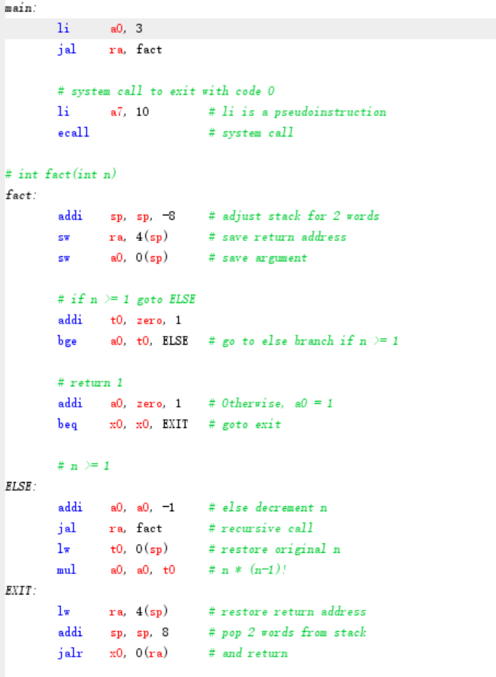
RISC-V code for fact

Slide 3
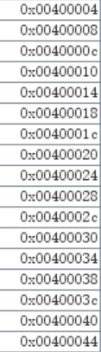
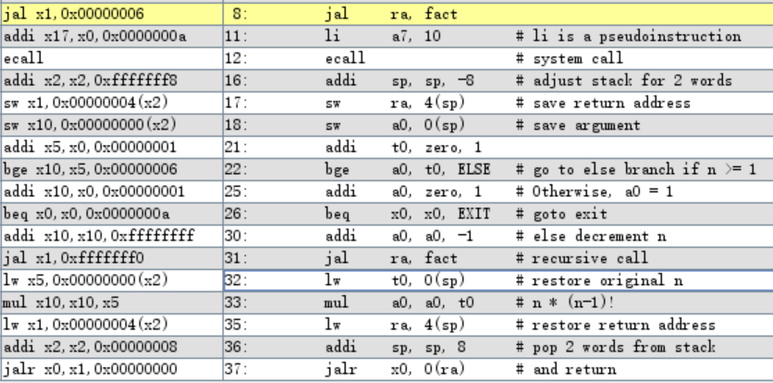
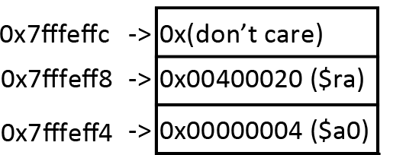
CSE 3666 Demo of Recursion
Created by: Dr. Caiwen Ding
SP=0x7fffeffc; n=3 (a0=3)
Addr
Inst
Inst Basic
Result
…
…
…
PC->
…
…
SP->
(fact)
…
…
…
(else)
…
…
…

Slide 4
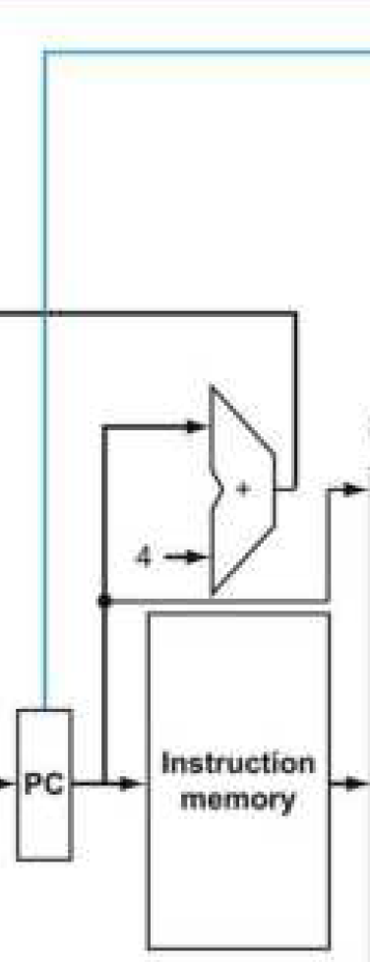
CSE 3666 Demo of Recursion
Created by: Dr. Caiwen Ding
SP=0x7fffeffc; n=3 (a0=3)
Addr
Inst
Inst Basic
Result
…
…
…
…
…
1. jump; 2.ra=PC+4=0x00400008
PC->
(fact)
SP->
…
…
…
(else)
…
…
…

Slide 5
CSE 3666 Demo of Recursion
Created by: Dr. Caiwen Ding
SP=0x7fffeffc; n=3 (a0=3)
Addr
Inst
Inst Basic
Result
…
…
…
…
…
1. jump; 2.ra=PC+4=0x00400008
(fact)
SP= 0x7fffeff4
PC->
…
…
…
SP->
(else)
…
…
…

Slide 6
CSE 3666 Demo of Recursion
Created by: Dr. Caiwen Ding
SP=0x7fffeffc; n=3 (a0=3)
Addr
Inst
Inst Basic
Result
…
…
…
…
…
1. jump; 2.ra=PC+4=0x00400008
(fact)
SP= 0x7fffeff4
PC->
0x00400008 (ra)
…
…
…
SP->
(else)
…
…
…

Slide 7
CSE 3666 Demo of Recursion
Created by: Dr. Caiwen Ding
SP=0x7fffeffc; n=3 (a0=3)
Addr
Inst
Inst Basic
Result
…
…
…
…
…
1. jump; 2.ra=PC+4=0x00400008
(fact)
SP= 0x7fffeff4
PC->
0x00400008 (ra)
…
…
…
0x00000003 (a0)
SP->
(else)
…
…
…

Slide 8
CSE 3666 Demo of Recursion
Created by: Dr. Caiwen Ding
SP=0x7fffeffc; n=3 (a0=3)
Addr
Inst
Inst Basic
Result
…
…
…
…
…
1. jump; 2.ra=PC+4=0x00400008
(fact)
SP= 0x7fffeff4
0x00400008 (ra)
…
t0= 1
PC->
SP->
0x00000003 (a0)
(else)
…

Slide 9
CSE 3666 Demo of Recursion
Created by: Dr. Caiwen Ding
SP=0x7fffeffc; n=3 (a0=3)
Addr
Inst
Inst Basic
Result
…
…
…
…
…
1. jump; 2.ra=PC+4=0x00400008
(fact)
SP= 0x7fffeff4
0x00400008 (ra)
…
t0= 1
SP->
0x00000003 (a0)
PC->
(else)
…

Slide 10
CSE 3666 Demo of Recursion
Created by: Dr. Caiwen Ding
SP=0x7fffeffc; n=3 (a0=0x00000003)
Addr
Inst
Inst Basic
Result
…
…
…
…
…
1. jump; 2.ra=PC+4=0x00400008
(fact)
SP= 0x7fffeff4
0x00400008 (ra)
…
t0= 1
SP->
0x00000003 (a0)
(else)
a0=0x00000002
PC->
…

Slide 11
CSE 3666 Demo of Recursion
Created by: Dr. Caiwen Ding
SP=0x7fffeffc; n=3 (a0=0x00000003)
Addr
Inst
Inst Basic
Result
…
…
…
…
…
PC->
(fact)
SP= 0x7fffeff4
0x00400008 (ra)
…
t0= 1
SP->
0x00000003 (a0)
(else)
a0=0x00000002
1. jump; 2.ra=PC+4=0x00400034
…

Slide 12
CSE 3666 Demo of Recursion
Created by: Dr. Caiwen Ding
SP=0x7fffeffc; n=3 (a0=0x00000003)
Addr
Inst
Inst Basic
Result
…
…
…
…
…
(fact)
PC->
0x00400008 (ra)
…
t0= 1
0x00000003 (a0)
0x7fffeff0->
(else)
a0=0x00000002
SP->
0x7fffefec->
1. jump; 2.ra=PC+4=0x00400034
…

Slide 13
CSE 3666 Demo of Recursion
Created by: Dr. Caiwen Ding
SP=0x7fffeffc; n=3 (a0=0x00000003)
Addr
Inst
Inst Basic
Result
…
…
…
…
…
(fact)
PC->
0x00400008 (ra)
…
t0= 1
0x00000003 (a0)
0x7fffeff0->
0x00400034 (ra)
(else)
a0=0x00000002
SP->
0x7fffefec->
1. jump; 2.ra=PC+4=0x00400034
…

Slide 14
CSE 3666 Demo of Recursion
Created by: Dr. Caiwen Ding
SP=0x7fffeffc; n=3 (a0=0x00000003)
Addr
Inst
Inst Basic
Result
…
…
…
…
…
(fact)
0x00400008 (ra)
PC->
…
t0= 1
0x00000003 (a0)
0x7fffeff0->
0x00400034 (ra)
(else)
a0=0x00000002
SP->
0x7fffefec->
0x00000002 (a0)
1. jump; 2.ra=PC+4=0x00400034
…

Slide 15
CSE 3666 Demo of Recursion
Created by: Dr. Caiwen Ding
SP=0x7fffeffc; n=3 (a0=0x00000003)
Addr
Inst
Inst Basic
Result
…
…
…
…
…
(fact)
0x00400008 (ra)
…
t0= 1
PC->
0x00000003 (a0)
0x7fffeff0->
0x00400034 (ra)
(else)
a0=0x00000002
SP->
0x7fffefec->
0x00000002 (a0)
1. jump; 2.ra=PC+4=0x00400034
…

Slide 16
CSE 3666 Demo of Recursion
Created by: Dr. Caiwen Ding
SP=0x7fffeffc; n=3 (a0=0x00000003)
Addr
Inst
Inst Basic
Result
…
…
…
…
…
(fact)
0x00400008 (ra)
…
t0= 1
0x00000003 (a0)
0x7fffeff0->
0x00400034 (ra)
PC->
(else)
a0=0x00000002
SP->
0x7fffefec->
0x00000002 (a0)
1. jump; 2.ra=PC+4=0x00400034
…

Slide 17
CSE 3666 Demo of Recursion
Created by: Dr. Caiwen Ding
SP=0x7fffeffc; n=3 (a0=0x00000003)
Addr
Inst
Inst Basic
Result
…
…
…
…
…
(fact)
0x00400008 (ra)
…
t0= 1
0x00000003 (a0)
0x7fffeff0->
0x00400034 (ra)
(else)
a0= 0x00000001
SP->
0x7fffefec->
0x00000002 (a0)
PC->
1. jump; 2.ra=PC+4=0x00400034
…

Slide 18
CSE 3666 Demo of Recursion
Created by: Dr. Caiwen Ding
SP=0x7fffeffc; n=3 (a0=0x00000003)
Addr
Inst
Inst Basic
Result
…
…
…
…
…
PC->
(fact)
0x00400008 (ra)
…
t0= 1
0x00000003 (a0)
0x7fffeff0->
0x00400034 (ra)
(else)
a0= 0x00000001
SP->
0x7fffefec->
0x00000002 (a0)
1. jump; 2.ra=PC+4=0x00400034
…

Slide 19
CSE 3666 Demo of Recursion
Created by: Dr. Caiwen Ding
SP=0x7fffeffc; n=3 (a0=0x00000003)
Addr
Inst
Inst Basic
Result
…
…
…
…
…
(fact)
PC->
0x00400008 (ra)
…
t0= 1
0x00000003 (a0)
0x7fffeff0->
0x00400034 (ra)
(else)
a0= 0x00000001
0x7fffefec->
0x00000002 (a0)
1. jump; 2.ra=PC+4=0x00400034
0x7fffeff0->
SP->
0x7fffefec->
…

Slide 20
CSE 3666 Demo of Recursion
Created by: Dr. Caiwen Ding
SP=0x7fffeffc; n=3 (a0=0x00000003)
Addr
Inst
Inst Basic
Result
…
…
…
…
…
(fact)
PC->
0x00400008 (ra)
…
t0= 1
0x00000003 (a0)
0x7fffeff0->
0x00400034 (ra)
(else)
a0= 0x00000001
0x7fffefec->
0x00000002 (a0)
1. jump; 2.ra=PC+4=0x00400034
0x7fffeff0->
0x00400034 (ra)
SP->
0x7fffefec->
…

Slide 21
CSE 3666 Demo of Recursion
Created by: Dr. Caiwen Ding
SP=0x7fffeffc; n=3 (a0=0x00000003)
Addr
Inst
Inst Basic
Result
…
…
…
…
…
(fact)
0x00400008 (ra)
PC->
…
t0= 1
0x00000003 (a0)
0x7fffeff0->
0x00400034 (ra)
(else)
a0= 0x00000001
0x7fffefec->
0x00000002 (a0)
1. jump; 2.ra=PC+4=0x00400034
0x7fffeff0->
0x00400034 (ra)
SP->
0x7fffefec->
0x00000001 (a0)
…

Slide 22
CSE 3666 Demo of Recursion
Created by: Dr. Caiwen Ding
SP=0x7fffeffc; n=3 (a0=0x00000003)
Addr
Inst
Inst Basic
Result
…
…
…
…
…
(fact)
0x00400008 (ra)
…
t0= 1
PC->
0x00000003 (a0)
0x7fffeff0->
0x00400034 (ra)
(else)
a0= 0x00000001
0x7fffefec->
0x00000002 (a0)
1. jump; 2.ra=PC+4=0x00400034
0x7fffeff0->
0x00400034 (ra)
SP->
0x7fffefec->
0x00000001 (a0)
…

Slide 23
CSE 3666 Demo of Recursion
Created by: Dr. Caiwen Ding
SP=0x7fffeffc; n=3 (a0=0x00000003)
Addr
Inst
Inst Basic
Result
…
…
…
…
…
(fact)
0x00400008 (ra)
…
t0= 1
0x00000003 (a0)
0x7fffeff0->
0x00400034 (ra)
PC->
(else)
a0= 0x00000001
0x7fffefec->
0x00000002 (a0)
1. jump; 2.ra=PC+4=0x00400034
0x7fffeff0->
0x00400034 (ra)
SP->
0x7fffefec->
0x00000001 (a0)
…

Slide 24
CSE 3666 Demo of Recursion
Created by: Dr. Caiwen Ding
SP=0x7fffeffc; n=3 (a0=0x00000003)
Addr
Inst
Inst Basic
Result
…
…
…
…
…
(fact)
0x00400008 (ra)
…
t0= 1
0x00000003 (a0)
0x7fffeff0->
0x00400034 (ra)
(else)
a0= 0x00000000
0x7fffefec->
0x00000002 (a0)
PC->
1. jump; 2.ra=PC+4=0x00400034
0x7fffeff0->
0x00400034 (ra)
SP->
0x7fffefec->
0x00000001 (a0)
…

Slide 25
CSE 3666 Demo of Recursion
Created by: Dr. Caiwen Ding
SP=0x7fffeffc; n=3 (a0=0x00000003)
Addr
Inst
Inst Basic
Result
…
…
…
…
…
PC->
(fact)
0x00400008 (ra)
…
t0= 1
0x00000003 (a0)
0x7fffeff0->
0x00400034 (ra)
(else)
a0= 0x00000000
0x7fffefec->
0x00000002 (a0)
1. jump; 2.ra=PC+4=0x00400034
0x7fffeff0->
0x00400034 (ra)
SP->
0x7fffefec->
0x00000001 (a0)
…

Slide 26
CSE 3666 Demo of Recursion
Created by: Dr. Caiwen Ding
SP=0x7fffeffc; n=3 (a0=0x00000003)
Addr
Inst
Inst Basic
Result
…
…
…
…
…
(fact)
PC->
0x00400008 (ra)
…
t0= 1
0x00000003 (a0)
0x7fffeff0->
0x00400034 (ra)
(else)
a0= 0x00000000
0x7fffefec->
0x00000002 (a0)
1. jump; 2.ra=PC+4=0x00400034
0x7fffeff0->
0x00400034 (ra)
0x7fffefec->
0x00000001 (a0)
…
0x7fffeff0->
SP->
0x7fffefec->

Slide 27
CSE 3666 Demo of Recursion
Created by: Dr. Caiwen Ding
SP=0x7fffeffc; n=3 (a0=0x00000003)
Addr
Inst
Inst Basic
Result
…
…
…
…
…
(fact)
PC->
0x00400008 (ra)
…
t0= 1
0x00000003 (a0)
0x7fffeff0->
0x00400034 (ra)
(else)
a0= 0x00000000
0x7fffefec->
0x00000002 (a0)
1. jump; 2.ra=PC+4=0x00400034
0x7fffeff0->
0x00400034 (ra)
0x7fffefec->
0x00000001 (a0)
…
0x7fffeff0->
0x00400034 (ra)
SP->
0x7fffefec->

Slide 28
CSE 3666 Demo of Recursion
Created by: Dr. Caiwen Ding
SP=0x7fffeffc; n=3 (a0=0x00000003)
Addr
Inst
Inst Basic
Result
…
…
…
…
…
(fact)
0x00400008 (ra)
PC->
…
t0= 1
0x00000003 (a0)
0x7fffeff0->
0x00400034 (ra)
(else)
a0= 0x00000000
0x7fffefec->
0x00000002 (a0)
1. jump; 2.ra=PC+4=0x00400034
0x7fffeff0->
0x00400034 (ra)
0x7fffefec->
0x00000001 (a0)
…
0x7fffeff0->
0x00400034 (ra)
SP->
0x7fffefec->
0x00000000 (a0)

Slide 29
CSE 3666 Demo of Recursion
Created by: Dr. Caiwen Ding
SP=0x7fffeffc; n=3 (a0=0x00000003)
Addr
Inst
Inst Basic
Result
…
…
…
…
…
(fact)
0x00400008 (ra)
…
t0= 1
PC->
0x00000003 (a0)
0x7fffeff0->
0x00400034 (ra)
(else)
a0= 0x00000000
0x7fffefec->
0x00000002 (a0)
1. jump; 2.ra=PC+4=0x00400034
0x7fffeff0->
0x00400034 (ra)
0x7fffefec->
0x00000001 (a0)
…
0x7fffeff0->
0x00400034 (ra)
SP->
0x7fffefec->
0x00000000 (a0)

Slide 30
CSE 3666 Demo of Recursion
Created by: Dr. Caiwen Ding
SP=0x7fffeffc; n=3 (a0=0x00000003)
Addr
Inst
Inst Basic
Result
…
…
…
…
…
(fact)
0x00400008 (ra)
…
t0= 1
0x00000003 (a0)
PC->
0x7fffeff0->
0x00400034 (ra)
(else)
a0= 0x00000000
0x7fffefec->
0x00000002 (a0)
1. jump; 2.ra=PC+4=0x00400034
0x7fffeff0->
0x00400034 (ra)
0x7fffefec->
0x00000001 (a0)
…
0x7fffeff0->
0x00400034 (ra)
SP->
0x7fffefec->
0x00000000 (a0)

Slide 31
CSE 3666 Demo of Recursion
Created by: Dr. Caiwen Ding
SP=0x7fffeffc; n=3 (a0=0x00000003)
Addr
Inst
Inst Basic
Result
…
…
…
…
…
(fact)
0x00400008 (ra)
…
t0= 1
0x00000003 (a0)
a0= 0x00000001
0x7fffeff0->
0x00400034 (ra)
PC->
(else)
0x7fffefec->
0x00000002 (a0)
0x7fffeff0->
0x00400034 (ra)
0x7fffefec->
0x00000001 (a0)
(exit)
…
0x7fffeff0->
0x00400034 (ra)
SP->
0x7fffefec->
0x00000000 (a0)

Slide 32
CSE 3666 Demo of Recursion
Created by: Dr. Caiwen Ding
SP=0x7fffeffc; n=3 (a0=0x00000003)
Addr
Inst
Inst Basic
Result
…
…
…
…
…
(fact)
0x00400008 (ra)
…
t0= 1
0x00000003 (a0)
a0= 0x00000001
0x7fffeff0->
0x00400034 (ra)
(else)
0x7fffefec->
0x00000002 (a0)
0x7fffeff0->
0x00400034 (ra)
PC->
0x7fffefec->
0x00000001 (a0)
(exit)
…
0x7fffeff0->
0x00400034 (ra)
SP->
0x7fffefec->
0x00000000 (a0)

Slide 33
CSE 3666 Demo of Recursion
Created by: Dr. Caiwen Ding
SP=0x7fffeffc; n=3 (a0=0x00000003)
Addr
Inst
Inst Basic
Result
…
…
…
…
…
(fact)
0x00400008 (ra)
…
t0= 1
0x00000003 (a0)
a0= 0x00000001
0x7fffeff0->
0x00400034 (ra)
(else)
0x7fffefec->
0x00000002 (a0)
0x7fffeff0->
0x00400034 (ra)
0x7fffefec->
0x00000001 (a0)
(exit)
ra= 0x00040034
PC->
…
0x7fffeff0->
0x00400034 (ra)
SP->
0x7fffefec->
0x00000000 (a0)

Slide 34
CSE 3666 Demo of Recursion
Created by: Dr. Caiwen Ding
SP=0x7fffeffc; n=3 (a0=0x00000003)
Addr
Inst
Inst Basic
Result
…
…
…
…
…
(fact)
0x00400008 (ra)
…
t0= 1
0x00000003 (a0)
a0= 0x00000001
0x7fffeff0->
0x00400034 (ra)
(else)
0x7fffefec->
0x00000002 (a0)
0x7fffeff0->
0x00400034 (ra)
SP->
0x7fffefec->
0x00000001 (a0)
(exit)
ra= 0x00040034
…
0x7fffeff0->
0x00400034 (ra)
PC->
0x00000000 (a0)
0x7fffefec->

Slide 35
CSE 3666 Demo of Recursion
Created by: Dr. Caiwen Ding
SP=0x7fffeffc; n=3 (a0=0x00000003)
Addr
Inst
Inst Basic
Result
…
…
…
…
…
(fact)
0x00400008 (ra)
…
t0= 1
0x00000003 (a0)
a0= 0x00000001
0x7fffeff0->
0x00400034 (ra)
(else)
0x7fffefec->
0x00000002 (a0)
PC->
0x7fffeff0->
0x00400034 (ra)
SP->
0x7fffefec->
0x00000001 (a0)
(exit)
ra= 0x00040034
…
0x7fffeff0->
0x00400034 (ra)
0x7fffefec->
0x00000000 (a0)

Slide 36
CSE 3666 Demo of Recursion
Created by: Dr. Caiwen Ding
SP=0x7fffeffc; n=3 (a0=0x00000003)
Addr
Inst
Inst Basic
Result
…
…
…
…
…
(fact)
0x00400008 (ra)
…
t0= 1
0x00000003 (a0)
a0= 0x00000001
0x7fffeff0->
0x00400034 (ra)
(else)
0x7fffefec->
0x00000002 (a0)
t0= 0x00000001
0x7fffeff0->
0x00400034 (ra)
PC->
0x00000001 (a0)
ra= 0x00040034
SP->
0x7fffefec->
(exit)
…
0x7fffeff0->
0x00400034 (ra)
0x7fffefec->
0x00000000 (a0)

Slide 37
CSE 3666 Demo of Recursion
Created by: Dr. Caiwen Ding
SP=0x7fffeffc; n=3 (a0=0x00000003)
Addr
Inst
Inst Basic
Result
…
…
…
…
…
(fact)
0x00400008 (ra)
…
t0= 1
0x00000003 (a0)
a0= 0x00000001
0x7fffeff0->
0x00400034 (ra)
(else)
0x7fffefec->
0x00000002 (a0)
t0= 0x00000001
0x7fffeff0->
0x00400034 (ra)
a0= 0x00000001
SP->
0x7fffefec->
0x00000001 (a0)
PC->
(exit)
ra= 0x00040034
…
0x7fffeff0->
0x00400034 (ra)
0x7fffefec->
0x00000000 (a0)

Slide 38
CSE 3666 Demo of Recursion
Created by: Dr. Caiwen Ding
SP=0x7fffeffc; n=3 (a0=0x00000003)
Addr
Inst
Inst Basic
Result
…
…
…
…
…
(fact)
0x00400008 (ra)
…
t0= 1
0x00000003 (a0)
a0= 0x00000001
0x7fffeff0->
0x00400034 (ra)
(else)
0x7fffefec->
0x00000002 (a0)
t0= 0x00000001
0x7fffeff0->
0x00400034 (ra)
a0= 0x00000001
SP->
0x7fffefec->
0x00000001 (a0)
(exit)
ra= 0x00040034
PC->
…
0x7fffeff0->
0x00400034 (ra)
0x7fffefec->
0x00000000 (a0)

Slide 39
CSE 3666 Demo of Recursion
Created by: Dr. Caiwen Ding
SP=0x7fffeffc; n=3 (a0=0x00000003)
Addr
Inst
Inst Basic
Result
…
…
…
…
…
(fact)
0x00400008 (ra)
…
t0= 1
0x00000003 (a0)
0x7fffeff0->
0x00400034 (ra)
(else)
SP->
0x7fffefec->
0x00000002 (a0)
t0= 0x00000001
0x7fffeff0->
0x00400034 (ra)
a0= 0x00000001
0x7fffefec->
0x00000001 (a0)
(exit)
ra= 0x00040034
PC->
…
0x7fffeff0->
0x00400034 (ra)
0x7fffefec->
0x00000000 (a0)

Slide 40
CSE 3666 Demo of Recursion
Created by: Dr. Caiwen Ding
SP=0x7fffeffc; n=3 (a0=0x00000003)
Addr
Inst
Inst Basic
Result
…
…
…
…
…
(fact)
0x00400008 (ra)
…
t0= 1
0x00000003 (a0)
0x7fffeff0->
0x00400034 (ra)
(else)
SP->
0x7fffefec->
0x00000002 (a0)
t0= 0x00000001
0x7fffeff0->
0x00400034 (ra)
a0= 0x00000001
0x7fffefec->
0x00000001 (a0)
(exit)
ra= 0x00040034
…
0x7fffeff0->
0x00400034 (ra)
PC->
0x7fffefec->
0x00000000 (a0)

Slide 41
CSE 3666 Demo of Recursion
Created by: Dr. Caiwen Ding
SP=0x7fffeffc; n=3 (a0=0x00000003)
Addr
Inst
Inst Basic
Result
…
…
…
…
…
(fact)
0x00400008 (ra)
…
t0= 1
0x00000003 (a0)
0x7fffeff0->
0x00400034 (ra)
(else)
SP->
0x7fffefec->
0x00000002 (a0)
PC->
t0= 0x00000001
0x7fffeff0->
0x00400034 (ra)
a0= 0x00000001
0x7fffefec->
0x00000001 (a0)
(exit)
ra= 0x00040034
…
0x7fffeff0->
0x00400034 (ra)
0x7fffefec->
0x00000000 (a0)

Slide 42
CSE 3666 Demo of Recursion
Created by: Dr. Caiwen Ding
SP=0x7fffeffc; n=3 (a0=0x00000003)
Addr
Inst
Inst Basic
Result
…
…
…
…
…
(fact)
0x00400008 (ra)
…
t0= 1
0x00000003 (a0)
0x7fffeff0->
0x00400034 (ra)
(else)
SP->
0x7fffefec->
0x00000002 (a0)
t0= 0x00000002
0x7fffeff0->
0x00400034 (ra)
PC->
0x00000001 (a0)
ra= 0x00040034
0x7fffefec->
(exit)
…
0x7fffeff0->
0x00400034 (ra)
0x7fffefec->
0x00000000 (a0)

Slide 43
CSE 3666 Demo of Recursion
Created by: Dr. Caiwen Ding
SP=0x7fffeffc; n=3 (a0=0x00000003)
Addr
Inst
Inst Basic
Result
…
…
…
…
…
(fact)
0x00400008 (ra)
…
t0= 1
0x00000003 (a0)
0x7fffeff0->
0x00400034 (ra)
(else)
SP->
0x7fffefec->
0x00000002 (a0)
t0= 0x00000002
0x7fffeff0->
0x00400034 (ra)
a0= 0x00000002
0x7fffefec->
0x00000001 (a0)
PC->
(exit)
ra= 0x00040034
…
0x7fffeff0->
0x00400034 (ra)
0x7fffefec->
0x00000000 (a0)

Slide 44
CSE 3666 Demo of Recursion
Created by: Dr. Caiwen Ding
SP=0x7fffeffc; n=3 (a0=0x00000003)
Addr
Inst
Inst Basic
Result
…
…
…
…
…
(fact)
0x00400008 (ra)
…
t0= 1
0x00000003 (a0)
0x7fffeff0->
0x00400034 (ra)
(else)
SP->
0x7fffefec->
0x00000002 (a0)
t0= 0x00000001
0x7fffeff0->
0x00400034 (ra)
a0= 0x00000001
0x7fffefec->
0x00000001 (a0)
(exit)
ra= 0x00040034
PC->
…
0x7fffeff0->
0x00400034 (ra)
0x7fffefec->
0x00000000 (a0)

Slide 45
CSE 3666 Demo of Recursion
Created by: Dr. Caiwen Ding
SP=0x7fffeffc; n=3 (a0=0x00000003)
Addr
Inst
Inst Basic
Result
…
…
…
…
…
(fact)
0x00400008 (ra)
…
t0= 1
SP->
0x00000003 (a0)
0x7fffeff0->
0x00400034 (ra)
(else)
0x7fffefec->
0x00000002 (a0)
t0= 0x00000001
0x7fffeff0->
0x00400034 (ra)
a0= 0x00000001
0x7fffefec->
0x00000001 (a0)
(exit)
ra= 0x00040034
…
0x7fffeff0->
0x00400034 (ra)
PC->
0x7fffefec->
0x00000000 (a0)

Slide 46
CSE 3666 Demo of Recursion
Created by: Dr. Caiwen Ding
SP=0x7fffeffc; n=3 (a0=0x00000003)
Addr
Inst
Inst Basic
Result
…
…
…
…
…
(fact)
0x00400008 (ra)
…
t0= 1
SP->
0x00000003 (a0)
0x7fffeff0->
0x00400034 (ra)
(else)
0x7fffefec->
0x00000002 (a0)
PC->
t0= 0x00000003
0x7fffeff0->
0x00400034 (ra)
0x7fffefec->
0x00000001 (a0)
(exit)
ra= 0x00040034
…
0x7fffeff0->
0x00400034 (ra)
0x7fffefec->
0x00000000 (a0)

Slide 47
CSE 3666 Demo of Recursion
Created by: Dr. Caiwen Ding
SP=0x7fffeffc; n=3 (a0=0x00000003)
Addr
Inst
Inst Basic
Result
…
…
…
…
…
(fact)
0x00400008 (ra)
…
t0= 1
SP->
0x00000003 (a0)
0x7fffeff0->
0x00400034 (ra)
(else)
0x7fffefec->
0x00000002 (a0)
t0= 0x00000003
0x7fffeff0->
0x00400034 (ra)
PC->
0x00000001 (a0)
ra= 0x00040034
0x7fffefec->
(exit)
…
0x7fffeff0->
0x00400034 (ra)
0x7fffefec->
0x00000000 (a0)

Slide 48
CSE 3666 Demo of Recursion
Created by: Dr. Caiwen Ding
SP=0x7fffeffc; n=3 (a0=0x00000003)
Addr
Inst
Inst Basic
Result
…
…
…
…
…
(fact)
0x00400008 (ra)
…
t0= 1
SP->
0x00000003 (a0)
0x7fffeff0->
0x00400034 (ra)
(else)
0x7fffefec->
0x00000002 (a0)
t0= 0x00000003
0x7fffeff0->
0x00400034 (ra)
a0= 0x00000006
0x7fffefec->
0x00000001 (a0)
PC->
(exit)
ra= 0x00040034
…
0x7fffeff0->
0x00400034 (ra)
0x7fffefec->
0x00000000 (a0)

Slide 49
CSE 3666 Demo of Recursion
Created by: Dr. Caiwen Ding
SP=0x7fffeffc; n=3 (a0=0x00000003)
Addr
Inst
Inst Basic
Result
…
…
…
…
…
(fact)
0x00400008 (ra)
…
t0= 1
SP->
0x00000003 (a0)
0x7fffeff0->
0x00400034 (ra)
(else)
0x7fffefec->
0x00000002 (a0)
t0= 0x00000003
0x7fffeff0->
0x00400034 (ra)
a0= 0x00000006
0x7fffefec->
0x00000001 (a0)
(exit)
ra= 0x00040008
PC->
…
0x7fffeff0->
0x00400034 (ra)
0x7fffefec->
0x00000000 (a0)

Slide 50
CSE 3666 Demo of Recursion
Created by: Dr. Caiwen Ding
SP=0x7fffeffc; n=3 (a0=0x00000003)
Addr
Inst
Inst Basic
Result
…
…
…
…
…
(fact)
SP->
0x00400008 (ra)
…
t0= 1
0x00000003 (a0)
0x7fffeff0->
0x00400034 (ra)
(else)
0x7fffefec->
0x00000002 (a0)
t0= 0x00000003
0x7fffeff0->
0x00400034 (ra)
a0= 0x00000006
0x7fffefec->
0x00000001 (a0)
(exit)
ra= 0x00040008
…
0x7fffeff0->
0x00400034 (ra)
PC->
0x7fffefec->
0x00000000 (a0)

Slide 51
CSE 3666 Demo of Recursion
Created by: Dr. Caiwen Ding
SP=0x7fffeffc; n=3 (a0=0x00000003)
Addr
Inst
Inst Basic
Result
…
…
…
…
…
PC->
system call to exit
(fact)
SP->
0x00400008 (ra)
…
t0= 1
0x00000003 (a0)
0x7fffeff0->
0x00400034 (ra)
(else)
0x7fffefec->
0x00000002 (a0)
t0= 0x00000003
0x7fffeff0->
0x00400034 (ra)
a0= 0x00000006
0x7fffefec->
0x00000001 (a0)
(exit)
ra= 0x00040008
…
0x7fffeff0->
0x00400034 (ra)
0x7fffefec->
0x00000000 (a0)

Slide 52
CSE 3666 Demo of Recursion
Created by: Dr. Caiwen Ding
SP=0x7fffeffc; n=3 (a0=0x00000003)
Addr
Inst
Inst Basic
Result
…
…
…
…
…
system call to exit
PC->
(fact)
SP->
0x00400008 (ra)
…
t0= 1
0x00000003 (a0)
0x7fffeff0->
0x00400034 (ra)
(else)
0x7fffefec->
0x00000002 (a0)
t0= 0x00000003
0x7fffeff0->
0x00400034 (ra)
a0= 0x00000006
0x7fffefec->
0x00000001 (a0)
(exit)
ra= 0x00040008
…
0x7fffeff0->
0x00400034 (ra)
0x7fffefec->
0x00000000 (a0)

