Slide 1
Project 1: Speed Dating
Jonathan Bae, Haotian Li

Slide 2
Quick Glance
As a male, if you are attractive and funny
You will get the most dates

Slide 3
Assumptions

Slide 4
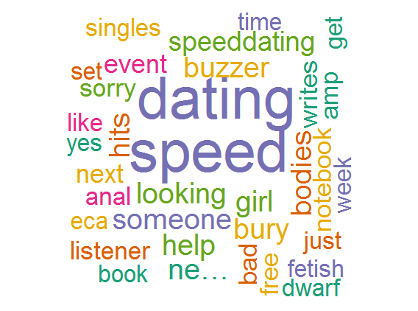
Sentiment Analysis
No results for “Speed Dating” in either Charlottesville or Manhattan
Word cloud for speed dating in general

Slide 5
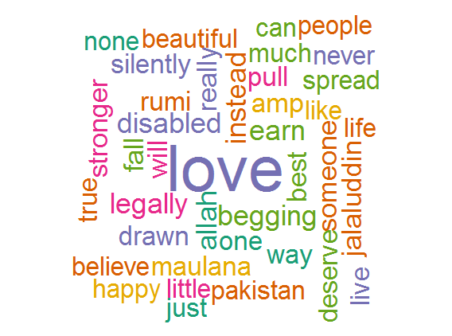
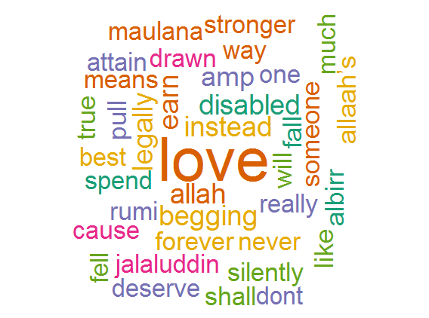
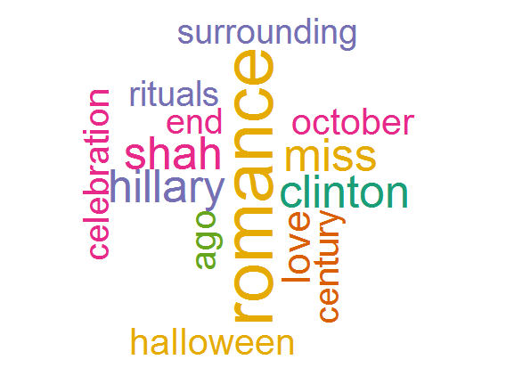
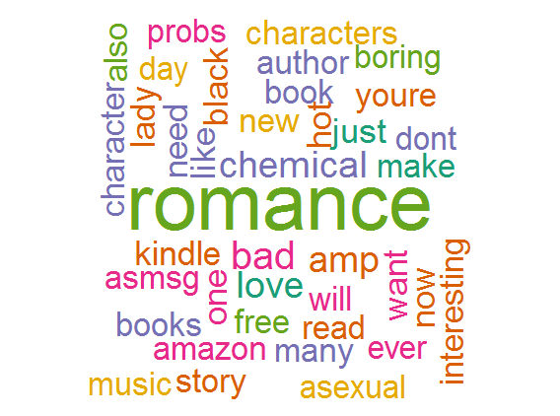
Love and Romance
A few word clouds for the word “Love”
A few word clouds for the word “Romance”
Left: Charlottesville, Right: Manhattan
Left: Charlottesville, Right: Everywhere

