Slide 1
Project 1: Speed Dating
Jonathan Bae, Haotian Li

Slide 2
Quick Glance
The objective of this study was to find what makes females decide yes to a male
As a male, if you are attractive and funny
You will get the most “yes” from females

Slide 3
Assumptions
Dec_o indicates correctly whether or not the female partner says yes or no
Field_cd maps to the correct field
Focus on men’s attributes only
Only things a man can control

Slide 4
Data Cleaning
The attributes used are

Slide 7
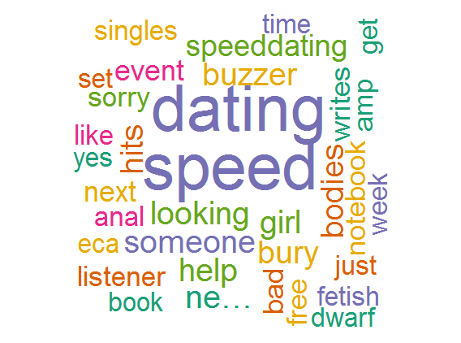
Sentiment Analysis
No results for “Speed Dating” in either Charlottesville or Manhattan
Word cloud for speed dating in general

Slide 8
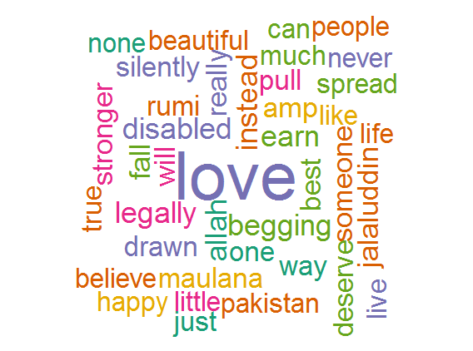
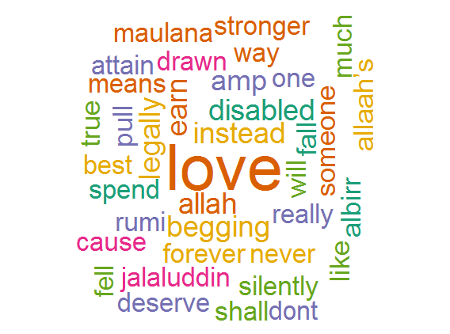
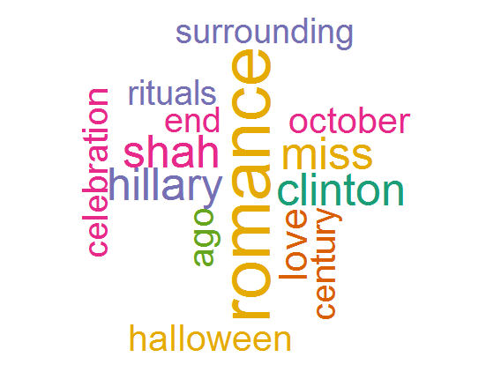
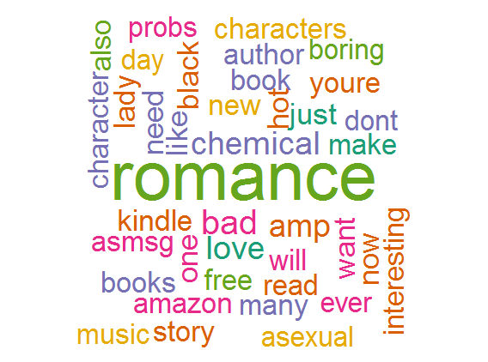
Love and Romance
A few word clouds for the word “Love”
A few word clouds for the word “Romance”
Left: Charlottesville, Right: Manhattan
Left: Charlottesville, Right: Everywhere

