Slide 1
Project 1: Speed Dating
Jonathan Bae, Haotian Li

Slide 2
Quick Glance
The objective of this study was to find what makes females decide yes to a male
As a male, if you are attractive and funny
You will get the most “yes” from females

Slide 3
Assumptions
Dec_o indicates correctly whether or not the female partner says yes or no
Field_cd maps to the correct field
Focus on men’s attributes only
Only things a man can control

Slide 4
Data Cleaning
The attributes used are
Imputation:
For na rating values from partners, use mean score of the iid
Na coding for field_cd or career_c, code to value of similar corresponding careers and fields

Slide 5
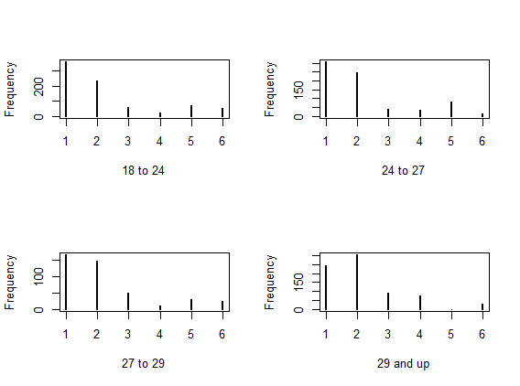
Daters reasons they go change
We see an increase in goal 4 which is “Looking for a serious relationship” as age increases

Slide 6
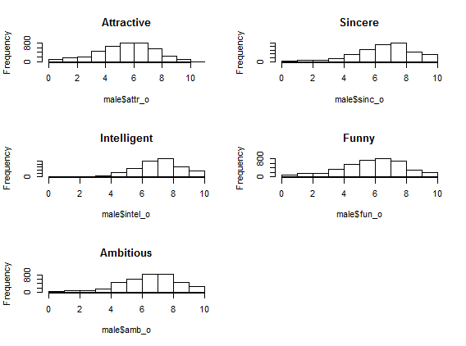
Ratings may be biased
Sincere, Intelligent, Funny, and Ambitious have similar distributions whereas Attractive seems more representative of the ways humans will rate people

Slide 7
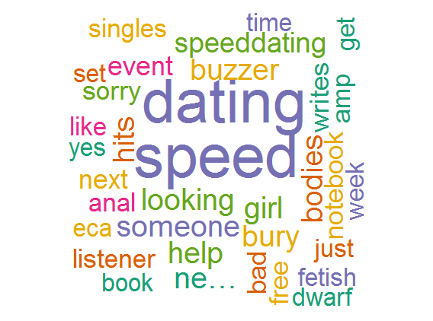
Sentiment Analysis
No results for “Speed Dating” in either Charlottesville or Manhattan
Word cloud for speed dating in general

Slide 8
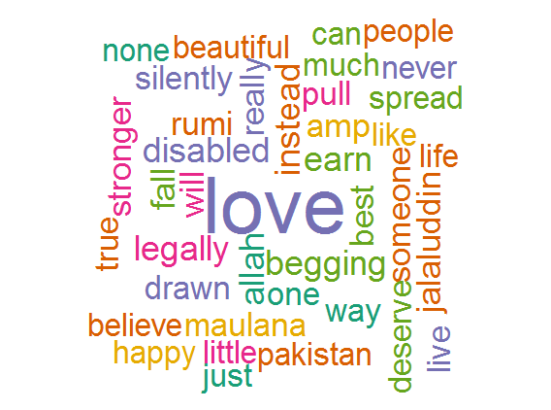
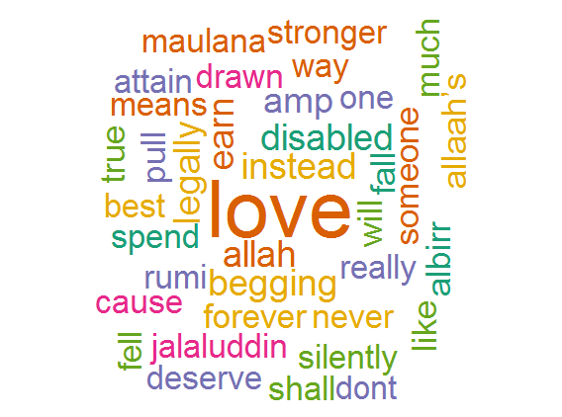
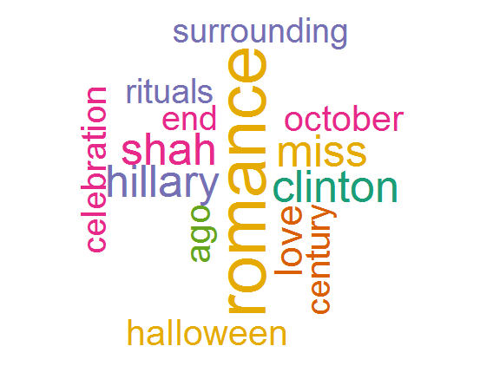
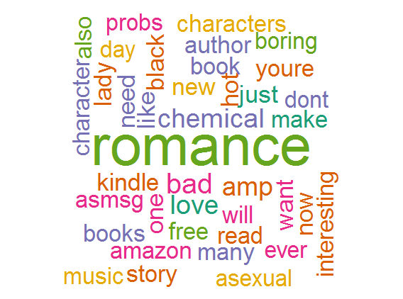
Love and Romance
A few word clouds for the word “Love”
Some unique words are seen (such as allah and disabled)
A few word clouds for the word “Romance”
Everywhere is focused more on book results
Left: Charlottesville, Right: Manhattan
Left: Charlottesville, Right: Everywhere

Slide 9
Classification

Slide 10
Conclusion

