Slide 1


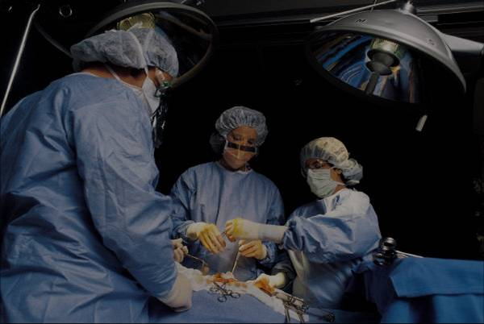
COMP 576 Intro to Deep Learning Final Project - Artificial Art
Jonathan Cai (jmc31), Skylar Xu (yx48)
Rice University, Computer Science
Abstract
Methods and Materials
Recently, there have been many developments in the area of Generative Adversarial Networks. In particular, people have been using these models to generate creative pieces, including paintings, music, faces etc.
This poses a philosophical question - what is art? Does it require a painter’s skilled hand and creative mind to produce a painting, or can a machine do the same?
We’re not sure if we can ever answer these questions, however we are interested in seeing if we can replicate these studies, while exploring the usefulness of GANs in this particular task of art generation.
Click here to insert your Methods and Materials text. Type it in or copy and paste from your Word document or other source.
This text box will automatically re-size to your text. To turn off that feature, right click inside this box and go to Format Shape, Text Box, Autofit, and select the “Do Not Autofit” radio button.
To change the font style of this text box: Click on the border once to highlight the entire text box, then select a different font or font size that suits you. This text is Calibri 20pt and is easily read up to 3 feet away on a 24x36 poster, and up to 6 feet away on a 48x72 poster.
Zoom out to 100% (for 24x36) or 200% (for 48x72) to preview what this will look like on your printed poster.
Chart 1. Label in 16pt Calibri.
Introduction
Results
Discussion
Recently, there have been many developments in the area of Generative Adversarial Networks. In particular, people have been using these models to generate creative pieces, including paintings, music, faces etc.
This poses a philosophical question - what is art? Does it require a painter’s skilled hand and creative mind to produce a painting, or can a machine do the same?
We’re not sure if we can ever answer these questions, however we are interested in seeing if we can replicate these studies, while exploring the usefulness of GANs in this particular task of art generation.
Click here to insert your Results text. Type it in or copy and paste from your Word document or other source.
This text box will automatically re-size to your text. To turn off that feature, right click inside this box and go to Format Shape, Text Box, Autofit, and select the “Do Not Autofit” radio button.
To change the font style of this text box: Click on the border once to highlight the entire text box, then select a different font or font size that suits you. This text is Calibri 20pt and is easily read up to 3 feet away on a 24x36 poster, and up to 6 feet away on a 48x72 poster.
Zoom out to 100% (for 24x36) or 200% (for 48x72) to preview what this will look like on your printed poster.
Speaking of Results, yours will look better if you remember to run a spell-check on your poster! After you’ve added your content click on Review, Spelling, or press F7.
Click here to insert your Discussion text. Type it in or copy and paste from your Word document or other source.
This text box will automatically re-size to your text. To turn off that feature, right click inside this box and go to Format Shape, Text Box, Autofit, and select the “Do Not Autofit” radio button.
To change the font style of this text box: Click on the border once to highlight the entire text box, then select a different font or font size that suits you. This text is Calibri 20pt and is easily read up to 3 feet away on a 24x36 poster, and up to 6 feet away on a 48x72 poster.
Zoom out to 100% (for 24x36) or 200% (for 48x72) to preview what this will look like on your printed poster.
Conclusions
Click here to insert your Conclusions text. Type it in or copy and paste from your Word document or other source.
This text box will automatically re-size to your text. To turn off that feature, right click inside this box and go to Format Shape, Text Box, Autofit, and select the “Do Not Autofit” radio button.
To change the font style of this text box: Click on the border once to highlight the entire text box, then select a different font or font size that suits you. This text is Calibri 20pt and is easily read up to 3 feet away on a 24x36 poster, and up to 6 feet away on a 48x72 poster.
Zoom out to 100% (for 24x36) or 200% (for 48x72) to preview what this will look like on your printed poster.
Table 1. Label in 16pt Calibri.
 | Heading | Heading | Heading
Item | 800 | 790 | 4001
Item | 356 | 856 | 290
Item | 228 | 134 | 238
Item | 954 | 875 | 976
Item | 324 | 325 | 301
Item | 199 | 137 | 186
Figure 1. Label in 16pt Calibri.
Figure 2. Label in 16pt Calibri.
Contact
References
Jonathan Cai
Email: jmc31@rice.edu
Skylar Xu
Email: yx48@rice.edu

