Slide 1
rackr
Jonathan Cai, Son Dinh, Reza Madhavan, Brandon Yuan

Slide 2
Demo

Slide 3
Purpose
Track personal finances by utilizing receipts to help people make informed decisions with their money

Slide 4



Alternatives

Slide 5
Features
Cash
Itemized transactions
Privacy
Insights

Slide 6
Target users
Tourists
College students
Everyone

Slide 7




Technologies

Slide 8

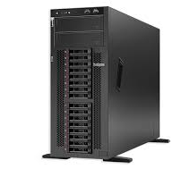

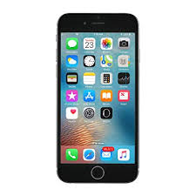
BACK END
JSON
NGROK
FRONT END

Slide 9
Difficulties
iOS
Windows sucks
Interfacing with Google Cloud API
Notes:
Cloud - never worked with cloud services before and workshop helped with learning how to use the Cloud API
iOS - workshop and mentors help

Slide 10
Future Implementations
Augmenting other services
Store/subscription recommendations
Discounts
Store returns

Slide 11
Questions?

