Slide 1
Update

Slide 2
Regressions (Diffusions of Microfinance)
Centrality Measure | Regressions
 | 1 | 2 | 3 | 4
Communication | 0.88162 |  | 0.62
Diffusion |  | 0.0234 |  | 0.015
Degree |  |  | -0.005 | -0.0042
Eigenvector |  |  | 3.73 | 3.94
Betweenness |  |  | 1.05 | 0.98
Katz-Bonacich |  |  | -0.075 | -0.103
Decay |  |  | 0.013 | 0.014
Closeness |  |  | -0.302 | -0.087
Paper R^2 | 0.406 | 0.442 | 0.53 | 0.515
R^2 | 0.226 | 0.236 | 0.469 | 0.449
RMSE | 0.0748 | 0.0744 | 0.0671 | 0.0683

Slide 3
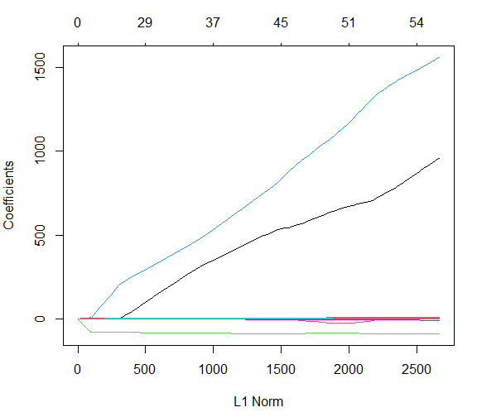
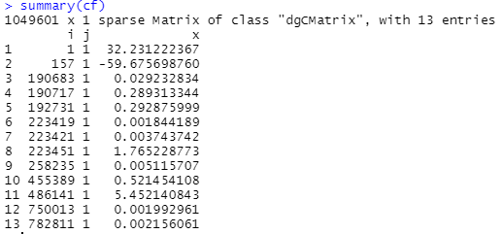

Lasso

Slide 4
PCA (Cross Validation)
4 libraries:
Prcomp()
Need to manually CV by using train and test sets
Sparsepca (pca())
Need to manually CV by using train and test sets
Pls&ISLR (pcr())
Kind of weird and wacky to use
Takes literally forever
PMA (SPC.cv())
Only performs CV on first Principal Component
Returns sum of absolute values of elements of v (?)
Ranges from 1 to sqrt(ncols(data))

Slide 5
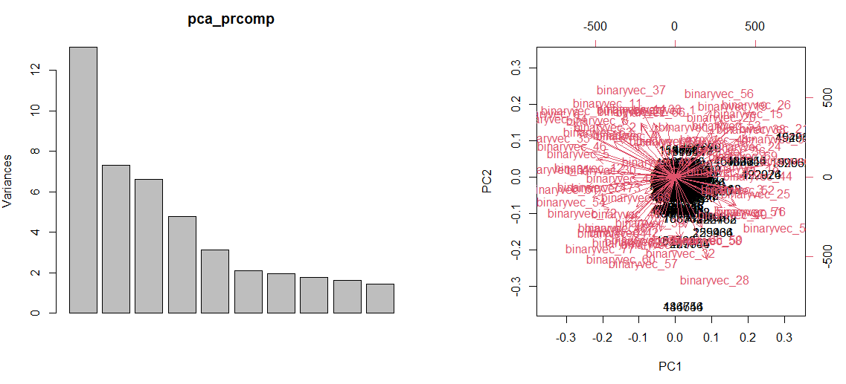
prcomp
Dimensions

Slide 6
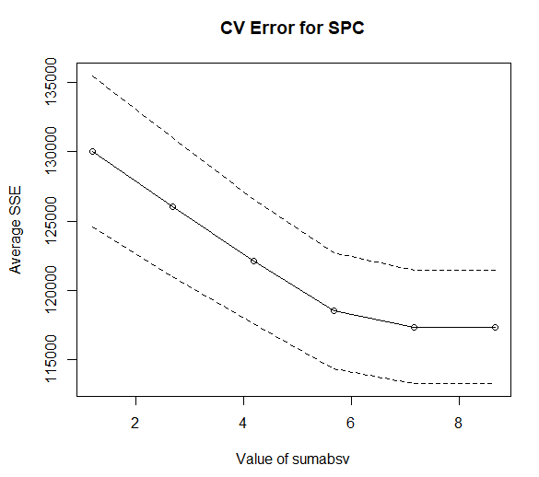
SPC.cv
Sumabsv – sum of absolute values of elements of v. It is between 1 and square root of number of columns in the data.

