Slide 1
Regressions

Slide 2
Y1: sum (total number)

Slide 3

PCR

Slide 4
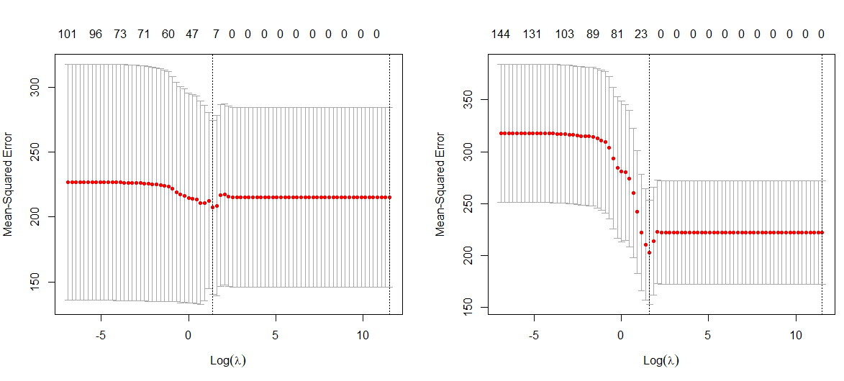


Lasso
0.75 Train 0.25 Test
Full

Slide 5
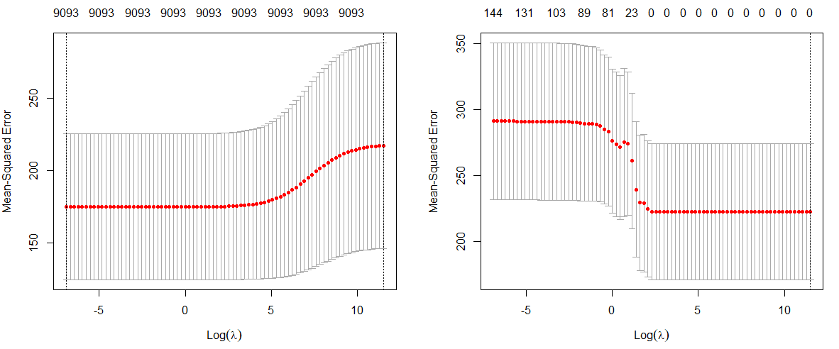


Ridge

Slide 6
Y2: ratio of sum/total

Slide 7

PCR

Slide 8
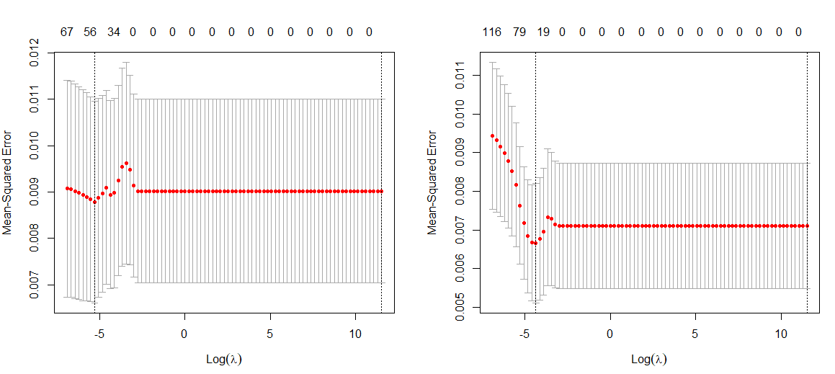


Lasso

Slide 9
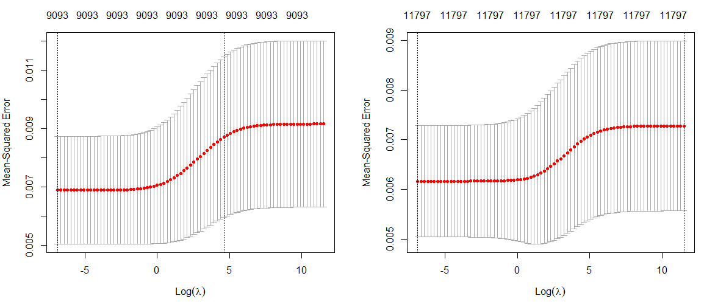


Ridge

