Slide 1
MLOps Intro
August | 2022

Slide 2
Intro & Agenda

Slide 3

Jonathan Cosme
AI/ML Solutions Architect
Jonathan.Cosme@run.ai

Slide 4
Agenda
1. MLOps overview
2. Roles & responsibilities
3. Maintenance step
4. Serving step
5. Build step

Slide 5
MLOps Overview

Slide 6
Goal of MLOps
End Step:
Maintain a model in production
Model
Production
Maintain

Slide 7
Steps of MLOps
End Step:
Maintain a model in production
End Step - 1:
Serve a model in production
End Step - 2:
Build a model
Model
Model
Model
Production
Production
Maintain

Slide 8


Process of MLOps
The process of MLOps is not linear
The process of MLOps is a feedback loop.
Maintain
Build
Serve
Maintain
Serve
Build

Slide 9
Role Responsibilities

Slide 10
Who’s responsibility is it?
Build
Data Scientist
It is the role of the data scientist to deliver trained and optimized models.
Serve
ML Engineer
Software Developer
The machine learning engineer arguably has the most difficult job: putting a model into production. Often, they will work alongside software developers/engineers to achieve this. A common mistake organizations make is hiring too many data scientist, and too few ML engineers.
Maintain
ML Engineer
Data Scientist
Stakeholder
Maintenance is a coordinated effort between the ML engineer, data scientist, and stakeholder.

Slide 11
Maintenance Step

Slide 12





Maintenance
Maintain
What do we want to do?
How do we do this?
Make sure our model is meeting our minimum threshold of performance.
1) Monitoring:
2) Retraining
Model Predictions
Performance
Model
Threshold
Input Data
Acceptable
Time
User Feedback
Unacceptable

Slide 13
Model Predictions
Maintain
Watching the distribution and frequencies of model predictions over time can help identify warning signs of model performance degradation.
In this example, we can see that over time, the frequencies of the model predictions move further and further away from our expected range.
Prediction Count
Month 1
Month 2
Month 3
Month 4
Month 5
Month 6
A
B
C
Expected Range

Slide 14
Input Data
Maintain
The underlying distribution of data can (and often) shifts with time It is crucial to keep an eye on data drift.
The figure for input data variable X1 illustrates this. Since it is common practice to normalize input data before feeding it to a model, it’s important to track distributions.
X1
Year 1
Year 2
Year 3
Year 4
As time goes by, it is common for a particular variable to be able to take on new values, that previously did not exist. The figure for input data variable X2 illustrates this. Since encodings for models are finite, the frequency and count of new unknown values must be monitored
X2
Decade 1
Decade 2
Decade 3
Genres
Drama
Action
Comedy
Romance
Genres
Drama
Action
Adventure
Comedy
Dark Comedy
Slapstick Comedy
Romance
Romantic Comedy
Documentary
Genres
Drama
Action
Adventure
Comedy
Dark Comedy
Slapstick Comedy
Romance
Romantic Comedy
Documentary
Foreign

Slide 15


User Feedback
Maintain
In order to gauge the effectiveness of a model, many AI systems have a method for obtaining user feedback built in.
A common feature is the thumbs-up or thumbs-down buttons available on recommender systems. Music and movie streaming services are heavy users of this. The proportion of feedback should be tracked, with the goal of trying to maintain as high a positive feedback proportion as possible.
Proportion
Threshold
Quarter 1
Quarter 2
Quarter 3
Quarter 4

Slide 16

Retraining
Maintain
Retraining your model is critical to the success of a machine learning or AI effort.
Retraining should occur when model performance is below par, when there are changes in data, after user feedback is received, and at regularly scheduled intervals.

Slide 17
Who’s responsibility is it?
Build
Data Scientist
It is the role of the data scientist to deliver trained and optimized models.
Serve
ML Engineer
Software Developer
The machine learning engineer arguably has the most difficult job: putting a model into production. Often, they will work alongside software developers/engineers to achieve this. A common mistake organizations make is hiring too many data scientist, and too few ML engineers.
Maintain
ML Engineer
Data Scientist
Stakeholder
Maintenance is a coordinated effort between the ML engineer, data scientist, and stakeholder.

Slide 18
Serve Step

Slide 19
Serve
Serve
What is needed to put a model into production?
A model, optimized for inference
A location to put the model
Ways to get data into the model
Ways to get model outputs to users
Ability to collect user feedback
Model retraining capabilities
Data, metadata, and model version tracking
As much automation as possible

Slide 20




Model
Serve
A trained model, optimized for inference
A place to put the model. You can either keep your model on a server, or on edge devices.
Maintaining models on a server is easier to set up an maintain, but has the disadvantage of not being accessible without a connection to the server.
Models on edge devices can perform inference at any time, without needing to contact a server. Maintaining models on edge devices is significantly more difficult however, as it involves maintaining any number of models, and potentially creating custom applications or software for the edge device.

Slide 21





Data
Serve
Models require very specific data, in a very specific way.
Clean
Transform
Normalize
In order to get to this clean data that a model can use, data preprocessing pipelines have to be created. They should be able to take raw data, clean it, transform it, and normalize it.
Dirty Data
Clean Data
Transform
Sometimes a model will also give results that are not too user friendly. In these cases, a post processing pipeline must be created.
“Cat”
Raw Output
Clean Output

Slide 22



Feedback
Serve
For recommender systems, user feedback is extremely important. A pipeline should be created for capturing user feedback.

Slide 23
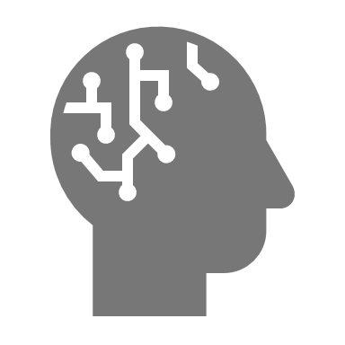
Retraining
Serve
Pipelines for retraining
on regular intervals,
on changed data,
on user feedback,
or for model performance,
should be created.

Slide 24



Tracking & Automation
Serve
It’s important to set up tracking of model changes and data schemas. Sometime case model reversion is necessary and we use tracking to do it.
Finally, automate as much as possible. It will still always be necessary to have some level of human input, but automation decreases time to production, and increases productivity
Model
1.0
1.1
2.0
Schema
1.0
1.1
1.1
Time

Slide 25
Who’s responsibility is it?
Build
Data Scientist
It is the role of the data scientist to deliver trained and optimized models.
Serve
ML Engineer
Software Developer
The machine learning engineer arguably has the most difficult job: putting a model into production. Often, they will work alongside software developers/engineers to achieve this. A common mistake organizations make is hiring too many data scientist, and too few ML engineers.
Maintain
ML Engineer
Data Scientist
Stakeholder
Maintenance is a coordinated effort between the ML engineer, data scientist, and stakeholder.

Slide 26
Build Step

Slide 27
Build
Serve
What is needed to build a model?
Data
labels
ETL
Model
architecture
tuning
Reproducibility
experiment tracking

Slide 28
Data
Build
In order to get our model to accept our data, it is necessary to apply data transformations to the raw data
Common data transformations include cleaning, scaling, encoding, and feature engineering
Cleaning
Label encoding
Example ID | Color
1 | Red
2 | NULL
3 | Green
Example ID | Color
1 | Red
3 | Green
Example ID | Color
1 | Red
2 | Blue
3 | Green
Example ID | Color
1 | 0
2 | 1
3 | 2
Scaling
Feature engineering
8000
1
5000
0

Slide 29
Data
Build
An often overlooked aspect of model building is data label consistency. Inconsistent labels can severely impact model performance
Annotator 1
Annotator 2
Annotator 3
In this example, we can see that the same set of instructions can be interpreted many ways by annotators.
Draw a box around triangles
(2 boxes)
(3 boxes)
(1 box)
In this example, the ambiguity of the word “bad” can lead different annotators to label the same sentence as opposite sentiments
Annotator 1
Annotator 2
Mark label as positive or negative sentiment
User ID | Text | Label
1 | He is a bad dude. | +
2 | He is a bad dude! | +
3 | He is a bad dude… | +
User ID | Text | Label
1 | He is a bad dude. | -
2 | He is a bad dude! | -
3 | He is a bad dude… | -

Slide 30
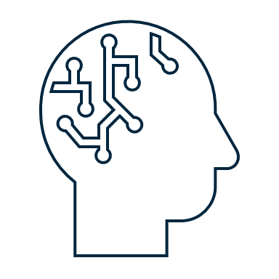
Model
Build
The model architecture selection(s) will depend on the problem
All else equal, we prefer a simpler model
Accuracy
Simple
Complex
Architecture

Slide 31
Model
Build
The model architecture selection(s) will depend on the problem
If our problem needs to be solved in real time (like autonomous driving), we will need to select a model with fast inference speed
If accuracy is the top priority (like in medical imaging), then we will focus on architectures with high accuracy
Accuracy
Accuracy
Slow
Fast
Slow
Fast
Inference Speed
Inference Speed

Slide 32
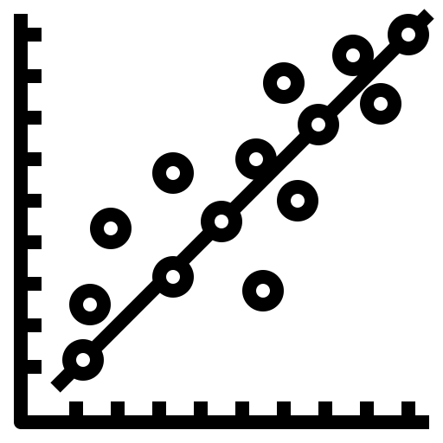
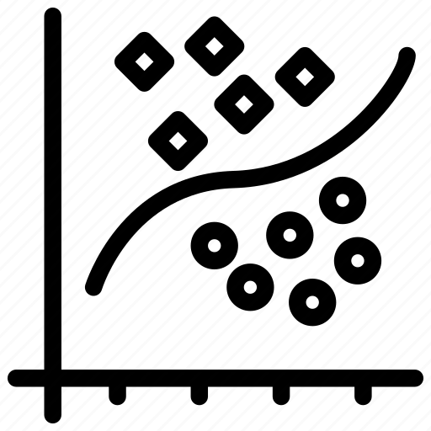
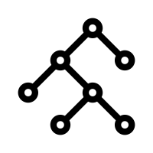
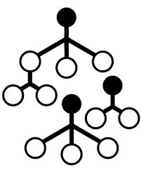
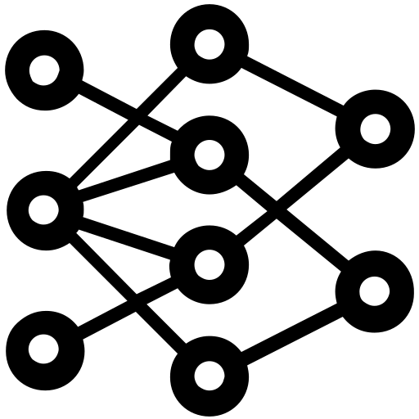
Model
Build
The model architecture selection(s) will depend on the problem
Explainability
If model fairness is an important metric, there will be a limitation on the architectures that can be used based on explainability,
OLS
Logistic
Decision Tree
Random Forest
Neural Network
Simple
Complex
Acceptable
Unacceptable

Slide 33
Model
Build
Hyperparameter tuning
Trying out different combinations of hyperparameters to arrive at the best model is a normal part of model building
Relu Activation
Selu Activation
Gelu Activation
Learning Rate
Learning Rate
Learning Rate
 | 0.01 | 0.001 | 0.0001
16
32 |  | Accuracy
64
 | 0.01 | 0.001 | 0.0001
16
32 |  | Accuracy
64
 | 0.01 | 0.001 | 0.0001
16
32 |  | Accuracy
64
Batch size
Batch size
Batch size

Slide 34



Reproducibility
Build
We want to be able to reproduce the results of any single experiment
Meticulous records of all aspects of model building must be kept
Data splits
Transformation pipelines
Models
Hyperparamters
Metrics
Evaluations

Slide 35
Who’s responsibility is it?
Build
Data Scientist
It is the role of the data scientist to deliver trained and optimized models.
Serve
ML Engineer
Software Developer
The machine learning engineer arguably has the most difficult job: putting a model into production. Often, they will work alongside software developers/engineers to achieve this. A common mistake organizations make is hiring too many data scientist, and too few ML engineers.
Maintain
ML Engineer
Data Scientist
Stakeholder
Maintenance is a coordinated effort between the ML engineer, data scientist, and stakeholder.

Slide 36
Thank you!

