Slide 1
Machine Learning Model for Car-like Robot
Name: Jonathan Kannan
UID: 120233593

Slide 2
Objective
Build a ML model to predict robot linear and angular velocity commands from lidar sensor and goal data.

Slide 3
Data Cleaning and Preprocessing
Cleaning Steps:
Removed duplicates.
Dropped rows with missing values.
Standardization:
Used StandardScaler to normalize laser data.
Dimensionality Reduction:
Applied PCA to reduce laser data features from 1,080 to ~100 while retaining 99% variance.

Slide 4
Feature Engineering
The distance to the final goal and distance to the local goal were calculated using the Euclidean distance formula. These features capture how far the robot is from its respective goals.
The angle to the final goal and angle to the local goal were calculated using the arctangent formula (`arctan2`), which captures the orientation of the robot relative to its goals.

Slide 5
Models Evaluated
Linear Models:
Linear Regression, Ridge, Lasso.
Tree-Based Models:
Decision Tree
Boosting Models:
XGBoost, LightGBM.
Evaluation Metric:
Root Mean Squared Error (RMSE).

Slide 6
Preliminary Results
Model | Training RMSE | Test RMSE
Linear Regression | 0.2235 | 0.2341
Ridge Regression | 0.2235 | 0.2341
Lasso Regression | 0.2246 | 0.2345
Decision Tree | 0.1222 | 0.1382
XGBoost | 0.0845 | 0.1193
LightGBM | 0.1218 | 0.1276

Slide 7
Hyperparameter Selection
Goal: Identify the best hyperparameters for the model.
Key Parameters: n_estimators, max_depth, learning_rate.
Tuning Method: RandomizedSearchCV.
Outcome:Optimized configurations improved accuracy and reduced overfitting.

Slide 8
Model Evaluation and Selection
Model | Train RMSE | Test RMSE | Train Time
XGBoost | 0.0441 | 0.0901 | Slower
LightGBM | 0.112 | 0.1136 | Faster
Why LightGBM Was Selected?
Performance: LightGBM achieved competitive test RMSE with stable generalization.
Efficiency: Significantly faster training time and lower computational requirements.
Reliability: More stable performance across validation and test datasets.
Balance: LightGBM provided the best trade-off between speed, accuracy, and efficiency.

Slide 9
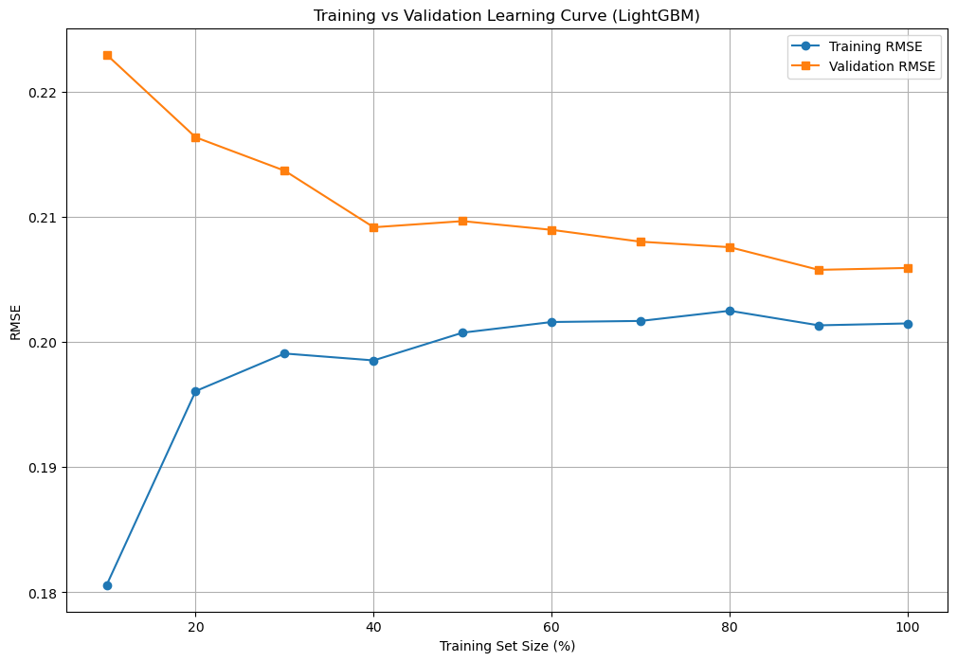
Learning Curves -LightGBM

Slide 10
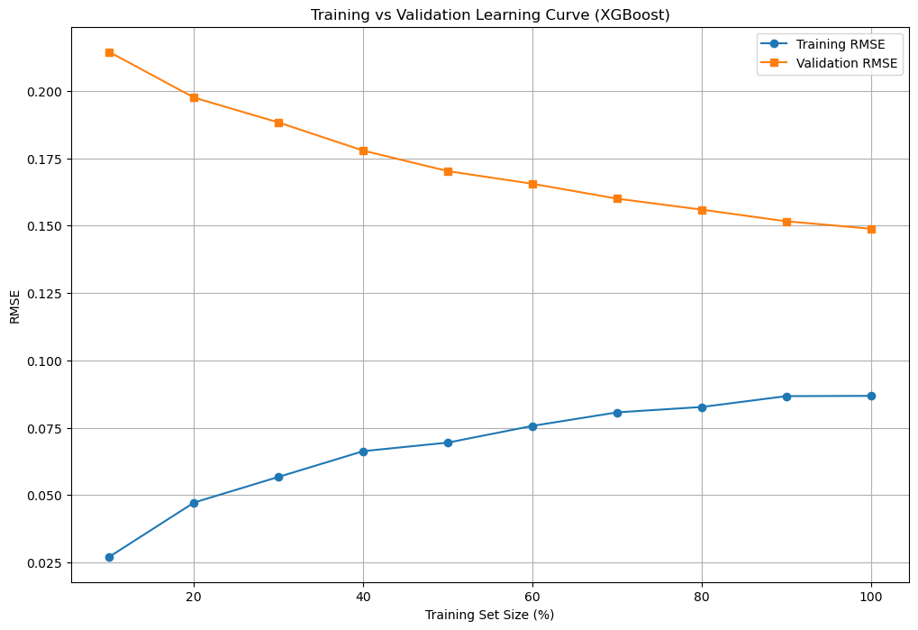
Learning Curves -XGBoost

Slide 11
Conclusion
LightGBM Achieved low RMSE on training and test datasets, demonstrating strong predictive capability.
RMSE values: Train - 0.1124, Test - 0.1136.
Dimensionality reduction via PCA retained 99% of variance while reducing laser scan features.
Engineered features like distance and angles to goals provided critical insights for improved model performance.

