Slide 1
Blockchain 201
Jonathan Dolan
jonathan.dolan@mediciventures.com

Slide 2
About me
Software developer at Medici Ventures
  Subsidiary of overstock.com focusing on blockchain technology and projects
Blockchain experience
  Core dev for phase 1 of ravencoin
  Other projects
BS Computer Information Systems from Westminster college

Slide 3
About this talk
The goal is to show off some interesting blockchain tech beyond bitcoin
  Trigger your curiosity
This talk will NOT cover
  Trading advice
  Price speculation
  Conspiracy theories
  FUD

Slide 4
Agenda
What is a blockchain?
Bitcoin overview
Smart contracts
Zk-SNARKs based projects
Alternative chain data structures
Alternatives to proof-of-work mining
IPFS

Slide 5
Economic note
Quality of the technology can influence the value of a project
Similar to “fundamentals” trading in traditional finance
  Financial status (SEC filings)
  Market trends
  Talent
Technology fundamentals
  Protocol design (whitepaper, your own analysis, security audits)
  How it fits into the wider ecosystem
  Talent

Slide 6
What is a blockchain?
Database for enemies
Trustless
Distributed
  No one company/group/organization has control over the network
Byzantine Fault Tolerant
Cryptographically secured
Immutable

Slide 7
Cryptographic hash functions
One-way functions
  Easy (fast) to do one way
  Hard (really slow) to do the other way
Reduces input data to a similarly formatted large number
Existence of hash output proves the existence of input data
Similar data results in different values

Slide 8

Bitcoin 101
Started with the paper “Bitcoin: A Peer-to-Peer Electronic Cash System” released on October 31 2008, by Satoshi Nakamoto
Bitcoin blockchain started on January 3 2009
  The Times 03/Jan/2009 Chancellor on brink of second bailout for banks
Satoshi Nakamoto is unknown, and inactive
  Lots of people claiming to be Satoshi
  Lots of theories

Slide 9
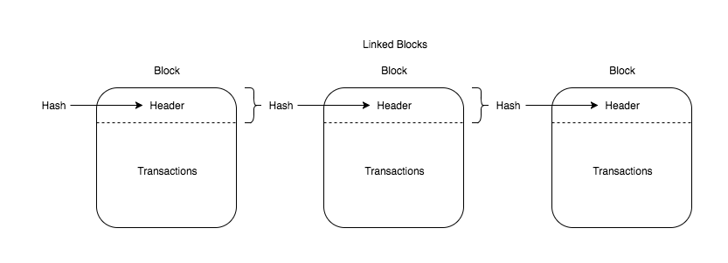
Bitcoin 101
Bitcoin data structure
  Groups of transactions are combined with metadata into blocks
  Each block contains the hash of the previous block
  Network considers the longest chain to be valid
  Changing any data in any previous block would require re-computing all of the following blocks

Slide 10
Bitcoin 101
Mining
  The creation of new blocks is called mining
  Each miner creates a block, and searches for a nonce that results in the block hash to be under a threshold
  Difficulty is calculated by each miner, and is adjusted by lowering the acceptance threshold as required
  Once a miner finds a nonce that is acceptable, they broadcast their block to the network
    Since their chain is longest, it is accepted by the network and all miners start the mining process over on a new block
  Miners are given the transaction fees and new bitcoin if applicable
  This mining style is called Proof of Work (PoW)

Slide 11
Bitcoin 101
Transactions
  Verified with public key cryptography
    Bitcoin address is the hash of your public key
    Bitcoin can be sent to that address by anyone
    Bitcoin is sent to that address with a signature from your private key
    If you don’t have the keys, it’s not your bitcoin
  Transactions are broadcast from wallets to the networks, to be included in a future block
    Incentivize the miners by giving them a higher transaction fee
  Transaction details (sender, receiver, amount) are public

Slide 12
Bitcoin 101
Properties of bitcoin
  Byzantine Fault Tolerance (BFT)
    Since the network accepts the longest chain, and mining each block takes work, an attacker would have to control the majority of the hashing power of the network
    Called a “51% attack”
  Block times remain roughly consistent
    Adjusting the acceptance threshold is an excellent way to adjust the time between each new block
    Each node does its own calculations and accepts/rejects the block accordingly

Slide 13
Make sense?

Slide 14

Smart contracts
Runnable code that can be submitted to the network, and run by each node
Ideal use case is as a legal contract that acts when certain conditions are met
  For example: A will could be written as a smart contract, which transfers your digital assets to a beneficiary if you die
Major platform for smart contracts is Ethereum

Slide 15
Smart contracts
Initial Coin Offerings (ICOs) are usually built using smart contracts
  Essentially a currency you create yourself
  Most ICOs on Ethereum use ERC20
    ERC20 is an interface for creating new tokens
  Some other platforms are EOS and Neo

Slide 16
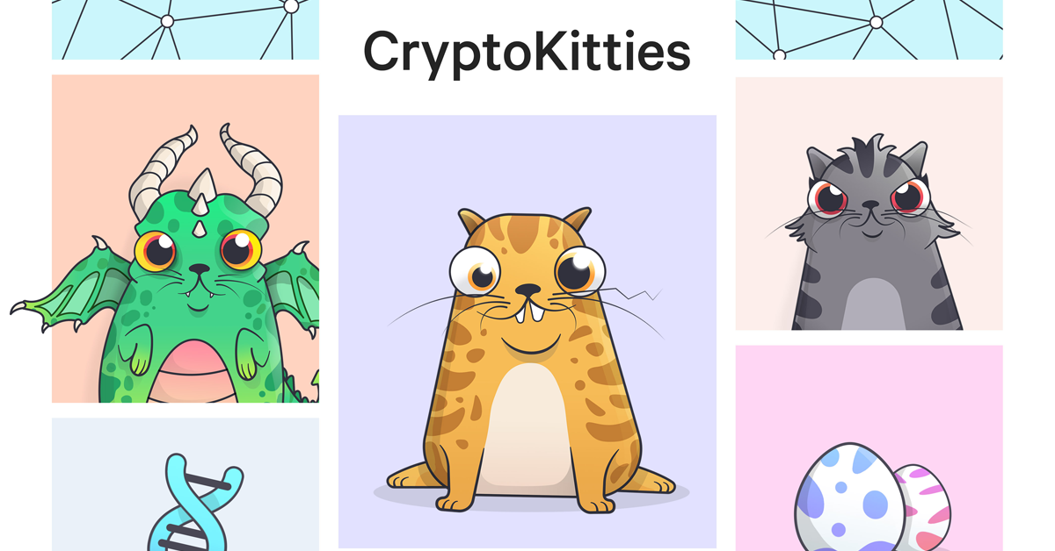
Smart contracts
Cryptokitties
  Cutest token ever
  Can be bred to create new variations with probabilistically determined traits
  Data determining appearance is read out of the contract in order to generate the images

Slide 17
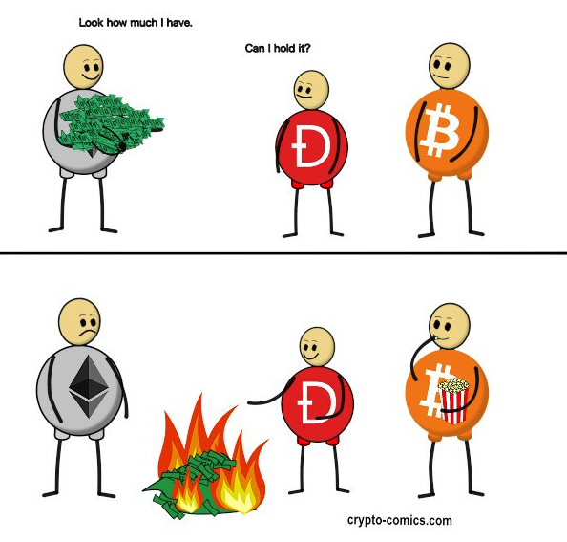
Smart contracts
Once submitted, they’re immutable
  Which has led to many hacks, when bugs are found in improperly tested smart contracts
How do you fix bugs in a smart contract?
  Hard fork the entire network
Formal verification
  Prevents bugs
  Is really hard

Slide 18
zk-SNARKs
Zero knowledge succinct non-interactive argument of knowledge
Alice can prove to herself that Bob knows fact X, satisfying some relation, without revealing X to Alice, or anyone else, and there is no interaction between Alice and Bob.
Cryptographic wizardry

Slide 19
zk-SNARKs
Used in Zcash to obfuscate transaction details (sender, recipient, amount)
Can be used in Ethereum smart contracts, as a library
  Enables the creation of privacy-focused tokens on top of Ethereum

Slide 20
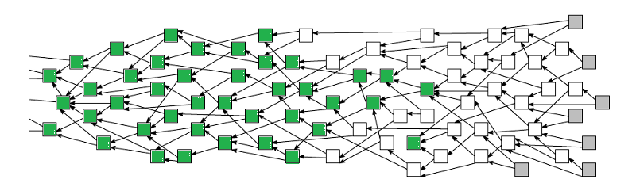
Alternative chain data structures
Some projects use the concepts of bitcoin on data structures other than a linked list
Iota uses a “tangle”
  Directed Acyclic Graph
  Increases transaction volume by allowing transactions to be verified in parallel

Slide 21
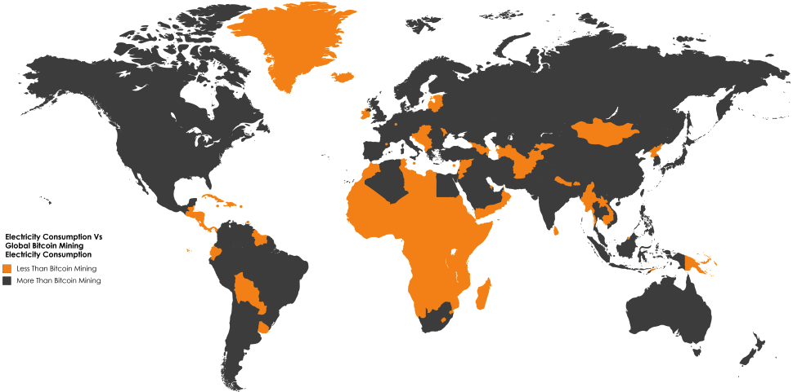
PoW alternatives
The bitcoin mining algorithm uses a lot of electricity, and encourages miners to centralize into large datacenters of ASICs

Slide 22

PoW alternatives
Proof of Research
  Used by Gridcoin and Curecoin
  Based on participation in BOINC projects such as Folding@Home
  Puts all of that electricity to better use

Slide 23
PoW alternatives
Proof of stake
  Creation of the next block is done by a select group of validators, which both propose new blocks and vote on which one to accept
  A node becomes a validator by putting some of their currency at stake, which they loose if the node is fraudulent
  Ethereum will switch from PoW to PoS at some point
    Update is called casper

Slide 24
PoW alternatives
No mining
  Some projects (iota, hashgraph) don’t have mining in the traditional sense
  Each transaction verifies others, and is required to use the network

Slide 25
PoW alternatives
Proof of Storage
  Used by Filecoin
    Blockchain based token/market/incentive structure built on top of IPFS
  Miners earn rewards based on storing data
    Cryptographic proof that data is saved
    Network effect algorithms to ensure duplication

Slide 26

IPFS
Inter Planetary File System
“A peer-to-peer hypermedia protocol to make the web faster, safer, and more open.”
An immutable, distributed architecture for the internet

Slide 27
IPFS
Like a git repository, hosted by a BitTorrent swarm
Uses content based addressing, rather than location based addressing
  Files are addressed by their hash, not location
Files submitted to IPFS are broken into blocks, and an index is generated on how to reassemble the blocks into the original file
Each node keeps a list of the blocks it has, and the blocks it wants, prioritizing the sharing of the rarest blocks

Slide 28
IPFS
Extremely fast
  Around 60% faster than HTTP
  With no need to set up servers, caching, fiber optic connections, etc.
Mountable
  You can mount the entire network, and treat it like an external drive

Slide 29
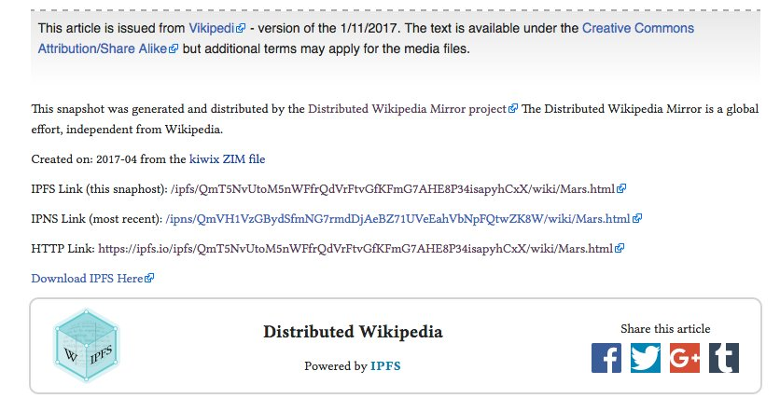
IPFS
Human-readable name service enables easy data lookup, and updates to content
Https gateway at https://ipfs.io/ipfs/<hash>
Used to save data from censorship

Slide 30
Conclusion
Lots of cool stuff
Very young field
New ways of thinking of programming
  Smart contracts
  Formal verification
  BFT
  Game theory

Slide 31
Questions?
jonathan.dolan@mediciventures.com

