Slide 1
Jonathan Dolan
KACCE

Slide 2
Agenda
Name
Project goals
How chess engines work
Challenges of computer chess
Brief overview of the history of computer chess
How other chess engines can be beaten
Project status
Difficulties encountered
Code examples
Demo
Q&A

Slide 3
What's in a name?
Kacce
Anti
Computer
Chess
Engine

Slide 4
Project goals
Create a chess engine that is optimized to play other chess engines, not humans.
Leverage Horizon Effect
Sporadic and changing evaluation function
Dummy evaluation function mimicking other chess engines

Slide 5
Chess engine overview
MiniMax algorithm (or variation)
Makes choice between possible moves
Evaluation function
Determines the value of a move for a given position
Board representation
Piece-wise, bitboards, etc.

Slide 6
Search space
10¹²⁰ = 1,000,000,000,000,000,000,000,000,000,000,000,000,000,000,000,000,000,000,000,000,000,000,000,000,000,000,000,000,000,000,000,000,000,000,000,000,000,000,000,000 possible moves

Slide 7
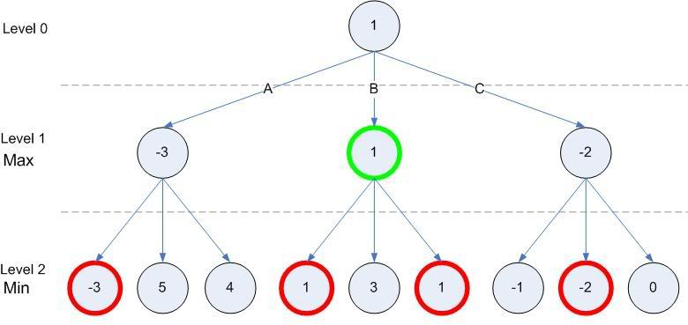
Minimax chart

Slide 8
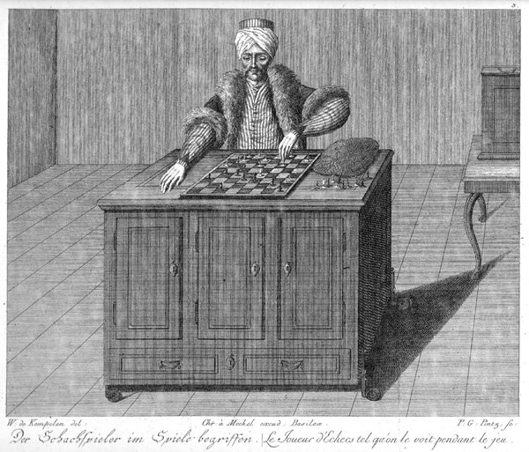
History of computer chess
1770 AD, The Turk – A clockwork robot that was said to play chess. In reality, was a hidden human was playing the game.

Slide 9
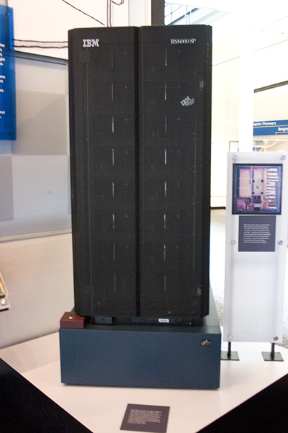
History of computer chess
1997 AD Kasparov vs Deep Blue – Gary Kasparov was defeated by an IBM supercomputer called Deep Blue. Controversial move in game 2 (caused by a bug) led Kasparov to believe that he was actually playing a human, which caused him to lose focus and lose the tournament.

Slide 10
Weakness in other engines
Horizon effect
What if there is an amazing move one ply ahead of what was searched for?
Focuses on only a few pieces
Expectation that opponent will play like you
Drastically alter the root of the game tree
Forces re-computation of game tree, renders pondering useless

Slide 11
Minimax chart

Slide 12
Project status
Encountered many difficulties, so it loses to other chess engines.
Plays at an ELO of around 1000
Stockfish plays at over 3000
Best human player plays at 2885
Board representation, game play, and several types of evaluation functions implemented.

Slide 13
Difficulties and challenges
Licensing
Wanted to use external software libraries for board representation.
Took a long time to figure out how to license them. (Thanks Dan & Greg for help with figuring it out!)
Issues with libraries
Badly written code
Inefficient logic
Bugs
Lack of internet
Internet issues at home

Slide 14
Technologies used
Written in go
Go is a general purpose language written by Google
Object Oriented
Compiled (Faster than C/C++ for same task)
Type inference
Type safe
Garbage collection
Built for concurrency/parallelism
External library for board representation
Buggy, lots of issues
Rewrote 2/3 of it
#! Linux
Deployed to Cerberus (Ubuntu)

Slide 15
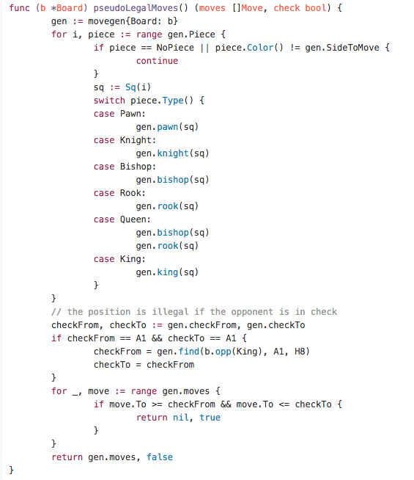
Code example
Inefficient code in library
PsuedoLegalMoves determines if a move is legal or not, and is used to generate moves, and validate their legality
Rewritten

Slide 16
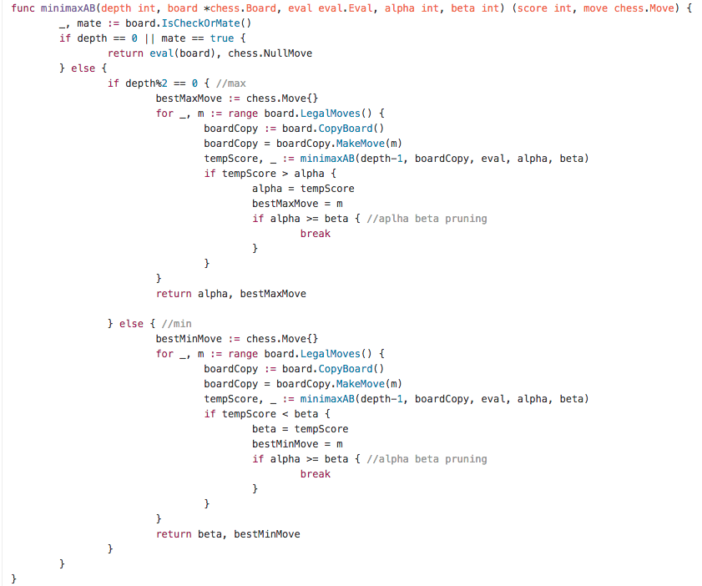
Code example
MiniMax search algorithm with Alpha/Beta pruning
Uses first order evaluation function

Slide 17
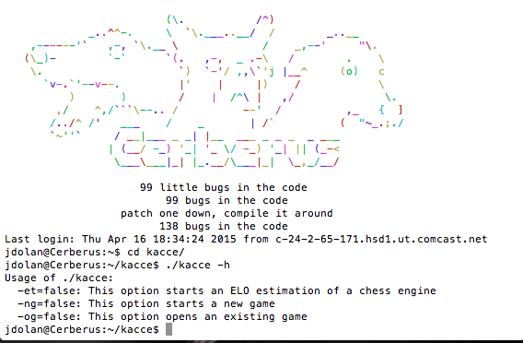
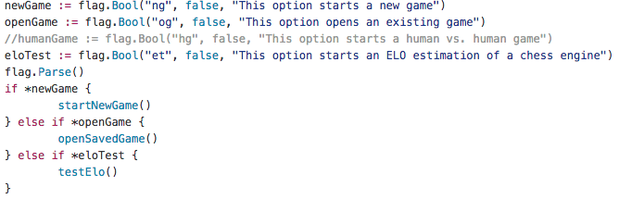
Code example

Slide 18
Current features
Play kacce vs. stockfish
Play kacce vs. kacce
Play human vs. human (kind of buggy)
ELO Estimation
Save game
View previously saved games

Slide 19
Demo!

Slide 20
Q&A
Any questions?

