Slide 1
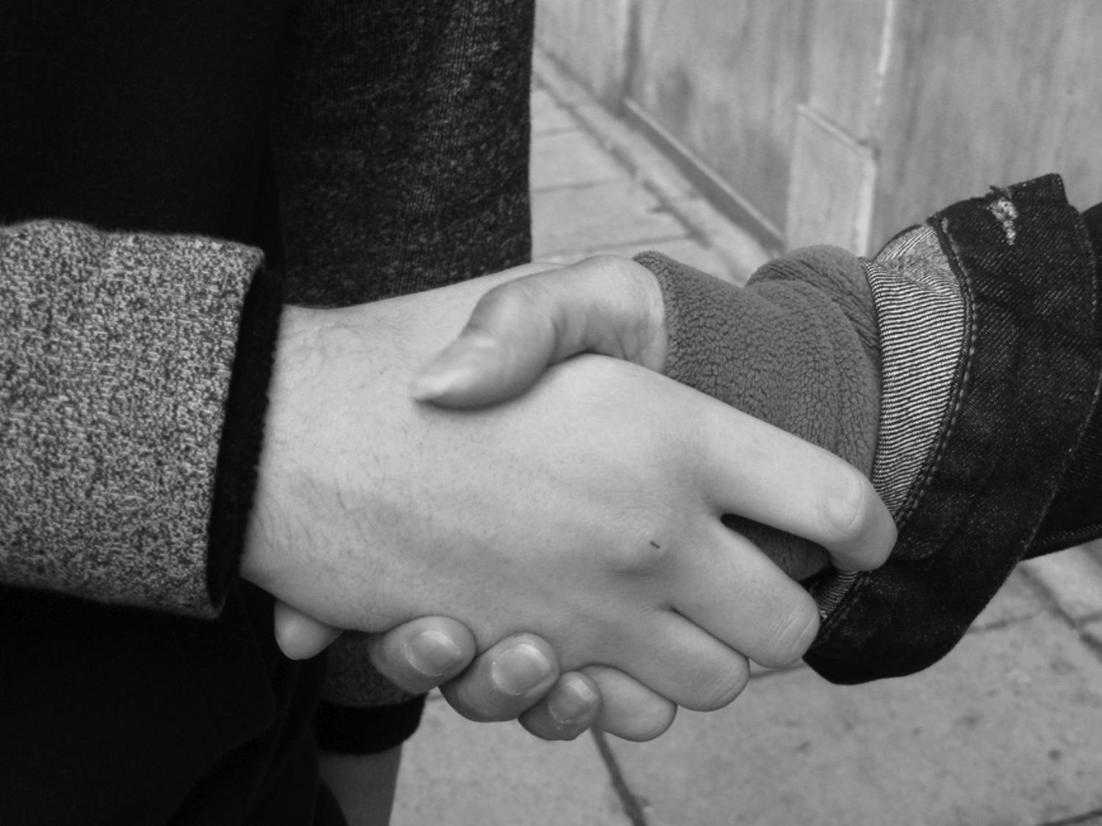

http://www.flickr.com/photos/95213174@N08/10329928973/in/photolist-gJPzZF-7MnYfa-8H4CYm-7K4pkQ-bYZ5rC-bRDniD-bbgAMg-dm7ZQ1-bocvhU-b7o6We-dv2kHu-8dQG3i-8WfERr-7Sz7nr-8dQG7n-9Bbgp9-894sng-88EEon-eifksN-eifnE3-b6iQb2-cqt5oQ-b6fLQv-b6fFPx-b6fGoT-b6iSVe-b6iSkk-8aZyUE-mvwQri-7WQ3Yy-7EAY63-aq4Pwc-b6eJYg-dxGwon-duVKuF-bz29nH-h2vyqz-9x4wPE-8tHHBW-cKgR7Q-dXCFs3-7LiiUw-8tHH9y-8tEF8t-8tHHHh-8tEEJB-8tHGBJ-8tEEi4-8tHHwu-8tEFDM-8tHGKU/
Notes:
Session 1: Exploring Dev environment + Objective-C, Ex: Simple hard-coded IsPrime / Factorial
Session 2: Single view, simple controls, manipulate data, Ex: A view that implements most controls
Session 3: MVC, Orientation, Switching Views, scrolling, Ex: Handle switching view with animation
Session 4: Picker, Toolbar and TableView, Ex: TableView
Session 5: Settings, Persistence & SQLite3, Ex: Save Settings
Session 6: Manual drawing, Ex: Scribble

Slide 2


































Titanium Sponsors
Platinum Sponsors
Gold Sponsors

Slide 3


Muljadi Budiman
  Principal Architect
  Radialogica, LLC
  President & Principal Architect
  Cultured Software, LLC
  SLU Workforce Center Instructor
E-Mail: muljadibudiman@gmail.com
http://geekswithblogs.net/NewThingsILearned
Twitter: @mulbud
http://www.flickr.com/photos/lilit/178345119/sizes/o/
Notes:
Ask for introductions from participants

