Slide 1


Behavior Testing with DTT | May 12, 2026
Get better at testing using Drupal Test Traits!
Jonathan “Jack” Franks
Principal Software Engineer
at Breakthrough Technologies
d.o: @franksj

Slide 2
Show of hands.
Who’s new to automated testing and needs to be convinced this is a good idea?
Who thinks it’s a great idea but needs to convince a boss or client?
Who thinks it’s a great idea but doesn’t know how?

Slide 3
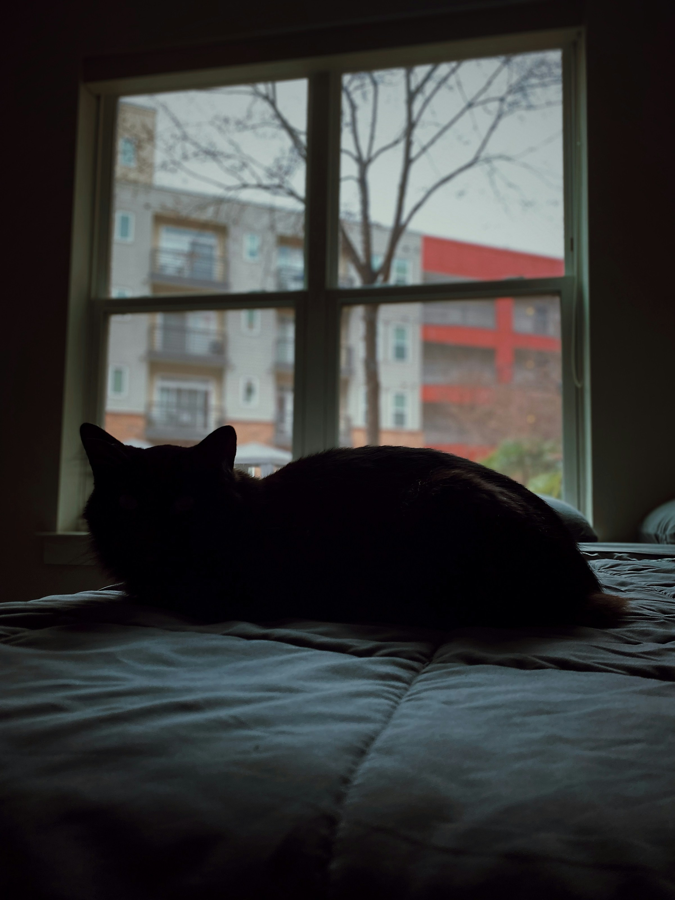
It is 3:47 in the morning. You are awake. It has been 12 hours since you deployed to QA.
Does your entire site still work?

Slide 4
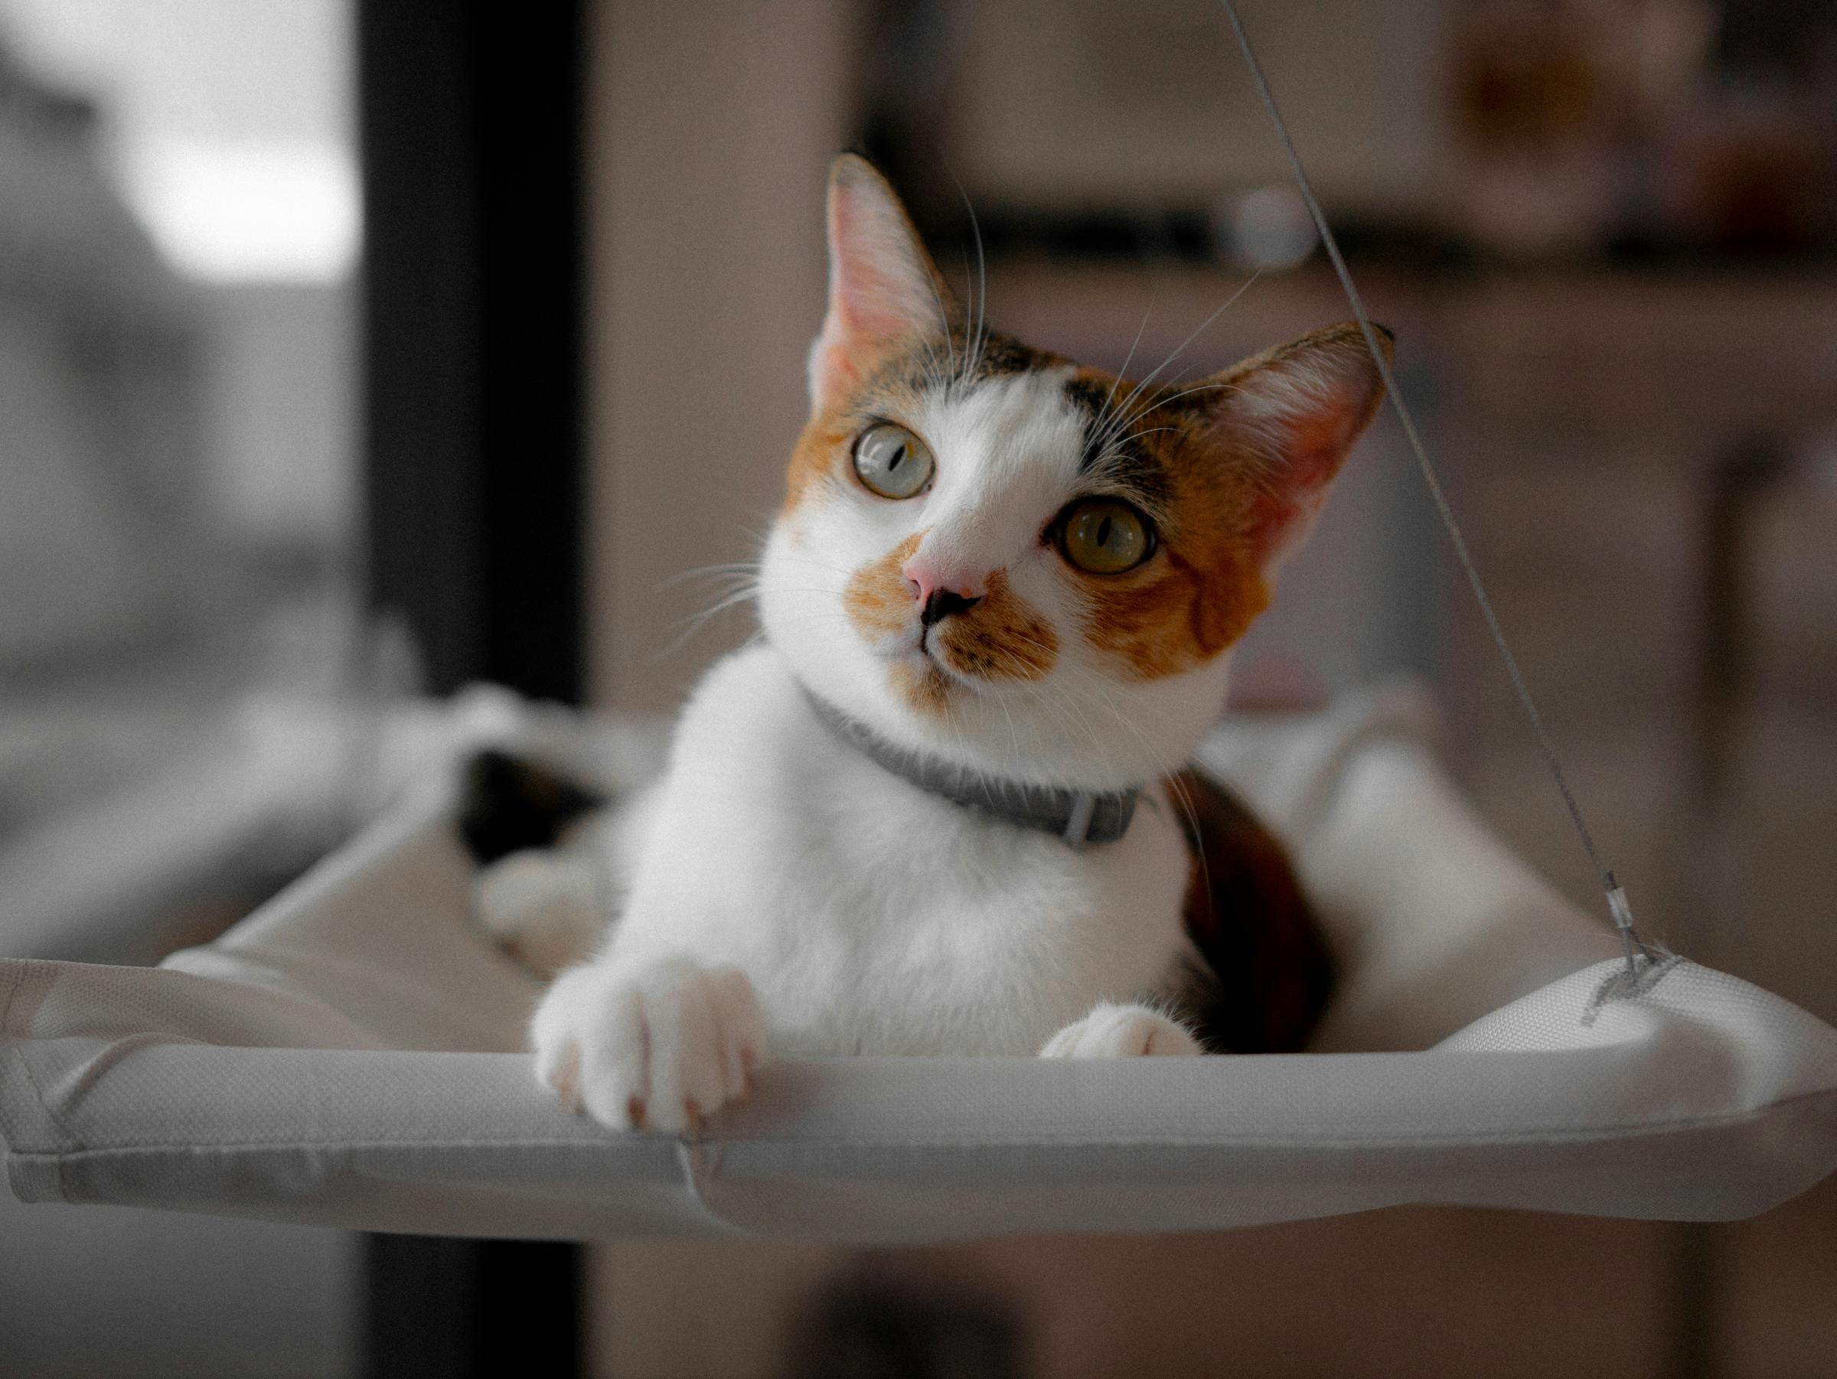
How do I convince my client to pay for automated testing?

Slide 5

You don’t.

Slide 6
TESTS ARE PART
OF THE WORK.

Slide 7
Things you don’t itemize on a quote
Composer.
Version control.
Code review.
Configuration management.
Local dev environments.
Linting.
…Automated tests?

Slide 8
WHAT TO TEST.
WHAT TO SKIP.
Test what your client paid you to build.

Slide 9
TEST … OR DON’T BOTHER?
TEST:
The user story, exactly.
Custom logic you wrote.
Unhappy paths.
Anything you have ever fixed twice.
DON’T BOTHER:
That core works the way it should.
That contrib does what its README says. (You’ll test the features you want in your own behavior tests.)
Implementation details.

Slide 10
THE USER STORY
Scenario 1: Add a new Article
Given I am logged in as a content editor
When I add a new Article
Then the Title field is named "New Article Title"

Slide 11
THE NEXT USER STORY
Scenario 1: Add a new Article
Given I am logged in as a content editor
When I add a new Article
Then the Title field is named "New Article Title”
Scenario 2: Update an existing Article
Given I am logged in as a content editor
When I update an existing Article
Then the Title field is named ”Update Article Title"

Slide 12

But how?!?!?!

Slide 13
TESTING IN DRUPAL
IS… A LOT.
But it is completely worth it.

Slide 14
Your four options
Unit tests: fast, isolated, but you end up testing your mocks as much as your functionality.
Kernel tests: half a Drupal. Real DB. No site.
Functional / FunctionalJS: full Drupal that reinstalls every run. Slow. No real data.
Behat: a BDD framework, pushed well beyond its limits.

Slide 15
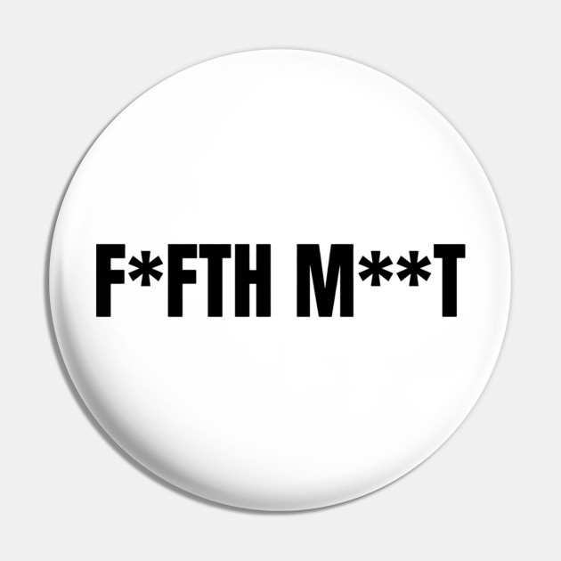
Wait, another option?

Slide 16
DRUPAL TEST
TRAITS.
drupal.org/project/dtt

Slide 17
PHPUnit tests against your already-installed dev site. With your real config and real content. No reinstall. No mocks.

Slide 18
Why it changes everything
Uses Drupal APIs to write test data
Cleans up its own data
Easy to script, like Cypress or Playwright but they can actually talk to Drupal natively

Slide 19
How to install
It’s so easy!
ddev composer require --dev drupal/core-dev
ddev composer require --dev weitzman/drupal-test-traits
Use the phpunit.xml from this repo, which points the bootstrap at DTT, not core.

Slide 20
DEMOS!
SHOW ME THE DTT!

Slide 21
CI/CD RUN YOUR TESTS AUTOMATICALLY

Slide 22
TREASURES.
STEAL THESE.

Slide 23
Lift these from the repo
JackotopiaTestBase — the base class. Extend it and you get all of this for free.
drupalGet() pre-seeds the big_pipe_nojs=1 cookie so BigPipe renders placeholders inline. No more silently-missing flash messages.
drupalGet() and click() auto-call assertNoErrorMessage(). Every page load gets a free error check.
assertNoErrorMessage() looks for .messages--error, .alert-danger, and the usual “unexpected error / Notice / Warning” texts.
clickLinkWithExplicitErrorMessageCheck() opts out of the auto-check when a test should assert a specific error is present.
ConfigTrait — getConfig($name) and assertConfigValue($name, $key, $expected). One-liner config assertions at dotted key paths.
DebugTrait::pauseForUserInput() — drop it into a running test, halts on STDIN. Click around the live site mid-test, press Return to continue.
NodeContentTrait — unpublishNodesOfBundle() wipes a content type for the duration of the test; republishUnpublishedNodes() restores them in tearDown. Assert “the empty state” without nuking real content.

Slide 24

The deal
Solidify your work. Prevent regressions. Develop faster.
Be more reliable. Get more sleep.

Slide 25
Resources
https://drupal.org/project/dtt - Drupal Test Traits project
https://www.breaktech.com/post/testing-is-hard-but-totally-worth-it — my article on why testing matters
https://github.com/jonathanfranks/dtt2026 - these slides and the repo

Slide 26

CONTRIBUTION DAY
Thursday 10:00 AM to 4:00 PM
You don't have to know code to give back!
New Contributor training 9:00 AM to 10:00 AM

Slide 27

Drupal Coffee Exchange
at MidCamp
Bring a bag of beans,
Leave with a bag of beans.
That’s how it works.
MidCamp is in Chicago May 12-14

Slide 28

THANK YOU. QUESTIONS?

Slide 29
PLEASE PROVIDE YOUR FEEDBACK!
mid.camp/29

Slide 30
Cat photo credits
Slide 2 — Madalyn Cox (Unsplash)
Slide 6 — Govit Pimthong (Pexels)
Slide 7 — Zoshua Colah (Unsplash)
Slide 11 — Maxim Tolchinskiy (Unsplash)
Slide 20 — Gaelle Marcel (Unsplash)
Slide 22 — Drew (Unsplash)
Thanks to the photographers and to the Unsplash and Pexels communities. Free-with-attribution licensing makes talks like this possible.

