Slide 1
BIOVAULT
BioVault
Biobank & Biospecimen Management System
Fundamentals of Databases • PostgreSQL 16 • Complete + Bonus
[REPLACE WITH STUDENT NAME]
[REPLACE WITH STUDENT ID]
01

Slide 2
WHY A SPREADSHEET IS NOT ENOUGH
The database problem
• One donor → many consents and collections
• One sample → many physical aliquots
• Many researchers ↔ many projects
• Every use changes governed inventory
1
N
Donor
Samples
M:N
Δ
Projects
Inventory
BioVault
02

Slide 3
A FOCUSED RESEARCH BIOBANK
Scope and stakeholders
• In: consent, collection, inventory, tests, usage
• Users: biobank, lab, quality, researchers
• Out: treatment, billing, direct identity
• Synthetic data only
IN
OUT
Research
Direct ID
WHO
DATA
Lab teams
Synthetic
BioVault
03

Slide 4
RULES ARE ENFORCEABLE, NOT JUST DOCUMENTED
Core business rules
• Typed, dated, versioned consent
• Unique codes and storage positions
• Quantity: 0 ≤ current ≤ initial
• Usage requires consent + membership + stock
✓
✓
Consent
Membership
✓
✓
Stock
Audit
BioVault
04

Slide 5
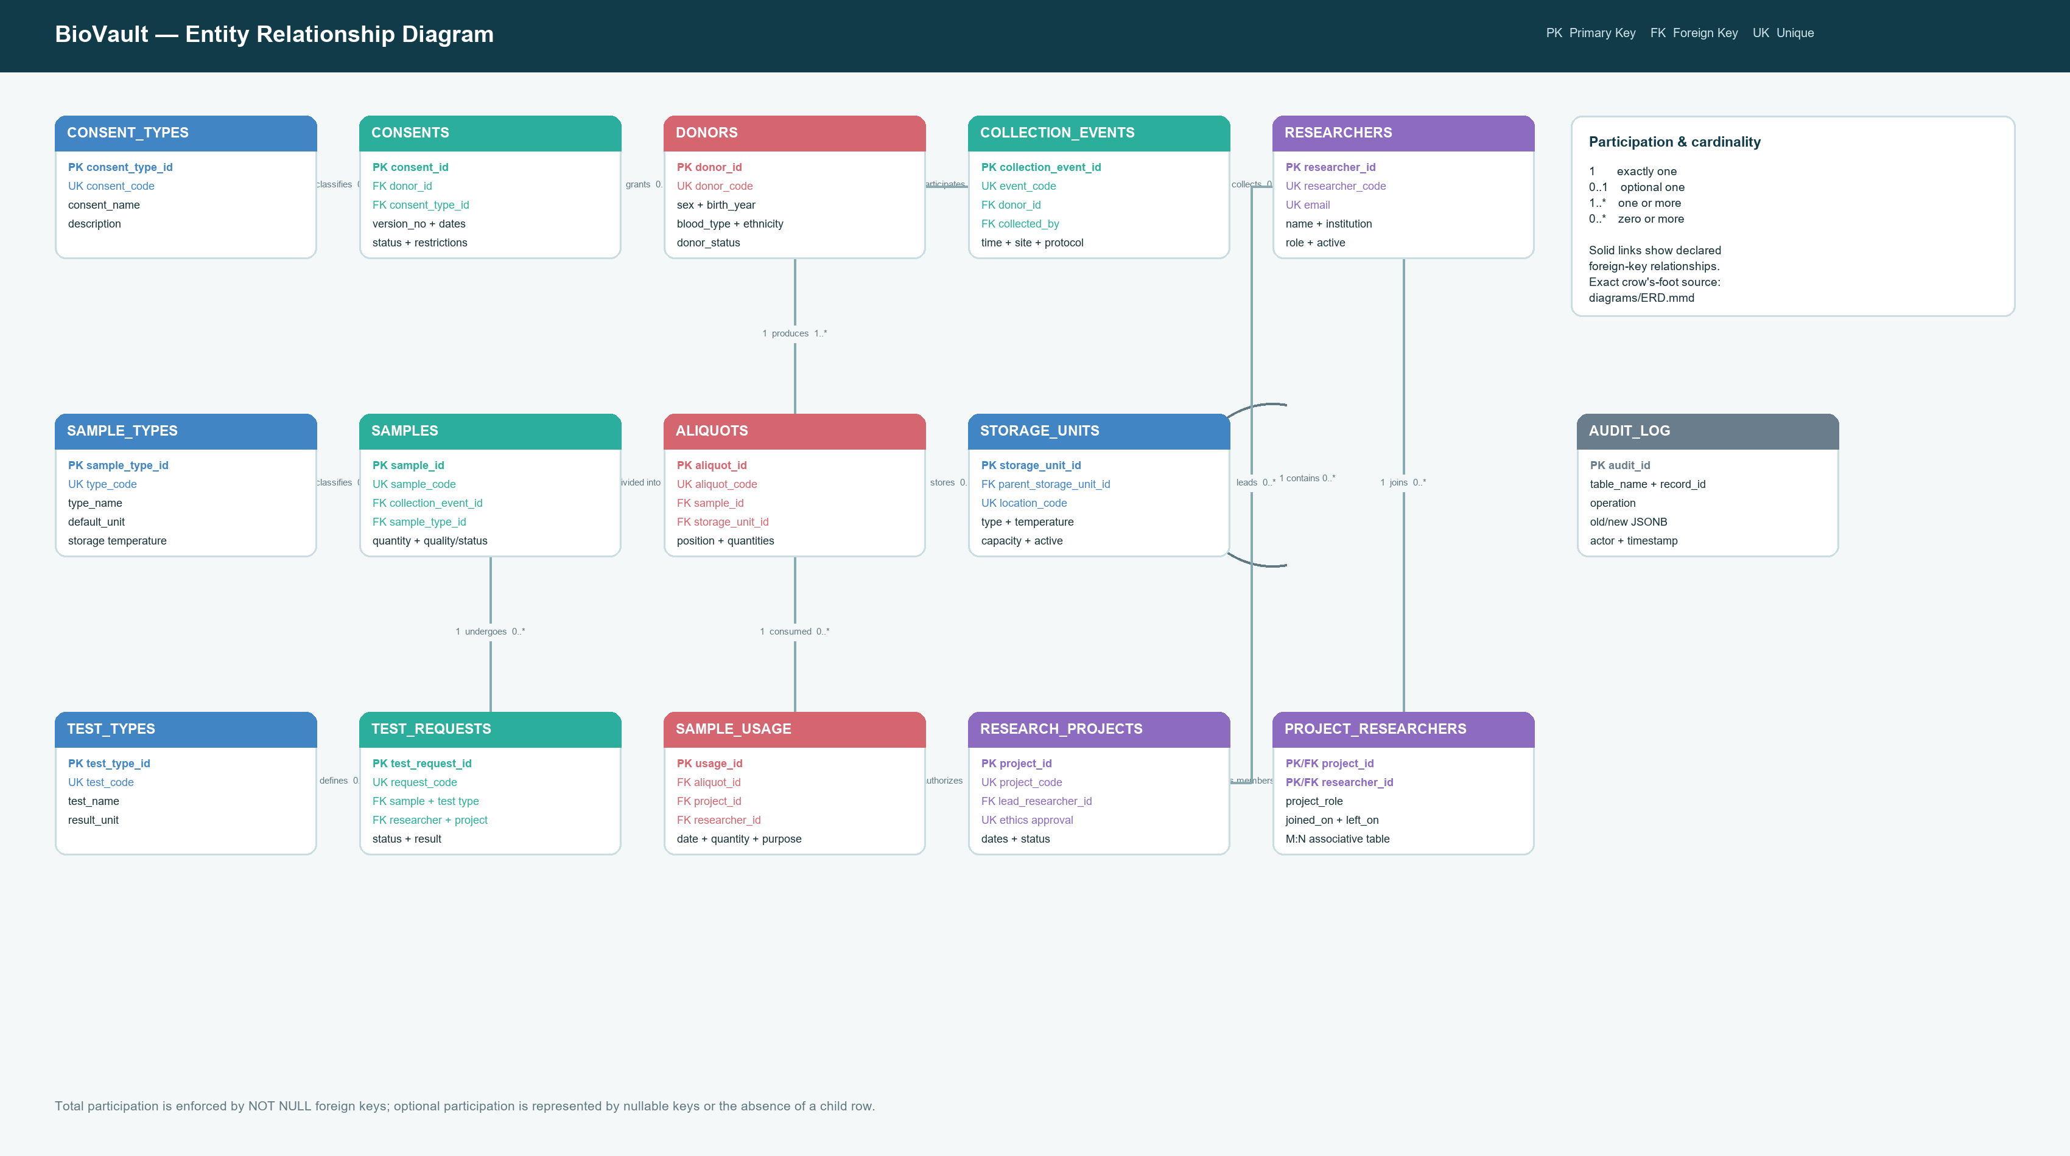
15 RELATIONS ACROSS FIVE RESPONSIBILITY AREAS
Conceptual ER model
• People & permission
• Specimen lineage
• Storage & testing
• Projects, usage & audit
BioVault
05

Slide 6
FOREIGN KEYS EXPRESS REQUIRED LINEAGE
Cardinality and participation
• Donor 1 → 0..* collection events
• Event 1 → 1..* samples
• Sample 1 → 1..* aliquots
• Project * ↔ * researcher via bridge
1
0..*
parent
children
1..*
M:N
required
bridge
BioVault
06

Slide 7
STABLE JOINS PLUS HUMAN-READABLE CANDIDATE KEYS
Relational schema and keys
• Identity primary keys
• Codes retained as UNIQUE candidate keys
• Restrictive historical deletion
• Composite membership primary key
PK
UK
identity
codes
FK
CK
lineage
domains
BioVault
07

Slide 8
REMOVING UPDATE, INSERT, AND DELETE ANOMALIES
Normalization to 3NF
• 1NF: atomic values, no repeating groups
• 2NF: bridge facts depend on the whole key
• 3NF: lookup facts stored once
• Audit JSONB is an intentional history object
1NF
2NF
atomic
whole key
3NF
JSONB
no transitives
history
BioVault
08

Slide 9
REPRODUCIBLE FROM ONE SETUP SCRIPT
PostgreSQL implementation
• create_tables.sql
• triggers_procedures.sql
• load_data.sql
• views.sql + setup.sql
01
02
DDL
logic
03
04
data
views
BioVault
09

Slide 10
INTEGRITY FIRST; SPEED WHERE QUERIES NEED IT
Constraints and indexes
• CHECK: formats, dates, states, quantities
• UNIQUE: codes, ethics approval, box position
• FK: complete scientific lineage
• Partial index: available aliquots with stock
CHECK
UNIQUE
valid states
identity
FK
INDEX
lineage
access
BioVault
10

Slide 11
CONCURRENCY-SAFE SAMPLE CONSUMPTION
Advanced business object
• 1. Lock aliquot FOR UPDATE
• 2. Validate project and membership
• 3. Validate active RESEARCH_USE consent
• 4. Reject overdraw; deduct atomically
1
Lock
2
Authorize
FOR UPDATE
project + member
3
Consent
4
Deduct
active on date
atomic stock
BioVault
11

Slide 12
OPERATIONAL READS AND DEFENDABLE QUERY VARIETY
Views and SQL operations
• 3 views: inventory, project use, consent
• 6-table lineage join
• Aggregation, HAVING, EXISTS, subquery
• Recursive CTE + window rank + CRUD
JOIN
Σ
lineage
aggregate
WITH
CRUD
recursive
safe
BioVault
12

Slide 13
BOUNDARY STATES ARE DELIBERATE TEST CASES
Meaningful synthetic data
• 12 donors • 20 samples • 20 aliquots
• 10 researchers • 10 projects • 20 memberships
• 15 test requests • 12 usage events
• Expired and withdrawn consent retained
12
20
donors
samples
15
12
tests
usage
BioVault
13

Slide 14
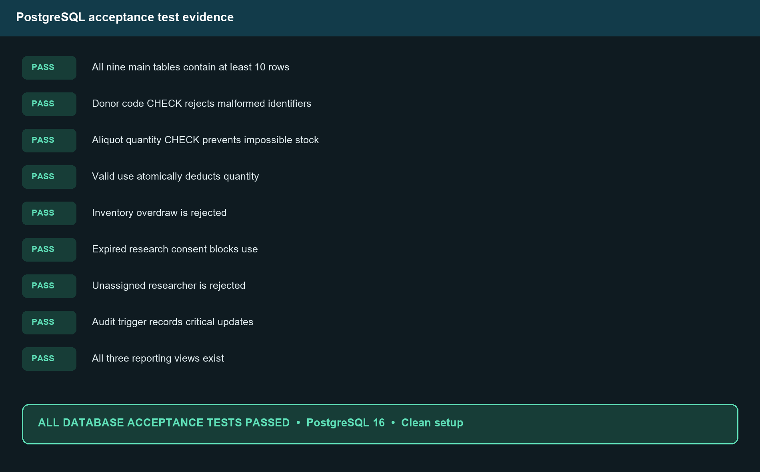
BUILT AND TESTED IN POSTGRESQL 16
Verification evidence
• 9 database assertions passed
• 8 Python CRUD/data tests passed
• Clean setup and all queries succeeded
• Negative tests prove rules fail safely
BioVault
14

Slide 15
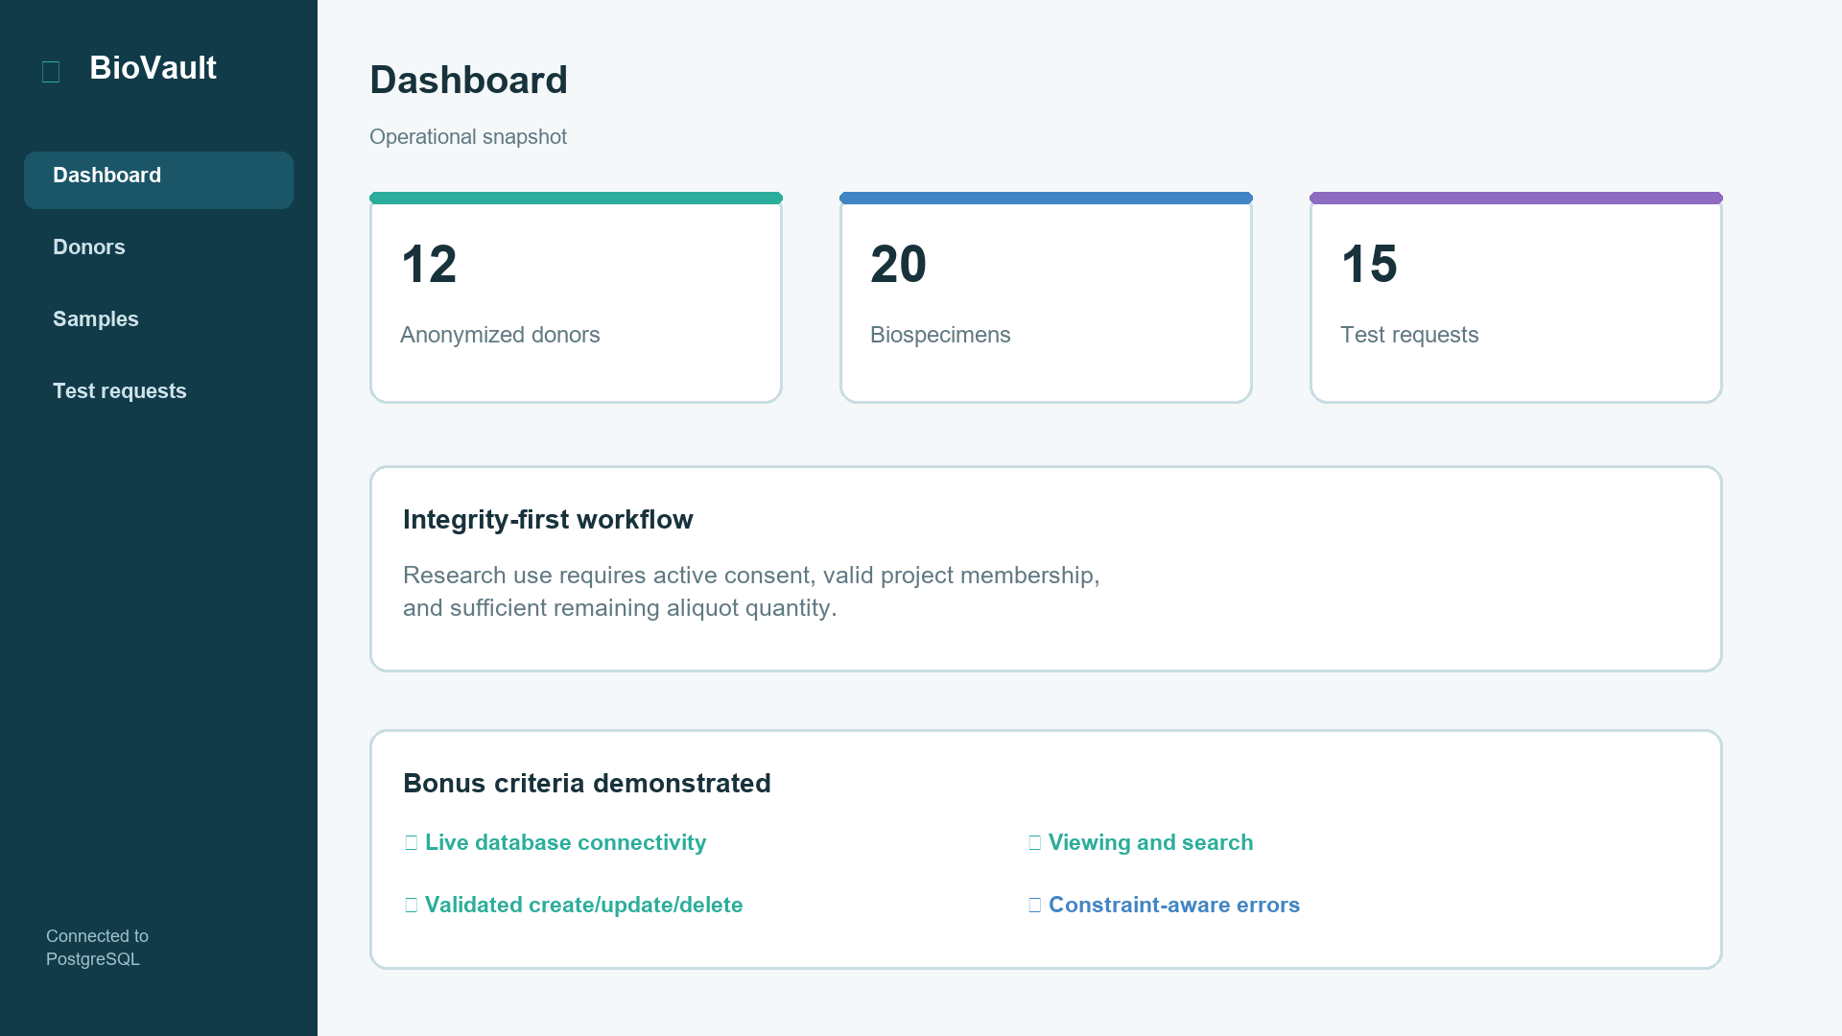
SEARCHABLE DATA AND VALIDATED CRUD
Bonus: connected desktop UI
• Live dashboard counts
• Donor, sample, and test search
• Create / update / protected delete
• PostgreSQL + instant SQLite demo
BioVault
15

Slide 16
A DETERMINISTIC FIVE-MINUTE WALKTHROUGH
Live demonstration plan
• Rebuild schema and show counts
• Run accepted + rejected usage
• Query the views and recursive path
• Create, edit, search, delete in UI
1
2
setup
tests
3
4
queries
UI
BioVault
16

Slide 17
A REALISTIC BOUNDARY FOR A COURSE PROJECT
Limitations and future work
• No authentication in local demo
• Generic test result fields
• No unit-conversion catalog
• Future: roles, barcodes, sensors, chain of custody
RBAC
BAR
security
barcodes
IoT
CoC
sensors
custody
BioVault
17

Slide 18
COMPLETE LIFECYCLE • VERIFIED INTEGRITY • WORKING BONUS
Conclusion & questions
• Requirements → ERD → 3NF → PostgreSQL
• Data → queries → trigger → tests
• Report → presentation → defense materials
• Connected CRUD application
ERD
3NF
designed
mapped
SQL
UI
verified
working
BioVault
18

