Slide 1
Tab 1 – Setting up datasets
Splitting training, validation, and test sets
Remove headers from datasets and put target in first column for XGBoost

Slide 2
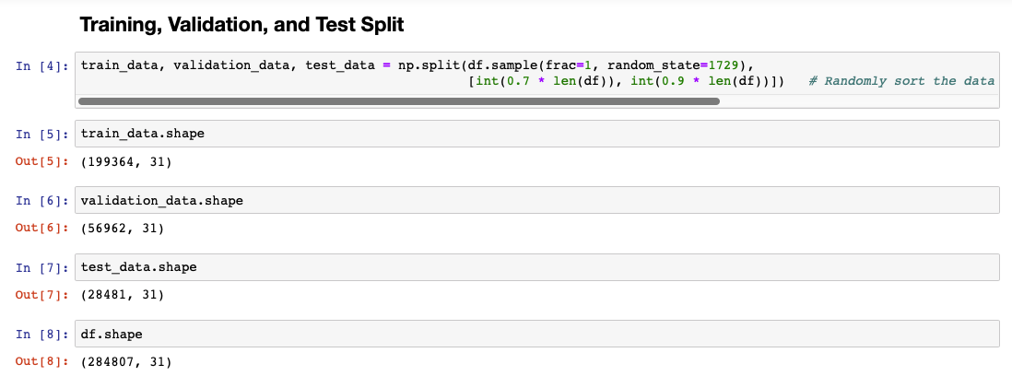
Splitting data into train, validation, and test sets

Slide 3
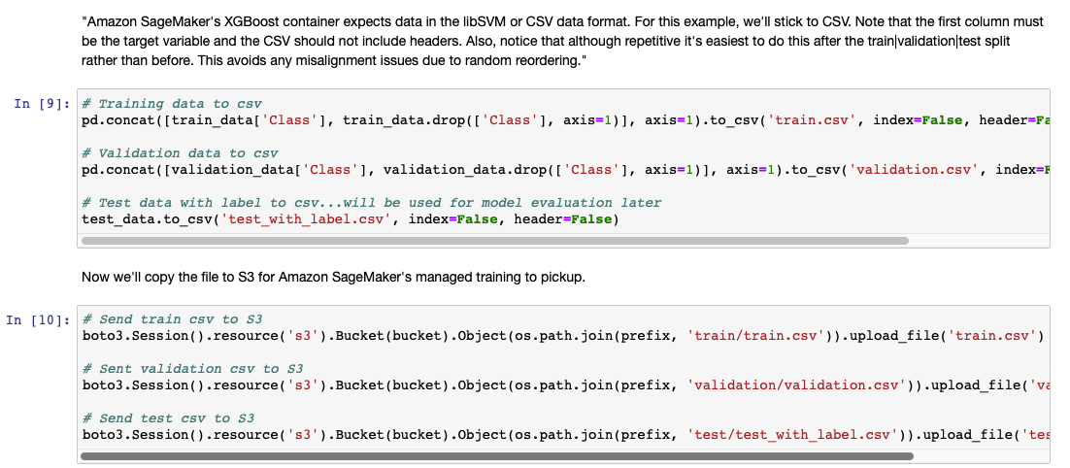
Remove headers from datasets and put target in first column for XGBoost

Slide 4
Tab 2 - Hyperparameter Tuning
Hyperparameter Tuning Configuration
Initial Training Configuration
Kick-off Hyperparameter Tuning
Get Hyperparameter Tuning Results
AWS SDK for Python (Boto 3)

Slide 5
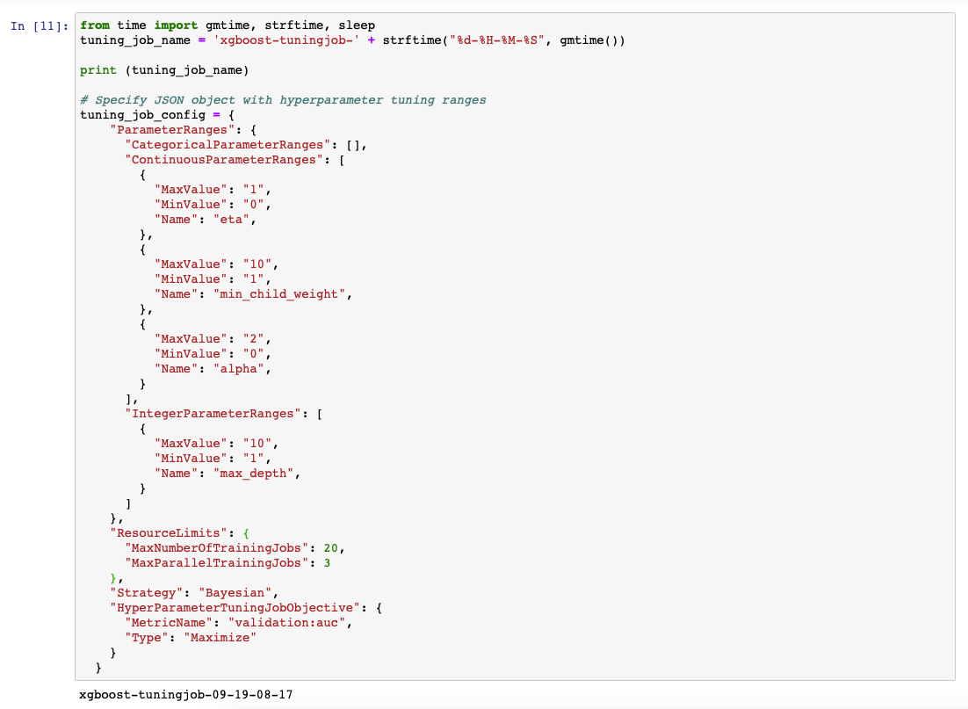
Hyperparameter Tuning Configuration

Slide 6
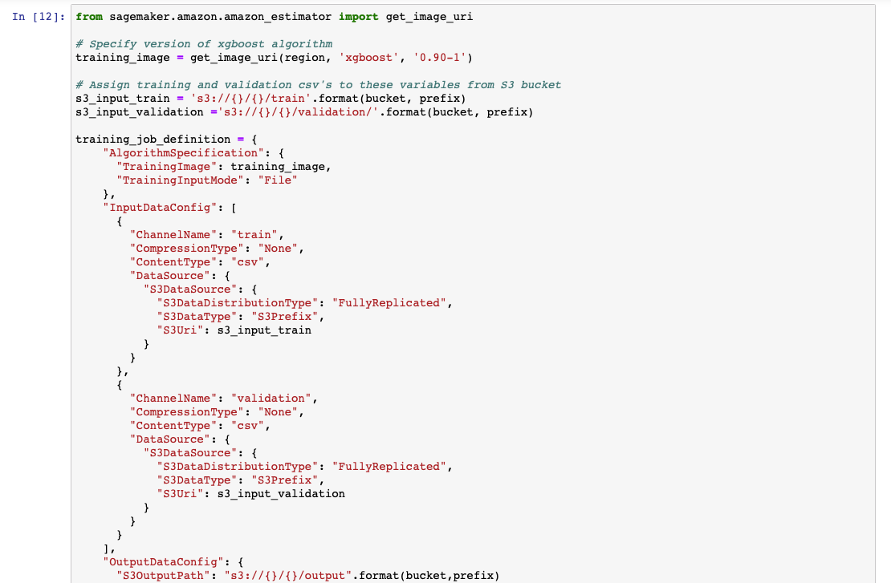
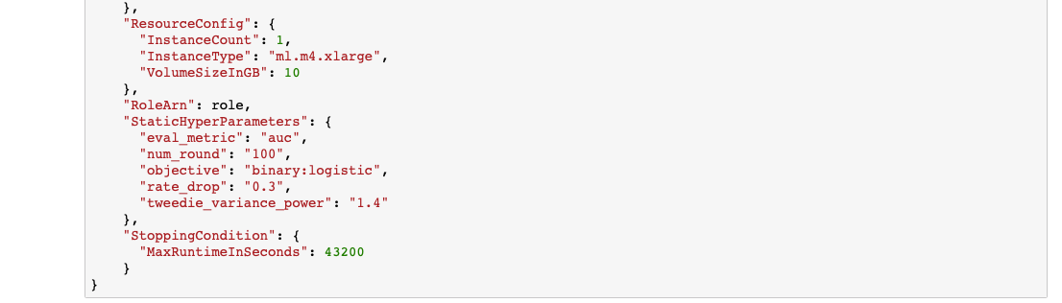
Initial Training Configuration

Slide 7
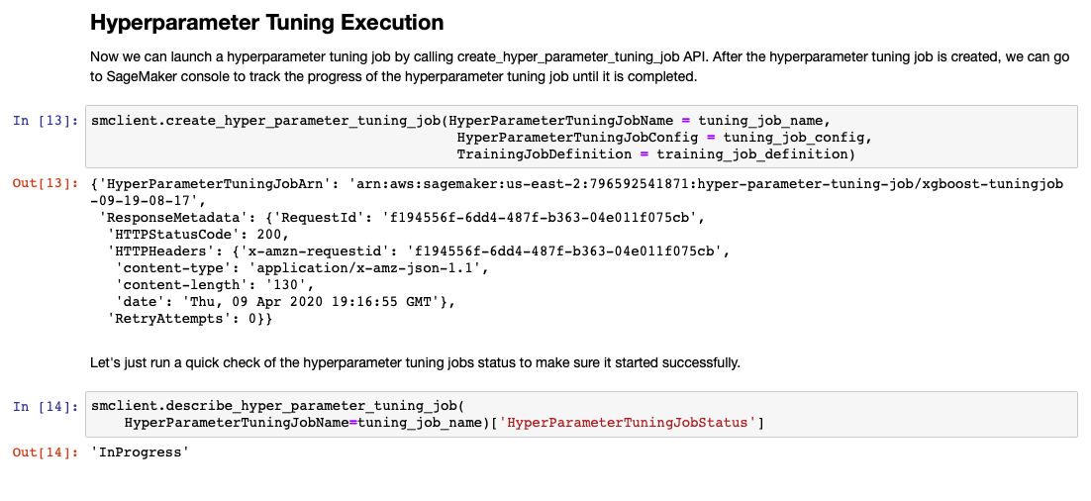
Kick-off Hyperparameter Tuning

Slide 8
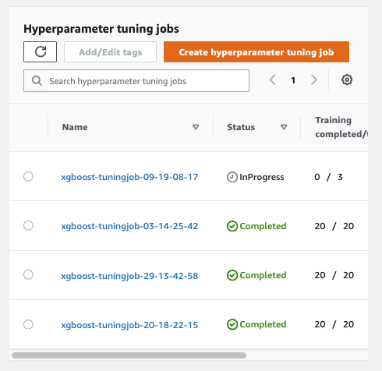
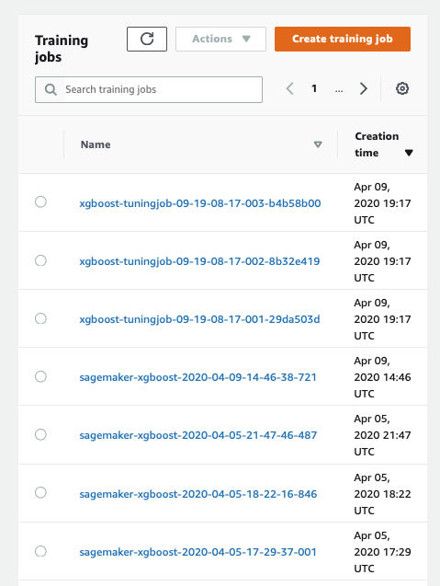
Kick-off Hyperparameter Tuning

Slide 9
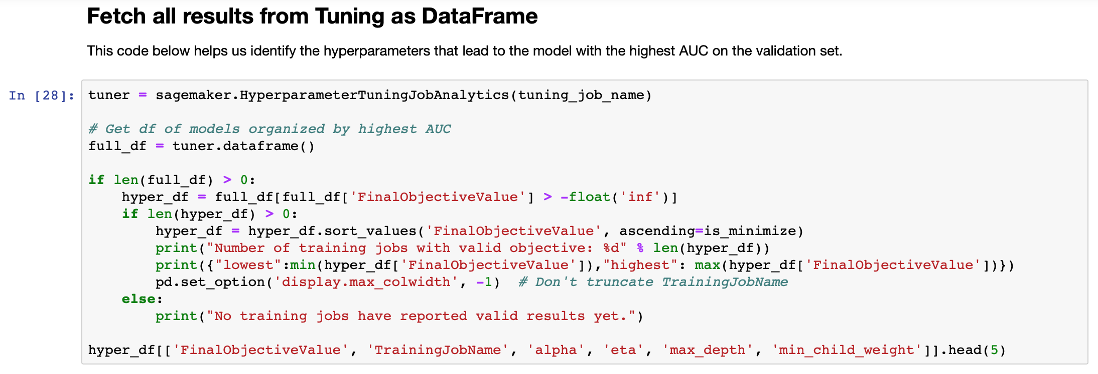
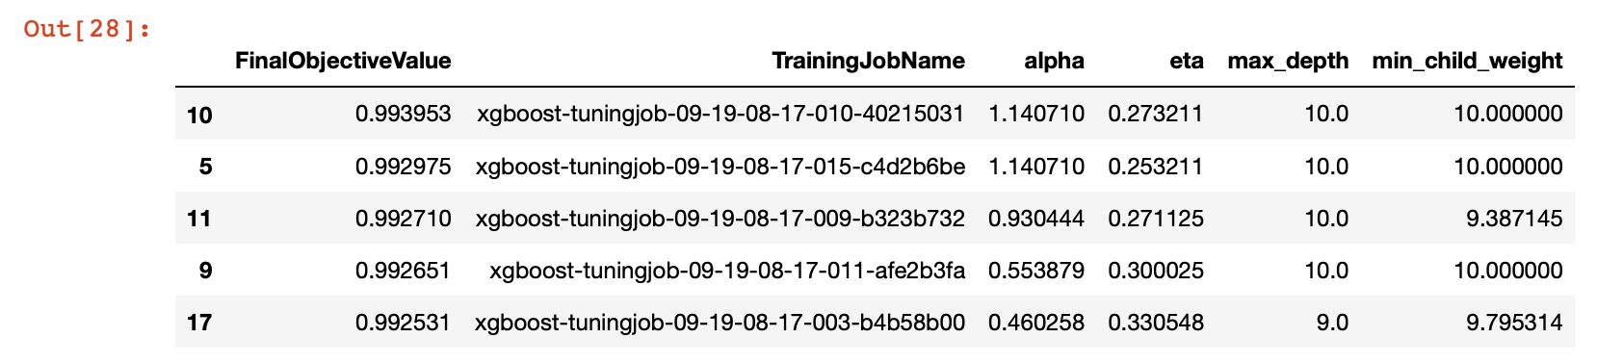
Get Hyperparameter Tuning Results

Slide 10
Tab 3 – Use Model with Optimal Parameters (New Notebook)
Get training and validation datasets from S3 bucket
Setup SageMaker estimator object and add hyperparameters from Notebook 1
Train the model
Feed model unlabeled test data
Get model output as a DataFrame
Amazon SageMaker High-level Python Library

Slide 11
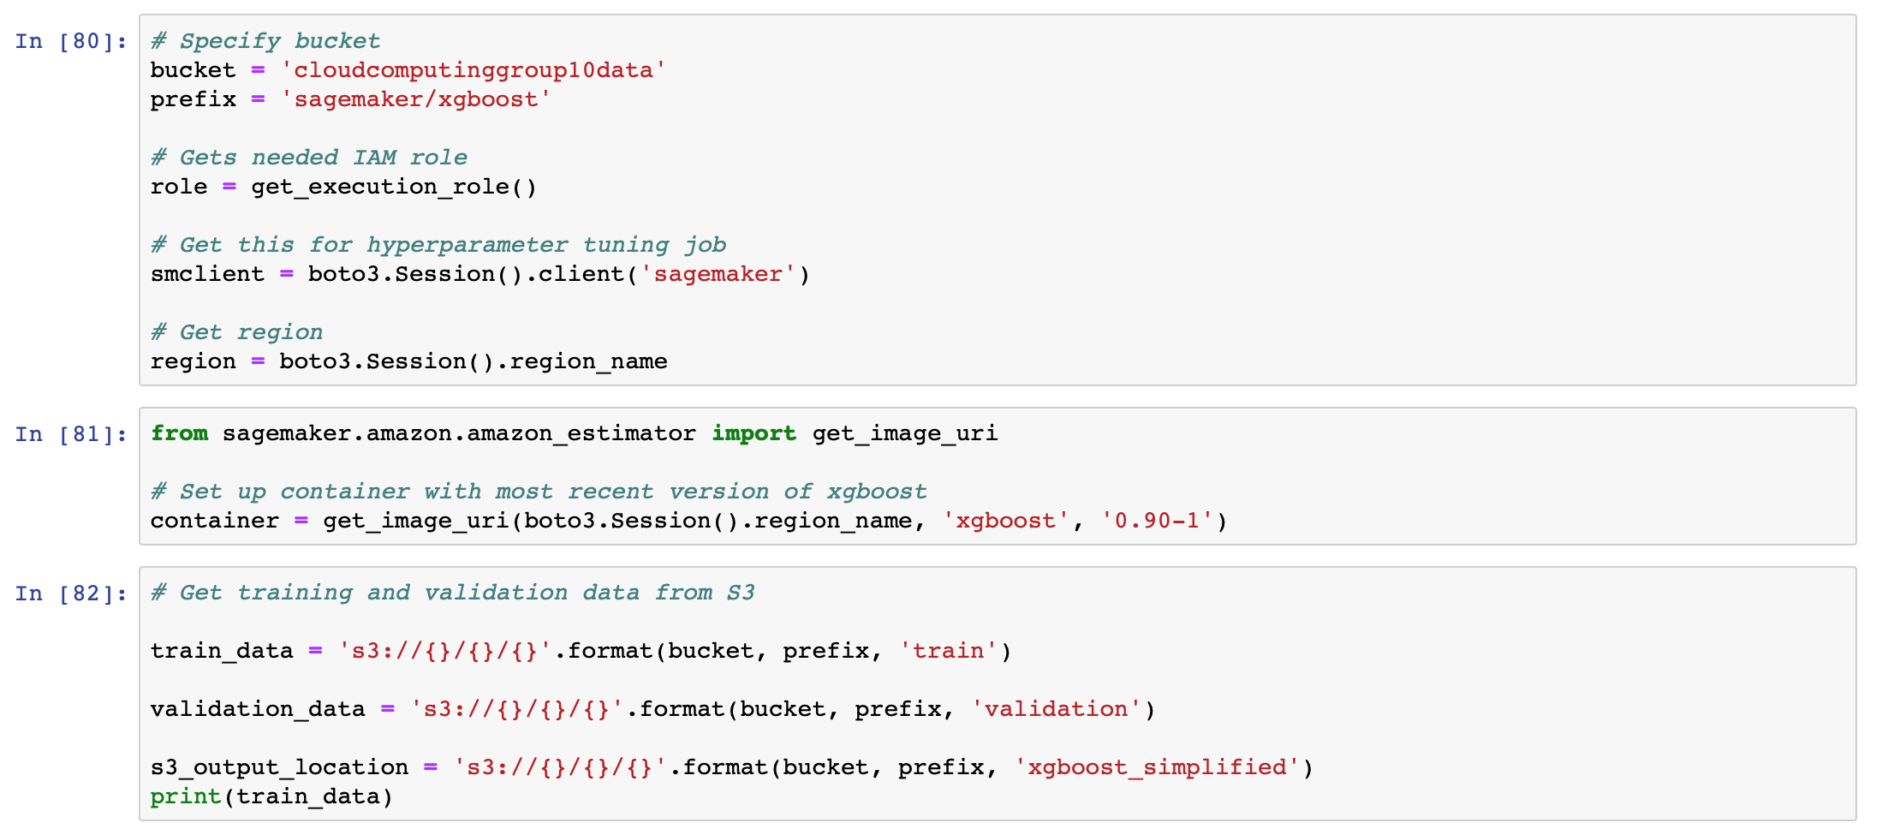
Get Training and Validation Datasets from S3 Bucket

Slide 12
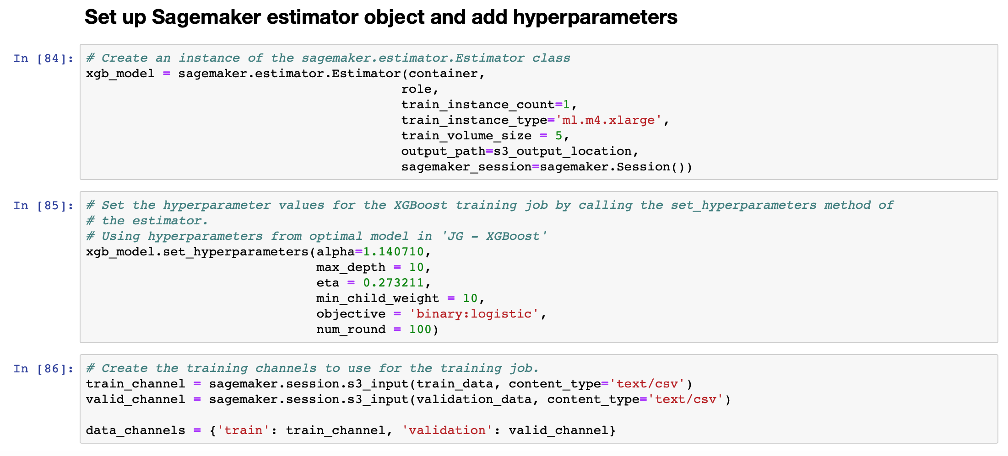
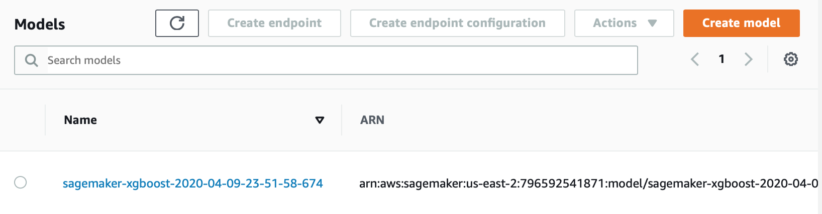
Setup SageMaker Estimator Object and Add Hyperparameters from Notebook 1

Slide 13
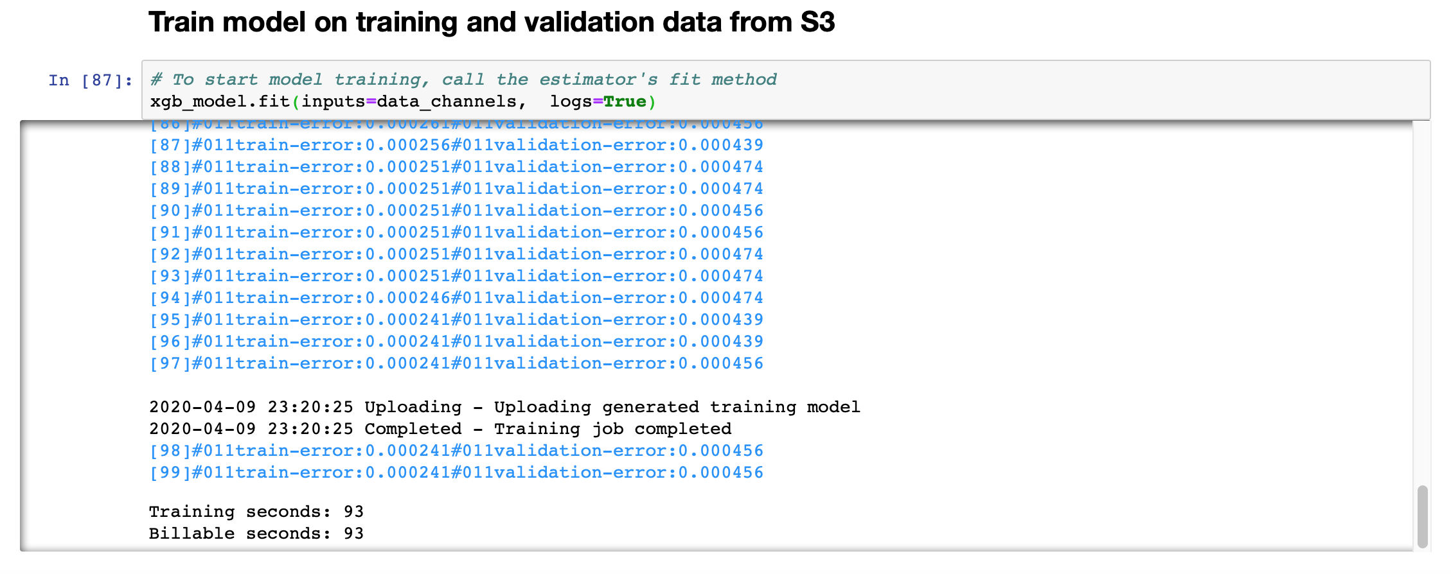
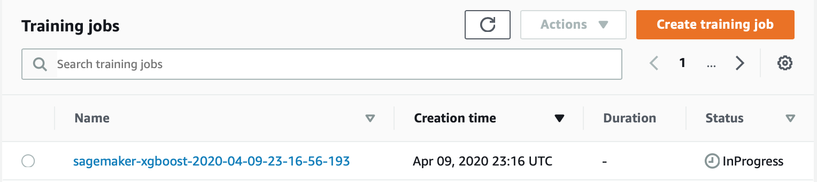
Train the Model

Slide 14
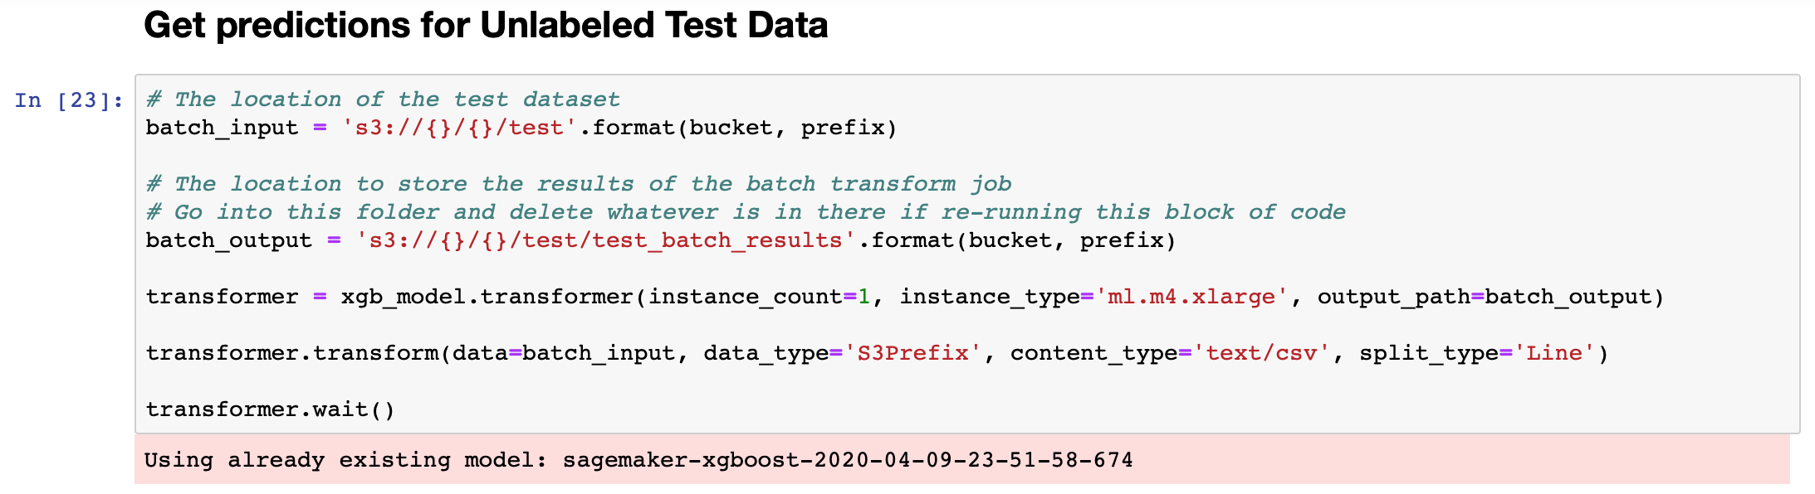
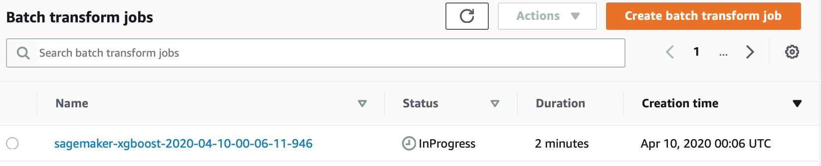
Feed the Trained Model Unlabeled Test Data

Slide 15
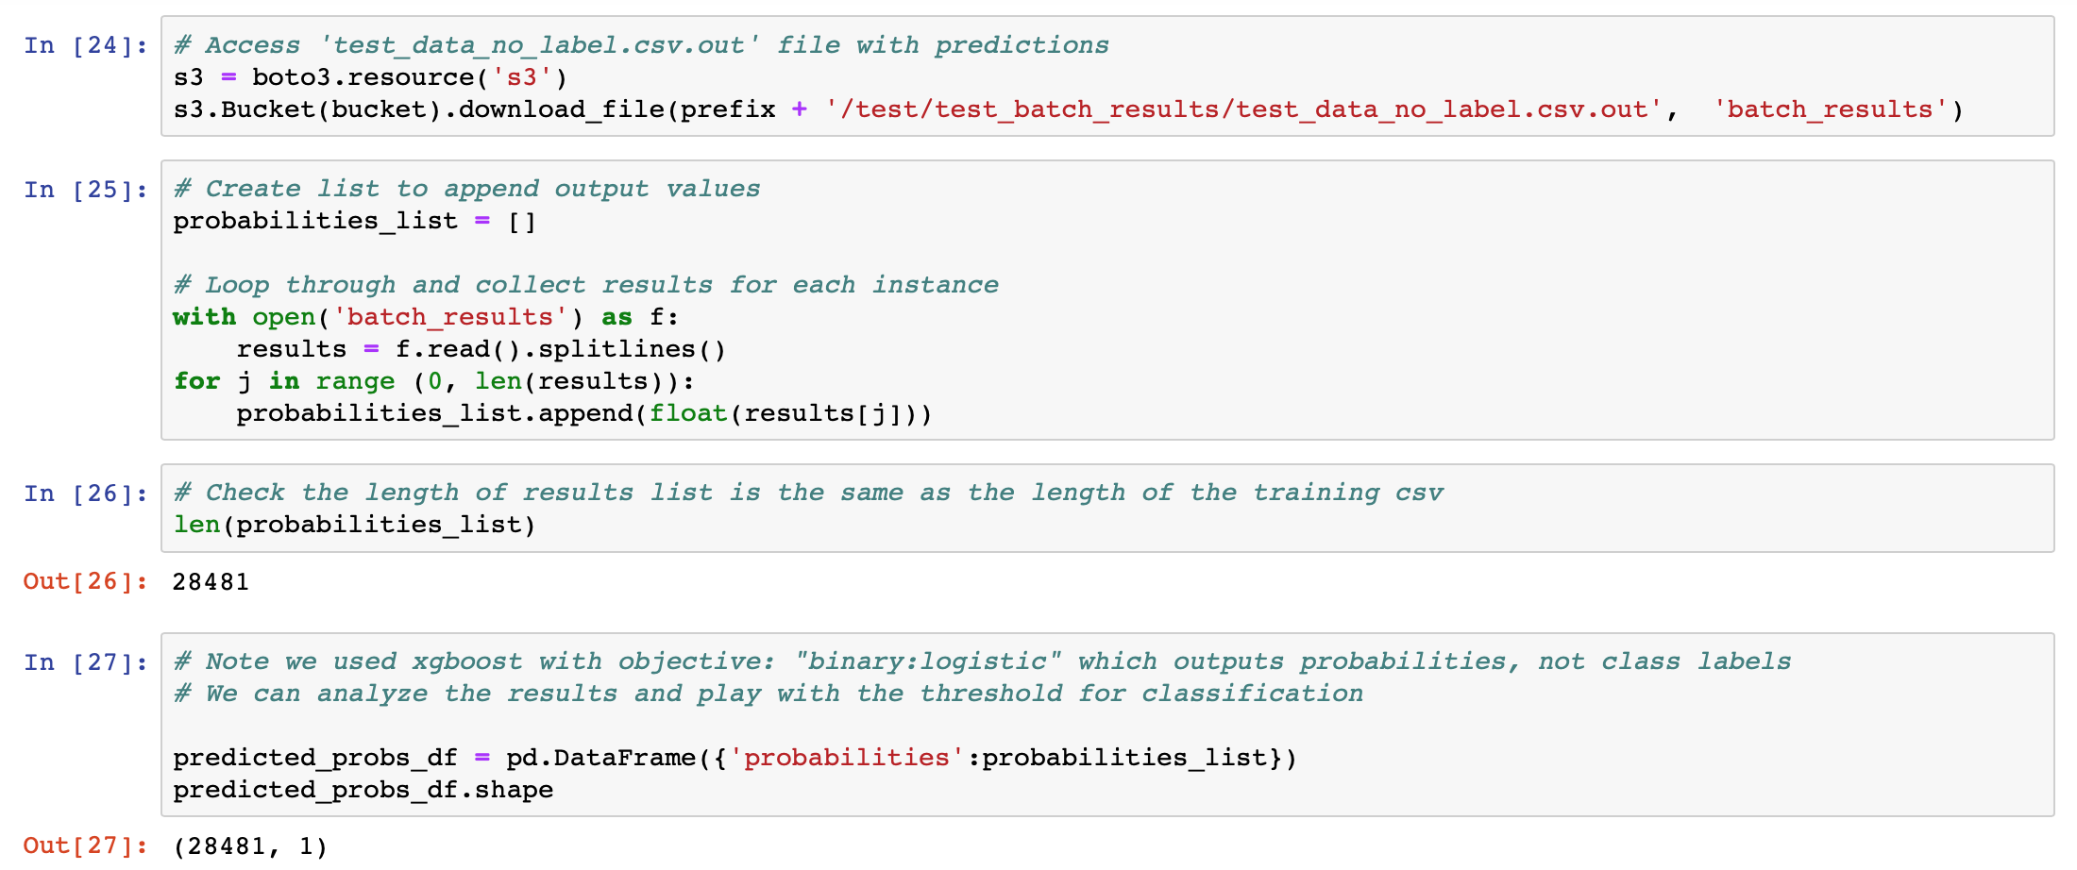
Get Model Output as a DataFrame

Slide 16
Tab 4 – Model Evaluation
Get true labels for test data
Get precision, recall, and thresholds
Find optimal threshold
Create confusion matrix
Get model evaluation metrics
Precision and Recall Curves
Understanding XGBoost Output

Slide 17
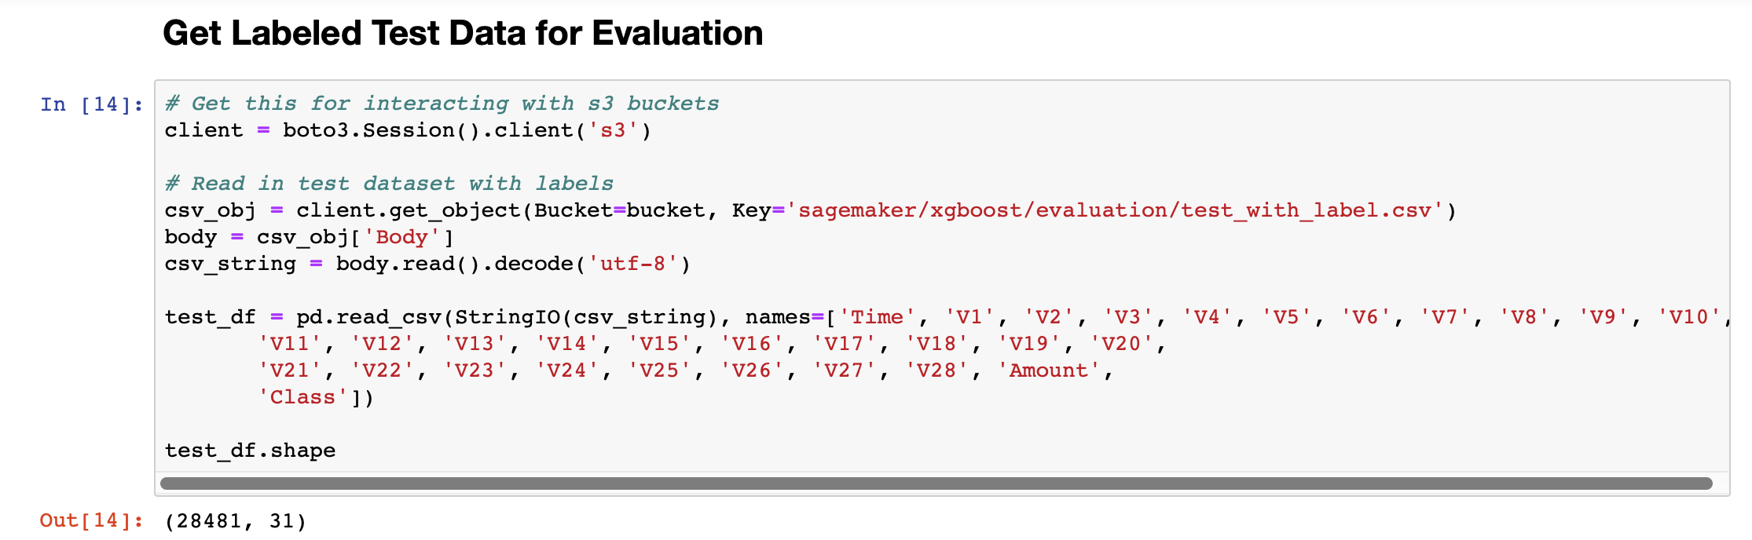
Get True Labels for Test Data

Slide 18
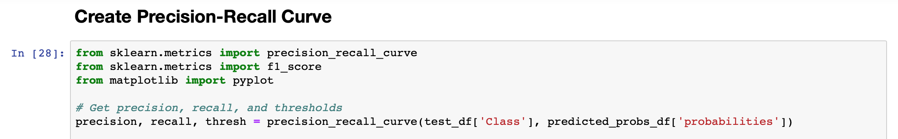
Get Precision, Recall, and Thresholds

Slide 19
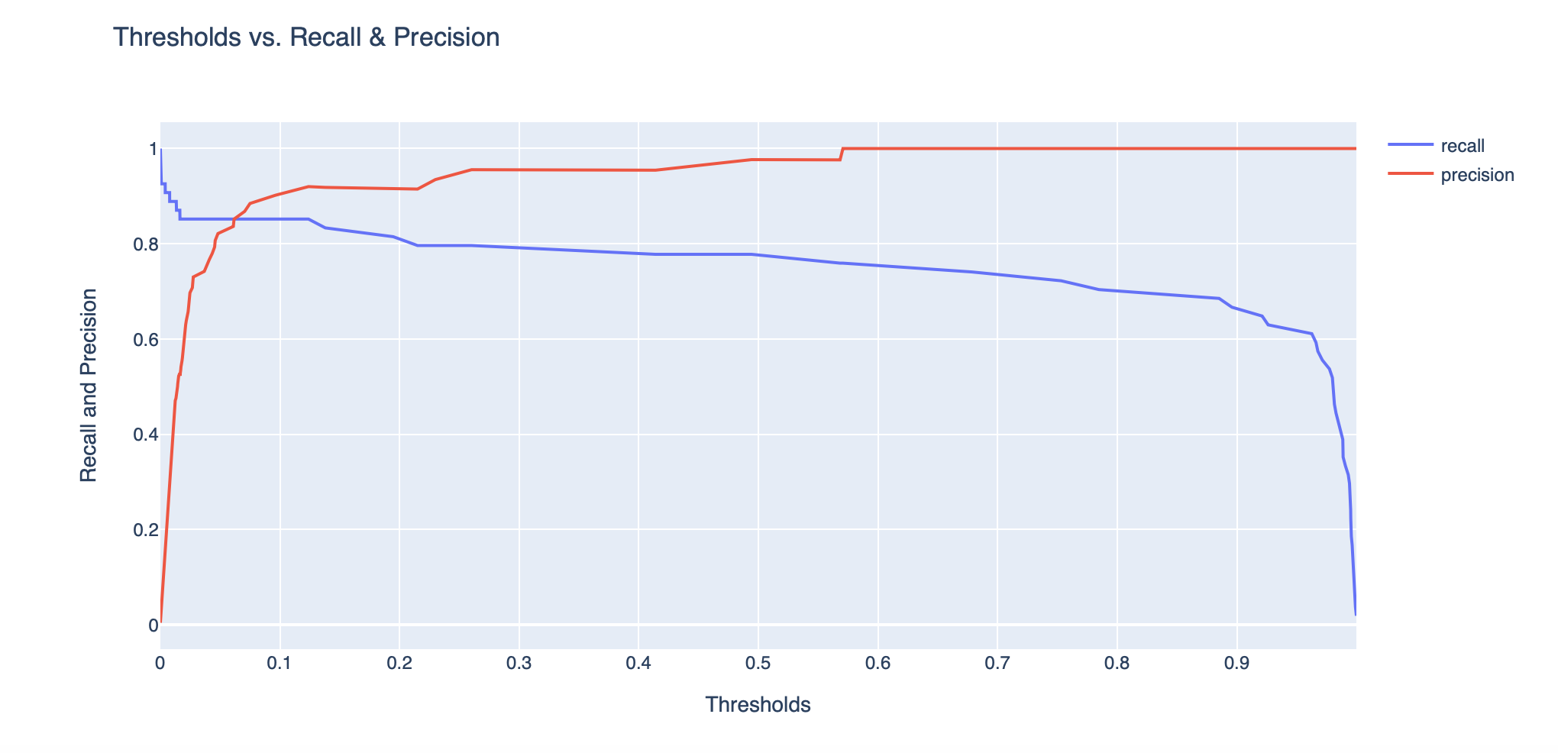
Find Optimal Threshold

Slide 20
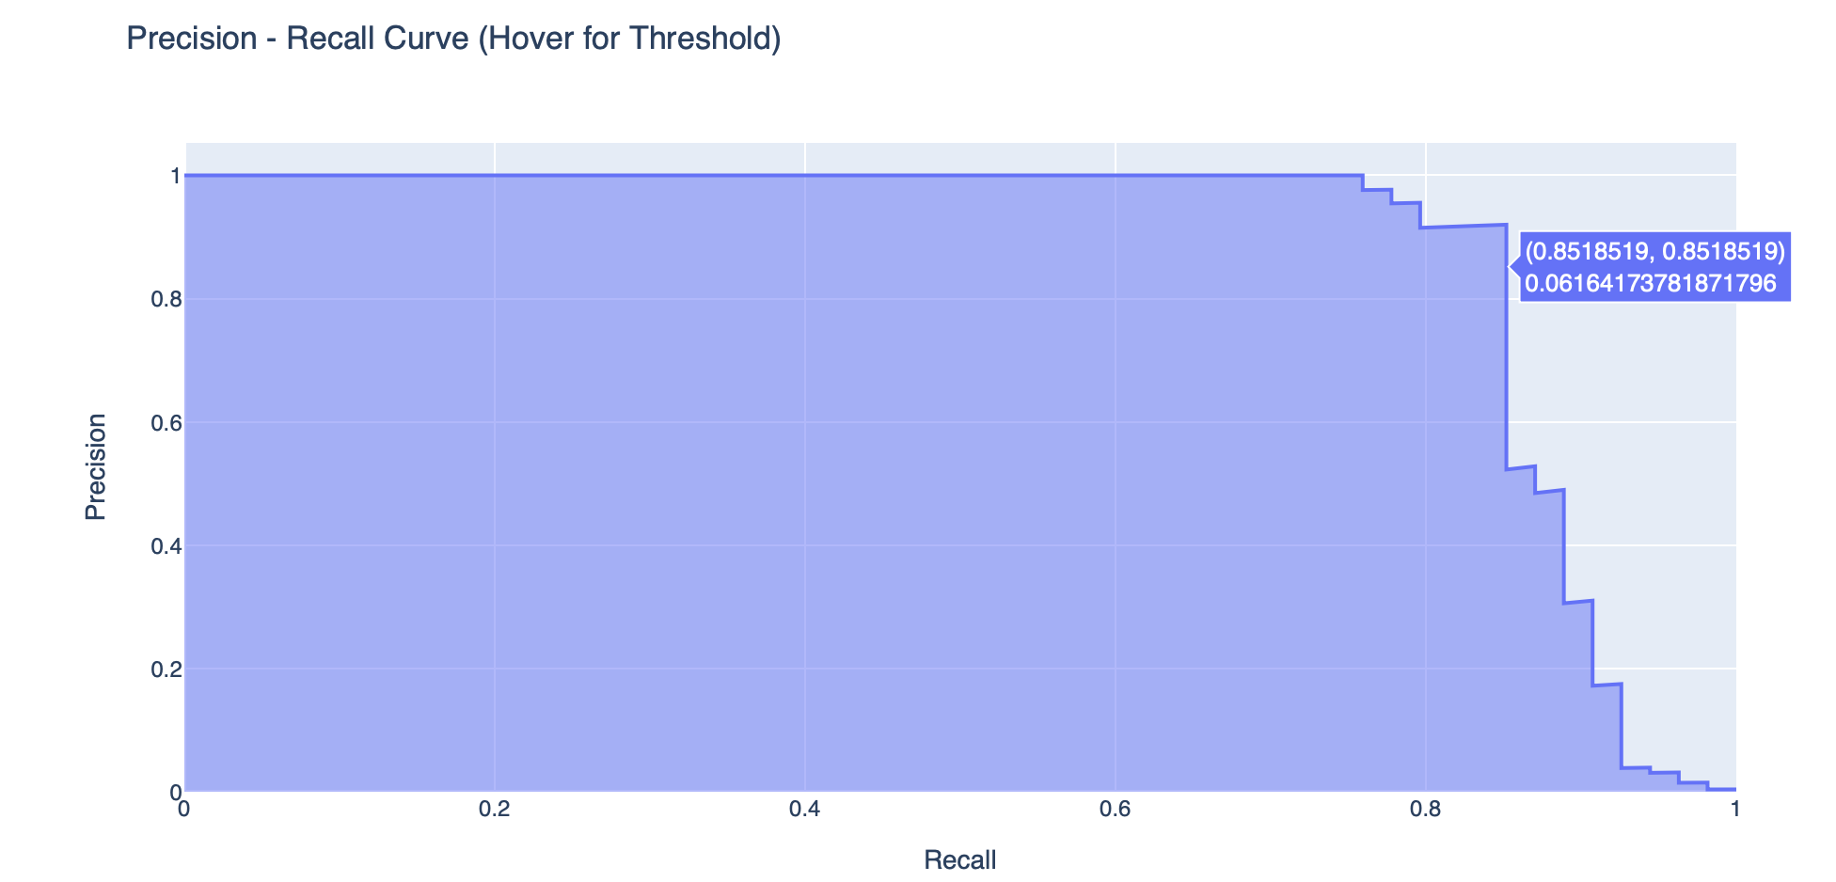
Find Optimal Threshold

Slide 21
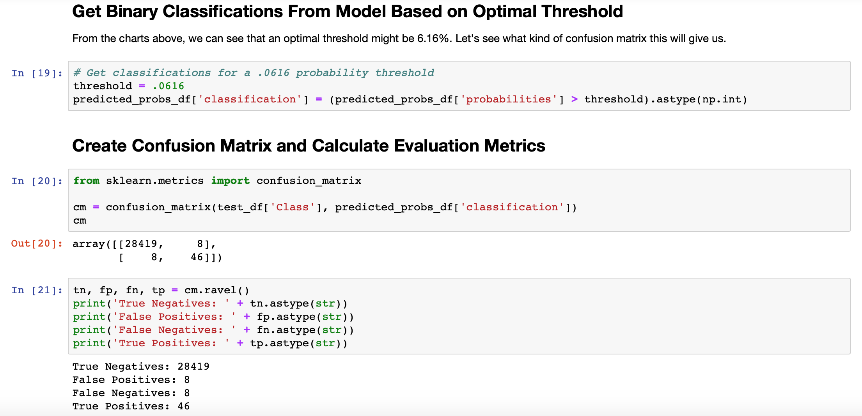
Create Confusion Matrix

Slide 22
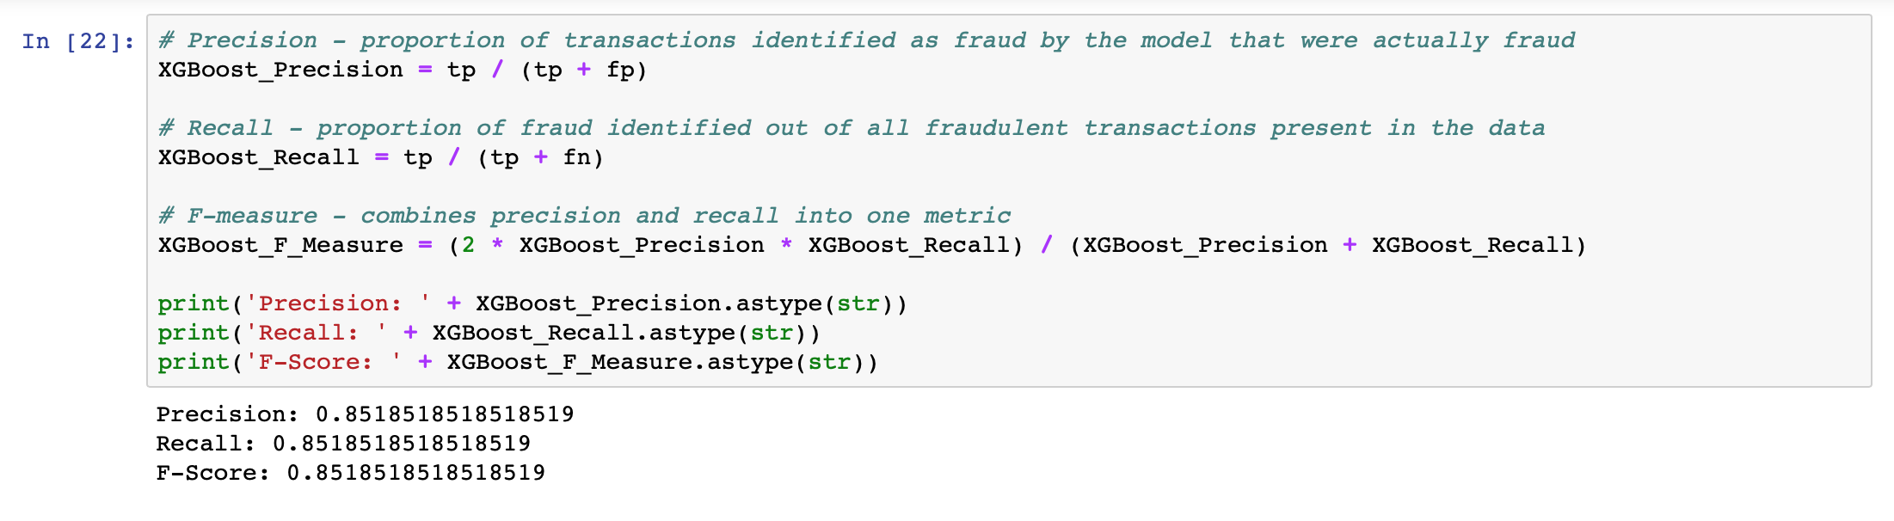
Get Model Evaluation Metrics

