Slide 1
College Football Playoff Predictor
by Jonathan Harper

Slide 2
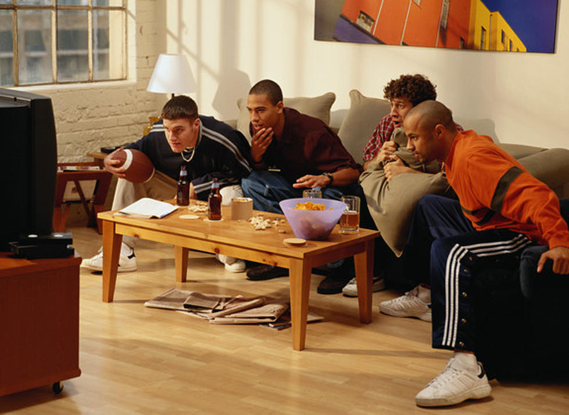
Motivation
Source: https://q985online.com
Notes:
All fall, my friends and I spent at least some of our Saturday each week watching college football. Our favorite college football team is the University of Michigan, which is very convenient as it is where I attend school, and Michigan did exceptionally well this season, which encouraged us to watch a lot of games. By the bowl season, we thought that we had a fairly good idea of who would win each game, and so I had the idea of building a tool that uses some level of sports analytics to predict the outcomes of each game and see if we could predict better than that tool.

Slide 3
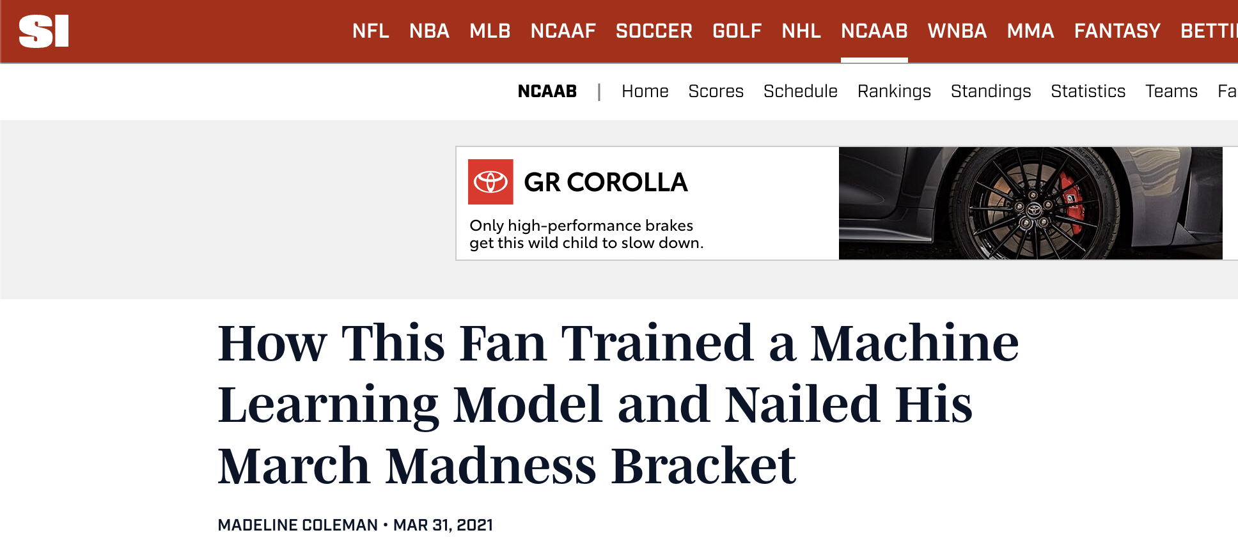
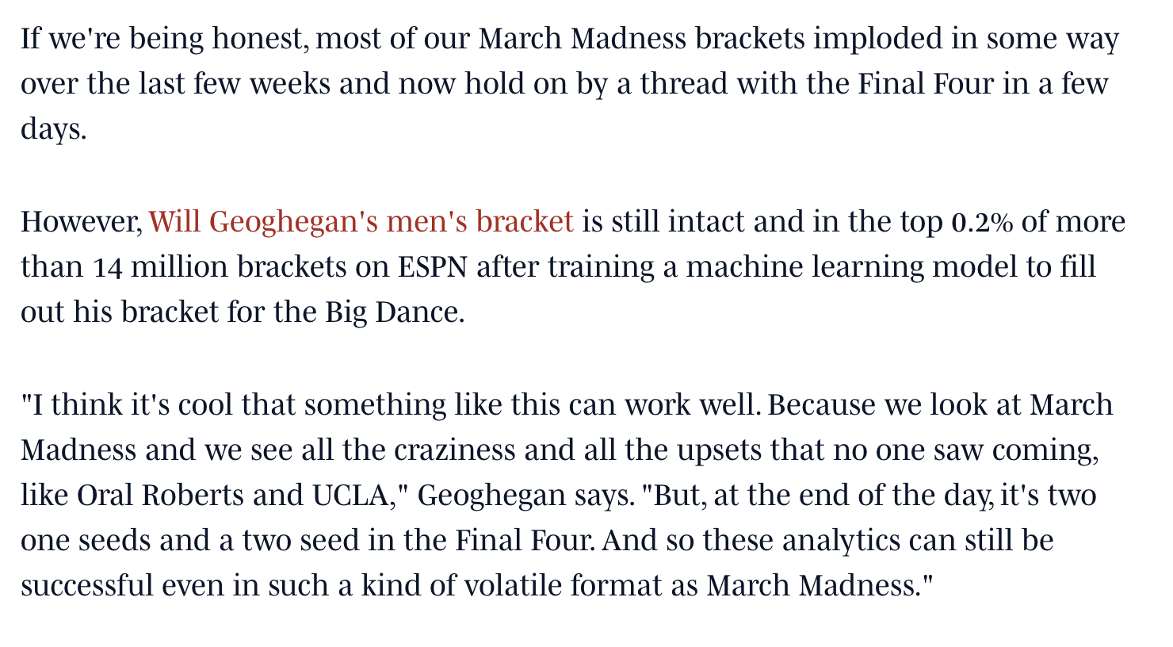
Data background
Notes:
There is countless data out there that could help with these predictions, and I decided to take inspiration from an article I found on a guy named Will Geoghegan, who used Massey Ratings data to fill out his March Madness tournament bracket a few years ago. Massey Ratings compiles up to 100 different ranking systems for the college football season, and each ranking system is determined by different characteristics. So, one rating may highly value total offensive output while another might only look at the amount of turnovers recovered by the defense. Massey does similar work for the college basketball season, and by using these ratings, Will created a bracket that beat 99.8% of all other brackets on ESPN.

Slide 4
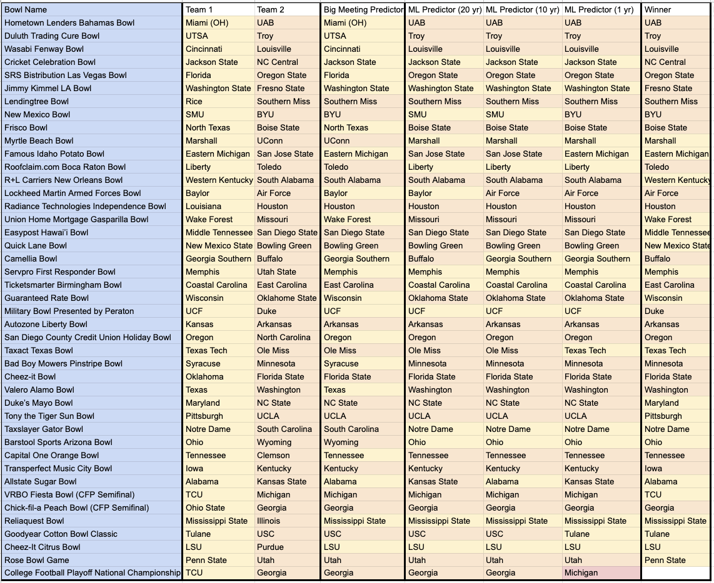
Notes:
With that being said, my main objective was to beat my friend group’s predictions. This was my first attempt at predicting game outcomes, so I decided to try a few different approaches. The first approach, obviously, was the predictions me and my friends made, which can be seen in the “Big Meeting Predictor” column. Then, I used a random forest classifier to build three different machine learning predictors. One predictor used 20 years of game data, one predictor used 10 years of game data, and one predictor only used this season’s data. I thought initially that if you had more data, you could make better predictions, but each year added also impacted the amount of expert ranking systems that we had. Not every ranking system was available each year. In the set that only used data from this year, we had information from around 100 different ranking systems, while the set that used 20 years of data only had access to about 20 different ranking systems.

Slide 5
Results
Human Predictions
CORRECT
INCORRECT
Model, 20 years
Model, 10 years
Model, 1 year
5
10
15
20
25 games
Notes:
And that access to different ranking systems seemed to impact results. As you can see, the predictions that were made using 20 years of game outcomes and rankings only guessed the correct outcome for half of the games. Ten years worth of game outcomes and rankings only improved the predictions a little, while the predictions that only had access to this year’s game outcomes and rankings performed the best. The best predictor concluded with 60% accuracy, which is far lower than I expected or would have hoped for. It seems like this method of predictions may work well for college basketball, but I may need to look into other data if I want to try this again next bowl season. That being said, my friends and I only predicted with 40% accuracy and have accepted that we may not be college football experts.

Slide 6
Ideas for next time
Players and coaches that opt out of the bowl season
Utah’s star cornerback Clark Phillips III did not play, which impacted their team’s ability to defend against the pass
Coastal Carolina played in bowl game without head coach Jamey Chadwell
Time between games
Teams perform differently when they are playing every week compared to the bowl season, when they have up to 5 weeks of rest. Performances from teams after bye weeks could be more indicative of how a team can perform in a bowl game.
Notes:
I did have a few thoughts as to what could make bowl games unique when compared to the rest of the college football season, and what may have made it difficult to predict.
The first factor is that some players and coaches decide to opt out of the bowl game season, as players may want to avoid injury as they prepare for the NFL and coaches may take other jobs in between the regular season and their bowl game. This seems to have specifically impacted Coastal Carolina and Utah in their bowl game.
The next factor is the time in between games. Throughout the season, teams are playing every week and have little time to prepare or rest in between games. Meanwhile, for the bowl game, teams have up to 5 weeks to prepare specifically for their opponent, and a slightly different team could be showing up for their bowl game compared to the one that had been playing all year.
Lastly, it is difficult to predict outcomes where human judgment and error can play such a critical role. I ran track collegiately myself, and I know that sometimes in sports, it can be impossible to predict what the future will hold. But I also know that trying to predict what the future will hold is sometimes what makes sports enjoyable.
Notes from Claire-Isabelle:
Lesson learn: data is so messy
Look at the parameters you selected
Random forest is only one, may not be the best for all projects. Deep learning only for large datasets.
Time series, more advanced and complicated but may be more appropriate if you want to increase the accuracy. Arima - Data mining 2

