Slide 1
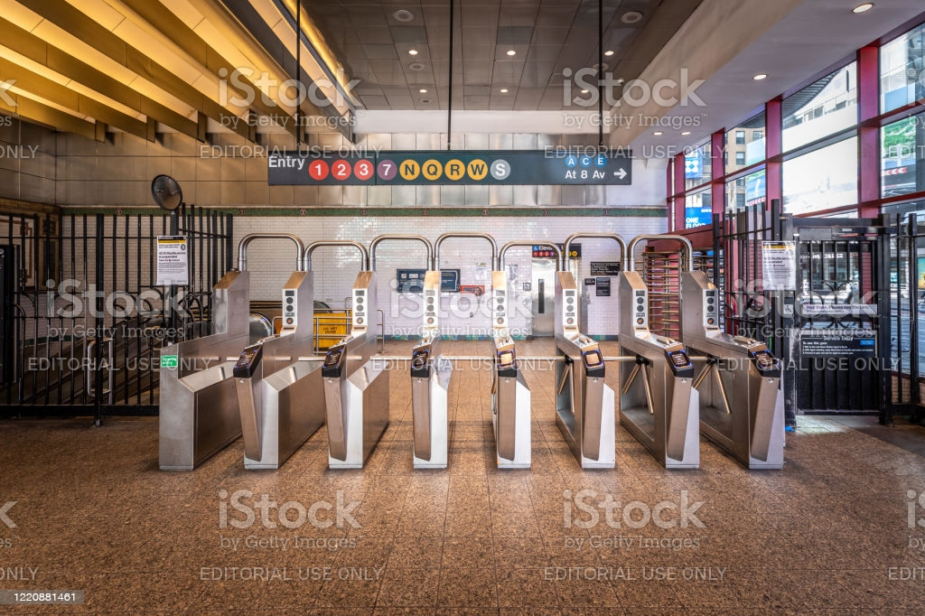
NYC Subway Ridership Analysis

Slide 2
Problem Statement/Background Information
We want to determine the most important factor or weights when determining ridership data.
This would be important for the agency because these models can help determine the type of service changes required to improve capacity in stations or overcrowding on trains.
In addition, these models can help make business decisions on service to cut due to low ridership levels. This is something that can help improve cost-saving measures for the agency.

Slide 3
The Datasets
2018/2019 ridership datasets
Station Accessibility Data

Slide 4
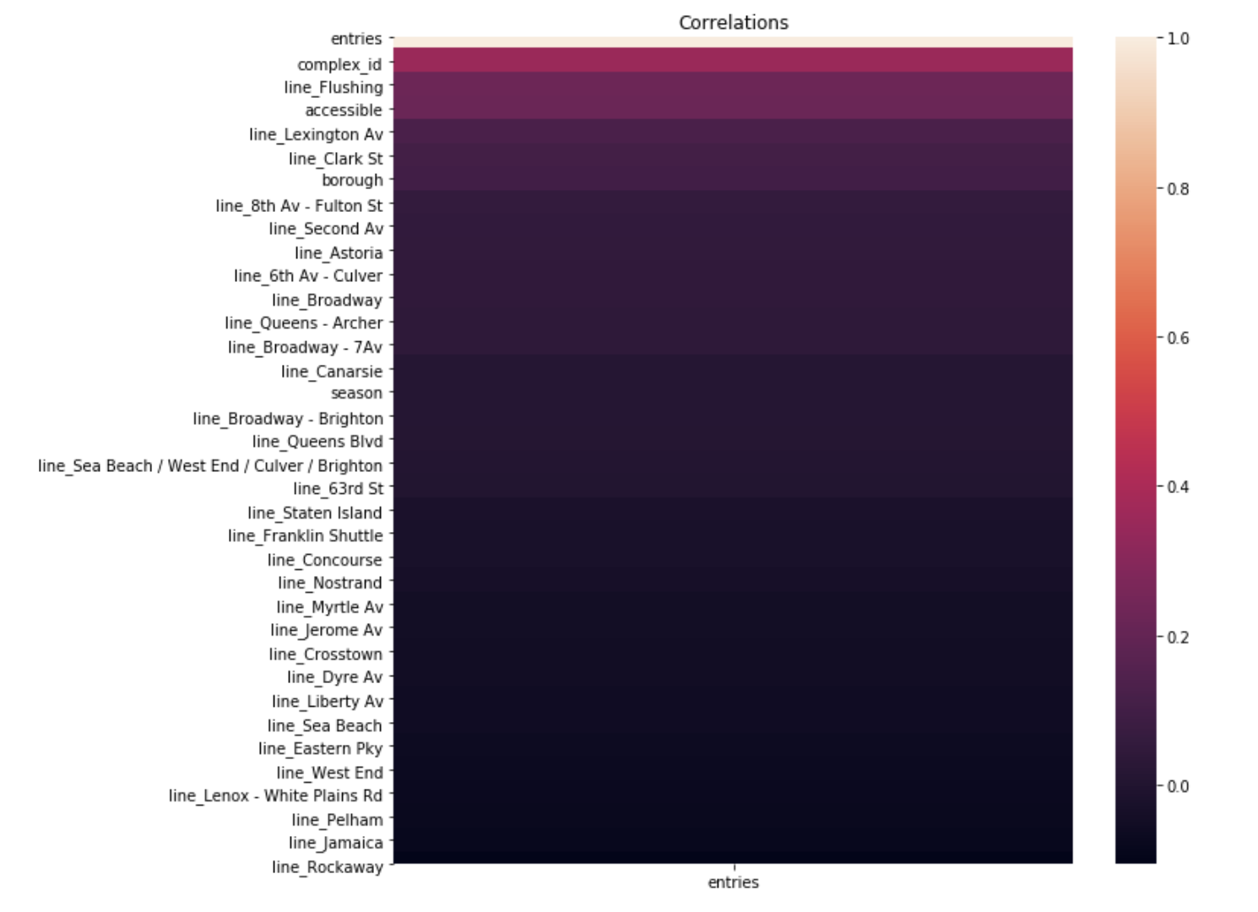
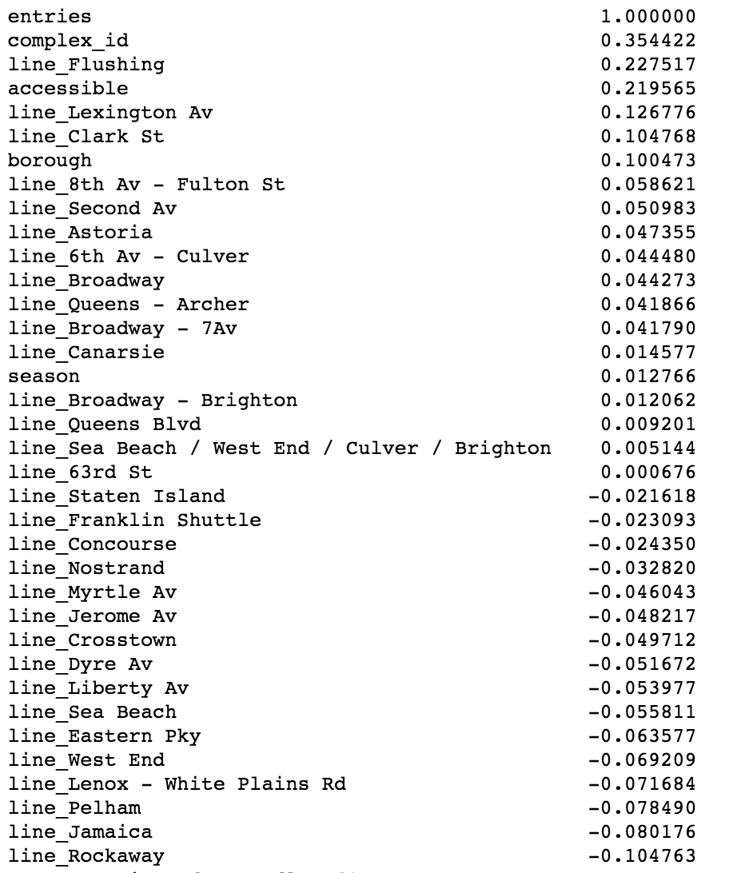
Correlations/Heatmap

Slide 5
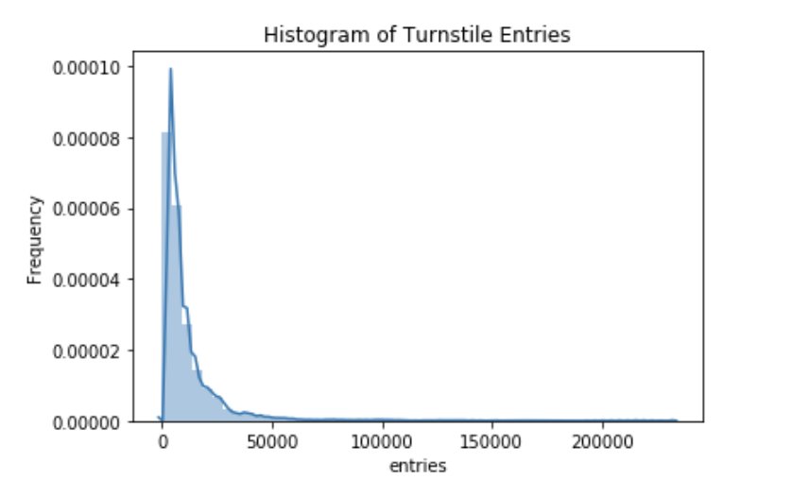
Prediction: Entries into the Subway

Slide 6
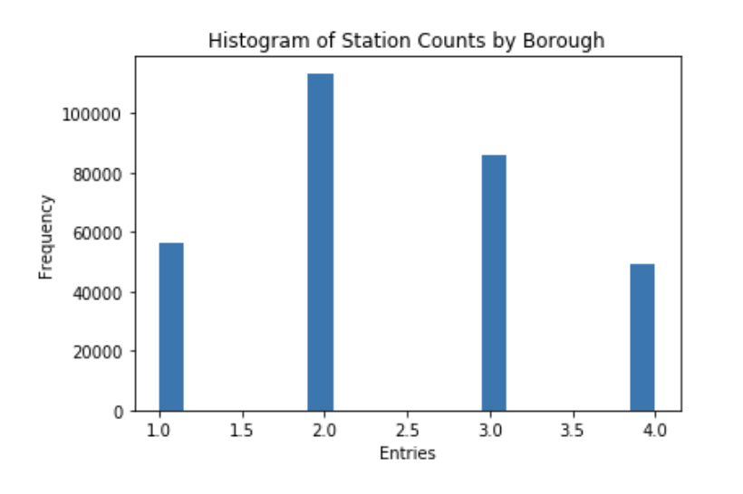
Distribution of Entries by Borough

Slide 7
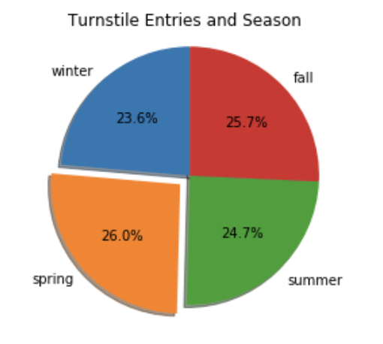
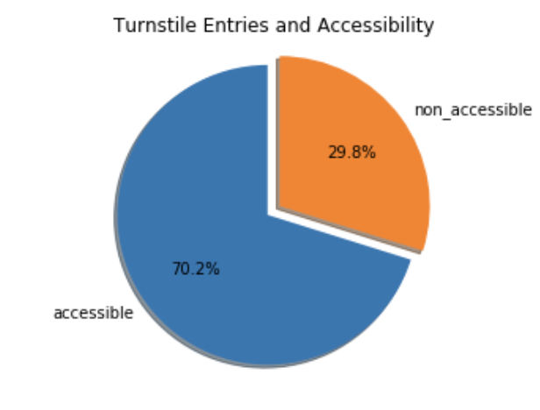
PieCharts of Entries

Slide 8
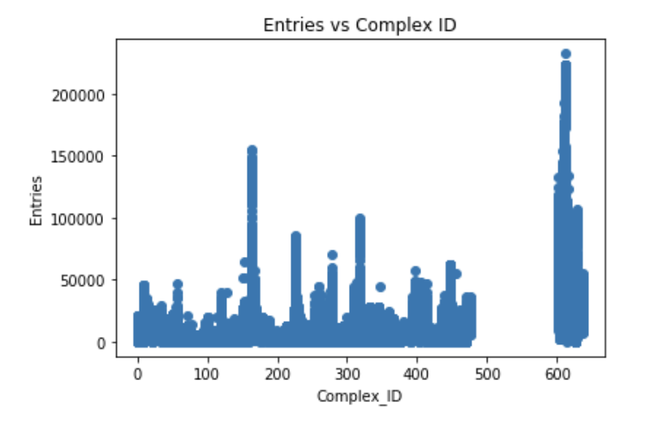
Scatterplot of Entries and Complex ID

Slide 9
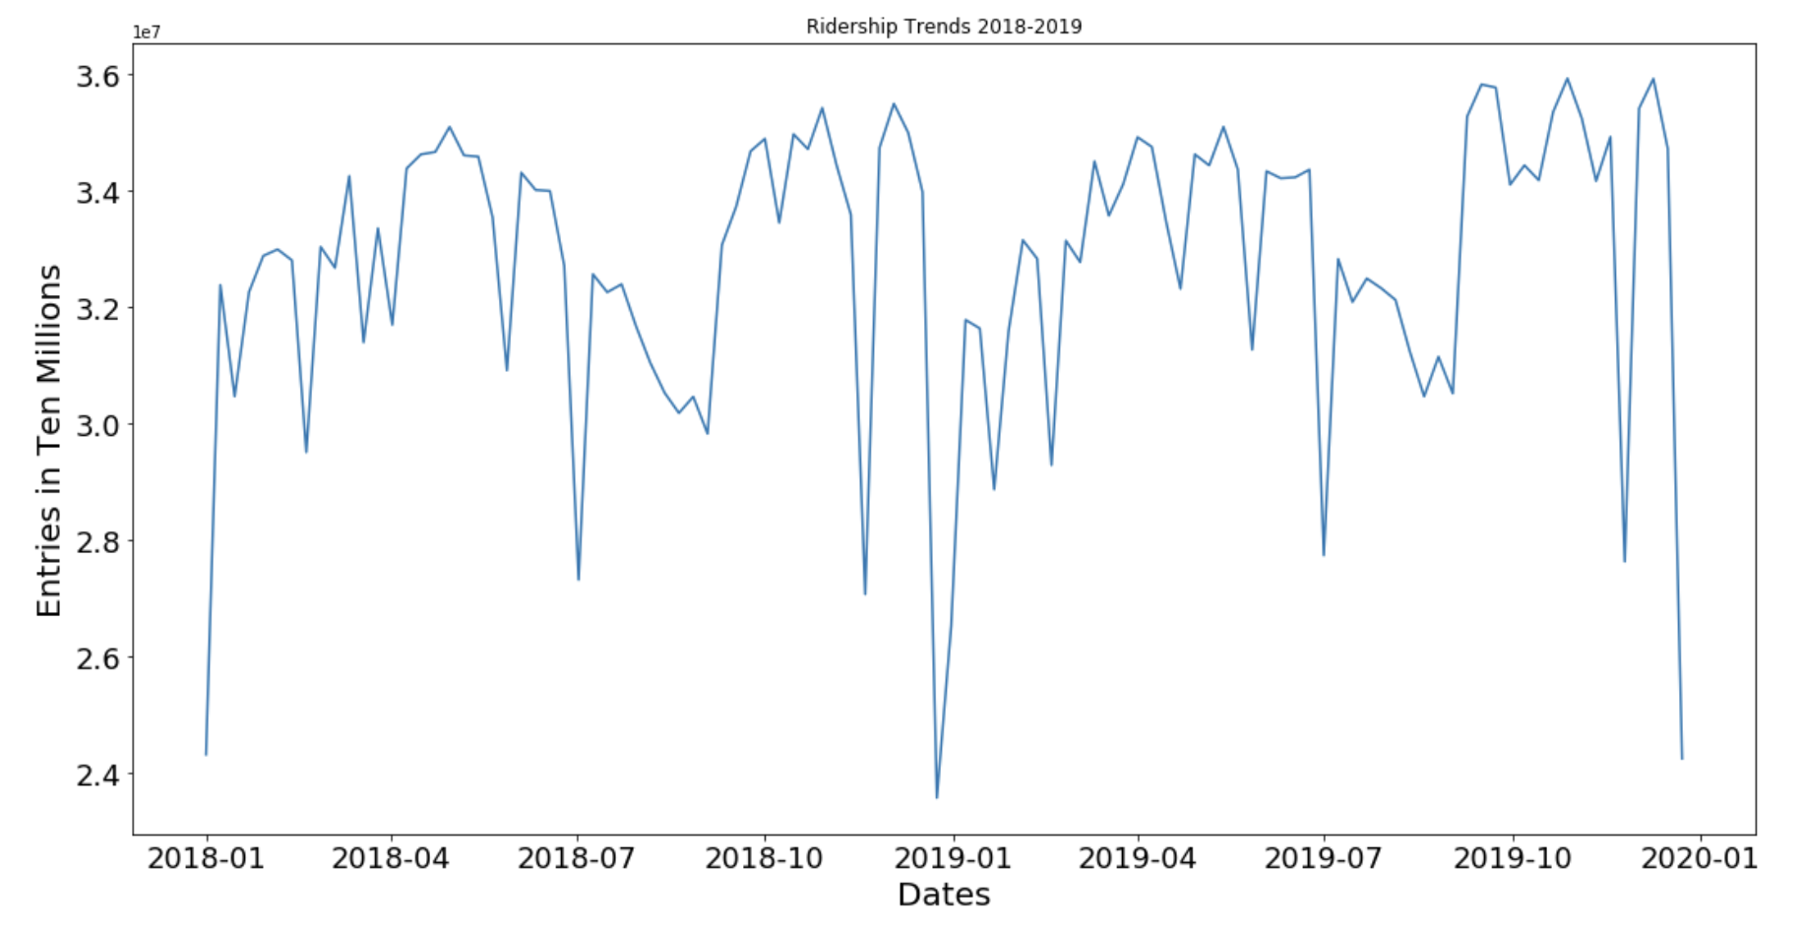
Time Series

Slide 10
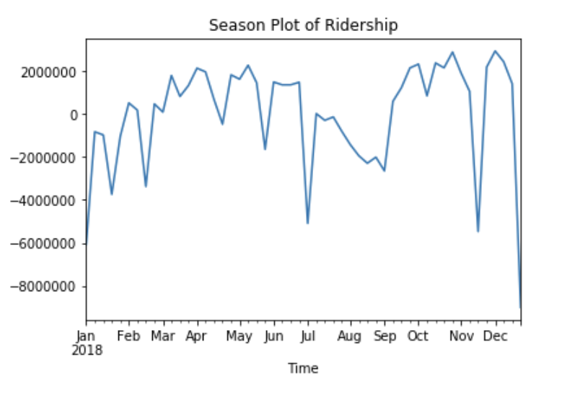
Seasonal Relationship Visualization

Slide 11
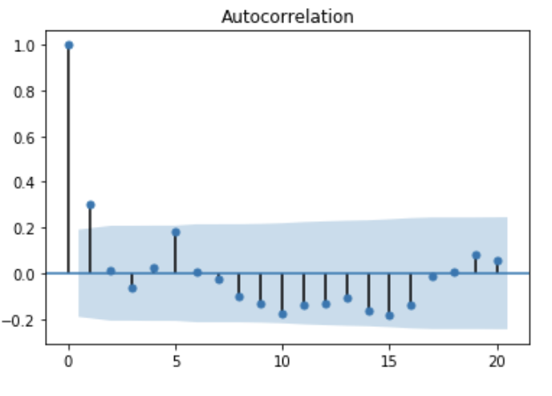
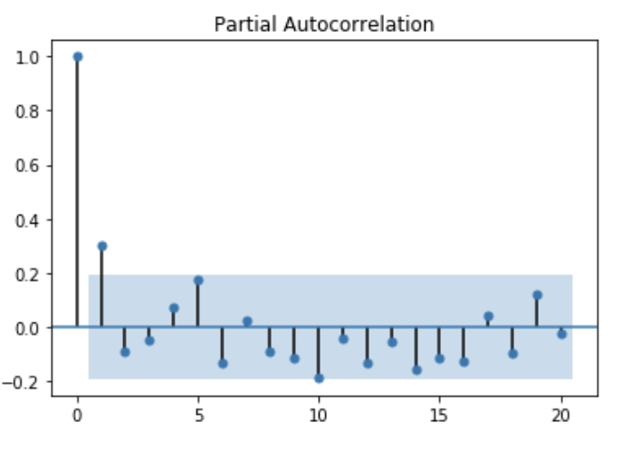
Correlation Plots

Slide 12
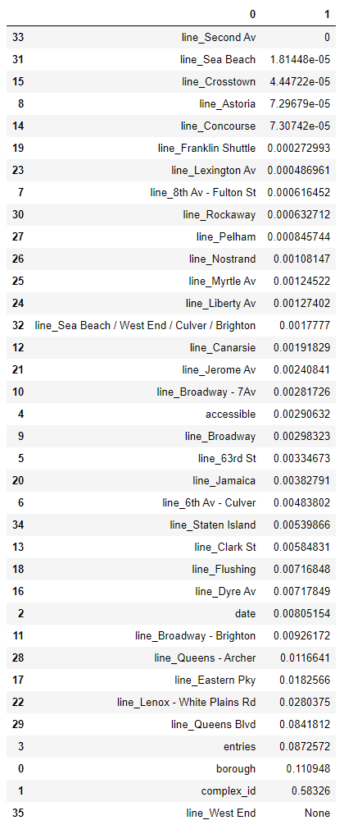
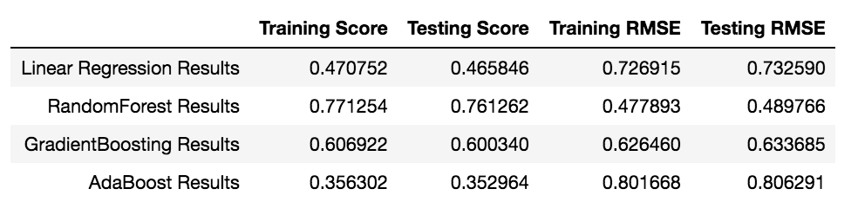
Regression Results

Slide 13
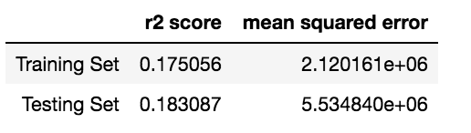
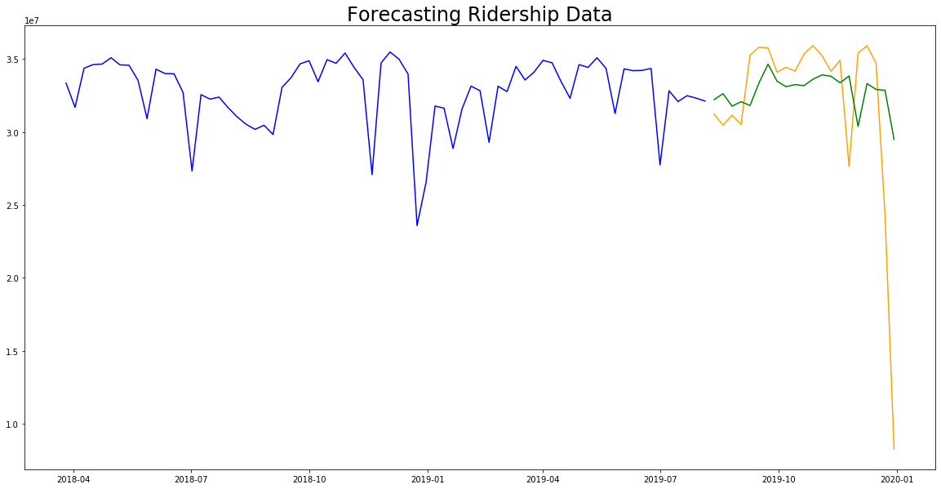
Time Series Results

Slide 14
Conclusions and Recommendations
Our RandomForest regression model performed the best when modeling ridership data.
Our time series model did not do as well as the regression models.
One-hot encode or feature engineer the boroughs for deeper results
Increase service on the Queens Blvd line
Limitations of the model?

