Slide 1
Intern-Buddy matching algorithm
Ash
Ben
Eva
Ollie
Tara

Slide 2
The Problem
What does a buddy mean?
Advice
Technology
Similar interests

Slide 3
Our Focus
What you want from a mentor
Time zones
Learning area
Different lines of business

Slide 4
Assumptions
Inherit assumption - we deliver what you want = satisfaction
We can collect what we want
“Time available” - you signed up, you will give at least 30 mins
There is enough mentors for mentees

Slide 5
Demo

Slide 6
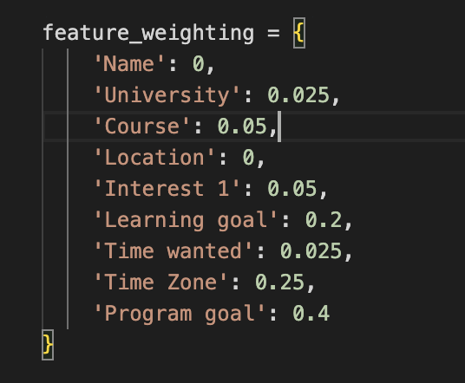
Compatibility Score with weighted feature set
Stable Marriage Algorithm
What you want from a mentor
Time zones
Learning area
Different lines of business

Slide 7
UI solution

Slide 8
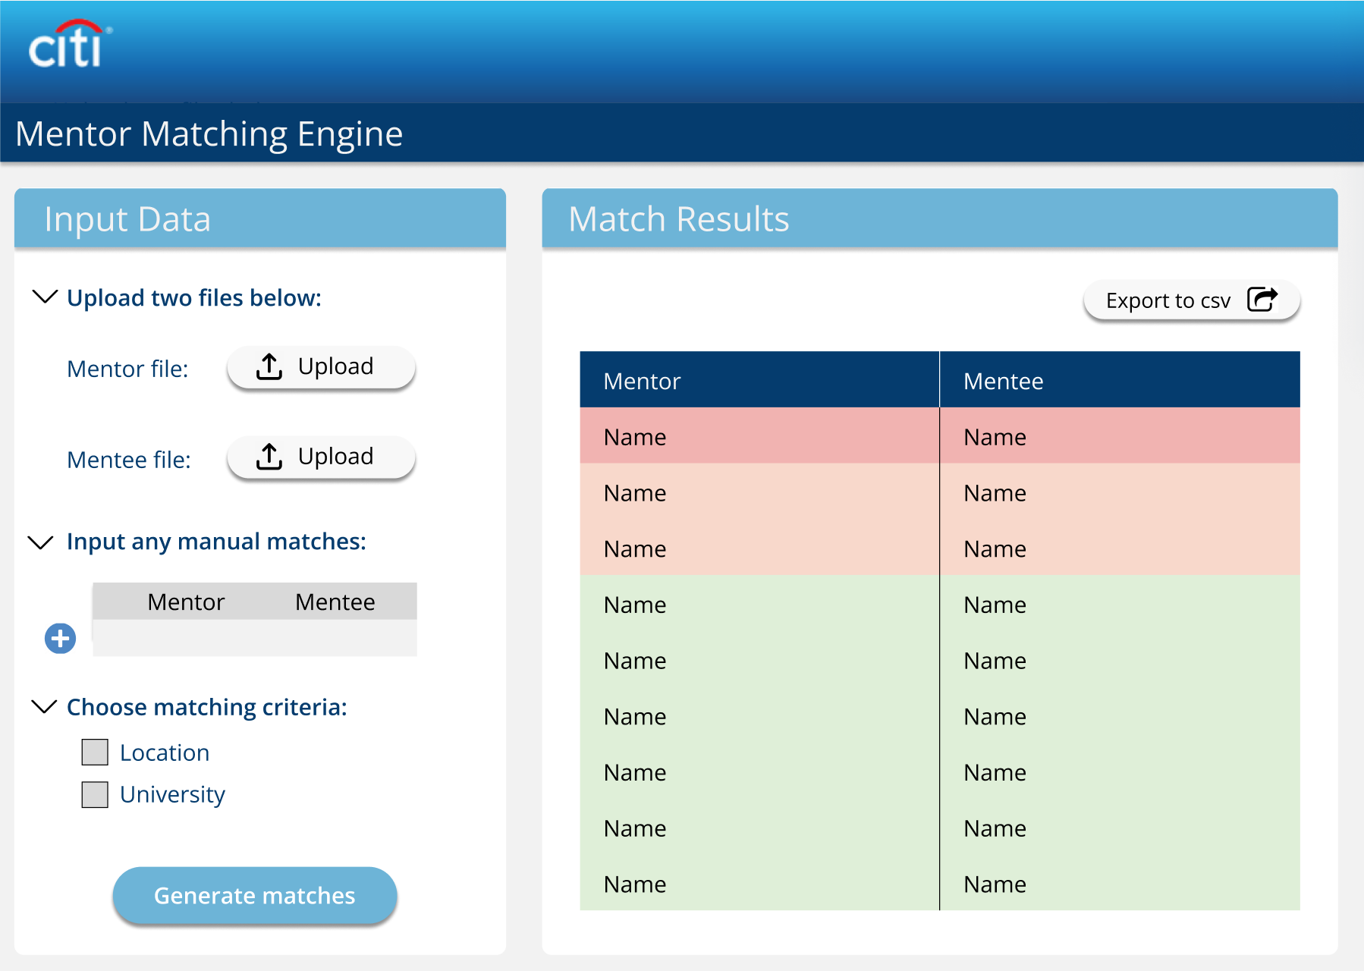

Slide 9
Extensible
Abstract implementation of the system in Event-B
Allows new features and requirements to be added in quickly and see how they fit in
Advantages include being able to spot errors and unwanted deadlocks early on, checking whether the requirements are met before and after an event.
Extra features added include:
HR’s forcing a marriage
Remove the limit for only interns to join, so all employees can join the scheme
Allow both married couples and forced marriage couples to divorce

Slide 10
Extensions
Apply to other locations and business areas
ML to learn based on feedback
Upload to cloud (ex// AWS Lambda)
Custom weighting

Slide 11
Questions?

