Slide 1
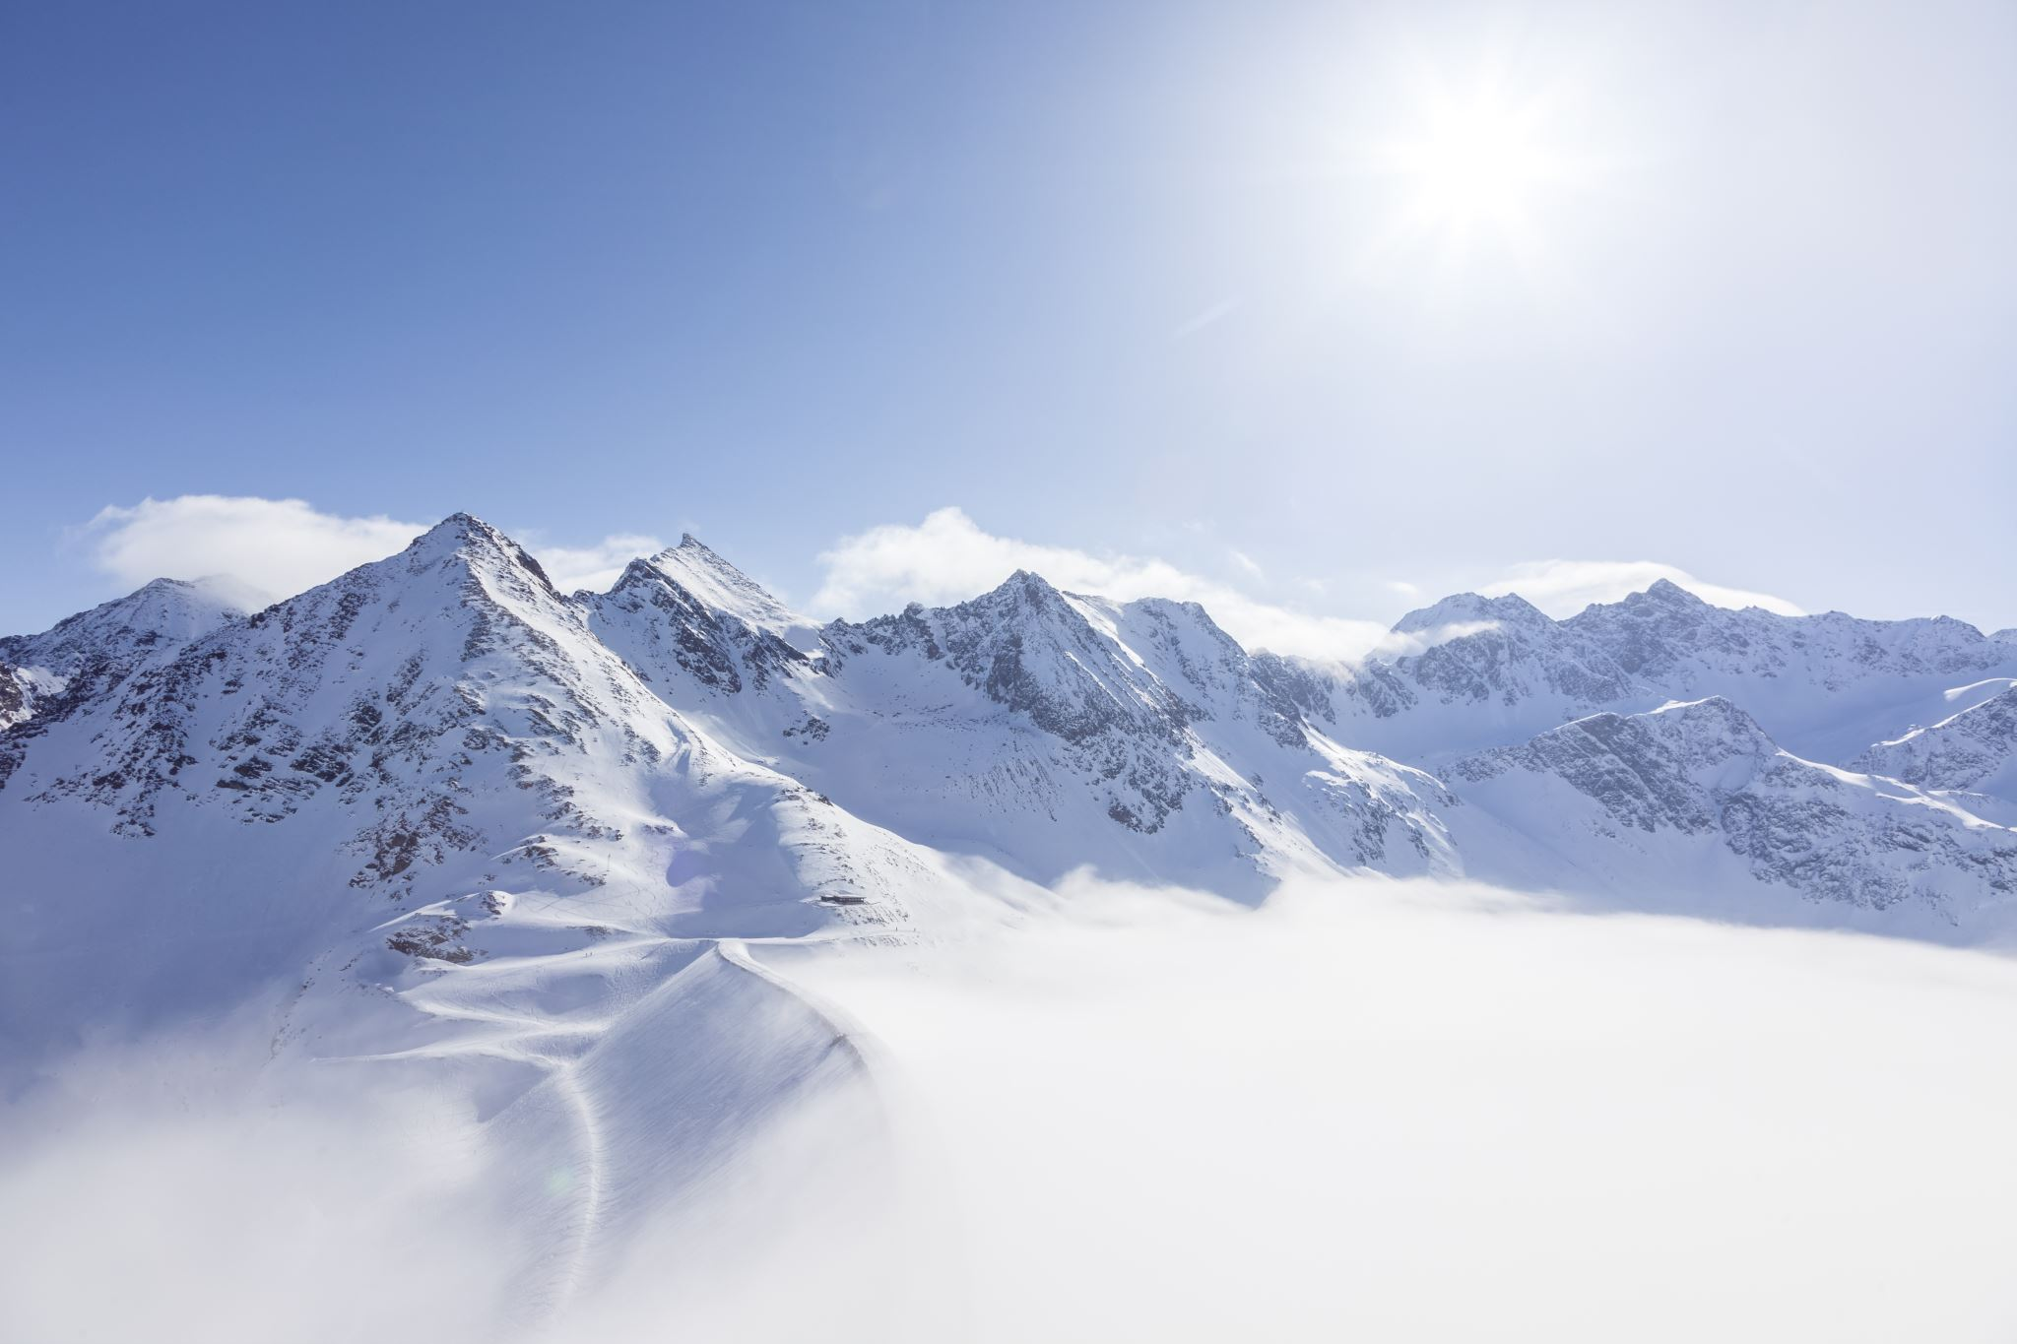
Guided Capstone Big Mountain Resort
Jonathan Lampkin
July 2021

Slide 2
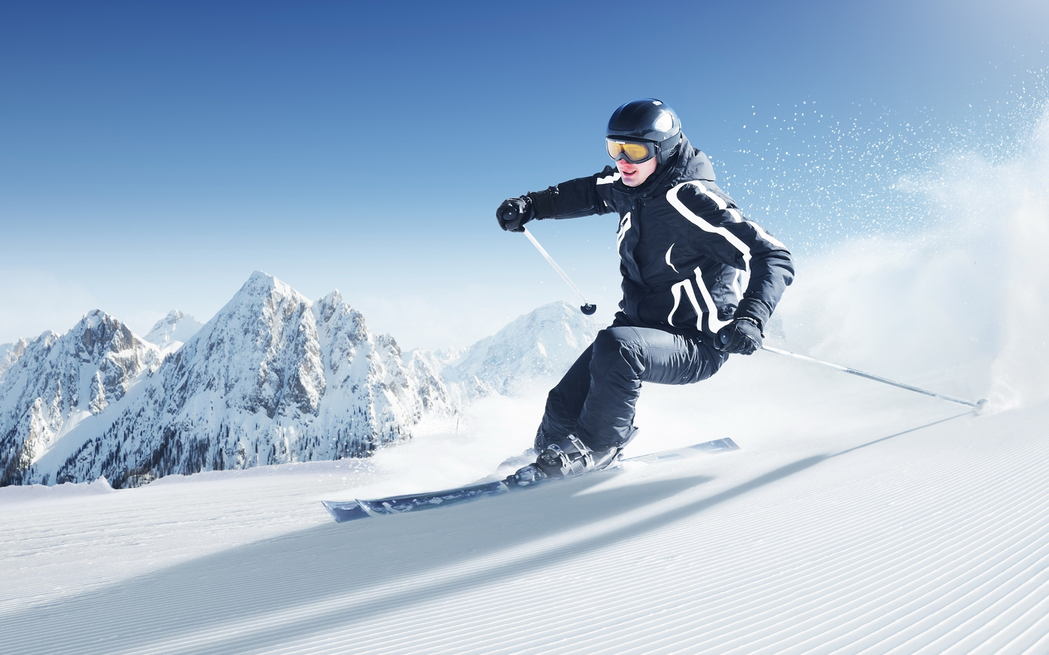
Problem identification
Use a data-driven approach to select a better value for ticket price.
Increase revenue
Increase vertical drop by adding another run
Add snow making coverage
Increase the longest run
Decrease costs
Permanently remove up to 10 least used runs

Slide 3
Recommendation and key finding
Prioritizing cost reduction can best improve gross profit margin.
Removing up to five runs can:
Reduce costs by upwards of $7,700,000. (assumption of each run costing $1,540,000)
Reduce revenue by approximately $1,200,000.
Add up to $6,500,000 to the profit margin.

Slide 4
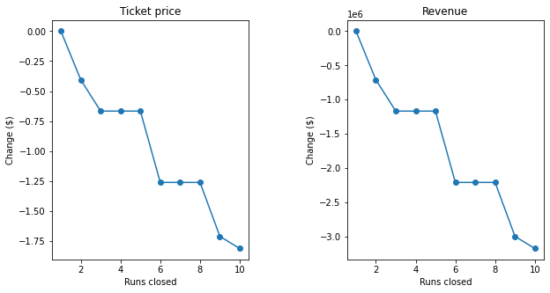
Modeling results
Predicted losses to ticket price and revenue respectively, if runs are closed.

Slide 5
Modeling results
Our suggestion to close runs assumes that each run costs about $1,540,000 seasonally.
Closing just two runs would better benefit the profit margin compared to an additional run.
Operating costs data is needed to evaluate actual cost savings from closing runs.

Slide 6
Modeling results
Alternatively,
There is sufficient data to support adding another run.
Increase ticket price by $1.99, or $3,500,000 approximated additional revenue.

Slide 7
summary & conclusion
An additional run is predicted to add $2,000,000 to the profit margin.
Current data supports additional run.
Removing up to five runs could possibly better benefit the profit margin.
More data could support removing runs.

