Slide 1
Article Presentation: Huang, T., Zhu, Y., Qiu, M. et al., “Extending Amdahl’s Law and Gustafson’s Law by Evaluating Interconnections on Multi-Core Processors,” J Supercomput (2013) 66: 305. https://doi.org/10.1007/s11227-013-0908-9
CPSC 5260 Parallel Algorithms
Jonathan Land

Slide 2
Structure of Presentation
I. Previous studies that influenced this article’s content
II. Main problem(s) that the authors are answering
III. Proposed solutions to the problem(s)
IV. Research suggestions

Slide 3
I. Previous studies that influenced this article’s content

Slide 4
I. Previous studies that influenced this article’s content
Hill MD, Marty MR (2008) Amdahl’s law in the multicore era. Computer 41(7): 33–38.
This study considered performance issues within multi-core architecture. Hill and Marty presented a cost model for the chip area (A(m,r) = m x r) to show the limitations of speedup when parallelizing.
Issue: Overlooked inter-core communication
Woo DH, Lee HHS (2008) Extending Amdahl’s law for energy-efficient computing in the multi-core era. Computer 41(12): 24–31
This study attempted to extend Amdahl’s law by including energy models into Amdahl’s formula/model.

Slide 5
I. Previous studies that influenced this article’s content (contd.)
Sun X-H, Chen Y (2010) Reevaluating Amdahl’s law in the multicore era. J Parallel Distrib Comput 70(2): 183–188
This study sought to extend Amdahl’s and Gustafson’s laws
Argued that these laws could be interpreted correctly if users would increase computing demands when given more computing power.

Slide 6
II. Main problem(s) that the authors are answering

Slide 7
II. Main problem(s) that the authors are answering
Amdahl’s and Gustafson’s laws can be easily misinterpreted and can produce imprecise results.
Primary reason: Their laws do not adequately account for inter-core communication (interconnects) and the overhead this causes in their cost models.
When these laws were created, “all processors contained single core with no room for concern over on-chip communications between multiple cores.”
Amdahl: overly-pessimistic
Gustafson: overly-optimistic
Hill and Marty: overlook interconnects and inter-core communication
Both laws tend to oversimplify the computational complexities within parallelization.
So, the article qualifies Amdahl’s and Gustafson’s laws a bit more to consider the importance of interconnection when discussing/applying speedup formulas.

Slide 8
II. Main problem(s) that the authors are answering(contd.)
What is the purpose of interconnects?
Interconnects are used to connect computer components
Can connect…
Processors and processors
Processors and memories (banks)
Processors and caches (banks)
Caches and caches
I/O devices

Slide 9
II. Main problem(s) that the authors are answering(contd.)
Effects of interconnects
Effects how large a system one can build
Effects how easily more processors can be added
Effects performance and efficiency
How fast processors, caches, and memory communicate
How long the latencies are
How much energy is spent in communicating

Slide 10
III. Proposed solutions to the problem(s)

Slide 11
III. Proposed solutions to the problem(s)
Extending Amdahl’s Law: Amdahl considered the parallelism on a system speedup given a fixed-size problem. Speedup is defined as the sequential execution time over parallel execution, which is shown in the following equation:

Slide 12
III. Proposed solutions to the problem(s) (contd.)
The authors extend Amdahl’s law by introducing the parameter i, or the number of interconnects, in order to represent the number of links of a single node or core in Network on Chip (NOCs) on multi-core processors.

Slide 13
III. Proposed solutions to the problem(s) (contd.)
Extending Gustafson’s Law: Gustafson wanted to show that parallelization allows us to deal with larger computational problem sizes in the same amount of time.
The scale of the problem size is bounded by the execution time.
SG = scaled workload within a fixed period of time / original workload within a fixed period of time

Slide 14
III. Proposed solutions to the problem(s) (contd.)
Here, w and w’ represent the original workload and the scaled-up workload.
Meaning: For Gustafson, a computer with m cores can deal with a larger workload than a single-core computer in the same amount of time.

Slide 15
III. Proposed solutions to the problem(s) (contd.)
Disagreement(s): Gustafson accounts for the computational workload, but does not account for how parallel computation also increases communication overhead.
The authors suggest that the following revision or extension of Gustafson’s law is necessary to show that if performance of interconnection stays the same, or does not grow with the number of cores, then the execution time will increase (i.e., there will be no speedup).

Slide 16
III. Proposed solutions to the problem(s) (contd.)
The inclusion of Δ is to correct the execution time of the original workload required by interconnection and the original processor.
In the denominator we have the new workload execution time with m processors and i interconnects.
By adding this factor, the authors have provided safeguards against the assumption that one can speed up a task simply by adding more cores.

Slide 17
Case Study
The authors used an image processing application (CT – Computer Tomography) to evaluate their speedup model when compared the speedup models of Hill, Sun, and friends.
Language used: CUDA
Test data structure: task graph (DAG)

Slide 18
Case Study (contd.)
Hardware used:
1. XC5VLX110T: Field-Programmable Gate Array(s) or FPGA
2. XC2VP130: FPGA
3. Intel Pentium 4: CPU
4. Quadro FX5600: GPU
5. Tesla C1060: GPU

Slide 19
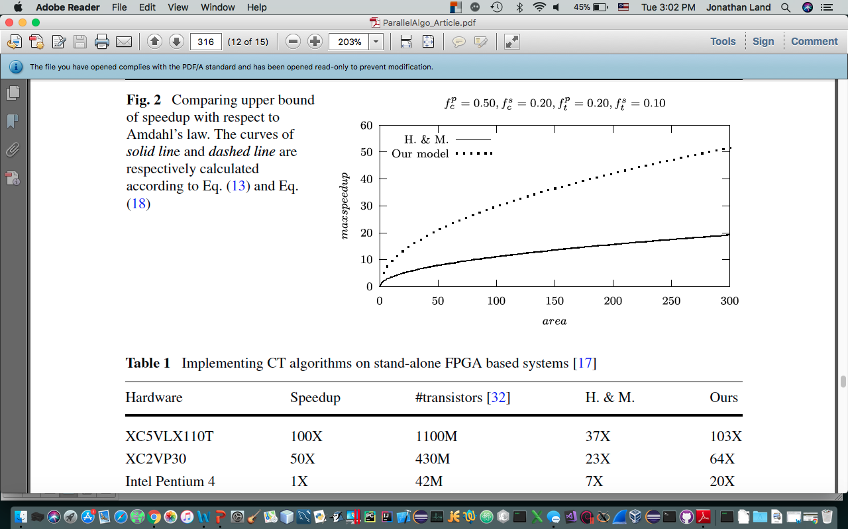
Case Study (contd.)
Compares upper bound of speedup with Amdahl’s law
The solid line represents Hill & Marty’s model
The dotted line represents the viewpoint of the authors
Authors argue that their model promises greater speedup
They are more optimistic than Hill and Marty’s study (Hill and Marty focused on parallelism of computation, not workload of transmission )
Table 1 also shows that Hill and Marty underestimate the speedup since they ignored interconnections in their research.

Slide 20
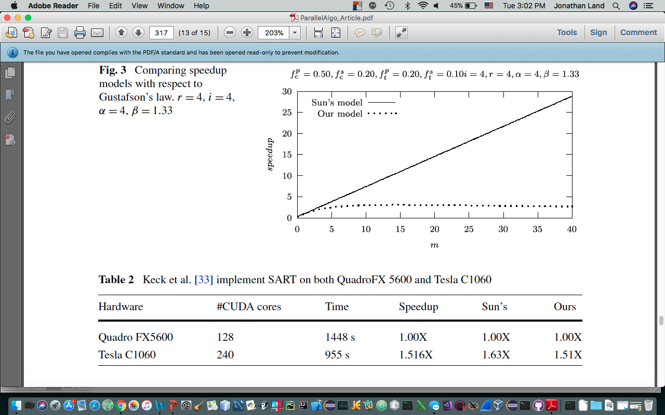
Case Study (contd.)
The dashed line represents the speedup of the author’s extensions
Their model quickly reaches an upper bound, then decreases at a slow rate
Compared to some studies (i.e., Sun’s), this is more pessimistic regarding speedup.
So, a mediating cost model

Slide 21
IV. Research suggestions

Slide 22
IV. Research suggestions
Continued research on hardware advances (multi-core chips) that reduce the interconnect bottleneck issue.
To follow these research guidelines when considering speedup:
Deal with interconnects at the initial phase of architectural designs
For a fixed-size problem with a given silicon area, the optimized number of cores and interconnects are respectively related to the parallelism of computation and transmission workload of a task.
The upper bound speedup of architecture is closely related to the task running on it and the silicon area it costs.
The area percentage spent on cores and interconnects is basically determined by the computation-to-transmission workload ratio of a task.

Slide 23
Summarizing this Summary
Just because there is speedup theoretically, does not necessarily mean that there is speedup actually.
Amdahl’s and Gustafson's laws should be interpreted in light of present-day hardware advances, as well as the limitations and tradeoffs that these advances bring with them (as of yet, there is no “perfect” system).
Interconnects have a major influence on the performance of multi-core systems.

