Slide 1
Dynamic Programming
CPSC 5210 Design and Analysis of Computer Algorithms
Fall 2017
Howell, Roland / Land, Jonathan / Saied, Noman

Slide 2
Dynamic Programming: Presentation Outline
Dynamic Programming: An Introduction
Fibonacci Numbers
Longest Common Subsequence
Knapsack Problem

Slide 3
Dynamic Programming
I. An Introduction

Slide 4
I. Dynamic Programming: An Introduction
What is dynamic programming (DP)?
Dynamic Programming (DP) is difficult to characterize. Generally, it is an approach or technique for solving problems in order to arrive at more optimized solutions without repeated work.
In order to better define/understand DP, we can compare and contrast this with the Divide and Conquer method (D&C).
How DP is similar to D&C: The thought process. For example, the D&C method takes a large
problem and breaks it into smaller parts. DP also does this.
Partition the problem into sub-problems
Recurse to solve the sub-problems
Join the solutions to sub-problems in order to arrive at a solution
Notes:
DP: recursion + memoization
technique to avoid cost of recalculation

Slide 5
I. Dynamic Programming: An Introduction
What is dynamic programming (DP)? (contd.)
How DP is different from D&C:
The D&C method repeatedly solves common sub-problems, whereas DP solves and saves repeated sub-problems to be re-used. (avoiding unnecessary work/recalculation).
In D&C algorithms the sub-problems are often unrelated (e.g., merge sort – sorting each half can be done independently), whereas in DP algorithms, the sub-problems are interrelated or overlap.

Slide 6
I. Dynamic Programming: An Introduction
As an approach/technique, when does DP work best?
Generally, when applied to optimization problems or brute force algorithms that have repeated calculations
Specifically, when D&C algorithmic solutions result in exponential time

Slide 7
I. Dynamic Programming: An Introduction
What are the main steps to implement DP algorithms?
Characterize the structure of an optimal solution
Recursively define the value of an optimal solution
Compute the value of an optimal solution (top-down and bottom-up approaches are valid options)
Construct an optimal solution from computed information

Slide 8
I. Dynamic Programming: An Introduction
What are the main ways to implement DP algorithms?
Top-down DP
Start with largest problem/value
Solve the problem recursively, as needed
Save the result(s) of the sub-problem in a data structure (e.g., hashtable, linked list, array, etc.).
Solutions are memoized or remembered (i.e., the results are cached)
Bottom-up DP
Depends on calculating smaller sub-problems first, then the larger sub-problems (sub-problems are sorted smallest to largest)
Repeated calculations are pre-computed
Algorithms are iterative

Slide 9
I. Dynamic Programming: An Introduction
While top-down and bottom up approaches are both valid options to implement DP algorithms, there are trade-offs.
“In general practice, if all subproblems must be solved at least once, a bottom-up dynamic-programming algorithm usually outperforms the corresponding top-down memoized algorithm by a constant factor, because the bottom-up algorithm has no overhead for recursion and less overhead for maintaining the table. Moreover, for some problems we can exploit the regular pattern of table accesses in the dynamic programming algorithm to reduce time or space requirements even further. Alternatively, if some subproblems in the subproblem space need not be solved at all, the memoized solution has the advantage of solving only those subproblems that are definitely required (Introduction to Algorithms, 289).

Slide 10
Dynamic Programming
Fibonacci Numbers

Slide 11
II. Dynamic Programming: Fibonacci Numbers
The Fibonacci sequence is a classic recursive example
Sequence: fib(n) = fib(n-1) + fib(n-2)
The idea: We have the first two Fibonacci numbers 0, 1 and then to get the rest we calculate the two previous numbers and add them successively until finding the n value.
Fib (0) = 0
Fib (1) = 1
Fib (2) = 1
Fib (3) = 2
Fib (4) = 3
Fib (5) = 5
Fib (6) = 8
etc.,

Slide 12
II. Dynamic Programming: Fibonacci Numbers
Common Non-DP/non-memoized algorithm for Fibonacci Numbers
public class Fibonacci
{
public static long fib(long n)
{
if (n == 0)
{
return 0;
}
else if (n == 1)
{
return 1;
}
else
{
return fib(n - 1) + fib(n - 2);
}
}

Slide 13
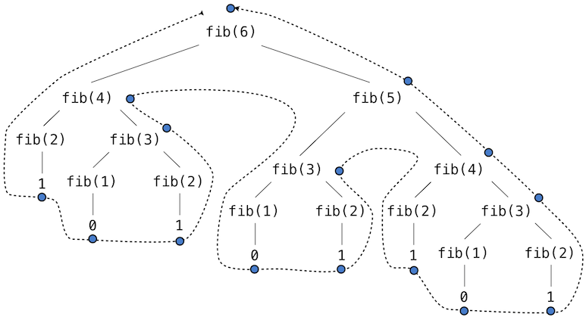
II. Dynamic Programming: Fibonacci Numbers
Non-DP/non-memoized Fibonacci tree illustration
Issues
Repeated calculations
fib(4) – calculated 2 times
fib(3) – calculated 3 times
fib (2) – calculated five times
Etc.,
Run-time grows as n grows (steps are doubled at each level 2^n)
NOTE: The recursive calls are not independent (they overlap), so DP can apply in this case.

Slide 14
II. Dynamic Programming: Fibonacci Numbers
Non-DP/non-memoized Fibonacci time complexity:
Lower Bound:
T(n-1) ≥ T(n-2)
T(n) = T(n-1) + T(n-2) + 4 ≥ T(n-2) + T(n-2) + 4
= 2T(n-2) + 4
≥ 2 (2T(n-4) + 4) + 4
…
≥ 2^k T(n-2k) + (2^k-1) * c
=

Slide 15
II. Dynamic Programming: Fibonacci Numbers
Non-DP/non-memoized Fibonacci time complexity:
Upper-bound:
T(n-1) ≥ T(n-2)
T(n) = T(n-1) + T(n-2) + 4 ≤ T(n-1) + T(n-1) + 4
= 2T(n-1) + 4
≤
…
T(n) ≤ 2^n T(0) + (2^n-1) * c
= O

Slide 16
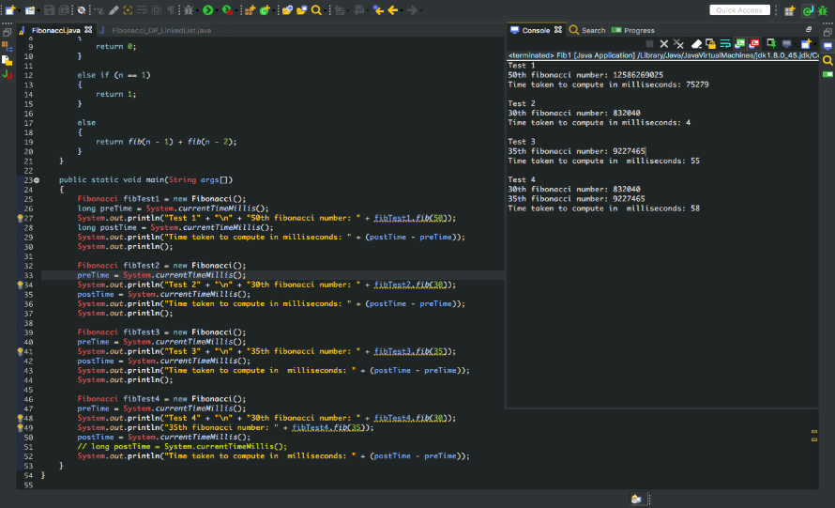
II. Dynamic Programming: Fibonacci Numbers
Non-DP/non-memoized Fibonacci time test - Fib(50) = 75279 ms or 75.279 sec

Slide 17
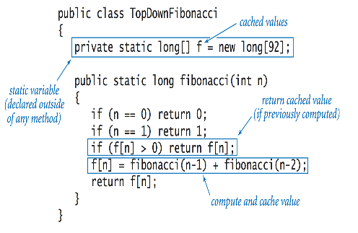
II. Dynamic Programming: Fibonacci Numbers
Example of top-down DP Fibonacci
Example of bottom-up DP Fibonacci
int fibonacci(int n)
{
int fib[ ];
fib[0] = 1;
fib[1] = 1;
for(int i = 2; i<=n; i++)
{
fib[i] = fib[i - 2] + fib[i-1];
}
return fib[n];
}
Note: Recursive
Note: Iterative

Slide 18
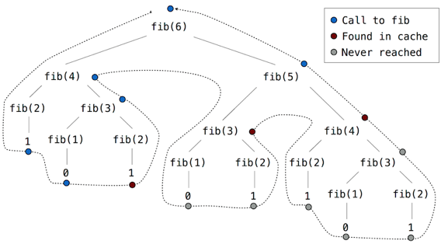
II. Dynamic Programming: Fibonacci Numbers
DP/Memoized Fibonacci tree

Slide 19
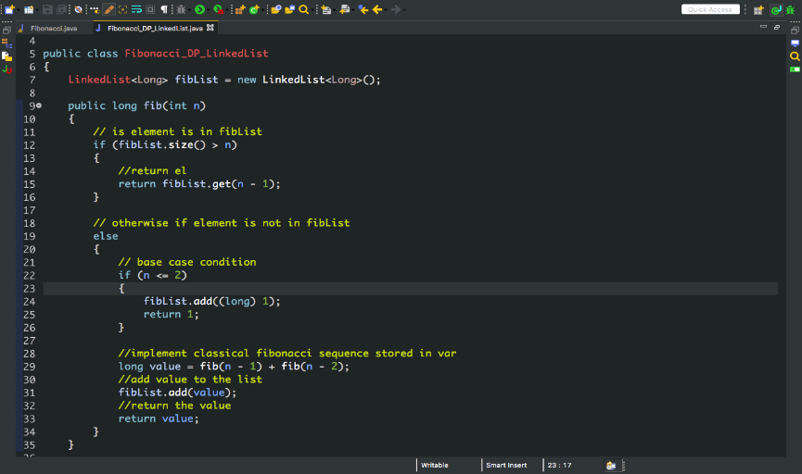
II. Dynamic Programming: Fibonacci Numbers
Memoized algorithm for Fibonacci Numbers using a LinkedList

Slide 20
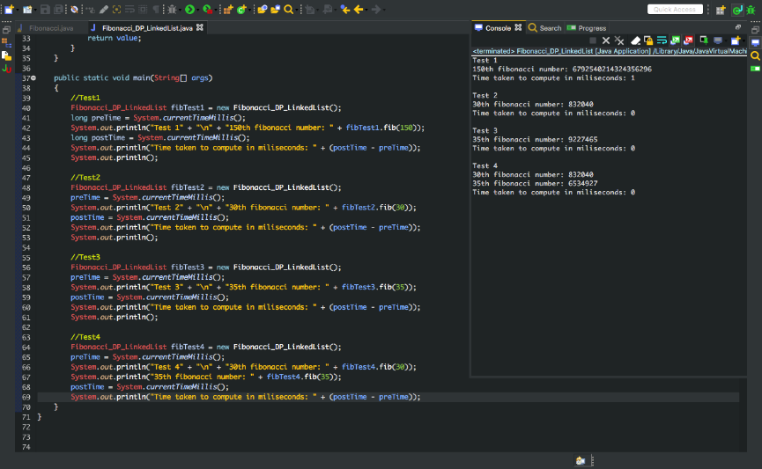
II. Dynamic Programming: Fibonacci Numbers
DP/Memoized Fibonacci time test - Fib(150) = 1 ms or 0.001 sec.

Slide 21
II. Dynamic Programming: Fibonacci Numbers
Non-DP/non-memoized Fibonacci
Test 1
fib(50): 75279 ms or 75.279 sec
Test 2
Fib(30): 4 ms or 0.004 sec
Test 3
fib(35): 55 ms or 0.055 sec
Test 4
fib(30): 58 ms or 0.058 sec
fib(35): 58 ms or 0.058 sec
DP/memoized Fibonacci
Test 1
fib(150): 1 ms / 0.001 sec
Test 2
Fib(30): 0 ms < 0.001 sec
Test 3
fib(35): 0 ms < 0.001 sec
Test 4
fib(30): 0 ms < 0.001 sec
fib(35): 0 ms < 0.001 sec

Slide 22
II. Dynamic Programming: Fibonacci Numbers
DP/memoized Fibonacci time complexity:
Recurrence:
T(n) = T(n-1) + s(n-2) + c
≤ T(n-1) + 2c
≤ T(n-2) + 4c
≤ T(n-3) + 6c
≤ T(0) + (2c) * n
= O(n)
Notes:
S(n) is the second call that is being stored in linked list
C – term calculated first then second call to this

Slide 23
II. Dynamic Programming: Fibonacci Numbers
Strengths of DP approach:
Great way to approach optimizing algorithms
Applying a DP/memoized solution to the Fibonacci numbers reduces exponential time to linear time (Note: there are logarithmic solutions also).
Since repetitive operations are stored in a data structure of some kind, branching is reduced (only re-curse as deep as the values are stored).
Weakness of DP approach:
Memoization using recursion still adds overhead
That said, depending on what data structure is used, the space complexity can be improved.

Slide 24
Dynamic Programming: Fibonacci Numbers (Bibliography)
Thomas H. Cormen, Charles E. Leiserson, Ronald L. Rivest, Clifford Stein, Introduction to Algorithms. 3rd Edition. Cambridge, Massachusetts: The MIT Press, 2009.
“Dynamic Programming I: Fibonacci, Shortest Paths.” MIT 6.006 Introduction to Algorithms. Released January 14, 2013. https://www.youtube.com/watch?v=OQ5jsbhAv_M. Accessed October 25, 2017.
https://introcs.cs.princeton.edu/java/23recursion/images/dynamic-programming-top-down.png
“Dynamic Programming [Top-Down vs. Bottom-Up Approach].” Released April 5, 2013. https://www.youtube.com/watch?v=n5kvaPME8SQ. Accessed October 25, 2017.
http://composingprograms.com/img/fib.png
http://composingprograms.com/img/fib_memo.png

Slide 25
III. Longest common subsequence problem

Slide 26
Longest common subsequence (LCS)
Given two sequences of items (Strings, files, numbers, etc.) Ex. DNA sequences dna1 = GACCCGTA, dna2 = TTGCTCCA
A common subsequence is not required to be consecutive, but must maintain the same order. Ex. “roots” is a subsequence of “robotics”
Finding the longest such sequence between the two sequences is the goal.

Slide 27
Brute Force Method
Consider two strings, x and y, of length m and n.
The number of subsequences of x is equal to the size of the powerset of x, 2^{m}.
Each of these subsequence must be compared to the characters in y, so n comparisons.
Running time is O(n∙ 2^{m}). Exponential growth quickly becomes computationally expensive
Can we use dynamic programming to improve?

Slide 28
Dynamic Programming Approach
The LCS problem has:
Optimal substructure, that is, the solution to subproblems are parts of final solution. Ex. The LCS between “roo” and “rob” is part of the LCS between “roots” and “robotics”
We can use this property to improve the algorithm.
Let x_{i} and y_{j} be the prefixes (i.e. substring starting at 0) of length i and j.
Define c[i, j] to be the length of LCS of x_{i} and y_{j} recursively:

Slide 29
Dynamic LCS
Problem: previous definition is still exponential. Each max() makes 2 new LCS calls
Solution: Memoization – keeping results from previous subproblems (recording a memo) so they don’t have to be recalculated. An m+1 by n+1 matrix stores the results for each [i,j] combination
The first row and column represent the length of LCS of empty strings so are all 0. We have m∙n comparisons to make, time complexity is O(m∙n).
However we have traded time for space: Two 4 KB length ASCII strings require 16 MB of storage. 2¹² x 2¹² = 2²⁴ bytes

Slide 30
Example
Two DNA sequences:
x = GACCCGTA y = TTGCTCCA
 | j | 0 | 1 | 2 | 3 | 4 | 5 | 6 | 7 | 8
i |  | y_{j} | T | T | G | C | T | C | C | A
0 | x_{i}
1 | G
2 | A
3 | C
4 | C
5 | C
6 | G
7 | T
8 | A

Slide 31
Example
First fill in the 0’s for the empty strings. These are the base cases.
 | j | 0 | 1 | 2 | 3 | 4 | 5 | 6 | 7 | 8
i |  | y_{j} | T | T | G | C | T | C | C | A
0 | x_{i} | 0 | 0 | 0 | 0 | 0 | 0 | 0 | 0 | 0
1 | G | 0
2 | A | 0
3 | C | 0
4 | C | 0
5 | C | 0
6 | G | 0
7 | T | 0
8 | A | 0

Slide 32
Example
Iterate through the comparisons.
 | j | 0 | 1 | 2 | 3 | 4 | 5 | 6 | 7 | 8
i |  | y_{j} | T | T | G | C | T | C | C | A
0 | x_{i} | 0 | 0 | 0 | 0 | 0 | 0 | 0 | 0 | 0
1 | G | 0 | 0 | 0 | 1
2 | A | 0
3 | C | 0
4 | C | 0
5 | C | 0
6 | G | 0
7 | T | 0
8 | A | 0

Slide 33
Example
Iterate through the comparisons.
 | j | 0 | 1 | 2 | 3 | 4 | 5 | 6 | 7 | 8
i |  | y_{j} | T | T | G | C | T | C | C | A
0 | x_{i} | 0 | 0 | 0 | 0 | 0 | 0 | 0 | 0 | 0
1 | G | 0 | 0 | 0 | 1 | 1 | 1 | 1 | 1 | 1
2 | A | 0
3 | C | 0
4 | C | 0
5 | C | 0
6 | G | 0
7 | T | 0
8 | A | 0

Slide 34
Example
Iterate through the comparisons.
 | j | 0 | 1 | 2 | 3 | 4 | 5 | 6 | 7 | 8
i |  | y_{j} | T | T | G | C | T | C | C | A
0 | x_{i} | 0 | 0 | 0 | 0 | 0 | 0 | 0 | 0 | 0
1 | G | 0 | 0 | 0 | 1 | 1 | 1 | 1 | 1 | 1
2 | A | 0 | 0 | 0 | 1
3 | C | 0
4 | C | 0
5 | C | 0
6 | G | 0
7 | T | 0
8 | A | 0

Slide 35
Example
Iterate through the comparisons.
 | j | 0 | 1 | 2 | 3 | 4 | 5 | 6 | 7 | 8
i |  | y_{j} | T | T | G | C | T | C | C | A
0 | x_{i} | 0 | 0 | 0 | 0 | 0 | 0 | 0 | 0 | 0
1 | G | 0 | 0 | 0 | 1 | 1 | 1 | 1 | 1 | 1
2 | A | 0 | 0 | 0 | 1 | 1 | 1 | 1 | 1 | 2
3 | C | 0
4 | C | 0
5 | C | 0
6 | G | 0
7 | T | 0
8 | A | 0

Slide 36
Example
Iterate through the comparisons.
 | j | 0 | 1 | 2 | 3 | 4 | 5 | 6 | 7 | 8
i |  | y_{j} | T | T | G | C | T | C | C | A
0 | x_{i} | 0 | 0 | 0 | 0 | 0 | 0 | 0 | 0 | 0
1 | G | 0 | 0 | 0 | 1 | 1 | 1 | 1 | 1 | 1
2 | A | 0 | 0 | 0 | 1 | 1 | 1 | 1 | 1 | 2
3 | C | 0 | 0 | 0 | 1 | 2 | 2 | 2 | 2 | 2
4 | C | 0
5 | C | 0
6 | G | 0
7 | T | 0
8 | A | 0

Slide 37
Example
Iterate through the comparisons.
 | j | 0 | 1 | 2 | 3 | 4 | 5 | 6 | 7 | 8
i |  | y_{j} | T | T | G | C | T | C | C | A
0 | x_{i} | 0 | 0 | 0 | 0 | 0 | 0 | 0 | 0 | 0
1 | G | 0 | 0 | 0 | 1 | 1 | 1 | 1 | 1 | 1
2 | A | 0 | 0 | 0 | 1 | 1 | 1 | 1 | 1 | 2
3 | C | 0 | 0 | 0 | 1 | 2 | 2 | 2 | 2 | 2
4 | C | 0 | 0 | 0 | 1 | 2 | 2 | 3 | 3 | 3
5 | C | 0
6 | G | 0
7 | T | 0
8 | A | 0

Slide 38
Example
Iterate through the comparisons.
 | j | 0 | 1 | 2 | 3 | 4 | 5 | 6 | 7 | 8
i |  | y_{j} | T | T | G | C | T | C | C | A
0 | x_{i} | 0 | 0 | 0 | 0 | 0 | 0 | 0 | 0 | 0
1 | G | 0 | 0 | 0 | 1 | 1 | 1 | 1 | 1 | 1
2 | A | 0 | 0 | 0 | 1 | 1 | 1 | 1 | 1 | 2
3 | C | 0 | 0 | 0 | 1 | 2 | 2 | 2 | 2 | 2
4 | C | 0 | 0 | 0 | 1 | 2 | 2 | 3 | 3 | 3
5 | C | 0 | 0 | 0 | 1 | 2 | 2 | 3 | 4 | 4
6 | G | 0
7 | T | 0
8 | A | 0

Slide 39
Example
Iterate through the comparisons.
 | j | 0 | 1 | 2 | 3 | 4 | 5 | 6 | 7 | 8
i |  | y_{j} | T | T | G | C | T | C | C | A
0 | x_{i} | 0 | 0 | 0 | 0 | 0 | 0 | 0 | 0 | 0
1 | G | 0 | 0 | 0 | 1 | 1 | 1 | 1 | 1 | 1
2 | A | 0 | 0 | 0 | 1 | 1 | 1 | 1 | 1 | 2
3 | C | 0 | 0 | 0 | 1 | 2 | 2 | 2 | 2 | 2
4 | C | 0 | 0 | 0 | 1 | 2 | 2 | 3 | 3 | 3
5 | C | 0 | 0 | 0 | 1 | 2 | 2 | 3 | 4 | 4
6 | G | 0 | 0 | 0 | 1 | 2 | 2 | 3 | 4 | 4
7 | T | 0
8 | A | 0

Slide 40
Example
Iterate through the comparisons.
 | j | 0 | 1 | 2 | 3 | 4 | 5 | 6 | 7 | 8
i |  | y_{j} | T | T | G | C | T | C | C | A
0 | x_{i} | 0 | 0 | 0 | 0 | 0 | 0 | 0 | 0 | 0
1 | G | 0 | 0 | 0 | 1 | 1 | 1 | 1 | 1 | 1
2 | A | 0 | 0 | 0 | 1 | 1 | 1 | 1 | 1 | 2
3 | C | 0 | 0 | 0 | 1 | 2 | 2 | 2 | 2 | 2
4 | C | 0 | 0 | 0 | 1 | 2 | 2 | 3 | 3 | 3
5 | C | 0 | 0 | 0 | 1 | 2 | 2 | 3 | 4 | 4
6 | G | 0 | 0 | 0 | 1 | 2 | 2 | 3 | 4 | 4
7 | T | 0 | 1 | 1 | 1 | 2 | 3 | 3 | 4 | 4
8 | A | 0

Slide 41
Example
Iterate through the comparisons.
 | j | 0 | 1 | 2 | 3 | 4 | 5 | 6 | 7 | 8
i |  | y_{j} | T | T | G | C | T | C | C | A
0 | x_{i} | 0 | 0 | 0 | 0 | 0 | 0 | 0 | 0 | 0
1 | G | 0 | 0 | 0 | 1 | 1 | 1 | 1 | 1 | 1
2 | A | 0 | 0 | 0 | 1 | 1 | 1 | 1 | 1 | 2
3 | C | 0 | 0 | 0 | 1 | 2 | 2 | 2 | 2 | 2
4 | C | 0 | 0 | 0 | 1 | 2 | 2 | 3 | 3 | 3
5 | C | 0 | 0 | 0 | 1 | 2 | 2 | 3 | 4 | 4
6 | G | 0 | 0 | 0 | 1 | 2 | 2 | 3 | 4 | 4
7 | T | 0 | 1 | 1 | 1 | 2 | 3 | 3 | 4 | 4
8 | A | 0 | 1 | 1 | 1 | 2 | 3 | 3 | 4 | 5

Slide 42
Example
The bottom corner c[m,n] contains the length of the LCS.
 | j | 0 | 1 | 2 | 3 | 4 | 5 | 6 | 7 | 8
i |  | y_{j} | T | T | G | C | T | C | C | A
0 | x_{i} | 0 | 0 | 0 | 0 | 0 | 0 | 0 | 0 | 0
1 | G | 0 | 0 | 0 | 1 | 1 | 1 | 1 | 1 | 1
2 | A | 0 | 0 | 0 | 1 | 1 | 1 | 1 | 1 | 2
3 | C | 0 | 0 | 0 | 1 | 2 | 2 | 2 | 2 | 2
4 | C | 0 | 0 | 0 | 1 | 2 | 2 | 3 | 3 | 3
5 | C | 0 | 0 | 0 | 1 | 2 | 2 | 3 | 4 | 4
6 | G | 0 | 0 | 0 | 1 | 2 | 2 | 3 | 4 | 4
7 | T | 0 | 1 | 1 | 1 | 2 | 3 | 3 | 4 | 4
8 | A | 0 | 1 | 1 | 1 | 2 | 3 | 3 | 4 | 5

Slide 43
Recreating the LCS
The length of the LCS has been found, but now to retrieve the actual sequence
Start in the bottom corner, c[m, n] and work backwards using the same definition.
If x_{i} = y_{j} , append that character to the sequence
Otherwise move up or left, whichever is largest. If you have a choice, pick a direction. There may be multiple LCS, but we will only trace back one of them.

Slide 44
Example
Traceback until 0 is reached.
 | j | 0 | 1 | 2 | 3 | 4 | 5 | 6 | 7 | 8
i |  | y_{j} | T | T | G | C | T | C | C | A
0 | x_{i} | 0 | 0 | 0 | 0 | 0 | 0 | 0 | 0 | 0
1 | G | 0 | 0 | 0 | 1 | 1 | 1 | 1 | 1 | 1
2 | A | 0 | 0 | 0 | 1 | 1 | 1 | 1 | 1 | 2
3 | C | 0 | 0 | 0 | 1 | 2 | 2 | 2 | 2 | 2
4 | C | 0 | 0 | 0 | 1 | 2 | 2 | 3 | 3 | 3
5 | C | 0 | 0 | 0 | 1 | 2 | 2 | 3 | 4 | 4
6 | G | 0 | 0 | 0 | 1 | 2 | 2 | 3 | 4 | 4
7 | T | 0 | 1 | 1 | 1 | 2 | 3 | 3 | 4 | 4
8 | A | 0 | 1 | 1 | 1 | 2 | 3 | 3 | 4 | 5

Slide 45
Recreating the LCS
From the previous slide we got ACCCG.
This is the LCS, but reversed.
Reversing the string gives us the actual LCS, GCCCA.
Tracing back the LCS takes O(m + n) worst case.
Reversing the LCS takes O(length of LCS). Worst case is LCS is as long as the shorter of m and n.
Total time is O(m·n) + O(m+n) + O(min(m,n)).
This is much better than O(n∙ 2^{m}).

Slide 46
Java code demo
Running the same example

Slide 47
Optimizations
Since the matrix grows with the product m·n, for longer files treat entire lines as single elements. Ex. Linux ‘diff’ command
Change strings to hashes to save space -Precomputing hashes takes time -Possible collisions
If only the LCS length is needed, reduce matrix to two rows, current and previous.

Slide 48
Sources
Thomas H. Cormen, Charles E. Leiserson, Ronald L. Rivest, Clifford Stein, Introduction to Algorithms. 3rd Edition. Cambridge, Massachusetts: The MIT Press, 2009.
https://en.wikipedia.org/wiki/Longest_common_subsequence_problem
http://www.cs.cmu.edu/afs/cs/academic/class/15451-s15/LectureNotes/lecture04.pdf
From this course’s materials: lecture32-dynamicProgramming-II.ppt
“An O(ND) Difference Algorithm and Its Variations” http://www.xmailserver.org/diff2.pdf

Slide 49
0-1 Knapsack problem
Notes:
Information and notes from Dr. David Luebke, University of Virginia modified by Dr. Ying Lu from University of Nebraska–Lincoln

Slide 50
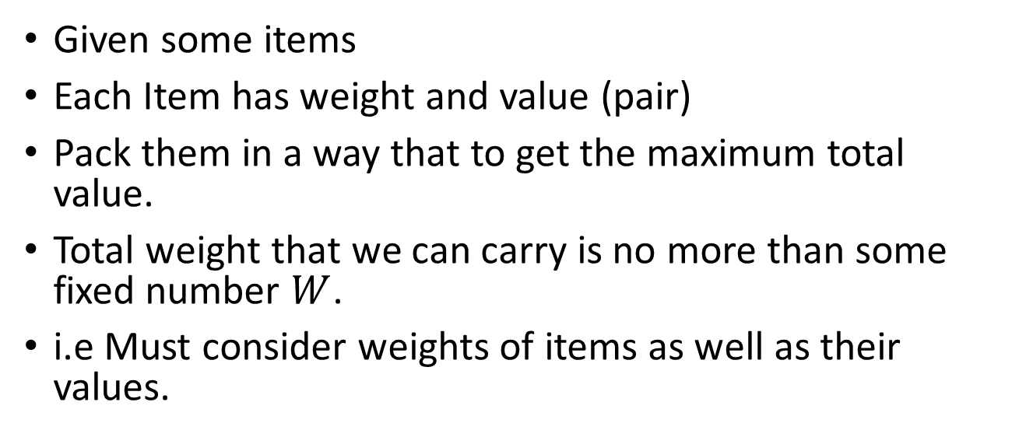
0-1 Knapsack
Given some items
Each Item has weight and value (pair)
Pack them in a way that to get the maximum total value.
Total weight that we can carry is no more than some fixed number $W$.
i.e Must consider weights of items as well as their values.
Item | Weigh | Value
a | 1 | 1
b | 3 | 4
c | 4 | 5
d | 5 | 7
e | 2 | 4

Slide 51
0-1 Knapsack
There are two versions of the problem:
0-1 knapsack problem
Items are indivisible; you either take an item or not. Some special instances can be solved with dynamic programming
Fractional knapsack problem
Items are divisible: you can take any fraction of an item

Slide 52
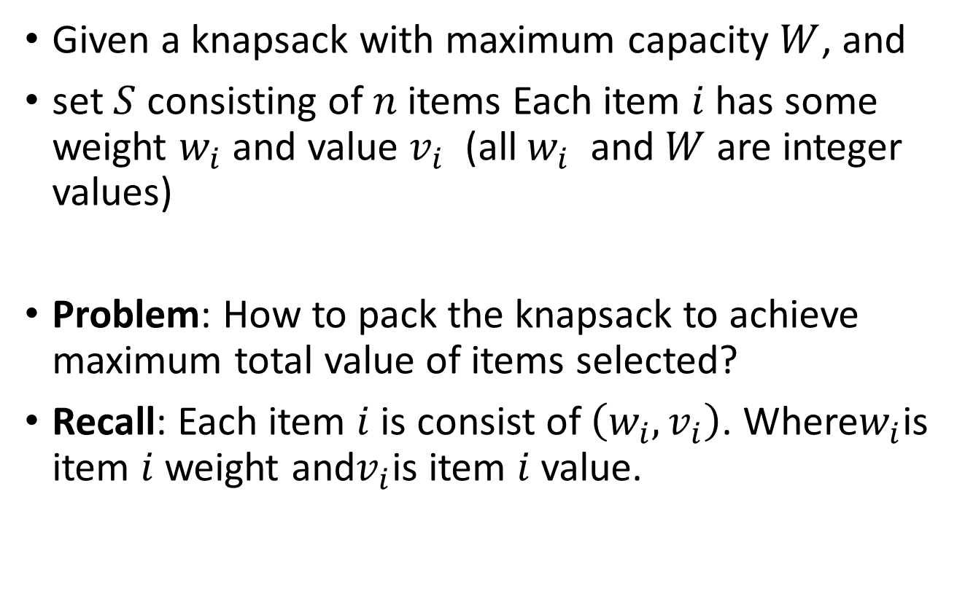
0-1 Knapsack
Given a knapsack with maximum capacity $W$, and
set $S$ consisting of $n$items Each item $i$ has some weight $w_{i}$ and value $v_{i}$ (all $w_{i}$ and $W$ are integer values)
Problem: How to pack the knapsack to achieve maximum total value of items selected?
Recall: Each item $i$ is consist of $\left(w_{i}, v_{i}\right)$. Where$w_{i}$is item $i$weight and$v_{i}$is item $i$value.

Slide 53

0-1 Knapsack
Problem in mathematical notation:
$$max\sum_{i ∈T}{v_{i} subject to\sum_{i ∈T}{w_{i}}} ≤W$$

Slide 54
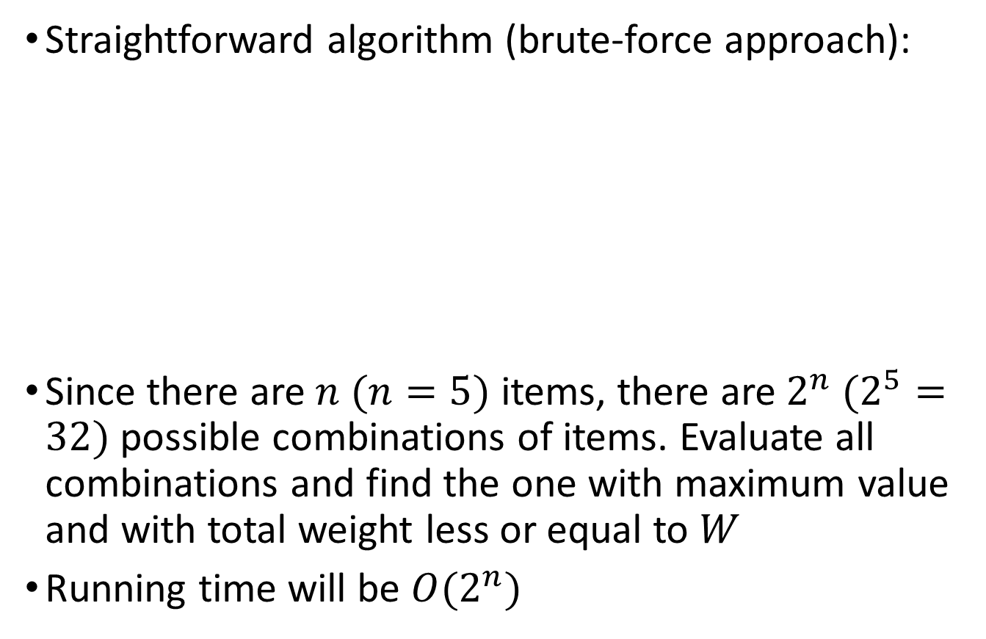
0-1 Knapsack
Straightforward algorithm (brute-force approach):
Since there are $n (n=5)$ items, there are $2^{n} (2^{5}=32)$ possible combinations of items. Evaluate all combinations and find the one with maximum value and with total weight less or equal to $W$
Running time will be $O(2^{n})$
Item | Weigh | Value
a | 1 | 1
b | 3 | 4
c | 4 | 5
d | 5 | 7
e | 2 | 4

Slide 55
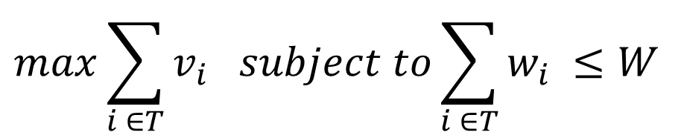
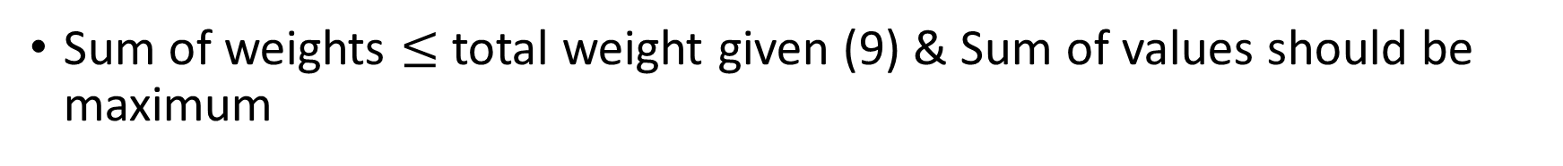
0-1 Knapsack
Items | Sum of Weights | Sum of Values
Total Weight $W$desired is 9
Item | Weigh | Value
a | 1 | 1
b | 3 | 4
c | 4 | 5
d | 5 | 7
e | 2 | 4
$$max\sum_{i ∈T}{v_{i} subject to\sum_{i ∈T}{w_{i}}} ≤W$$
Sum of weights total weight given (9) & Sum of values should be maximum

Slide 56
0-1 Knapsack
Items | Sum of Weights | Sum of Values
Total Weight $W$desired is 9
Item | Weigh | Value
a | 1 | 1
b | 3 | 4
c | 4 | 5
d | 5 | 7
e | 2 | 4
$$max\sum_{i ∈T}{v_{i} subject to\sum_{i ∈T}{w_{i}}} ≤W$$
Sum of weights total weight given (9) & Sum of values should be maximum

Slide 57
0-1 Knapsack
Items | Sum of Weights | Sum of Values
Total Weight $W$desired is 9
Item | Weigh | Value
a | 1 | 1
b | 3 | 4
c | 4 | 5
d | 5 | 7
e | 2 | 4
$$max\sum_{i ∈T}{v_{i} subject to\sum_{i ∈T}{w_{i}}} ≤W$$
Sum of weights total weight given (9) & Sum of values should be maximum

Slide 58
0-1 Knapsack
Items | Sum of Weights | Sum of Values
 |  | 3
Total Weight $W$desired is 9
Item | Weigh | Value
a | 1 | 1
b | 3 | 4
c | 4 | 5
d | 5 | 7
e | 2 | 4
$$max\sum_{i ∈T}{v_{i} subject to\sum_{i ∈T}{w_{i}}} ≤W$$
Sum of weights total weight given (9) & Sum of values should be maximum

Slide 59
0-1 Knapsack
Items | Sum of Weights | Sum of Values
 |  | 3
Total Weight $W$desired is 9
Item | Weigh | Value
a | 1 | 1
b | 3 | 4
c | 4 | 5
d | 5 | 7
e | 2 | 4
$$max\sum_{i ∈T}{v_{i} subject to\sum_{i ∈T}{w_{i}}} ≤W$$
Sum of weights total weight given (9) & Sum of values should be maximum

Slide 60
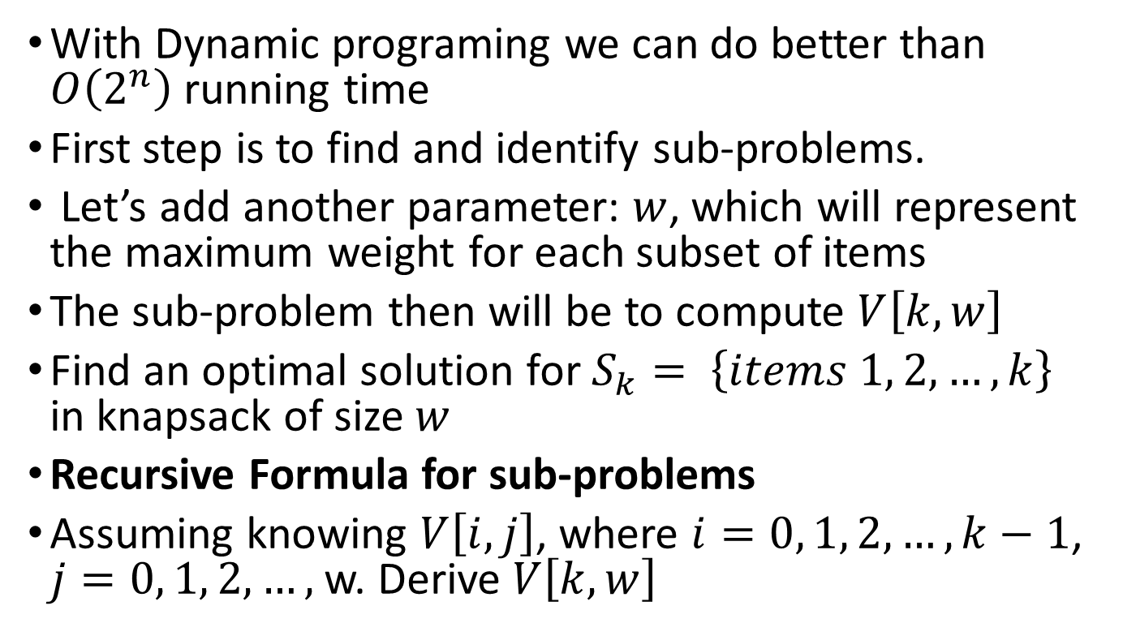
0-1 Knapsack
With Dynamic programing we can do better than $O\left(2^{n}\right)$ running time
First step is to find and identify sub-problems.
Let’s add another parameter: $w$, which will represent the maximum weight for each subset of items
The sub-problem then will be to compute $V\left[k, w\right]$
Find an optimal solution for $S_{k}= \left\{items 1, 2, …, k\right\}$ in knapsack of size $w$
Recursive Formula for sub-problems
Assuming knowing $V\left[i, j\right]$, where $i=0, 1, 2, …, k−1$, $j=0, 1, 2, …,$w. Derive $V\left[k, w\right]$

Slide 61
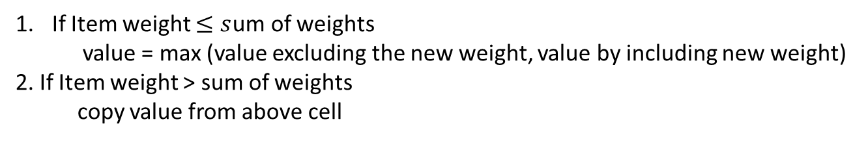
0-1 Knapsack
Total Weight $W$desired is 9
Sum of Weights
Item | Weigh | Value
a | 1 | 1
e | 2 | 4
b | 3 | 4
c | 4 | 5
d | 5 | 7
0 | 1 | 2 | 3 | 4 | 5 | 6 | 7 | 8 | 9
If Item weight $≤s$um of weights
value = max (value excluding the new weight, value by including new weight)
2. If Item weight > sum of weights
copy value from above cell
Include the new weight and it value
Remaining weight, get the value from the above row (sum of weight – new weight)

Slide 62
0-1 Knapsack
Total Weight $W$desired is 9
Sum of Weights
Item | Weigh | Value
a | 1 | 1
e | 2 | 4
b | 3 | 4
c | 4 | 5
d | 5 | 7
0 | 1 | 2 | 3 | 4 | 5 | 6 | 7 | 8 | 9
0
0
0
0
0
If Item weight $≤s$um of weights
value = max (value excluding the new weight, value by including new weight)
2. If Item weight > sum of weights
copy value from above cell
Include the new weight and it value
Remaining weight, get the value from the above row (sum of weight – new weight)

Slide 63
0-1 Knapsack
Total Weight $W$desired is 9
Sum of Weights
Item | Weigh | Value
a | 1 | 1
e | 2 | 4
b | 3 | 4
c | 4 | 5
d | 5 | 7
0 | 1 | 2 | 3 | 4 | 5 | 6 | 7 | 8 | 9
0 | 1 | 1 | 1 | 1 | 1 | 1 | 1 | 1 | 1
0
0
0
0
If Item weight $≤s$um of weights
value = max (value excluding the new weight, value by including new weight)
2. If Item weight > sum of weights
copy value from above cell
Include the new weight and it value
Remaining weight, get the value from the above row (sum of weight – new weight)

Slide 64
0-1 Knapsack
Total Weight $W$desired is 9
Sum of Weights
Item | Weigh | Value
a | 1 | 1
e | 2 | 4
b | 3 | 4
c | 4 | 5
d | 5 | 7
0 | 1 | 2 | 3 | 4 | 5 | 6 | 7 | 8 | 9
0 | 1 | 1 | 1 | 1 | 1 | 1 | 1 | 1 | 1
0 | 1 | 4 | 5 | 5 | 5 | 5 | 5 | 5 | 5
0
0
0
If Item weight $≤s$um of weights
value = max (value excluding the new weight, value by including new weight)
2. If Item weight > sum of weights
copy value from above cell
Include the new weight and it value
Remaining weight, get the value from the above row (sum of weight – new weight)

Slide 65
0-1 Knapsack
Total Weight $W$desired is 9
Sum of Weights
Item | Weigh | Value
a | 1 | 1
e | 2 | 4
b | 3 | 4
c | 4 | 5
d | 5 | 7
0 | 1 | 2 | 3 | 4 | 5 | 6 | 7 | 8 | 9
0 | 1 | 1 | 1 | 1 | 1 | 1 | 1 | 1 | 1
0 | 1 | 4 | 5 | 5 | 5 | 5 | 5 | 5 | 5
0 | 1 | 4 | 5 | 5 | 8 | 9 | 9 | 9 | 9
0
0
If Item weight $≤s$um of weights
value = max (value excluding the new weight, value by including new weight)
2. If Item weight > sum of weights
copy value from above cell
Include the new weight and it value
Remaining weight, get the value from the above row (sum of weight – new weight)

Slide 66
0-1 Knapsack
Total Weight $W$desired is 9
Sum of Weights
Item | Weigh | Value
a | 1 | 1
e | 2 | 4
b | 3 | 4
c | 4 | 5
d | 5 | 7
0 | 1 | 2 | 3 | 4 | 5 | 6 | 7 | 8 | 9
0 | 1 | 1 | 1 | 1 | 1 | 1 | 1 | 1 | 1
0 | 1 | 4 | 5 | 5 | 5 | 5 | 5 | 5 | 5
0 | 1 | 4 | 5 | 5 | 8 | 9 | 9 | 9 | 9
0 | 1 | 4 | 5 | 5 | 8 | 9 | 10 | 10 | 13
0
If Item weight $≤s$um of weights
value = max (value excluding the new weight, value by including new weight)
2. If Item weight > sum of weights
copy value from above cell
Include the new weight and it value
Remaining weight, get the value from the above row (sum of weight – new weight)

Slide 67
0-1 Knapsack
Total Weight $W$desired is 9
Sum of Weights
Item | Weigh | Value
a | 1 | 1
e | 2 | 4
b | 3 | 4
c | 4 | 5
d | 5 | 7
0 | 1 | 2 | 3 | 4 | 5 | 6 | 7 | 8 | 9
0 | 1 | 1 | 1 | 1 | 1 | 1 | 1 | 1 | 1
0 | 1 | 4 | 5 | 5 | 5 | 5 | 5 | 5 | 5
0 | 1 | 4 | 5 | 5 | 8 | 9 | 9 | 9 | 9
0 | 1 | 4 | 5 | 5 | 8 | 9 | 10 | 10 | 13
0 | 1 | 4 | 5 | 5 | 8 | 9 | 11 | 12 | 13
2-2=0
5-3=2
9–4=5
If Item weight $≤s$um of weights
value = max (value excluding the new weight, value by including new weight)
2. If Item weight > sum of weights
copy value from above cell
Include the new weight and it value
Remaining weight, get the value from the above row (sum of weight – new weight)

Slide 68
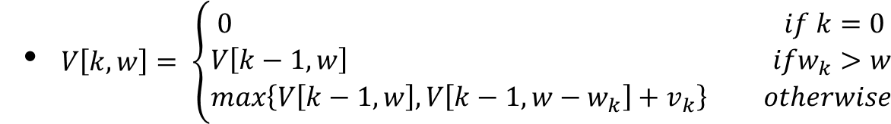
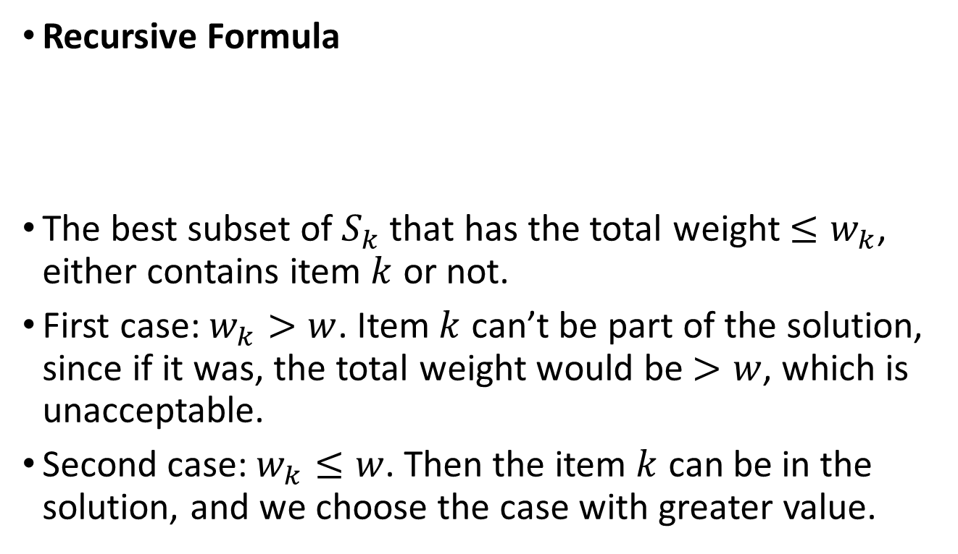
0-1 Knapsack
Recursive Formula
The best subset of that has the total weight , either contains item or not.
First case: . Item can’t be part of the solution, since if it was, the total weight would be , which is unacceptable.
Second case: . Then the item can be in the solution, and we choose the case with greater value.

Slide 69


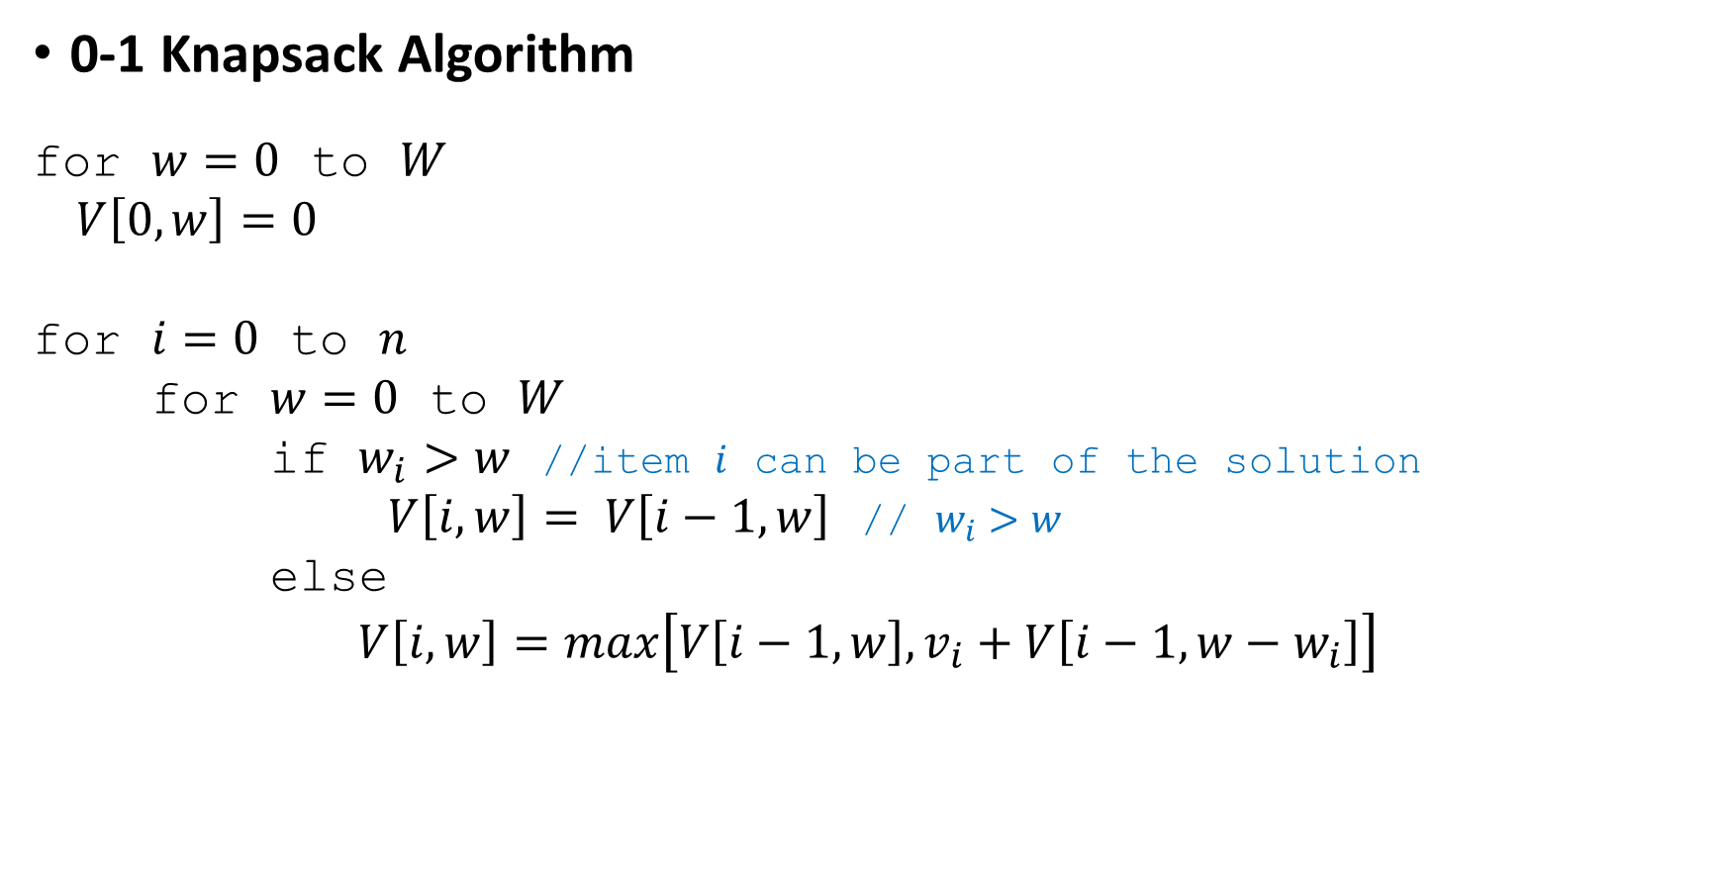
0-1 Knapsack
0-1 Knapsack Algorithm
for to
for to
for to
if //item can be part of the solution
//
else
$$O(W∗n)$$
Clearly time complexity is $O\left(W∗n\right)$, which is better than $2^{n}\text{.}$
$\text{Storage} \text{complexity} \text{is}$ $O\left(W∗n\right)$

Slide 70

0-1 Knapsack
Exercise
Total Weight $W$desired is 5
Given
Find the set that maximize the total value
Item | Weigh | Value
a | 2 | 3
b | 3 | 4
c | 4 | 5
d | 5 | 6

Slide 71
0-1 Knapsack
References
Information and notes from Dr. David Luebke, University of Virginia modified by Dr. Ying Lu from University of Nebraska–Lincoln
http://www.es.ele.tue.nl/education/5MC10/Solutions/knapsack.pdf
https://algorithmsandme.in/2014/01/12/dynamic-programming-0-1-knapsack-problem/
http://oucsace.cs.ohiou.edu/~razvan/courses/cs4040/lecture16.pdf
https://en.wikipedia.org/wiki/Knapsack_problem
https://www.youtube.com/watch?v=8LusJS5-AGo
https://www.youtube.com/watch?v=sVAB0p58tlg

Slide 72
Dynamic Programming: QUIZ
(T/F) DP is an approach or technique for solving problems in order to arrive at more optimized solutions without repeated work.
(T/F) A “memoized” DP algorithm is a top-down approach, where the values are cached in a data structure of some kind (e.g., array, linked list, hashtable, etc.)
(T/F) Dynamic programming algorithms can be implemented using top down or bottom up coding approaches.
(T/F) The worst case brute force LCS algorithm is O(mn).

