Slide 1
CIT 590
Swing/GUI in Java

Slide 2
How to create a GUI
Create a window in which to display things—usually a JFrame (for an application),
Use the setLayout(LayoutManager manager) method to specify a layout manager
Throw some components in.
Create some listeners and attach them to your components.
When you do something to a component, an event is generated which is ‘listened’ to. When the listener ‘hears’ the event, it executes code to deal with it
Display your window.

Slide 3
Frames v Applets
A lot of what we cover applies to both Applications and Applets
Applications are basically what we have been writing so far – everything running on your computer
Applets were the predecessors of things like Flash on the internet
Basically can be embedded in HTML
Runs in browser
Currently very very few people use Applets.
http://programmers.stackexchange.com/questions/21843/where-did-java-go-wrong-on-the-client
We will only do application programming – safely assume everything is a frame.

Slide 4
So many packages to import …
CTRL(Command) + SHIFT + O = magic!
That keyboard shortcut will import all that is needed.
If you are curious….
Javax.swing.*
Java.awt.*
Java.awt.event.*
Javax.swing.event.*
And others ….
I always use CTRL + SHIFT +O
If it doesn’t work (rare but can happen), I google and find out what I need to import.

Slide 5
Layouts for your container
The most important layout managers are:
BorderLayout
Provides five areas into which you can put components
This is the default layout manager for both JFrame and JApplet
FlowLayout
Components are added left to right, top to bottom
GridLayout
Components are put in a rectangular grid
All areas are the same size and shape
BoxLayout
Creates a horizontal row or a vertical stack
This can be a little weird to use

Slide 6
Add components
container.add(component);
What is a component?
Buttons, textboxes, checkboxes, textareas etc etc
For FlowLayout, GridLayout, and BoxLayout, this adds the component to the next available location
For BorderLayout, this puts the component in the CENTER by default
For BorderLayout, it’s usually better to use container.add(component, BorderLayout.position);
position is one of NORTH, SOUTH, EAST, WEST, or CENTER

Slide 7
Useful resources
http://www.cis.upenn.edu/~matuszek/General/SwingExamples.jar
A jar file is just a bunch of compressed java files.

Slide 8
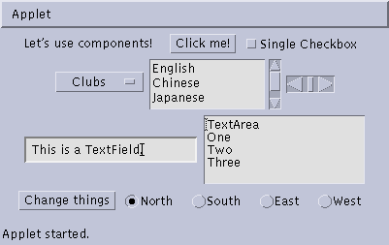
Some types of components
JButton
JCheckbox
JLabel
JChoice
JScrollbar
JTextField
JList
JTextArea
JButton
JCheckbox
JCheckboxGroup

Slide 9
Create components
JButton button = new JButton("Click me!");
JLabel label = new JLabel("This is a JLabel");
JTextField textField1 = new JTextField("This is the initial text");
JTextField textField2 = new JTextField("Initial text", columns);
JTextArea textArea1 = new JTextArea("Initial text");
JTextArea textArea2 = new JTextArea(rows, columns);
JTextArea textArea3 = new JTextArea("Initial text", rows, columns);
JCheckBox checkbox = new JCheckBox("Label for checkbox");
JRadioButton radioButton1 = new JRadioButton("Label for button");
ButtonGroup group = new ButtonGroup(); group.add(radioButton1); group.add(radioButton2); etc.
This is just a sampling of the available constructors; see the javax.swing API for all the rest

Slide 10
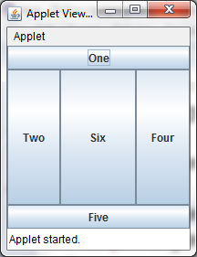
public class BorderLayoutExample extends JFrame{ public BorderLayoutExample () { setLayout(new BorderLayout ()); add(new JButton("One"), BorderLayout.NORTH); add(new JButton("Two"), BorderLayout.WEST); add(new JButton("Three"), BorderLayout.CENTER); add(new JButton("Four"), BorderLayout.EAST); add(new JButton("Five"), BorderLayout.SOUTH); add(new JButton("Six")); } }

Slide 11
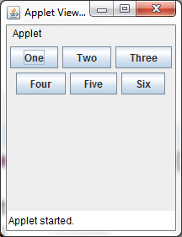
FlowLayout

Slide 12
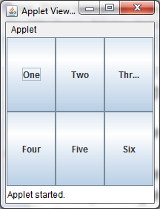
GridLayout

Slide 13
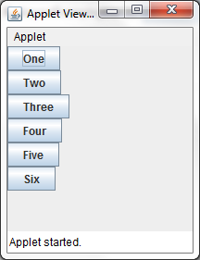
BoxLayout example
As mentioned, this can be a little weird to use but useful if you want to stack things vertically or horizontally

Slide 14
Nested layouts
A JPanel is both a JContainer and a Component
Because it’s a container, you can put other components into it
Because it’s a component, you can put it into other containers
All but the very simplest GUIs are built by creating several JPanels, arranging them, and putting components (possibly other JPanels) into them
A good approach is to draw (on paper) the arrangement you want, then finding an arrangement of JPanels and their layout managers that accomplishes this

Slide 15
Container container = new JFrame() or JApplet(); JPanel p1 = new JPanel(); p1.setLayout(new BorderLayout()); p1.add(new JButton("A"), BorderLayout.NORTH); // also add buttons B, C, D, E JPanel p2 = new JPanel(); p2.setLayout(new GridLayout(3, 2)); p2.add(new JButton("F")); // also add buttons G, H, I, J, K JPanel p3 = new JPanel(); p3.setLayout(new BoxLayout(p3, BoxLayout.Y_AXIS)); p3.add(new JButton("L")); // also add buttons M, N, O, P container.setLayout(new BorderLayout()); container.add(p1, BorderLayout.CENTER); container.add(p2, BorderLayout.SOUTH); container.add(p3, BorderLayout.EAST);

Slide 16
Create and attach listeners
JButton okButton = new JButton("OK");
okButton.addActionListener(new MyOkListener());
class MyOkListener implements ActionListener { public void actionPerformed(ActionEvent event) { // code to handle okButton click } }
A small class like this is often best implemented as an anonymous inner class

Slide 17
What is a listener
Components like button, textbox etc have events that can be ‘listened’ to
When the event is triggered, the next lines of code executed will be the ones corresponding to the listener code.
A listener is always going to implement one of the ‘standard’ interfaces
ActionListener
KeyListener
MouseListener

Slide 18
Suggested program arrangement 1
class SomeClass {
// Declare components as instance variables JFrame frame; // Can also define them here if you prefer JButton button;
public static void main(String[] args) { new SomeClass().createGui(); }
// Define components and attach listeners in a method void createGui() { frame = new JFrame(); button = new JButton("OK"); frame.add(button); // (uses default BorderLayout) button.addActionListener(new MyOkListener()); }
// Use an inner class as your listener class MyOkButtonListener implements ActionListener { public void actionPerformed(ActionEvent event) { // Code to handle button click goes here } } }

Slide 19
Suggested program arrangement 2
class SomeClass extends JFrame {
// Declare components as instance variables // JFrame frame; // Don't need this JButton button;
public static void main(String[] args) { new SomeClass().createGui(); }
// Define components and attach listeners in a method void createGui() { // frame = new JFrame(); // Don't need this button = new JButton("OK"); add(button); // Was: frame.add(button); button.addActionListener(new MyOkListener()); }
// Use an inner class as your listener class MyOkButtonListener implements ActionListener { public void actionPerformed(ActionEvent event) { // Code to handle button click goes here } } }

Slide 20
Components use various listeners
JButton, JMenuItem, JComboBox, JTextField:
addActionListener(ActionListener)
public void actionPerformed(ActionEvent event)
JCheckBox, JRadioButton:
addItemListener(ItemListener)
public void itemStateChanged(ItemEvent event)
JSlider
addChangeListener(ChangeListener)
public void stateChanged(ChangeEvent event)
JTextArea
getDocument().addDocumentListener(DocumentListener)
public void insertUpdate(DocumentEvent event)
public void removeUpdate(DocumentEvent event)
public void changedUpdate(DocumentEvent event)

Slide 21
Getting values
Some user actions normally cause the program to do something: clicking a button, or selecting from a menu
Some user actions set values to be used later: entering text, setting a checkbox or a radio button
You can listen for events from these, but it’s not usually a good idea
Instead, read their values when you need them
String myText = myJTextField.getText();
String myText = myJTextArea.getText();
boolean checked = myJCheckBox.isSelected();
boolean selected1 = myJRadioButton1.isSelected();

Slide 22
Enabling and disabling components
It is poor style to remove components you don’t want the user to be able to use
“Where did it go? It was here a minute ago!”
It’s better to enable and disable controls
Disabled controls appear “grayed out”
The user may still wonder why?, but that’s still less confusing
anyComponent.setEnabled(enabled);
Parameter should be true to enable, false to disable

Slide 23
Summary I: Building a GUI
Create a container, either have a Jframe instance variable or extend JFrame
Choose a layout manager
Create more complex layouts by adding JPanels; each JPanel can have its own layout manager
Create other components and add them to whichever JPanels you like

Slide 24
Summary II: Building a GUI
For each active component, look up what kind of Listeners it can have
Implement the Listeners
often there is one Listener for each active component
Active components can share the same Listeners
For each Listeners you implement, supply the methods that it requires

Slide 25
Dialogs
A dialog (small accessory window) can be modal or nonmodal
When your code opens a modal dialog, it waits for a result from the dialog before continuing
When your code opens a nonmodal dialog, it does so in a separate thread, and your code just keeps going
Sun supplies a few simple (but useful) modal dialogs for your use
You can create your own dialogs (with JDialog), but they are nonmodal by default

Slide 26
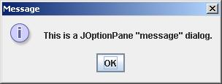
Message dialogs
JOptionPane.showMessageDialog(parentJFrame, "This is a JOptionPane \"message\" dialog.");
Notice that showMessageDialog is a static method of JOptionPane
The “parentJFrame” is typically your main GUI window (but it’s OK to use null if you don’t have a main GUI window)

Slide 27
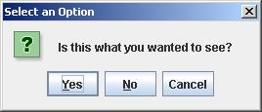
Confirm dialogs
int yesNo = JOptionPane.showConfirmDialog(parentJFrame, "Is this what you wanted to see?");
if (yesNo == JOptionPane.YES_OPTION) { ... }

Slide 28
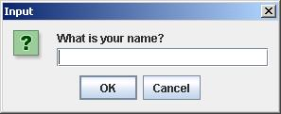
Input dialogs
String userName = JOptionPane.showInputDialog(parentJFrame, "What is your name?")

Slide 29
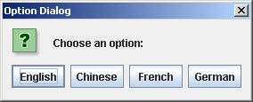
Option dialogs
Object[] options = new String[] {"English", "Chinese", "French", "German" }; int option = JOptionPane.showOptionDialog(parentJFrame, "Choose an option:", "Option Dialog", JOptionPane.YES_NO_OPTION, JOptionPane.QUESTION_MESSAGE, null, options, options[0]); // use as default
Fourth argument could be JOptionPane.YES_NO_CANCEL_OPTION
Fifth argument specifies which icon to use in the dialog; it could be one of ERROR_MESSAGE, INFORMATION_MESSAGE, WARNING_MESSAGE, or PLAIN_MESSAGE
Sixth argument (null above) can specify a custom icon

Slide 30
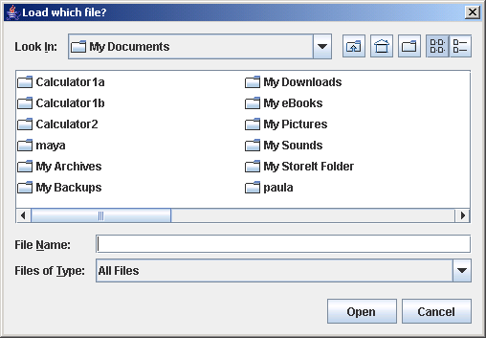
Load file dialogs
JFileChooser chooser = new JFileChooser(); chooser.setDialogTitle("Load which file?");
int result = chooser.showOpenDialog(enclosingJFrame); if (result == JFileChooser.APPROVE_OPTION) { File file = chooser.getSelectedFile(); // use file }
You could also test for CANCEL_OPTION or ERROR_OPTION
You will get back a File object; to use it, you must know how to do file I/O

Slide 31
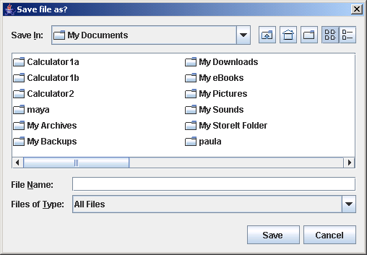
Save file dialogs
JFileChooser chooser = new JFileChooser(); chooser.setDialogTitle(“Save file as?");
int result = chooser.showSaveDialog(enclosingJFrame); if (result == JFileChooser.APPROVE_OPTION) { File file = chooser.getSelectedFile(); // use file }
You could also test for CANCEL_OPTION or ERROR_OPTION
You will get back a File object; to use it, you must know how to do file I/O

Slide 32
Quitting the program
gui.setDefaultCloseOperation(JFrame.EXIT_ON_CLOSE);
Other options are DO_NOTHING_ON_CLOSE, HIDE_ON_CLOSE, and DISPOSE_ON_CLOSE

Slide 33
Summary I: Building a GUI
Create a container, either have a Jframe instance variable or extend JFrame
Choose a layout manager
Create more complex layouts by adding JPanels; each JPanel can have its own layout manager
Create other components and add them to whichever JPanels you like

Slide 34
Summary II: Building a GUI
For each active component, look up what kind of Listeners it can have
Implement the Listeners
often there is one Listener for each active component
Active components can share the same Listeners
For each Listeners you implement, supply the methods that it requires

