Slide 1


MBTA Tracker
Jonathan Li
CS443

Slide 2
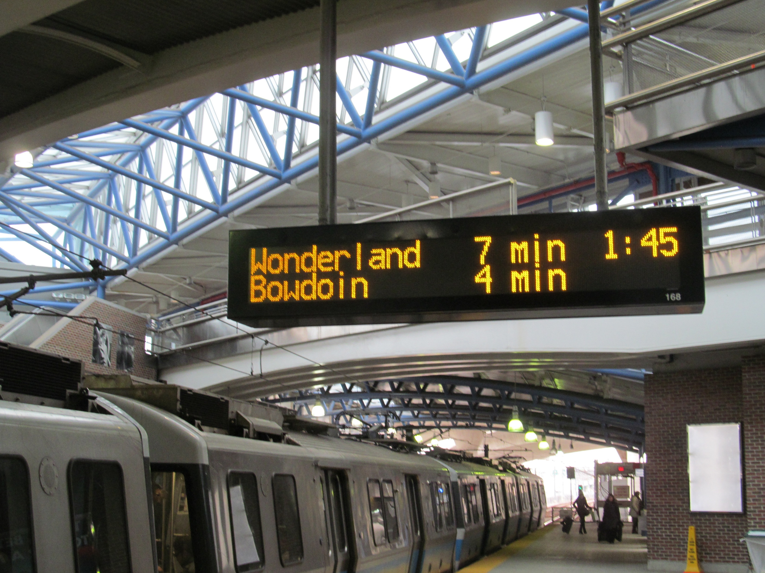
Purpose
Users can easily use their phone to lookup train arrival predictions for MBTA stations
Users can also view surrounding area in Google Maps

Slide 3
How it works
Retrieves data from online connection using the MBTA API
Downloads and stores MBTA routes and stations on the app
User types in a station name
Station names are hard-coded as a HashMap to refer to the ID in the MBTA API
For example: “park st” → “place-pktrm”
Google Maps uses station coordinates to zoom in to that location

Slide 4

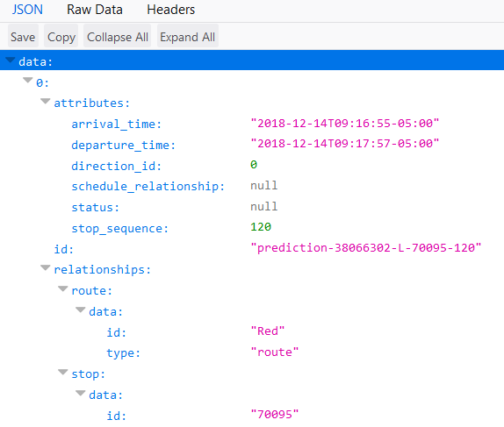
Async Task uses the API to download real-time predictions for that station
Data is downloaded in the JSON format, where individual information is then retrieved

Slide 5
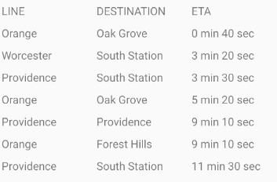
From the JSON for train predictions, the app extracts the route, destination, and ETA
The information is displayed in a RecyclerViewLayout, which is similar to a GridLayout

Slide 6
Demo

Slide 7
Questions?

