Slide 1
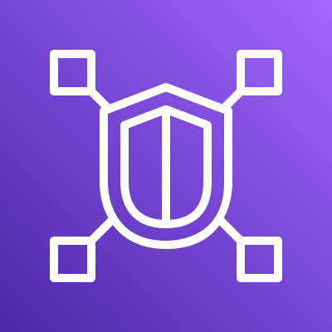
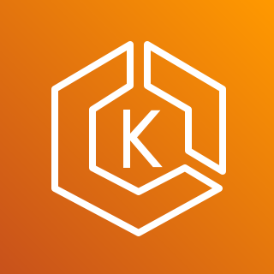



How VPC Lattice relates to Kubernetes objects
AWS Lattice
Amazon EKS
GatewayClass
Infrastructure
provider
Service Network
Service Policy
Optional
Gateway
Cluster
operator
Service with Service Policy
HTTPRoute
Target Group-v2
Target Group-v1
Application
developer
K8s Service -1
K8s Service-2
Target
Target
Target
Target
K8s Deployment-v1
K8s Deployment-v2
Pod1
Pod2
Pod1
Pod2

Slide 2


Single-cluster/VPC service-to-service communications
VPC 1
HTTPRoute
HTTPRoute
apiVersion: gateway.networking.k8s.io/v1alpha2
kind: HTTPRoute
metadata:
name: rates
spec:
parentRefs:
- name: my-hotel
sectionName: http
- name: my-hotel
sectionName: https
rules:
- backendRefs
- name: parking
kind: Service
port: 8090
matches:
- path:
type: PathPrefix
value: /parking
- backendRefs:
- name: review
kind: Service
port: 8090
matches:
- path:
type: PathPrefix
value: /review
rates
inventory
Rev 1.21
/parking
/review
100%
Service parking
Service review
Service inventory-ver1
K8s Pods
K8s Pods
K8s Pods
Traffic
K8S gateway/VPCLattice
HTTPRoute (K8S Gateway API)

Slide 3
Multiple clusters/VPCs service-to-service communications
VPC 1
HTTPRoute
apiVersion: gateway.networking.k8s.io/v1alpha2
kind: HTTPRoute
metadata:
name: inventory
spec:
parentRefs:
- name: my-hotel
sectionName: http
- name: my-hotel
sectionName: https
rules:
- backendRefs
- name: inventory-ver1
kind: Service
weight: 10
- name: inventory-ver2
kind: ServiceImport
weight: 90
Service inventory-ver1
inventory
10%
Rev 1.21
APP-1
APP-2
Cluster-1
K8s Pods
K8S gateway/VPCLattice
VPC 2
90%
Service inventory-ver2
Rev 1.23
Cluster-2
K8s Pods
K8S gateway/VPCLattice
Traffic
HTTPRoute (K8S Gateway API)

Slide 4
Recommended Multi-Cluster Architecture
VPC 1
my-gateway
Gateway
AWS Gateway API Controller
my-httproute
HTTPRoute
Config Cluster
Service Network VPC Association (SNVA)
Path match
/service-1
Path match
/service-2
service-1
ServiceImport
service-2
ServiceImport
SNVA
VPC Lattice
Service Network
SNVA
VPC 2
VPC 3
service-1
ServiceExport
service-2
ServiceExport
AWS Gateway API Controller
AWS Gateway API Controller
service-1 Service
service-2
Service
Workload Cluster-1
Workload Cluster-2
service-1 Pods
service-2 Pods

