Slide 1
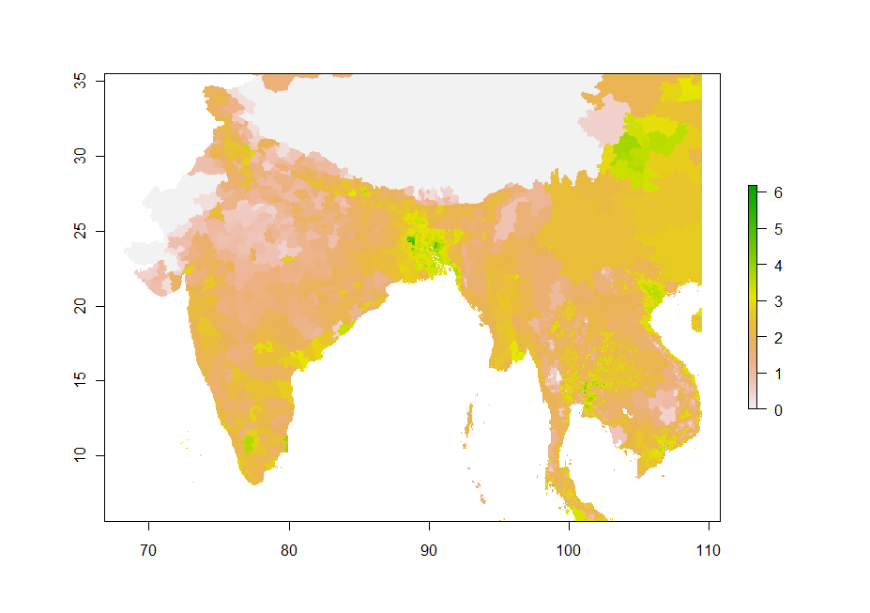
Chicken density (Log-scale legend): ChDn.asc

Slide 2
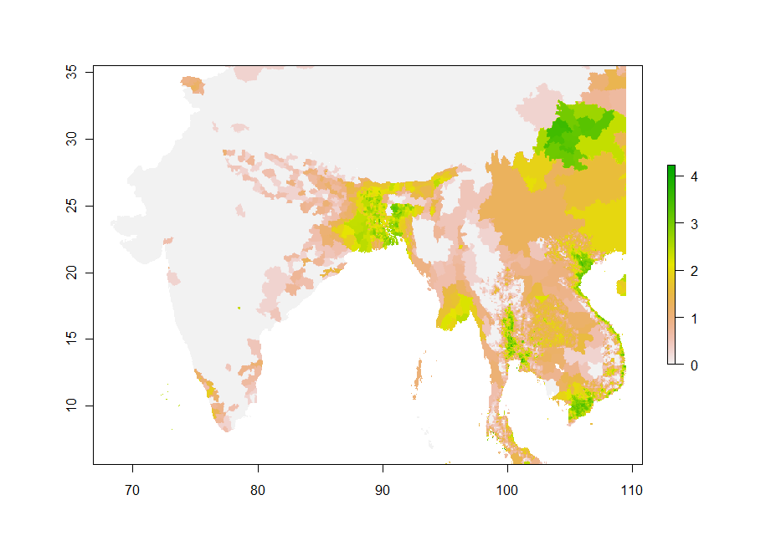
Duck density (log-scale legend): DuDn.asc

Slide 3
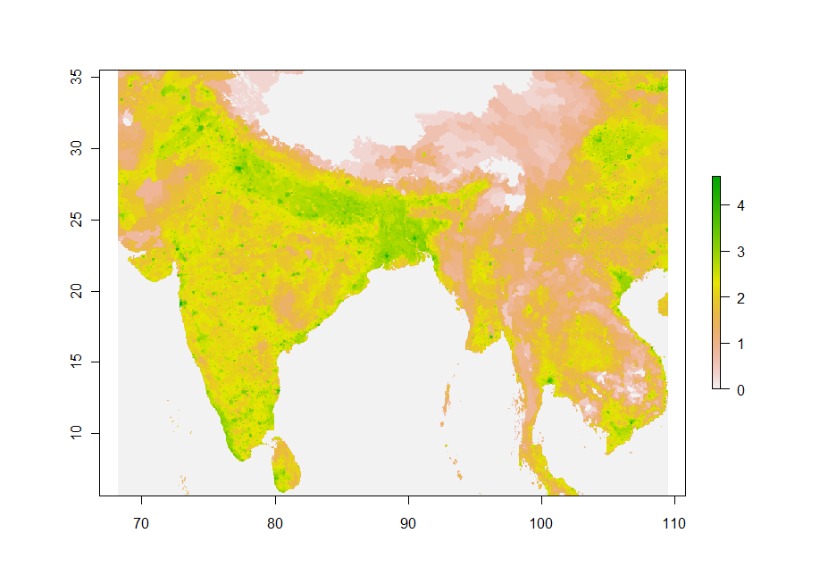
Human pop. Dens. (log-scale legend): HpDn

Slide 4
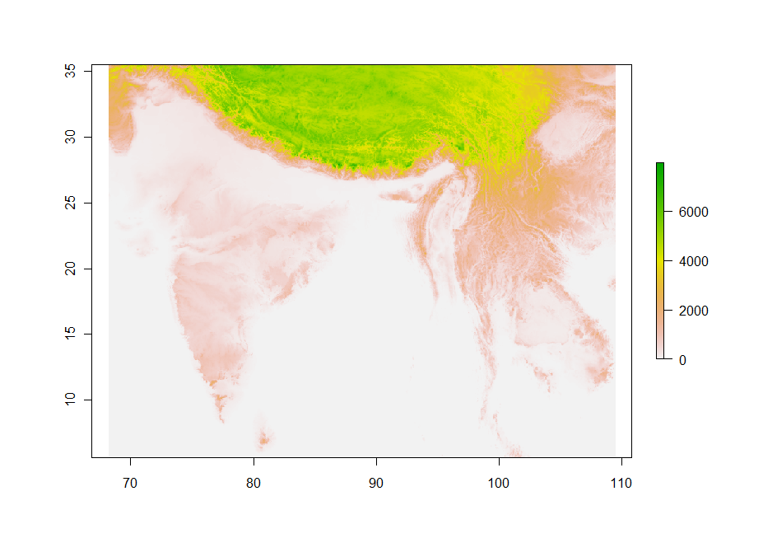
Elevation: dem.asc

Slide 5
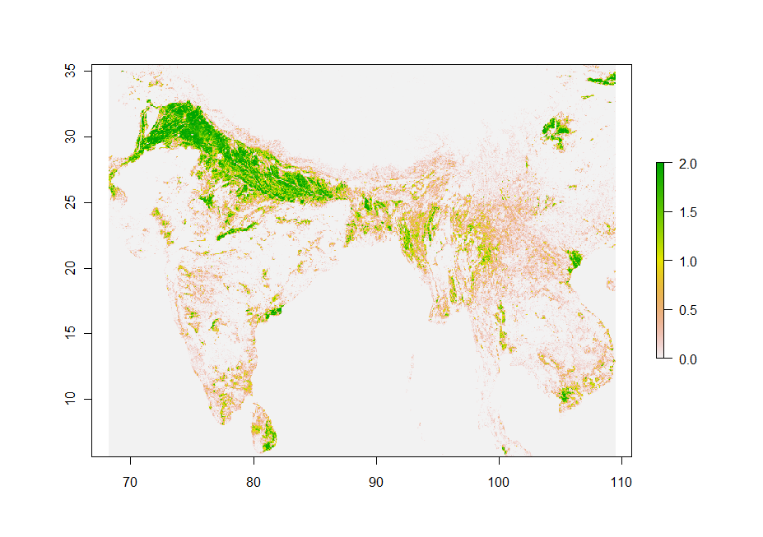
Cropping intensity (new method): ncropn.asc

Slide 6
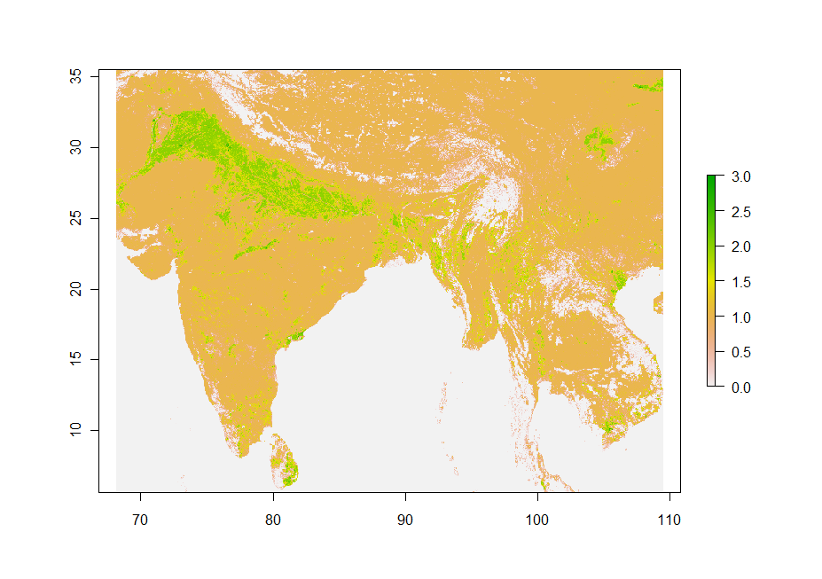
Cropping intensity (PNAS version): ncropo.asc

Slide 7
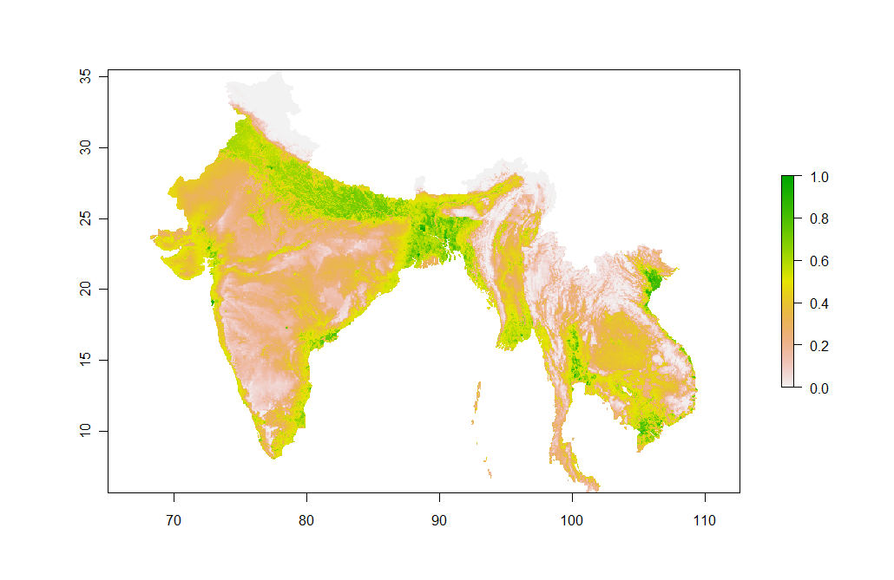
PNAS model predictions: PNASPred.asc

Slide 8
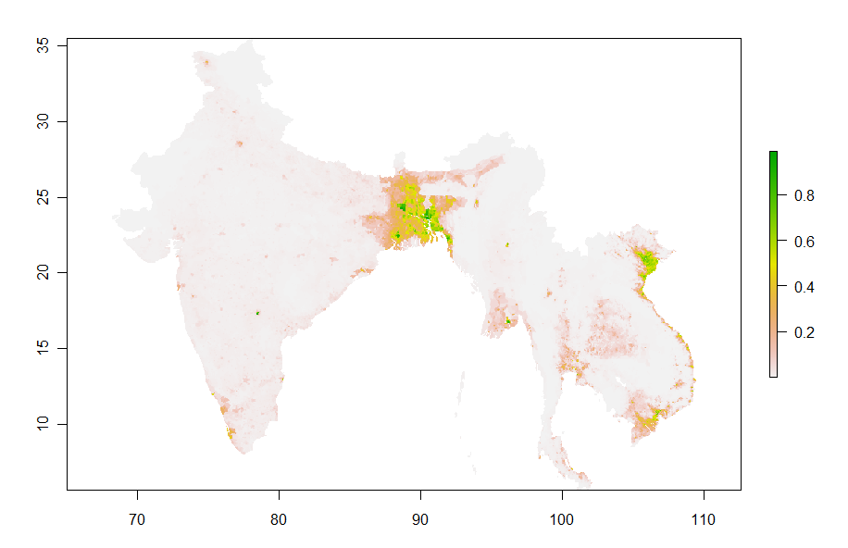
South Asia Model Predictionts: SAPred.asc

Slide 9
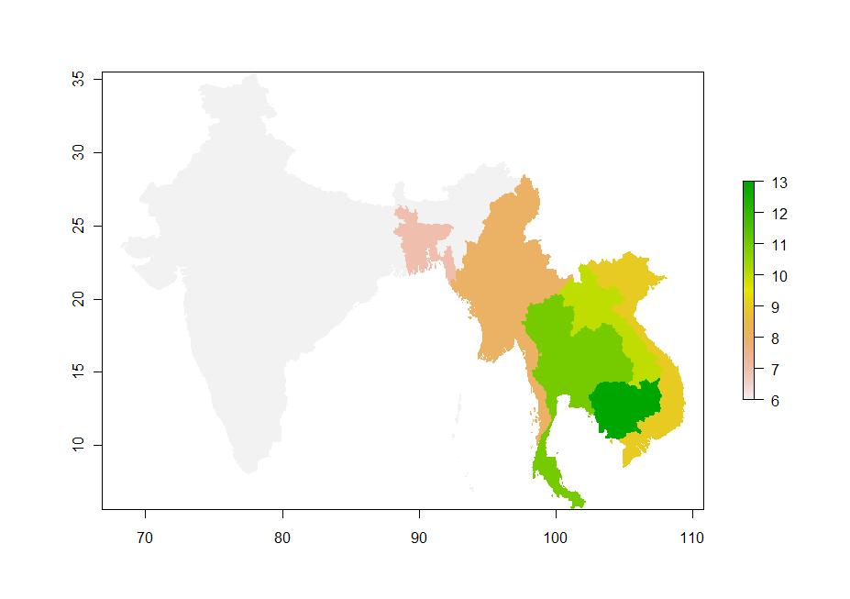
Country code (categorical): ccode.asc

