Slide 1

Hands busy.
Keyboard waiting.

Slide 2

Patient care.
Computer interruptions.

Slide 3

Another click.
Another glove change.

Slide 4

Introducing
touchless
control

Slide 5
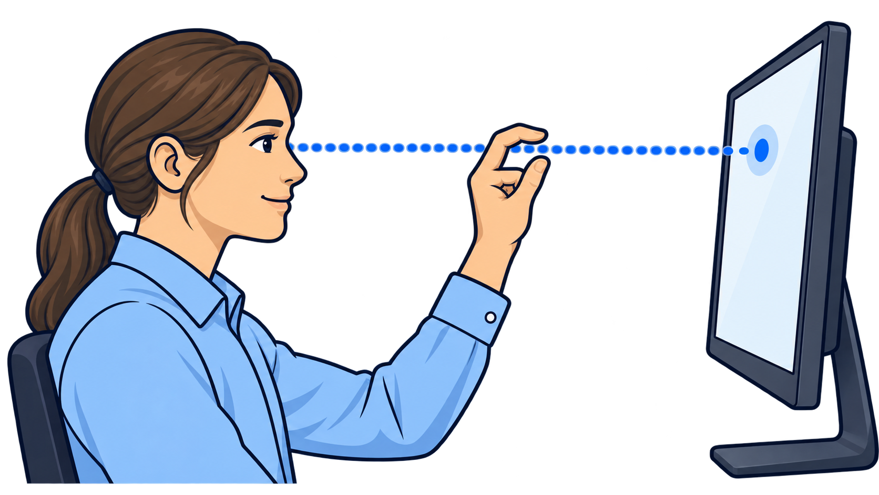
Eye, hand, screen.
Aligned.

