Slide 1

Laboratory work shouldn’t require
keyboard contact

Slide 2

Healthcare professionals need
touchless computer control

Slide 3

Glove changes interrupt
healthcare work

Slide 4
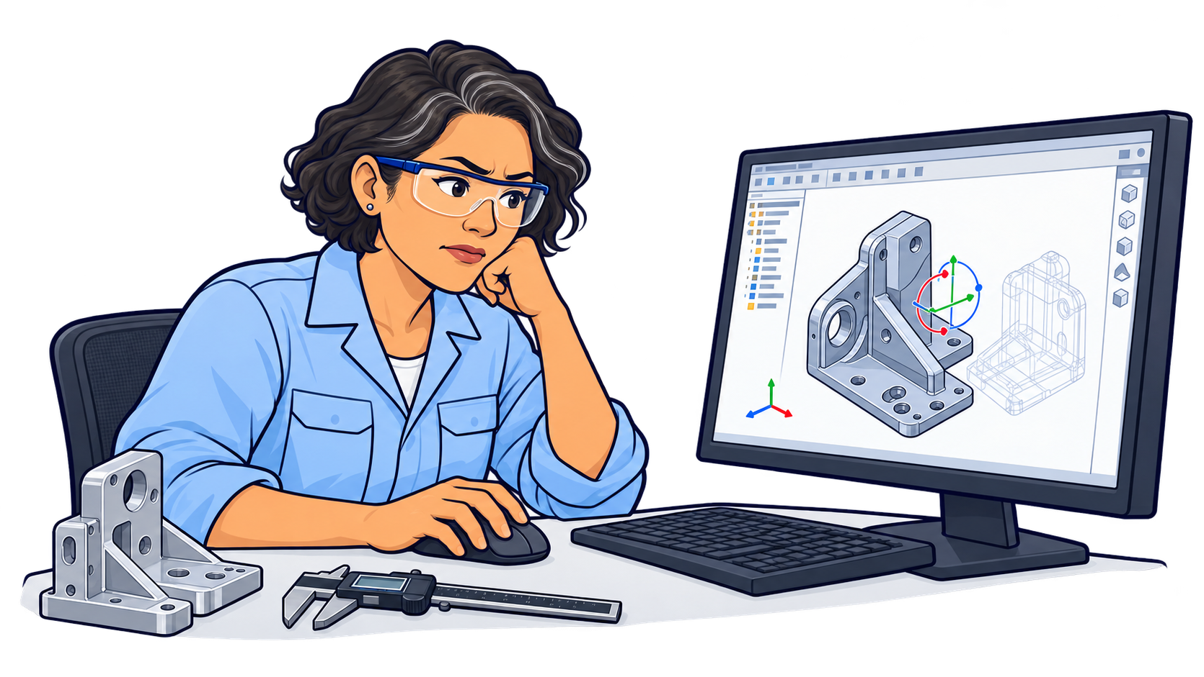
CAD parts can be difficult
to manipulate in 2D

Slide 5

Introducing
touchless
control

Slide 6
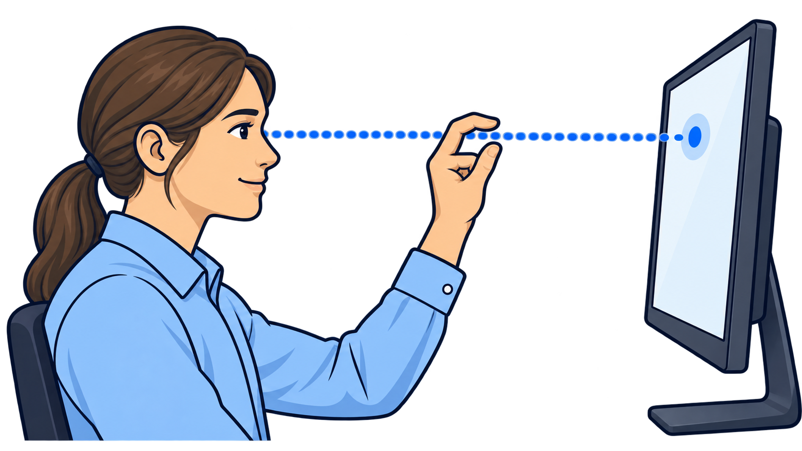
Eye, hand, screen.
Aligned.

