Slide 1

Lab work shouldn’t require keyboards and mice

Slide 2

Patient care shouldn’t require keyboards and mice

Slide 3

Computer use interrupts gloved work

Slide 4

Introducing

Slide 5
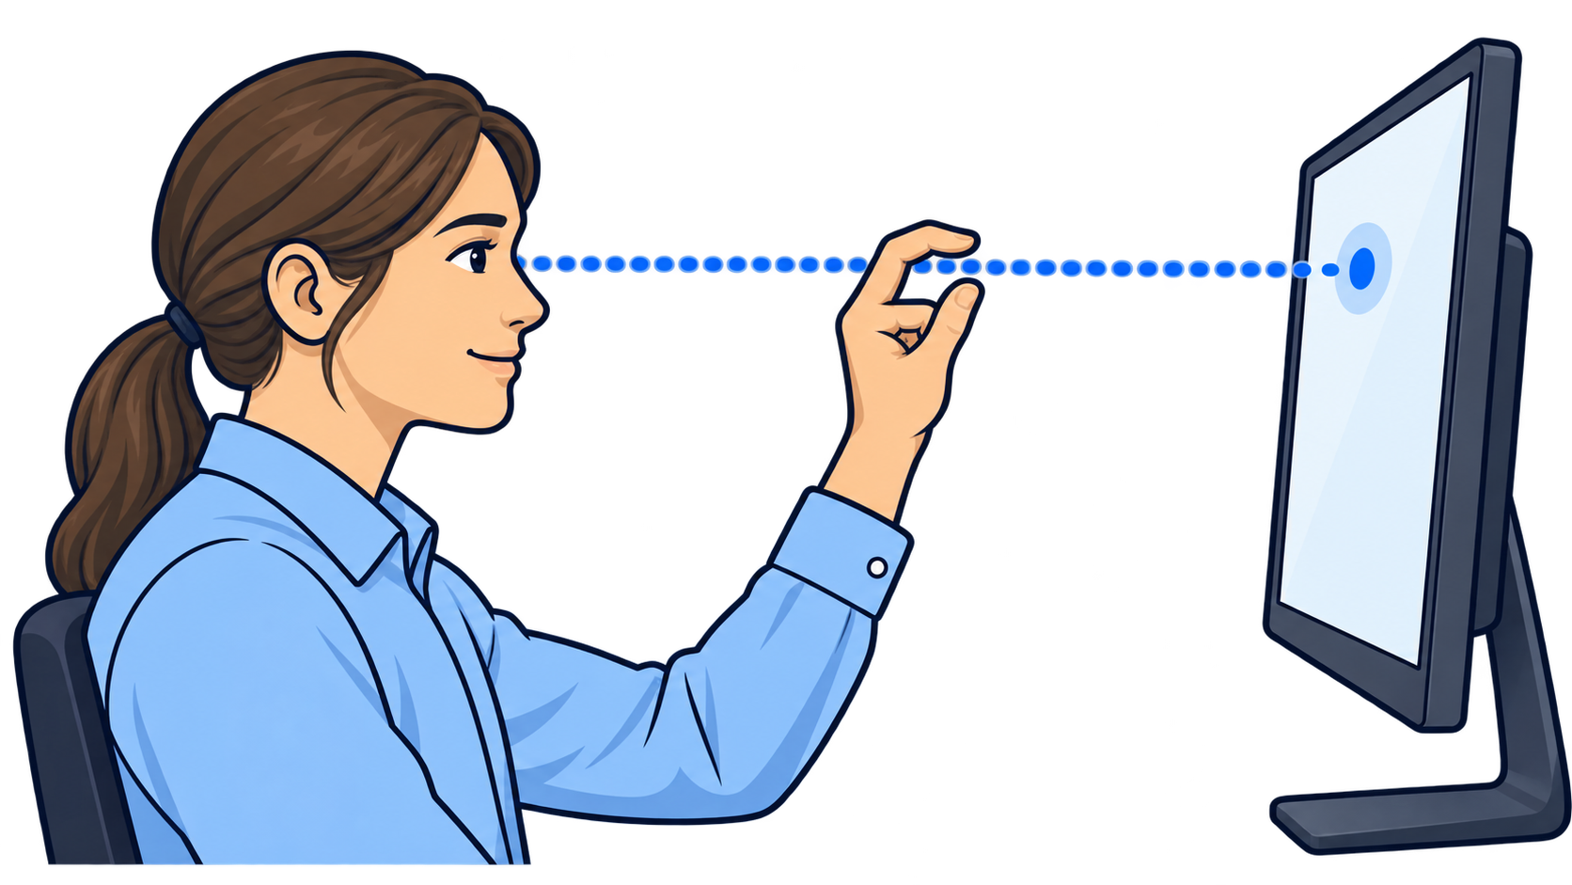
The innovation: eye, hand, screen alignment

