Slide 1
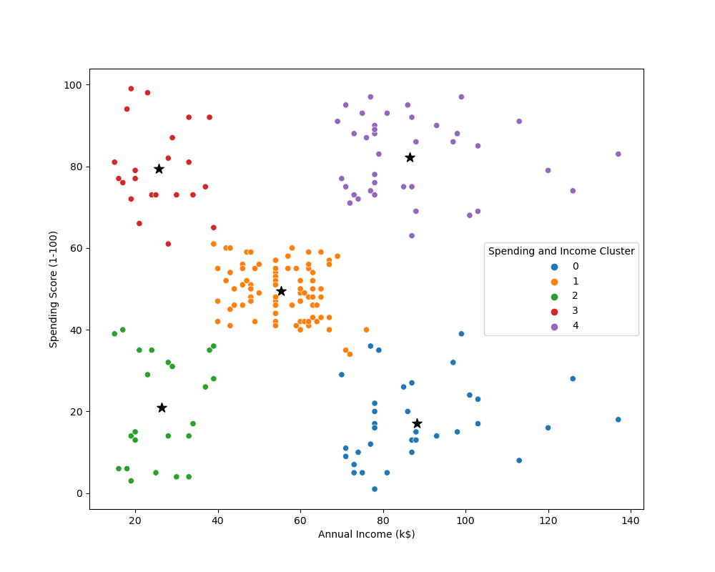
Analysis
Target Cluster
Target group would be cluster 1
which has a high spending Score
and high income
54 percentage of cluster 1 shoppers
are women. We should look for ways
to attract these customers using a
marketing campaign targeting
popular items in this cluster
Cluster 2 presents an interesting
opportunity to market to the
customers for sales event on
popular items

