Slide 1
Introduction to MPI
Presented By: Jonathan O’Berry, Kris Roker, and Poonkuzhali Vasudevan

Slide 2
What is MPI ?
MPI stands for Message Passing Interface
MPI is a message-passing library specification that provides a de-facto "standard" message passing model for distributed and shared memory computers
Designed to provide a portable parallel programming interface.

Slide 3
What is MPI? (cont.)
MPI is not endorsed by any standards organization, but it is considered the standard in industry.
Five versions of the MPI standard called [1]:
MPI-1 (1994): Provides over 115 functions and is fully implemented by all libraries.
MPI-2 (1996): Provides over 500 functions but is not fully implemented by all libraries.
MPI-3 (2014): Improves scalability and offers multicore and cluster support. Removed language bindings for C++
MPI-4 (2021): Introduced Partitioned Communications.
MPI-5: Still Under Development

Slide 4
Key Concepts [1]
Comm
Color
Key
Newcomm
Derived data types
Point-to-point
Collective basics
One-sided

Slide 5
Where Do I Find a Version of MPI
Most vendors have their own implementations optimized for their architecture and communication subsystems
Microsoft (Microsoft MPI v10.1.13)[2]
Cray (Cray MPICH)[3]
IBM (IBM Spectrum MPI)[4]
Intel (Intel MPI Library)[5]
Open-source
MPICH
OpenMPI
DeinoMPI[6]

Slide 6
MPI Languages and Compiling
MPI has language bindings for C and Fortran
MPI 1 and 2 also have language bindings for C++
Python has a package PyMPI
To compile MPI in C MPICC must be used rather than GCC.
MPICC is necessary because it invokes a series of complex GCC compiler and linker flags that are necessary for programs using MPI [7].

Slide 7
A Minimal MPI Program (C)
#include <mpi.h>
#include <stdio.h>
int main( int argc, char *argv[] )
{
MPI_Init( &argc, &argv );
printf( "Hello, world!\n" );
MPI_Finalize();
return 0;
}

Slide 8
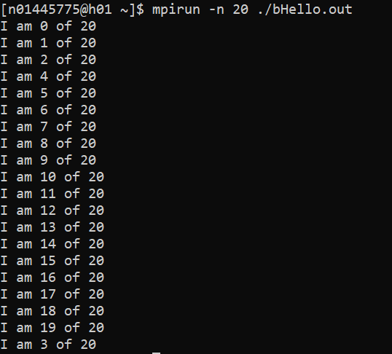
Better Hello (C)
#include <mpi.h>
#include <stdio.h>
int main( int argc, char *argv[] )
{
int rank, size;
MPI_Init( &argc, &argv );
MPI_Comm_rank( MPI_COMM_WORLD, &rank );
MPI_Comm_size( MPI_COMM_WORLD, &size );
printf( "I am %d of %d\n", rank, size );
MPI_Finalize();
return 0;
}

Slide 9
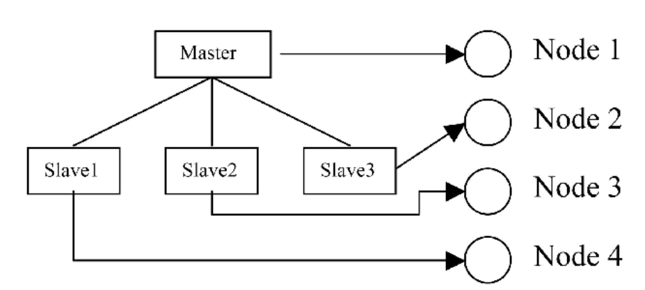
Using SPMD (Single Program Multiple Data) Computational Model
#include <mpi.h>
#include <stdio.h>
int main (int argc, char *argv[])
{
int myrank, mysize;
MPI_Init(&argc, &argv);
MPI_Comm_rank(MPI_COMM_WORLD, &myrank); /*find process rank */
MPI_Comm_size( MPI_COMM_WORLD, &mysize );
if (myrank == 0) { /*Master*/
printf( "I am %d of %d\n", myrank, mysize );
printf("ZEEEERRRROOO\n\n\n\n");
} else {/*Slave*/
printf("Not Zero\n");
printf( "I am %d of %d\n\n\n\n", myrank, mysize);
}
MPI_Finalize();
}
Master and Slave are executed by the Master and slave process respectively.
[8]

Slide 10
MPI Definitions of Blocking and Non-Blocking
Blocking - return after their local actions complete, though the message transfer may not have been completed.
Return when “locally complete” - when location used to hold message can be used again or altered without affecting message being sent.
Blocking send will send message and return - does not mean that message has been received, just that process free to move on without adversely affecting message.
Non-blocking - return immediately.
These terms may have different interpretations in other systems.

Slide 11
Message Buffers
An area of memory where data is stored in the process of being moved
Message will be added to buffer before sending in some modes
User can specify a buffer to be used in sending messages
MPI_BUFFER_ATTACH(buffer_addr, size) to attach a defined buffer
MPI_BUFFER_DETACH(buffer_addr, size) to detach buffer from MPI
Where buffer is the address of the buffer being attached
Where size is the size of that buffer in bytes
Only one buffer can be attached to a process at a time

Slide 12
How message-passing routines return before message transfer completed
Message buffer needed between source and destination to hold message:
Process 1
Process 2
Time
Message b
uff
er
send();
Contin
ue
recv();
process
Read
message b
uff
er

Slide 13
Parameters of Blocking Send
MPI_Send(buf, count, datatype, dest, tag, comm)
Address of
Datatype of
Message tag
send b
uff
er
each item
Number of items
Rank of destination
Comm
unicator
to send
process

Slide 14
Parameters of Blocking Receive
MPI_Recv(buf, count, datatype, src, tag, comm, status)
Status
Address of
Datatype of
Message tag
after oper
ation
receiv
e b
uff
er
each item
Maxim
um n
umber
Rank of source
Comm
unicator
of items to receiv
e
process

Slide 15
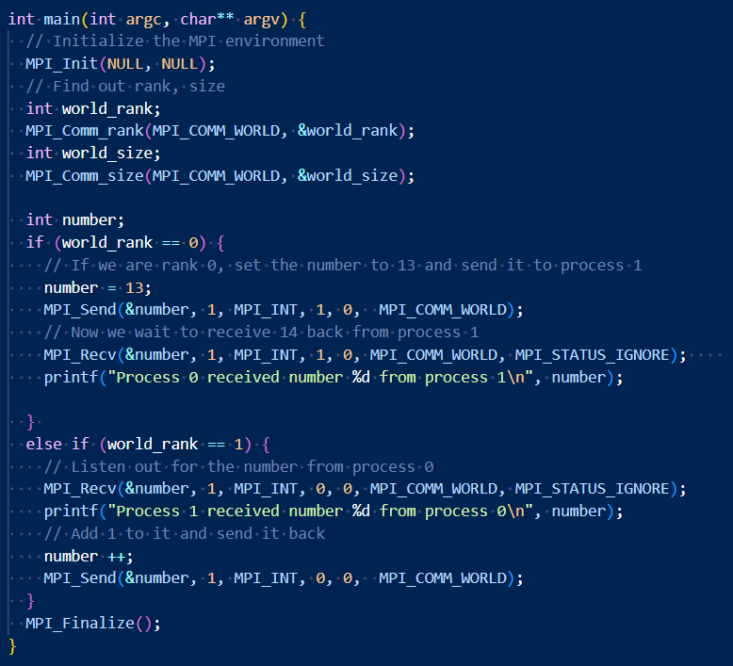

Example
To send an integer from process 0 to process 1, do an operation on it, and send it back

Slide 16
Blocking MPI Send Modes
MPI_Send()
Standard blocking send
Will not return until either the send buffer is available or a matching receive is posted
Two protocols
Eager
Entire message is sent assuming the receiver can get it
Only used for small messages
Rendezvous
Sender asks receiver to send data, and will send when receiver has a buffer for it
Higher synchronization delays; can lower performance

Slide 17
Blocking MPI Send Modes
MPI_BSend()
Buffered send
Will start and may complete before a matching receive is posted
Will buffer the message if no matching receive
User must define buffer for it
MPI_SSend()
Synchronous send
Will start whether or not a matching receive was posted
Will only complete when that receive is posted
MPI_RSend()
Ready send
Will only start if the matching receive has already been posted

Slide 18
MPI Nonblocking Routines
Nonblocking send - MPI_Isend() - will return “immediately” even before source location is safe to be altered.
Has similar send modes to blocking routines
MPI_Isend()
MPI_Ibsend()
MPI_Issend()
MPI_Irsend()
Nonblocking receive - MPI_Irecv() - will return even if no message to accept.

Slide 19
Nonblocking Routine Formats
MPI_Isend(buf,count,datatype,dest,tag,comm,request)
MPI_Irecv(buf,count,datatype,source,tag,comm, request)
Completion detected by MPI_Wait() and MPI_Test().
MPI_Wait() waits until operation completed and returns then.
MPI_Test() returns with flag set indicating whether operation completed at that time.
Need to know whether particular operation completed.
Determined by accessing request parameter.

Slide 20
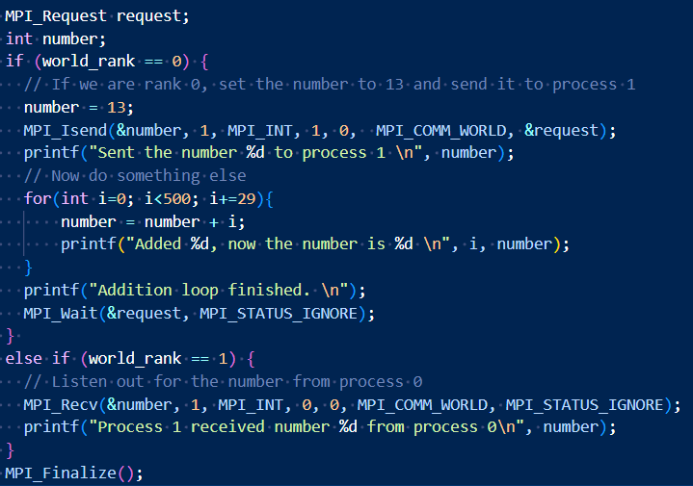
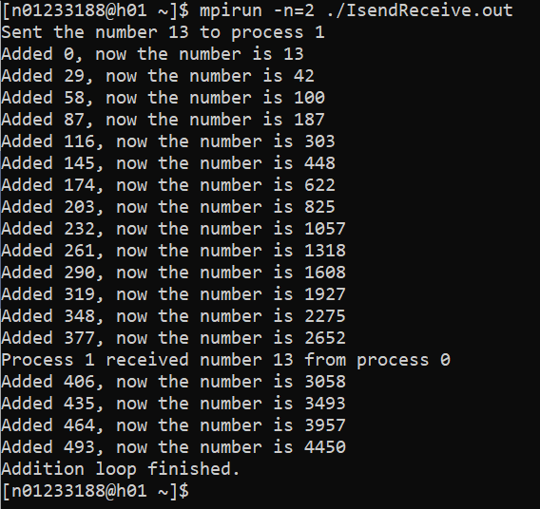
Example
To send an integer from process 0 to process 1 and allow process 0 to continue,

Slide 21
Blocking vs Nonblocking
Blocking communication is beneficial for synchronized processes
Can cause performance bottlenecks when processes must stop until communication is done
This is not usually expected to be a problem
Nonblocking communication allows processes to do something else while it waits for a send/receive
Provides performance increases when communication and computation can be done in parallel
Makes it difficult for processes to deadlock
Nonblocking sends can be used with blocking receives and vice-versa

Slide 22
Deadlocks
When two or more processes are blocked due to a circular dependency
Happens under 4 conditions:
Mutual Exclusion
Some resources are useable by one process at a time
Hold and Wait
A blocked process is holding a resource and is waiting for another one
No Preemption
Held resources can only be released by the process holding it
Circular Wait
One process is waiting for another process to finish, which is waiting for the first process to finish

Slide 23
Safe Scenario
Always succeeds, even if no buffering is done.
if(rank==0)
{
MPI_Send(1,…);
MPI_Recv(1,...);
}
else if(rank==1)
{
MPI_Recv(0,...);
MPI_Send(0,...);
}

Slide 24
Deadlock
Will always deadlock, no matter the buffering mode.
if(rank==0)
{
MPI_Recv(1,...);
MPI_Send(1,...);
}
else if(rank==1)
{
MPI_Recv(0,...);
MPI_Send(0,...);
}

Slide 25
Unsafe Scenario
Only succeeds if sufficient buffering is present -- unsafe!
if(rank==0)
{
MPI_Send(1,...);
MPI_Recv(1,...);
}
else if(rank==1)
{
MPI_Send(0,...);
MPI_Recv(0,...);
}

Slide 26
Some Solutions to the “unsafe” Problem
Order the operations more carefully:
Use non-blocking operations:
Process 0
Send(1)
Recv(1)
Process 1
Recv(0)
Send(0)
Process 0
Isend(1)
Irecv(1)
Waitall
Process 1
Isend(0)
Irecv(0)
Waitall

Slide 27
Multiple Recv
if(rank==0)
{
MPI_Recv(1,...);
MPI_Recv(2,...);
}
else if(rank==1)
{
MPI_Send(0,...);
} else if (rank==2) {
MPI_Send(0,...);
}

Slide 28
Collective Communication of MPI

Slide 29
Point to Point vs Collective Communication
Point-to-point communication involves direct data exchange between two individual processes.
Example: MPI_Send and MPI_Recv
Collective communication involves data exchange among a group of processes (usually all the processes in a communicator). The operation is defined to involve all processes in a communicator, ensuring synchronization.
Example: MPI_Bcast, MPI_Reduce
Notes:
Point to Point:
One process sends the data (sender), and the other process receives it (receiver).
Characteristics:
• Direct: The communication is explicitly defined between a sender and a receiver.
• Blocking vs. Non-blocking: Blocking operations wait until the communication is completed before proceeding, while non-blocking operations allow overlap of computation and communication.
• Flexibility: Suitable for a variety of communication patterns, such as one-to-one or one-to-many (using multiple point-to-point calls).
Collective communication:
Characteristics:
• Group Communication: Involves all processes in a communicator, making it more structured than point-to-point.
• Synchronization: Implicit synchronization occurs, as all processes in the communicator must participate in the collective operation.
• Higher-level Operations: Optimized for specific group communication patterns, often using underlying algorithms that are more efficient than multiple point-to-point calls.

Slide 30
Characteristics
• Group Coordination: Collective routines involve coordinated communication within a group of processes (identified by an MPI communicator).
• Simplifies Complex Communication: Serve as substitutes for a complex sequence of point-to-point calls.
• Blocking Behavior: Must block until they complete locally (for blocking calls).
• Synchronization: May or may not use synchronized communication (depends on implementation).
• Root Process: Some routines specify a root process to originate or collect all data.
• Data Matching: Must match data amounts between senders and receivers exactly.
• No Message Tags: Collective routines do not use message tags.
• Variations: Include many variations within basic categories (e.g., MPI_Bcast, MPI_Reduce, MPI_Gather).
• Efficiency: Built upon point-to-point routines but optimized for group communication.
Notes:
MPI collective communication routines differ in many ways from MPI point-to-point communication routines, which were introduced in MPI Point-to-Point. Here are some characteristics that distinguish the MPI collective communication routines:
Involve coordinated communication within a group of processes identified by an MPI communicator
Substitute for a more complex sequence of point-to-point calls
For blocking calls, must block until they have completed locally
May, or may not, use synchronized communications (implementation dependent)
Specify a root process to originate or receive all data (in some cases)
Must exactly match amounts of data specified by senders and receivers
Do not use message tags
Have many variations within the basic categories
Collective communication routines are built upon point-to-point communication routines. In principle, you could build your own collective communication routines in this way, but it might involve a lot of tedious work and might not be as efficient.

Slide 31
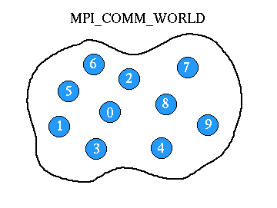
Communicators
An MPI Communicator is an object that defines a group of processes that can communicate with each other in an MPI program.
MPI_COMM_WORLD includes all the processes started by the MPI program.
Each process in a communicator has a unique rank (ID).
Notes:
Within a communicator, every process has its own unique, integer identifier assigned by the system when the process initializes. A rank is sometimes also called a "process ID". Ranks are contiguous and begin at zero.
Used by the programmer to specify the source and destination of messages. Often used conditionally by the application to control program execution (if rank=0 do this / if rank=1 do that).

Slide 32
Three Types of Operations
Synchronization:
Processes wait until all members of the group have reached the synchronization point.
Function: MPI_Barrier
Data Movement:
broadcast, scatter/gather, all to all.
Collective Computation (Reductions):
One member of the group collects data from other members and performs an operation (min, max, add, multiply, etc.) on that data.
Notes:
Synchronization
• Definition: Processes wait until all members of the group have reached the synchronization point.
• Function: MPI_Barrier
• Use Case: Ensuring all processes align before proceeding to the next phase of computation.
2. Data Movement
• Broadcast: One process sends data to all other processes (MPI_Bcast).
• Scatter/Gather: Distribute data from one process to others (MPI_Scatter), or collect data from all processes to one (MPI_Gather).
• All-to-All: Every process sends and receives data to/from every other process (MPI_Alltoall).
3. Collective Computation (Reductions)
• Operation: One member of the group collects data from other members and performs operations like:
• Min, Max: MPI_Reduce with MPI_MIN or MPI_MAX.
• Add, Multiply: MPI_Reduce with MPI_SUM or MPI_PROD.
• Use Case: Useful for calculating global sums, averages, maximum values, etc.

Slide 33
Barrier Synchronization
A collective operation where all processes in a communicator wait until each process reaches the synchronization point.
Ensures that all processes align before any of them proceed to the next section of code.
Function: int MPI_Barrier(MPI_Comm comm)
comm: The communicator containing the group of processes.
return value is an integer value error code.
Blocking: The function call blocks the processes until every member of the communicator has called MPI_Barrier.
Notes:
Use Case:
• Useful for synchronizing stages in parallel programs.
• Ensures data consistency before proceeding with dependent operations.
When to Use
• When you need to synchronize all processes before starting a new phase of computation or communication.
• For debugging to control the flow of parallel execution.

Slide 34
Data Movement
MPI provides three types of collective data movement routines:
Broadcast
Gather
Scatter

Slide 35
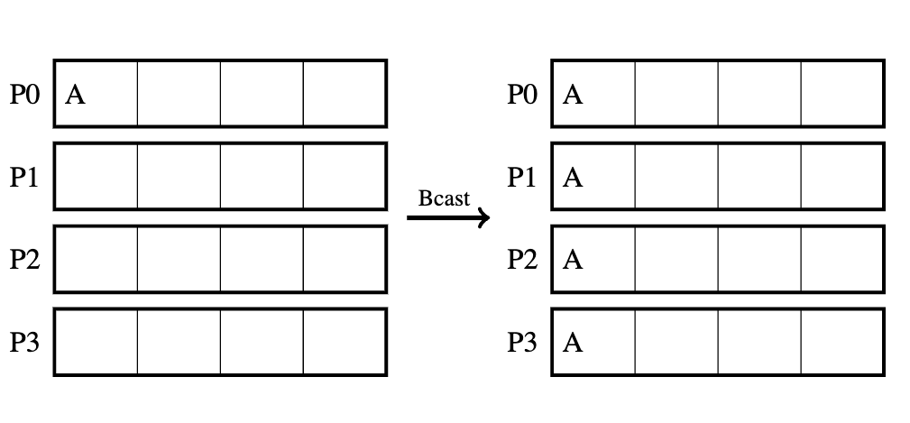
Broadcast
A collective operation where one process (the root) sends data to all other processes in the communicator.
int MPI_Bcast(void *buf, int count, MPI_Datatype datatype, int
source, MPI_Comm comm)
[9]
Notes:
• Root Process: The process that originates the data.
• Use Case: Distributing common data, like configuration parameters, to all processes.
buf :the address of the send buffer.
count : the number of elements sent to each process.
datatype : is MPI defined constant indicating the data type of the elements
in the buffer.
root :is an integer indicating the rank of broadcast root process
comm :the communicator.
The MPI_Bcast must be called by each process in the group, specifying the same comm and root. The message is sent from the root process to all processes in the group, including the root process. If we think in terms of a matrix whose rows and columns correspond to the data and processes, respectively, then the states of this matrix before and after the call can be illustrated as follows:

Slide 36
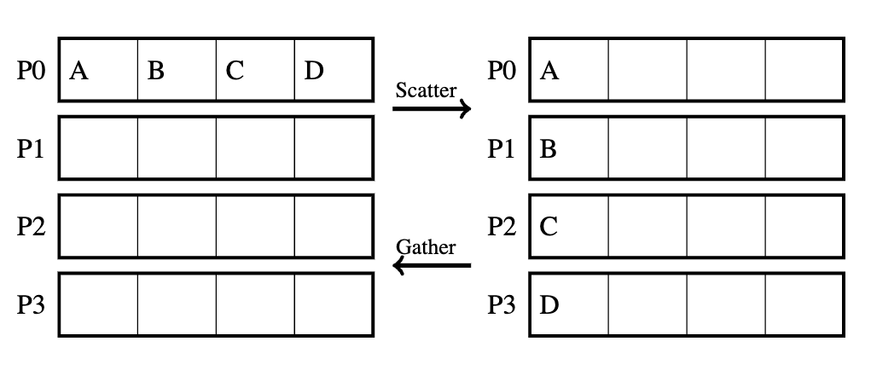
Gather
Collects data from all processes in the communicator and gathers it into a single array at the root process.
int MPI_Gather(void *sbuf, int scount, MPI_Datatype stype, void *rbuf, int rcount, MPI_Datatype rtype, int root, MPI_Comm comm )
[9]
Notes:
If an array is scattered across all processes in the group and one wants to collect each piece of the array into a specified array on a single process, the call to use is GATHER. On the other hand, if one wants to distribute the data into n segments, where the i-th segment is sent to the ith process in the group which has n processes, use SCATTER. Think of it as the inverse to GATHER.
We will first consider the basic form of these MPI gather/scatter operations, in which the number of data items collected from or sent to processes is the same for all processes, and the data items are arranged contiguously in order of process rank
sendbuf : the address of the send buffer.
sendcnt : the number of elements in the send buffer.
sendtype : the data type of the send buffer elements.
recvbuf : the starting address of the receive buffer.
recvcnt : the number of elements for any single receive.
recvtype : the data type of the receive buffer elements.
root : the rank of the receiving process.
comm : the communicator.

Slide 37
Scatter
Divides data from the root process into equal parts and distributes them to all processes in the communicator.
int MPI_Scatter(void *sbuf, int scount, MPI_Datatype stype, void *rbuf, int rcount, \ MPI_Datatype rtype, int root, MPI_Comm comm)
[9]
Notes:
sendbuf : the address of the send buffer.
sendcnt : the number of elements sent to each process.
sendtype : the data type of the send buffer elements.
recvbuf : the address of the receive buffer.
recvcnt : the number of elements in the receive buffer.
recvtype : the data type of the receive buffer elements.
root : the rank of the sending process.
comm : the communicator.

Slide 38
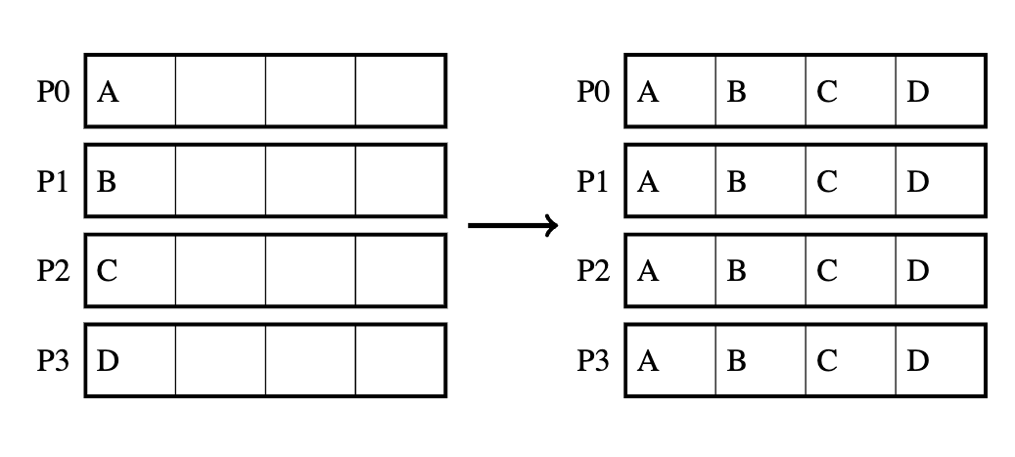
All gather
A collective operation where each process in the communicator sends its data to all other processes, collecting the data from all processes into a single array on every process.
int MPI_Allgather(void *sbuf, int scount, MPI_Datatype stype, void *rbuf, int rcount, MPI_Datatype rtype, MPI_Comm comm)
[9]
Notes:
Each process shares its data with every other process, resulting in all processes having the complete dataset.
MPI_Allgather can be thought of as an MPI_Gather where all processes, not just the root, receive the result. The jth block of the receive buffer is reserved for data sent from the jth rank; all the blocks are the same size. MPI_Allgatherv works similarly, except the block size can depend on rank j, in direct analogy to MPI_Gatherv. It's not surprising, then, that the syntax of MPI_Allgather and MPI_Allgatherv turns out to be close to MPI_Gather and MPI_Gatherv, respectively. The main difference is that the argument root is dropped from the argument lists because there is no root process for the "all" type commands.
sbufis the starting address of the send bufferscount[s]is the [array of the] number of elements to send to each processstypeis the data type of send buffer elementsrbufis the address of the receive bufferrcount[s]is [an array containing] the number of elements to be received from each process[displs]is an array specifying the displacement of data relative to rbufrtypeis the data type of the receive buffer elementscommis the group communicator

Slide 39
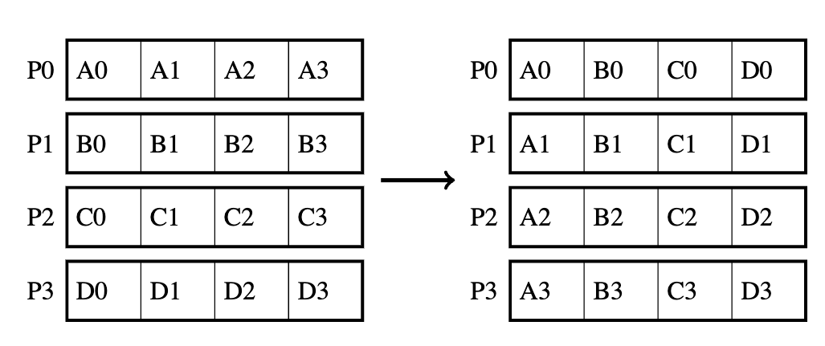
All to All
Every process sends data to and receives data from every other process in the communicator.
int MPI_Alltoall(void *sbuf, int scount, MPI_Datatype stype, void *rbuf, int rcount, MPI_Datatype rtype, MPI_Comm comm)
[9]
Notes:
Each process shares its data with all other processes.
recvbuf of target process stores data in rank order
• sendcount specifies no. of elements sent to each process
n applications like matrix transposes or Fast Fourier Transforms (FFTs), an MPI_Alltoall call is very helpful. This is an extension to MPI_Allgather where each process sends distinct data to each receiver. The j-th block from process i is received by process j and stored in the i-th block. A graphic representation of the MPI_Alltoall is shown below:

Slide 40
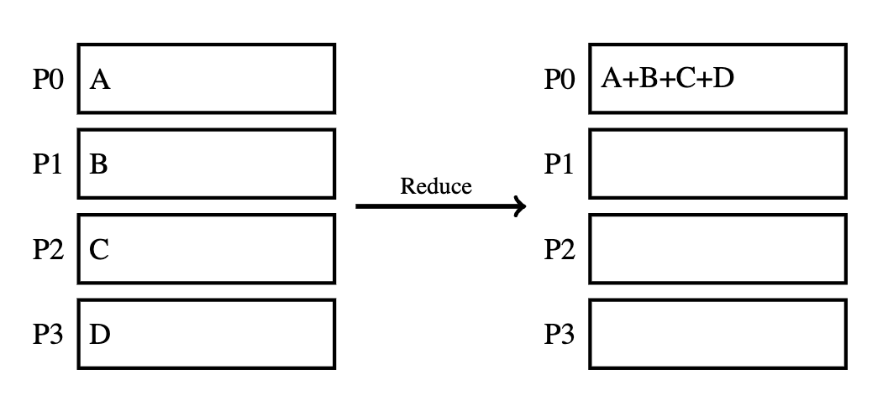
Reduce
A collective operation that combines data from all processes in a communicator using a specified operation (e.g., sum, minimum, maximum) and returns the result to one process (or all processes).
Common Function:
MPI_Reduce: Reduces data to a single process (root).
MPI_Allreduce: Reduces data and distributes the result to all processes.
[9]

Slide 41
int MPI_Reduce(void *sbuf, void *rbuf, int count, MPI_Datatype stype, MPI_Op op, int root, MPI_Comm comm)
int MPI_Allreduce(void *sbuf, void *rbuf, int count, MPI_Datatype stype, MPI_Op op, MPI_Comm comm)

Slide 42
MPI_Reduce_scatter: Combines data across all processes and scatters parts of the result back to each process.
int MPI_Reduce_scatter(void *sbuf, void *rbuf, int *rcount, MPI_Datatype stype, MPI_Op op, MPI_Comm comm)

Slide 43
MPI predefined operations
Name | Meaning | C type
MPI_MAX | maximum | integer, float
MPI_MIN | minimum | integer, float
MPI_SUM | sum | integer, float
MPI_PROD | product | integer, float
MPI_LAND | logical and | integer
MPI_BAND | bit-wise and | integer, MPI_BYTE
MPI_LOR | logical or | integer
MPI_BOR | bit-wise or | integer, MPI_BYTE
MPI_LXOR | logical xor | integer
MPI_BXOR | bit-wise xor | integer, MPI_BYTE
MPI_MAXLOC | max value and location | combination of int, float, double, and long double
MPI_MINLOC | min value and location | combination of int, float, double, and long double
[10]
Notes:
MPI predefined operations that can be used in calls to MPI_Reduce (or a variant)

Slide 44
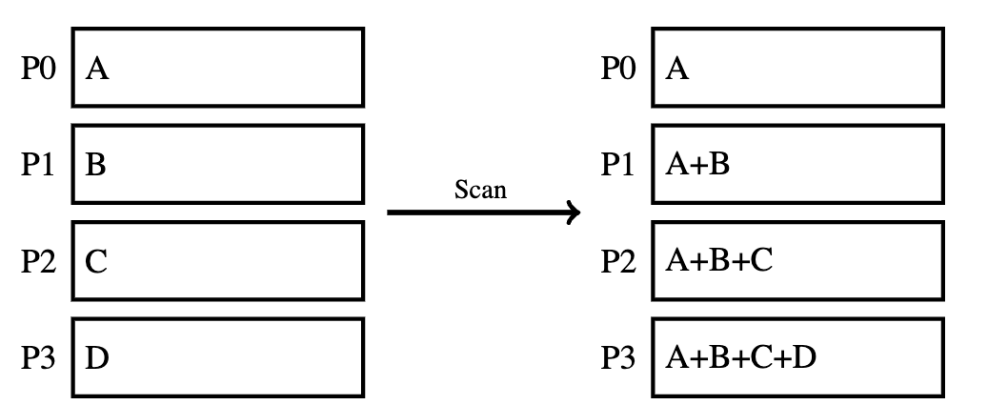
Scan
A collective operation that performs a prefix reduction (cumulative operation) across all processes in a communicator. Each process receives the result of the reduction up to its own rank.
int MPI_Scan(void *sbuf, void *rbuf, int count, MPI_Datatype datatype, MPI_Op op, MPI_Comm comm)
[9]
Notes:
Cumulative Reduction: Each process receives a partial reduction result that includes data from all preceding processes up to its own rank.
• Supported Operations: Works with built-in operations (MPI_SUM, MPI_PROD, MPI_MAX, MPI_MIN, etc.) and custom user-defined operations.
• Data Flow: Each process contributes its data, and the result is accumulated in a rank-order fashion.
• Use Cases:
• Computing prefix sums.
• Generating cumulative statistics (e.g., running totals).
• Building progressive results in parallel computations.

Slide 45
Evaluating Parallel Programs
Sequential execution time, t_{s}: Estimate by counting computational steps of best sequential algorithm.
Parallel execution time, t_{p}: In addition to number of computational steps, t_{comp}, need to estimate communication overhead, t_{comm}:
t_{p} = t_{comp} + t_{comm}

Slide 46
Communication Time
Many factors, including network structure and network contention. As a first approximation, use
t_{comm} = t_{startup} + nt_{data}
t_{startup} is startup time, essentially time to send a message with no data. Assumed to be constant.
t_{data} is transmission time to send one data word, also assumed constant, and there are n data words.

Slide 47

Benchmark Factors
With t_{s}, t_{comp}, and t_{comm}, can establish speedup factor and computation/communication ratio for a particular algorithm/implementation:
Both functions of number of processors, p, and number of data elements, n.
Speedup factor gives indication of scalability of parallel solution with increasing number of processors and problem size.
Computation/communication ratio will highlight effect of communication with increasing problem size and system size.

Slide 48
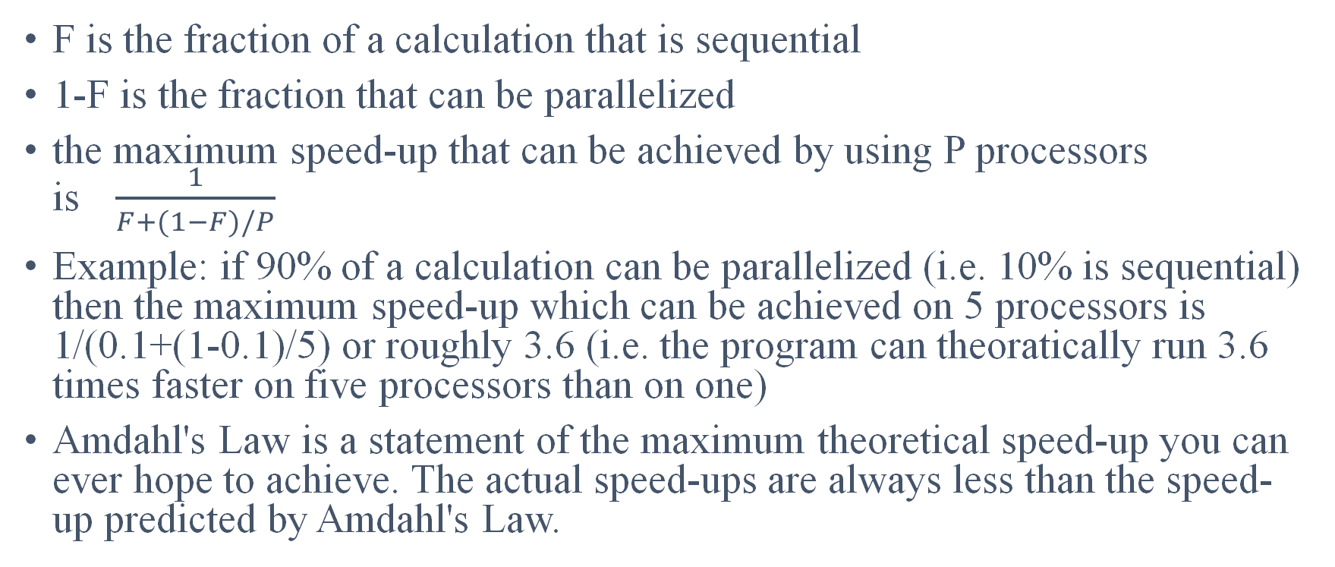
Amdahl's Law
F is the fraction of a calculation that is sequential
1-F is the fraction that can be parallelized
the maximum speed-up that can be achieved by using P processors is$\frac{1}{F+(1−F)/P}$
Example: if 90% of a calculation can be parallelized (i.e. 10% is sequential) then the maximum speed-up which can be achieved on 5 processors is 1/(0.1+(1-0.1)/5) or roughly 3.6 (i.e. the program can theoratically run 3.6 times faster on five processors than on one)
Amdahl's Law is a statement of the maximum theoretical speed-up you can ever hope to achieve. The actual speed-ups are always less than the speed-up predicted by Amdahl's Law.

Slide 49
!!!! Trivia Time !!!!
https://www.flexiquiz.com/live

Slide 50
GitHub
https://github.com/jonathanoberry/MPI_Pres_Files

Slide 51
References
[1] A. S. Gillis and S. J. Bigelow, “What is message passing interface (MPI)?,” Enterprise Desktop, https://www.techtarget.com/searchenterprisedesktop/definition/message-passing-interface-MPI (accessed Sep. 13, 2024).
[2] Download Microsoft MPI V10.1.3 from official Microsoft Download Center, https://www.microsoft.com/en-us/download/details.aspx?id=105289 (accessed Sep. 13, 2024).
[3] NERSC, “Cray MPICH,” Cray MPICH - NERSC Documentation, https://docs.nersc.gov/development/programming-models/mpi/cray-mpich/ (accessed Sep. 13, 2024).
[4] IBM, “IBM Spectrum MPI - Overview,” IBM, https://www.ibm.com/products/spectrum-mpi?utm_content=SRCWW&p1=Search&p4=43700067987454015&p5=p&p9=58700007548292905&gclid=CjwKCAjwxY-3BhAuEiwAu7Y6s5rb1xR9H6NwqLsTcAFoxi80pSOMxg87zUly_piX0KoPXaBqsFWRzhoC0qkQAvD_BwE&gclsrc=aw.ds (accessed Sep. 13, 2024).
[5] Intel, “Intel® MPI Library,” Intel, https://www.intel.com/content/www/us/en/developer/tools/oneapi/mpi-library.html#gs.ejds3u (accessed Sep. 13, 2024).
[6] “Deinompi,” DeinoMPI - High Performance Parallel Computing for Windows, https://mpi.deino.net/ (accessed Sep. 13, 2024).
[7] OpenMPI, “9.1. quick start: Building MPI applications,” 9.1. Quick start: Building MPI applications - Open MPI 5.0.x documentation, https://docs.open-mpi.org/en/v5.0.x/building-apps/quickstart.html (accessed Sep. 14, 2024).

Slide 52
References
[8] Xiao Qin, Hong Jiang, A. Manzanares, Xiaojun Ruan, and Shu Yin, “Communication-aware load balancing for parallel applications on clusters,” IEEE Transactions on Computers, vol. 59, no. 1, pp. 42–52, Jan. 2010. doi:10.1109/tc.2009.108
[9] D. Bindel, ”Applications of Parallel Computers, MPI Programming," Cornell University, Oct. 6, 2020. [Online]. Available: https://www.cs.cornell.edu/courses/cs5220/2020fa/lec/2020-10-06-mpi.html. [Accessed: Sep. 15, 2024].
[10] Cornell Virtual Workshop, "Introduction to MPI Collective Communication," Cornell University. [Online]. Available: https://cvw.cac.cornell.edu/mpicc/intro/index. [Accessed: Sep. 15, 2024].
[11] NSA, “Capt. Grace Hopper on Future Possibilities: Data, Hardware, Software, and People (Part One, 1982),” YouTube, https://www.youtube.com/watch?v=si9iqF5uTFk (accessed Sep. 15, 2024).

Slide 53
Thank You

Slide 54
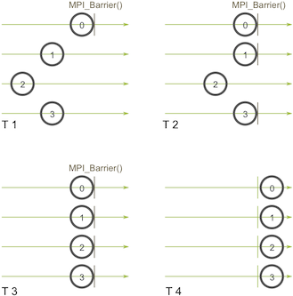
Barrier
Notes:
Process zero first calls MPI_Barrier at the first time snapshot (T 1). While process zero is hung up at the barrier, process one and three eventually make it (T 2). When process two finally makes it to the barrier (T 3), all of the processes then begin execution again (T 4).
MPI_Barrier can be useful for many things. One of the primary uses of MPI_Barrier is to synchronize a program so that portions of the parallel code can be timed accurately.

Slide 55
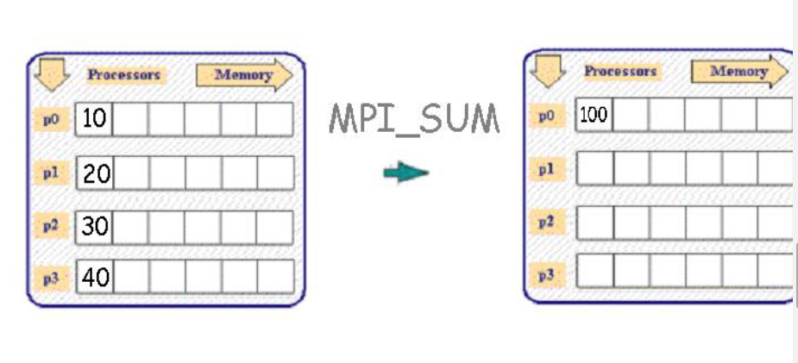

Slide 56
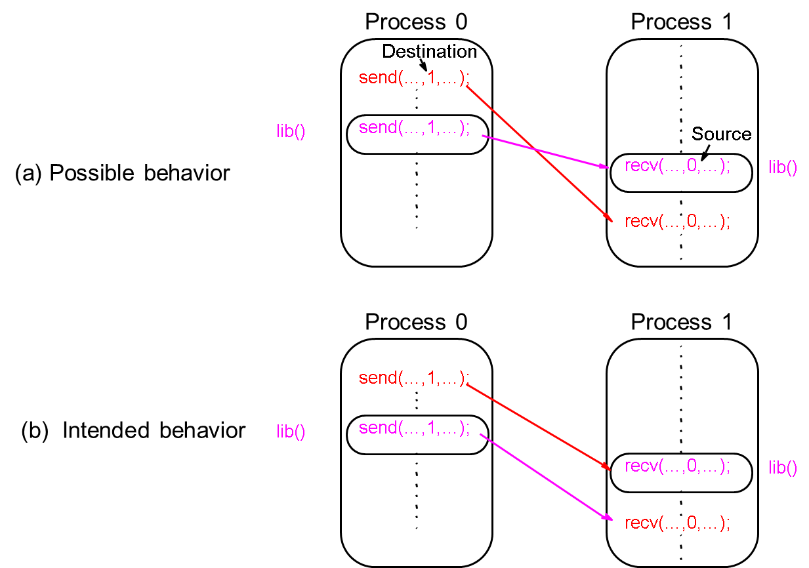
Message passing - Example

Slide 57
Message Tag
Used to differentiate between different types of messages being sent.
Message tag is carried within message.
If special type matching is not required, a wild card message tag, MPI_ANY_TAG, is used, so that the recv() will match with any send().

Slide 58
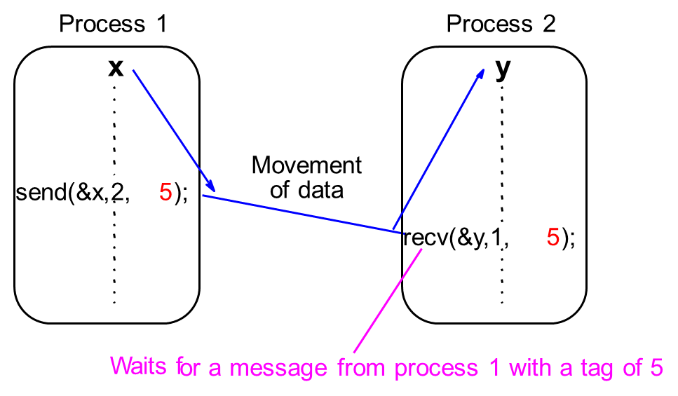
Message Tag Example
To send a message, x, with message tag 5 from a source process, 1, to a destination process, 2, and assign to y:

Slide 59
Retrieving Further Information
Status is a data structure allocated in the user’s program.
In C:
int recvd_tag, recvd_from, recvd_count;
MPI_Status status;
MPI_Recv(..., MPI_ANY_SOURCE, MPI_ANY_TAG, ..., &status )
recvd_tag = status.MPI_TAG;
recvd_from = status.MPI_SOURCE;
MPI_Get_count( &status, datatype, &recvd_count );

Slide 60

Collective Communication
Involves set of processes, defined by a communicator. Message tags not present. Principal collective operations:
MPI_Bcast() - Broadcast from root to all other processes
MPI_Gather() - Gather values for group of processes
MPI_Scatter() - Scatters buffer in parts to group of processes
MPI_Alltoall() - Sends data from all processes to all processes
MPI_Reduce() - Combine values on all processes to single value
MPI_Reduce_scatter() - Combine values and scatter results
MPI_Scan() - Compute prefix reductions of data on processes

Slide 61
Broadcast
Sending the same message to all processes.
int MPI_Bcast(void *buffer, int count, MPI_Datatype datatype, int root, MPI_Comm comm)
Process 0
Process 1
Process
p
-
1
data
data
data
Action
buf
bcast();
bcast();
bcast();
Code

Slide 62
Reduce
Gather operation combined with specified arithmetic/logical operation.
Example: Values could be gathered and then added together by root:
int MPI_Reduce(void *sendbuf, void *recvbuf, int count, MPI_Datatype datatype, MPI_Op op, int root, MPI_Comm comm)
Process 0
Process 1
Process
p
-
1
data
data
data
Action
buf
+
reduce();
reduce();
reduce();
Code

Slide 63
MPI Operations for MPI_Reduce
MPI operation Meaning MPI_MAX maximum, max MPI_MIN minimum, min MPI_SUM sum MPI_PROD product MPI_LAND logical and MPI_LOR logical or MPI_LXOR logical exclusive or MPI_BAND bitwise and MPI_BOR bitwise or MPI_BXOR bitwise exclusive or

Slide 64
Example: Factorial of n
#include <stdio.h> #include <stdlib.h> #include <mpi.h> int main(int argc, char** argv) { int MyRank, NumProcs, i, n, first, last, prod=1, result=1, Root=0; MPI_Init(&argc, &argv); MPI_Comm_rank(MPI_COMM_WORLD, &MyRank); MPI_Comm_size(MPI_COMM_WORLD, &NumProcs); MPI_Bcast(&n, 1, MPI_INT, Root, MPI_COMM_WORLD); first = (MyRank*n)/NumProcs; last = ((MyRank+1)*n)/NumProcs; //Last is the first element of the next processor for(i=first+1; i<=last; i++) prod*=i; MPI_Reduce(&prod, &result, 1, MPI_INT, MPI_PROD, Root, MPI_COMM_WORLD); if(MyRank == Root) printf("\nFactorial %d is %d", n, result); MPI_Finalize(); return 0; }
A program to calculate the factorial of n numbers using p processors. The number n is input by the user. Root broadcasts the number to all the processes in MPI_COMM_WORLD. Each processor computes its share of the product, and the result is collected back in root using MPI_PROD as the reduce function.

Slide 65
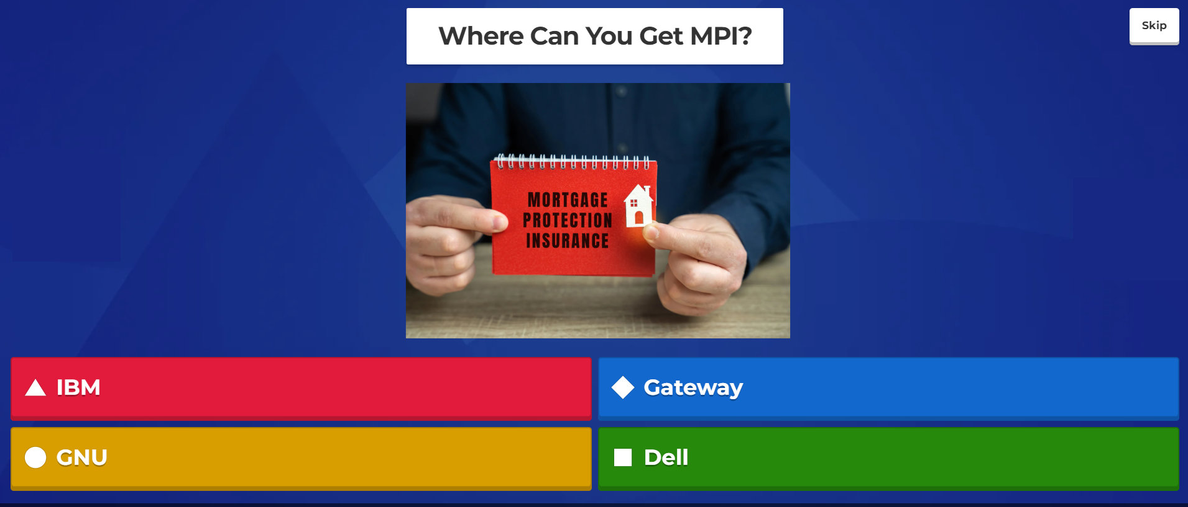

Slide 66

The Correct Answer Is:

Slide 67
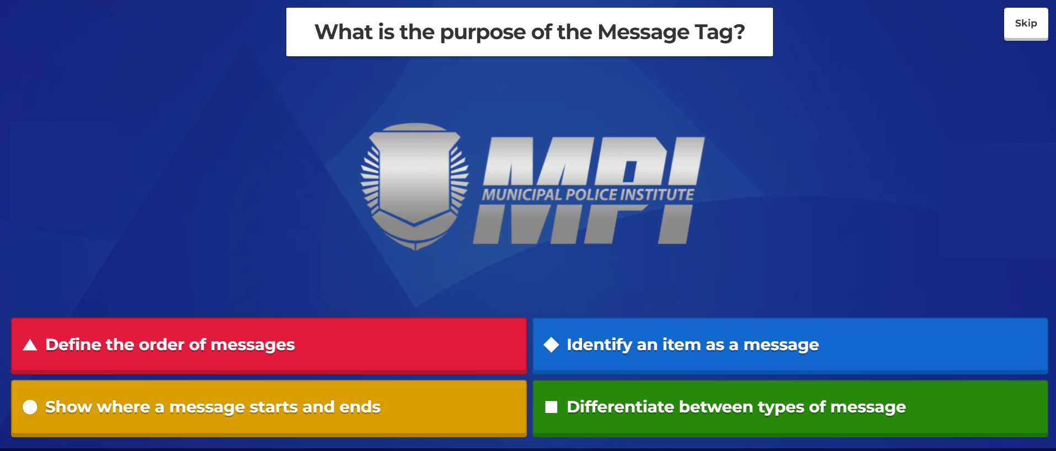

Slide 68
The Correct Answer Is:

Slide 69


Slide 70
The Correct Answer Is:

Slide 71
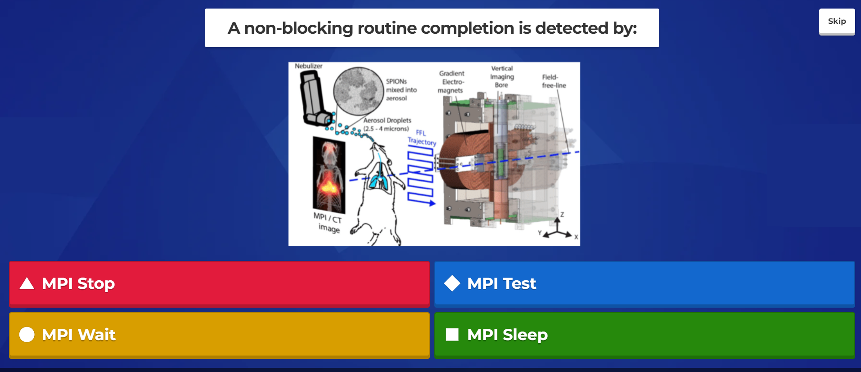

Slide 72
The Correct Answer Is:

