Slide 1
Simple Store Application

Slide 2
Solution Architecture
Frontend: User interacts with a simple and clean web-based user interface.
Backend: Handles user requests, item management, cart management, and logging.

Slide 3
Technology Stack
Frontend:
HTML, CSS, JavaScript
React.js (or another frontend library/framework of your choice)
Backend:
Node.js (for server-side JavaScript)
Express.js (for building APIs and handling requests)
Database: SQLite (for its simplicity and lightweight nature, suitable for your requirements)
Framework and Libraries:
Frontend:
React.js: For building the dynamic user interface and managing state.
Axios: For making API requests to the backend.
Backend:
Express.js: For creating API endpoints and handling HTTP requests.
Sequelize (optional): For database interactions (even though you're using SQLite, Sequelize can help with a consistent data access pattern).

Slide 4
Sprint Duration: 2 Weeks
Sprint Goal: Implement a functional web-based app for price calculation, quantity tracking, and logging.
Sprint To-Do List:
Week 1: Planning and Setup and creating React frontend
Project Setup and Initial Design
Set up the development environment (Node.js, npm).
Sketch a basic wireframe for the user interface.
Frontend UI Framework and Styling
Create the main layout with React.js and CSS
Implement the basic UI components (item cards, cart, buttons).
Apply a simple and clean design.

Slide 5
Sprint Duration: 2 Weeks
Sprint Goal: Implement a functional web-based app for price calculation, quantity tracking, and logging.
Sprint To-Do List:
Week 2: Integrating a React frontend with an Express.js backend, SQLite for database storage, and Axios for making API requests
Backend and Database Creation
Set Up Express.js Server
Set Up Axios in React
Integrate React with Express
Configure Proxy for Development

Slide 6
Steps to Implement
Design the SQLite database schema for storing item details and logs.
Implement the backend API endpoints for fetching items, managing the cart, and handling the checkout process.
Create the frontend UI with React.js, displaying the items, quantities, and cart functionality.
Integrate the frontend with the backend using API calls.
Implement the logging mechanism to record quantity sold and price logs in the SQLite database.
Test the application thoroughly, addressing any bugs or issues.
Optimize and refine the UI for a simple and clean look.
Deploy the application to a free web host (e.g., GitHub Pages, Netlify, Vercel).
Note:
Since user authentication is not needed, you can simplify the overall application architecture and skip the authentication-related components.
Please keep in mind that some free web hosts might have limitations, such as storage and bandwidth restrictions. You may need to ensure that your chosen host supports the technologies and database setup you intend to use.
Remember to follow best practices for code organization, error handling, and security (even though this is a basic app) to ensure a smooth and reliable user experience.

Slide 7
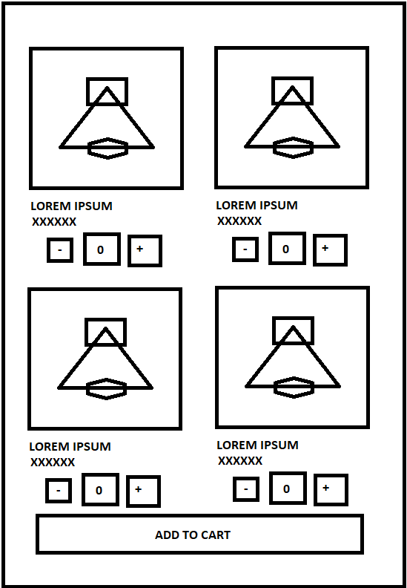
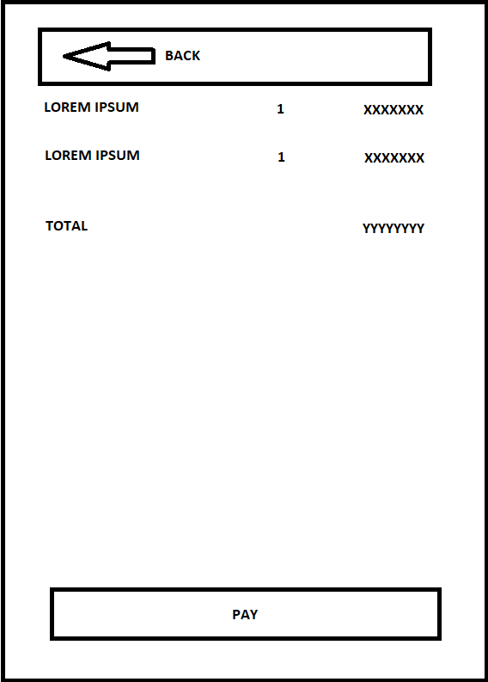
DESIGN

