Slide 2
Solution Architecture
Frontend: User interacts with a simple and clean web-based user interface.
Backend: Handles user requests, item management, cart management, and logging.

Slide 3
Technology Stack
Frontend:
HTML, CSS, JavaScript
React.js (or another frontend library/framework of your choice)
Backend:
Node.js (for server-side JavaScript)
Express.js (for building APIs and handling requests)
Database: SQLite (for its simplicity and lightweight nature, suitable for your requirements)
Framework and Libraries:
Frontend:
React.js: For building the dynamic user interface and managing state.
Axios: For making API requests to the backend.
Backend:
Express.js: For creating API endpoints and handling HTTP requests.
Sequelize (optional): For database interactions (even though you're using SQLite, Sequelize can help with a consistent data access pattern).

Slide 4
Steps to Implement
Design the SQLite database schema for storing item details and logs.
Implement the backend API endpoints for fetching items, managing the cart, and handling the checkout process.
Create the frontend UI with React.js, displaying the items, quantities, and cart functionality.
Integrate the frontend with the backend using API calls.
Implement the logging mechanism to record quantity sold and price logs in the SQLite database.
Test the application thoroughly, addressing any bugs or issues.
Optimize and refine the UI for a simple and clean look.
Deploy the application to a free web host (e.g., GitHub Pages, Netlify, Vercel).
Note:
Since user authentication is not needed, you can simplify the overall application architecture and skip the authentication-related components.
Please keep in mind that some free web hosts might have limitations, such as storage and bandwidth restrictions. You may need to ensure that your chosen host supports the technologies and database setup you intend to use.
Remember to follow best practices for code organization, error handling, and security (even though this is a basic app) to ensure a smooth and reliable user experience.

Slide 5
Sprint Duration: 2 Weeks
Sprint Goal: Implement a functional web-based app for price calculation, quantity tracking, and logging.
Sprint To-Do List:
Week 1: Planning and Setup
Day 1-2: Project Setup and Initial Design
Set up the development environment (Node.js, npm).
Create a new React.js project using a boilerplate.
Sketch a basic wireframe for the user interface.
Day 3-4: Backend Setup and API Design
Initialize an Express.js server.
Design API endpoints for fetching items and managing the cart.
Define the database schema for SQLite.
Day 5: Frontend UI Framework and Styling
Create the main layout with HTML and CSS.
Implement the basic UI components (item cards, cart, buttons).
Apply a simple and clean design.

Slide 6
Sprint To-Do List:
Week 2: Implementation and Deployment
4. Day 6-7: Frontend Functionality
Implement fetching and displaying items from the API.
Implement adding/removing items to/from the cart.
Implement the cart reset functionality.
Day 8-9: Backend Logic
Write API handlers for cart management and checkout.
Implement logging of quantity sold and price.
Test the backend logic thoroughly.
Day 10: Integration and Testing
Integrate frontend and backend through API calls.
Test end-to-end functionality of the app.
Address any bugs or issues.
Day 11-12: Optimization and Finalization
Refine the UI for better user experience.
Optimize the codebase for performance.
Ensure responsive design for various screen sizes.
Day 13: Documentation and Deployment
Write clear documentation for setting up and running the project.
Deploy the app to a free web host (e.g., GitHub Pages, Netlify).
Perform final testing on the deployed app.

Slide 7
Best Practices for Each Task:
Project Setup and Initial Design:
Use version control (e.g., Git) from the beginning.
Consider using a UI framework (e.g., Bootstrap) for consistent styling.
Backend Setup and API Design:
Follow RESTful API design principles for clean and intuitive endpoints.
Keep the API endpoints organized and modular.
Frontend UI Framework and Styling:
Focus on creating a simple and intuitive user interface.
Use semantic HTML for better accessibility.
Frontend Functionality:
Practice modular programming for reusable components.
Implement error handling for API calls and user interactions.
Backend Logic:
Keep API handlers and logic separate for maintainability.
Sanitize and validate input data to prevent security vulnerabilities.
Integration and Testing:
Perform thorough unit testing and integration testing.
Use tools like Postman for testing API endpoints.
Optimization and Finalization:
Minimize unnecessary requests and optimize rendering.
Use CSS frameworks (e.g., BEM) for organized styling.
Documentation and Deployment:
Write comprehensive setup instructions and API documentation.
Ensure the deployed app is accessible and functional.

Slide 8
Day 1-2: Project Setup and Initial Design
Step 1: Set up the Development Environment (Node.js, npm): Node.js is a JavaScript runtime that allows you to execute JavaScript code on the server side. npm (Node Package Manager) is a tool that helps you manage and install libraries and packages.
Step 2: Create a New React.js Project: React.js is a JavaScript library for building user interfaces. You'll create a new React project using a tool called "Create React App."
Step 3: Sketch a Basic Wireframe for the User Interface: Sketching a wireframe helps you plan the layout and structure of your app's user interface.

Slide 9
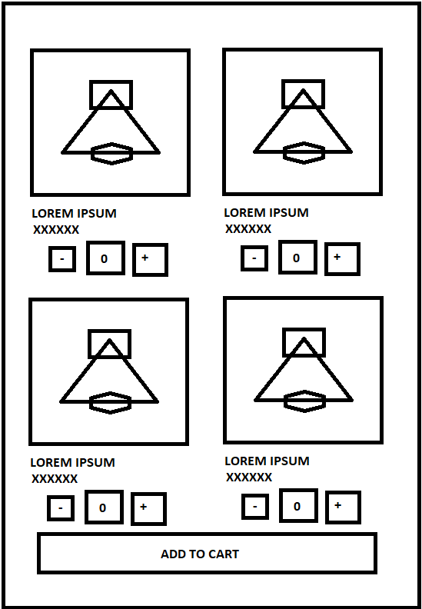
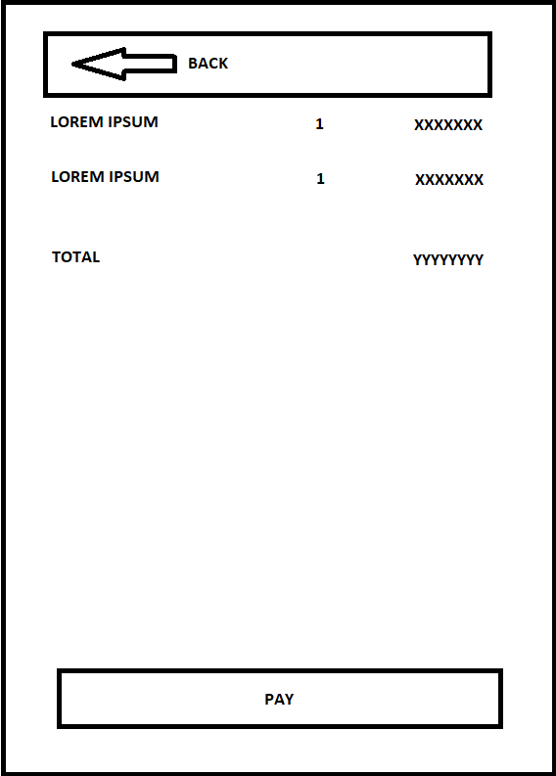
DESIGN

