Slide 1
Overview of Class Problem

Slide 2
Objective
The objective of this exercise is to demonstrate the procedure for developing a three-dimensional saltwater intrusion model using SEAWAT.

Slide 3
Exercise Parts
Exercise B. Design and run a 2D cross-section model to obtain the steady-state pre-withdrawal distribution of head and salinity
Exercise C: Design and run a 3D model to determine the effects of groundwater pumping on saltwater interface movement
Exercise C (cont): Determine wellfield protection area

Slide 4
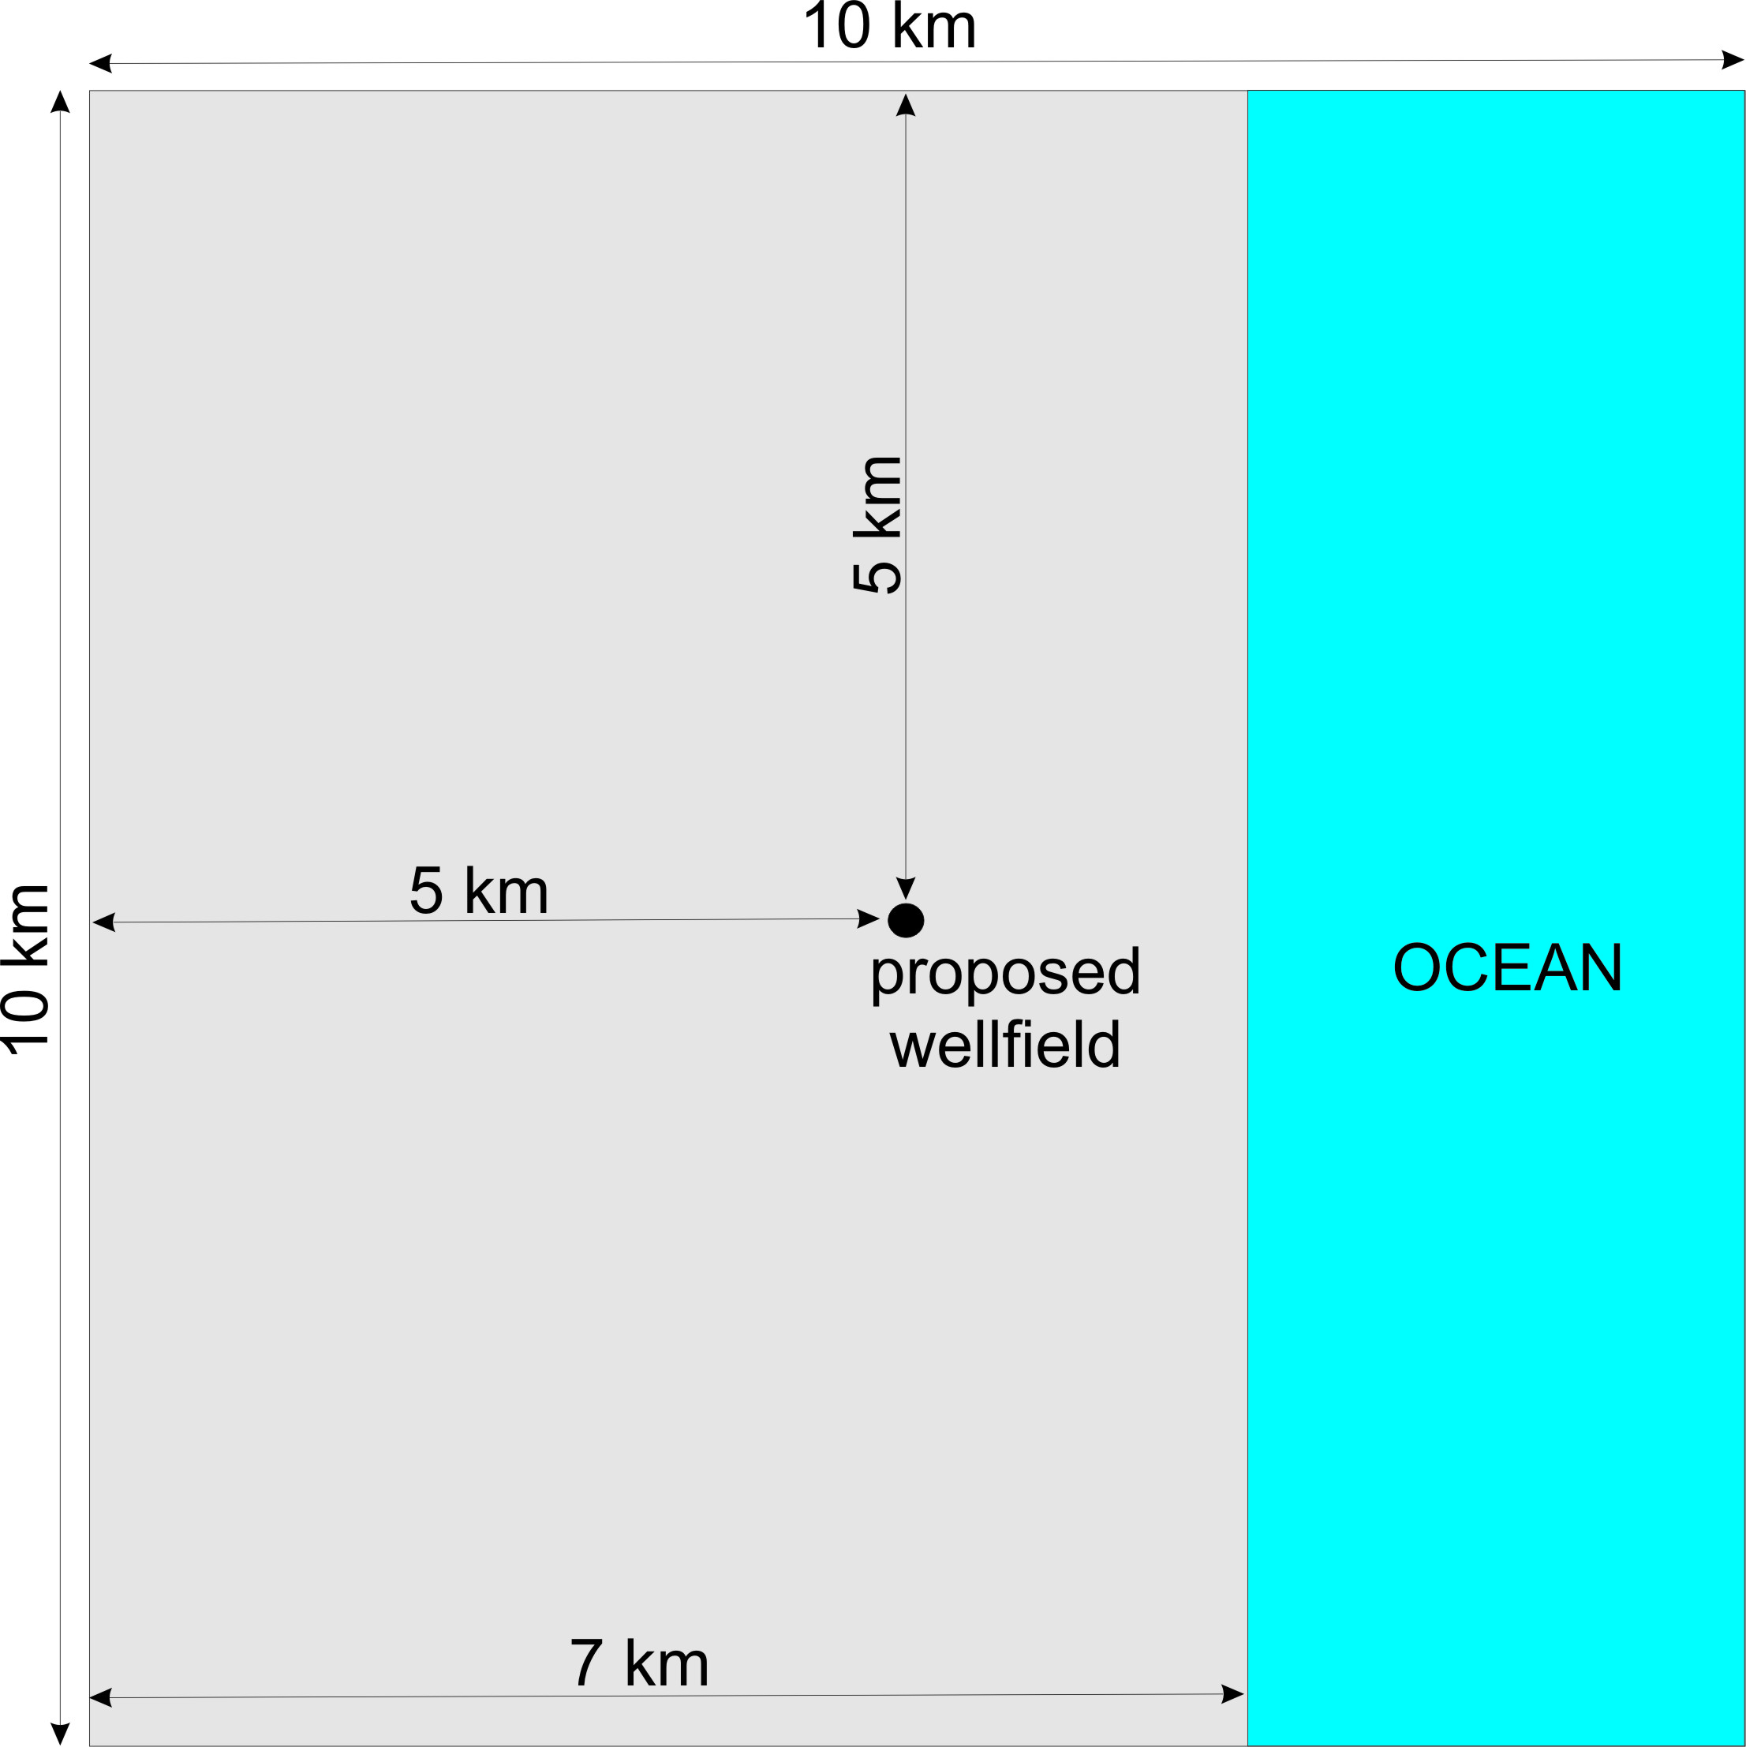
Map View

Slide 5
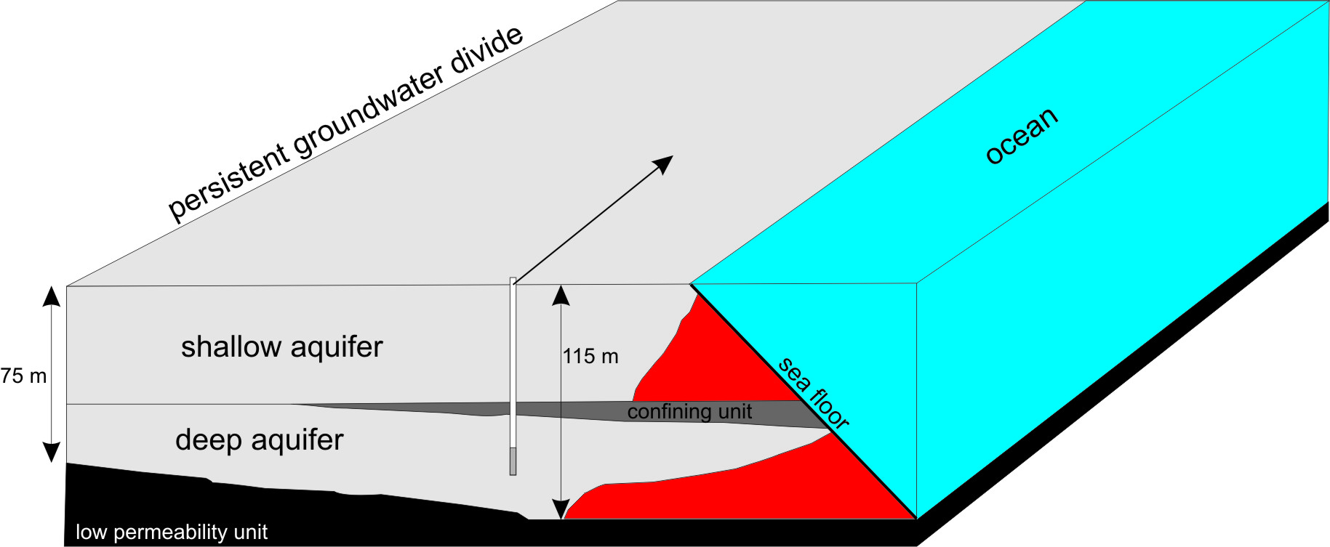
Block Diagram

Slide 6
Concepts/Skills to Focus On
Transport options in MT3DMS/SEAWAT
Numerical dispersion
Mass balance
Animation of SEAWAT results with Modelviewer
Use of SEAWAT results with other applications such as MODPATH
Creation of SEAWAT datasets using FloPy
Post processing of SEAWAT results using Python

Slide 7
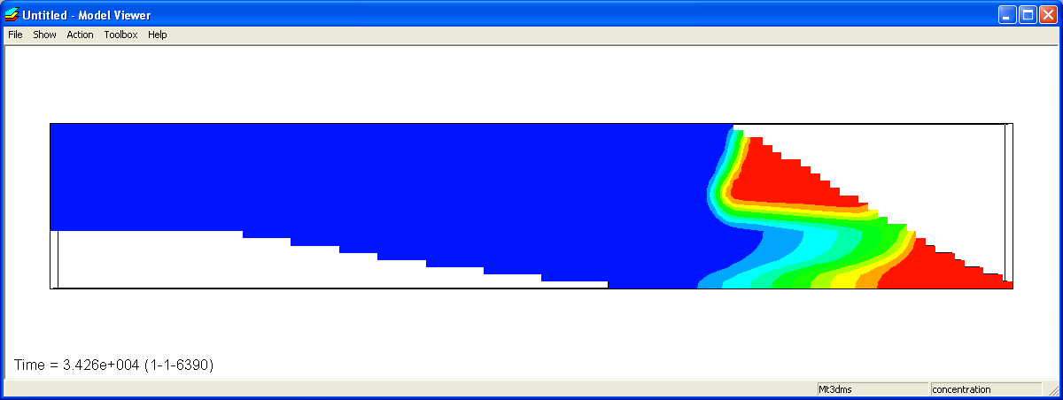
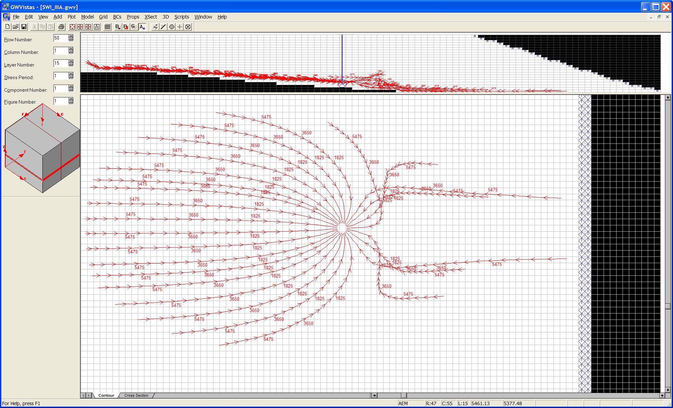
What to Expect

