Slide 1
SWIM Short Course SEAWAT Concepts
2018 Salt Water Intrusion Meeting
June 17 – 22, 2018
Gdansk, Poland

Slide 2
SEAWAT Computer Program
Finite difference
Combined version of MODFLOW and MT3DMS
Designed to simulate transient, three-dimensional, fully saturated, variable-density groundwater flow

Slide 3
Approaches for Representing Variable-Density Flow
Ignore it!
Sharp interface approach
Fully coupled flow and dispersive transport approach

Slide 4
Classes of Variable-Density Models
Sharp Interface Approach
Fast
No dispersion
Dispersed Interface Approach
Can predict changes in concentration
Represent free convection processes
Slow

Slide 5
Why use SEAWAT?
Accurate
Documented
Public domain
Relatively easy to use
Based on MODFLOW and MT3D
Modular—Process/Package approach
Compatible with existing pre and post processors
Compatible with a wide range of utility programs (MODPATH, ZONEBUDGET, etc)

Slide 6
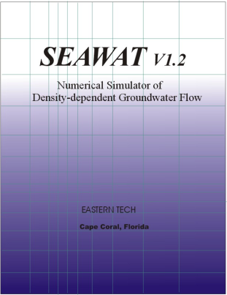
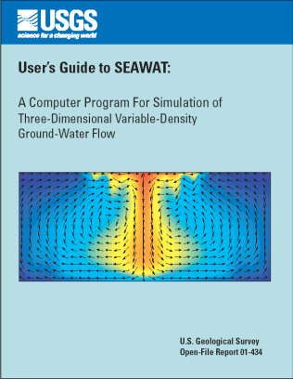
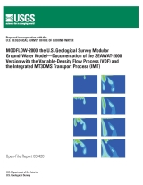
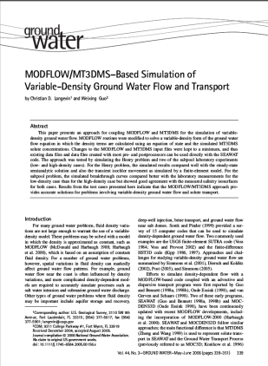
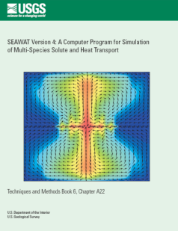
Documentation
Version 1
Guo, W., and Bennett, G.D., 1999, SEAWAT Version 1.2: A computer program for simulations of groundwater flow of variable density: Eastern Tech, Cape Coral, Florida.
Version 2
Guo, W., and Langevin, C.D., 2002, User’s guide to SEAWAT: A computer program for simulation of three-dimensional variable-density ground-water flow: U.S. Geological Survey Techniques of Water Resources Investigations Book 6, Chapter A7, 79 p.
Version 3
Langevin, C.D., Shoemaker, W.B., and Guo, Weixing, 2004, MODFLOW-2000, the U.S. Geological Survey Modular Ground-Water Model–Documentation of the SEAWAT-2000 Version with the Variable-Density Flow Process (VDF) and the Integrated MT3DMS Transport Process (IMT): U.S. Geological Survey Open-File Report 03-426, 43 p.
Langevin, C.D., and Guo, W., 2006. MODFLOW/MT3DMS-based simulation of variable density ground water flow and transport: Ground Water vol. 44, no. 3:339-351.
Version 4
Langevin, C.D., Thorne, D.T., Dausman, A.M., Sukop, M.C., and Guo, Weixing, 2008, SEAWAT Version 4: A computer program for simulation of multi-species solute and heat transport. U.S. Geological Survey Techniques and Methods Book 6, Chapter A22, 39 p.

Slide 7
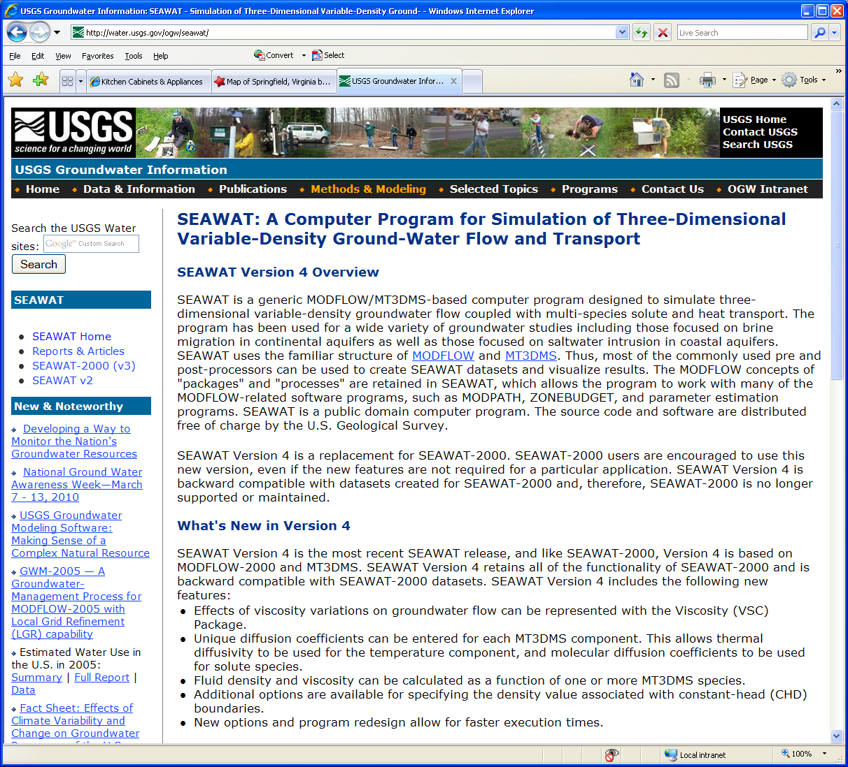
Public Domain
http://water.usgs.gov/ogw/seawat

Slide 8
SEAWAT Concept
Combine MODFLOW and MT3DMS into a single program
Insert MT3DMS into MODFLOW main program
Modify MODFLOW routines to solve the variable-density groundwater flow equation

Slide 9
Fluid Density (ρ)
Total Mass (fluid and salt) / Volume
Dimensions [ML⁻³]
Commonly denoted with ρ
Typical Values for Water
Fresh: ρ = 1000 kg/m³; ρ = 62.43 lbs/ft³
Seawater: ρ = 1025 kg/m³; ρ = 64.00 lbs/ft³

Slide 10
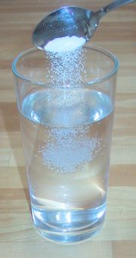
Solute Concentration (C)
Solute mass fraction (ω)
Mass of solute / total mass of fluid
Solute volumetric concentration (C)
Mass of solute / volume of fluid
Relation: C = ρ * ω

Slide 11
Head-Based Formulation?
Many variable-density codes solve equations in terms of pressure, but equations can also be formulated using head
Why head instead of pressure?
Perhaps more intuitive
Use popular codes, such as MODFLOW?
Complication: what is “head” in a variable-density system?

Slide 12
Measures of Head
piezometer filled
with aquifer water
at well opening
piezometer filled
with freshwater
piezometer filled
with adjacent aquifer water
h_{f}
h
h_{e}
freshwater
brackish water
seawater
point-water
head (h)
freshwater
head (h_{f})
environmental
head (h_{e})

Slide 13
Point-Water and Freshwater Head
A
B
Piezometer filled
with freshwater
Piezometer filled
with saline water
h: head
h_{f}: equivalent freshwater head
P: pressure
ρ: density
ρ _{f} : density of freshwater
g: gravity
Z: elevation
N
Datum

Slide 14
Converting between h_{f} and h

Slide 15
Why use h_{f} in SEAWAT?
Conceptually straightforward (i.e. for freshwater system, h_{f} = h)
Finite-difference form of governing equation can be solved by MODFLOW (with a few modifications)

Slide 16
Darcy’s Law
equivalent freshwater head and hydraulic conductivity
pressure and permeability
can assume

Slide 17
Governing Equation for Variable-Density Flow
or

Slide 18
Governing Equation for Solute Transport
ADV
DSP
SSM
RCT

Slide 19
Equation of State
Equation of state is used to relate fluid density to pressure, temperature, and concentration
Most rigorous form:
ρ = ρ ₀exp[B_{P}(P-P₀) + B_{T}(T-T₀)+Β_{C}(C-C₀)]
Β_{P} = 1/ ρ*δρ/δP|_{T,C} (fluid compressibility)
Β_{T} = 1/ ρ*δρ/δT|_{P,C} (fluid coefficient of thermal expansion)
Β_{C} = 1/ ρ*δρ/δC|_{P,T} (slope of fluid density as a function of solute concentration, divided by reference density)
A linear approximation is often used, which can be written as:
ρ = ρ ₀[1 + B_{P}(P-P₀) + B_{T}(T-T₀)+Β_{C}(C-C₀)], or
ρ = ρ ₀+ dρ/dP* (P-P₀) + dρ/dT* (T-T₀) + dρ/dC* (C-C₀)]
In SEAWAT, we assume that density is not affected by pressure or temperature, and that the reference density is freshwater with a concentration of zero
ρ = ρ _{f} + dρ/dC * C
DENSE = DENSEREF + DENSESLP * CONC
Value for dρ/dC is about 0.7143 (25/35) for a freshwater-seawater mixture, if density and concentration are expressed in equivalent units
Note: parts of this taken from Kipp (1987), Kolditz et al. (1998) and Diersch and Kolditz (2002)

Slide 20
Coupled Flow and Transport
Groundwater flow is affected by fluid density
q = f(ρ,…)
Concentration is affected by flow velocity (advection and dispersion)
C = f(q,…)
Fluid density is function of solute concentration
ρ = f(C)

Slide 21
Solute Transport Processes
Physical Transport of solute
Advection
Diffusion
Mechanical Dispersion
Reactive Transport
Geochemical reactions
Biological reactions

Slide 22
Advection
Transport of solute in flowing groundwater with average groundwater velocity
In most cases, advection is primary process for solute transport

Slide 23
Dispersion
Spreading of a solute over a greater area than would be predicted solely from average groundwater velocity
v Δ t₂
vΔt₁
Longitudinal dispersion
Transverse dispersion

Slide 24
Molecular Diffusion
(A) Container with saline water and distilled water separated by a glass plate
(B) Ionic distribution after removal of glass plate
Spread of solute caused by concentration gradients
(C) Ionic distribution at time t1 after removal of plate
(D) Final ionic distribution

Slide 25
Mechanical Dispersion
Spreading of solute as a result of differences in actual velocity and average velocity
Pore Scale
Macro Scale

Slide 26
Governing Equation for Solute Transport
ADV
DSP
SSM
RCT
Or, as in MT3DMS
DSP
ADV
SSM
RCT

Slide 27
Heat/Energy Transport (conserve Energy/Mass)
Stored
Conducted and Dispersed
Convected
Sink/Source
RCT(produced/lost)

Slide 28
Heat transport…
Solute transport…

Slide 29
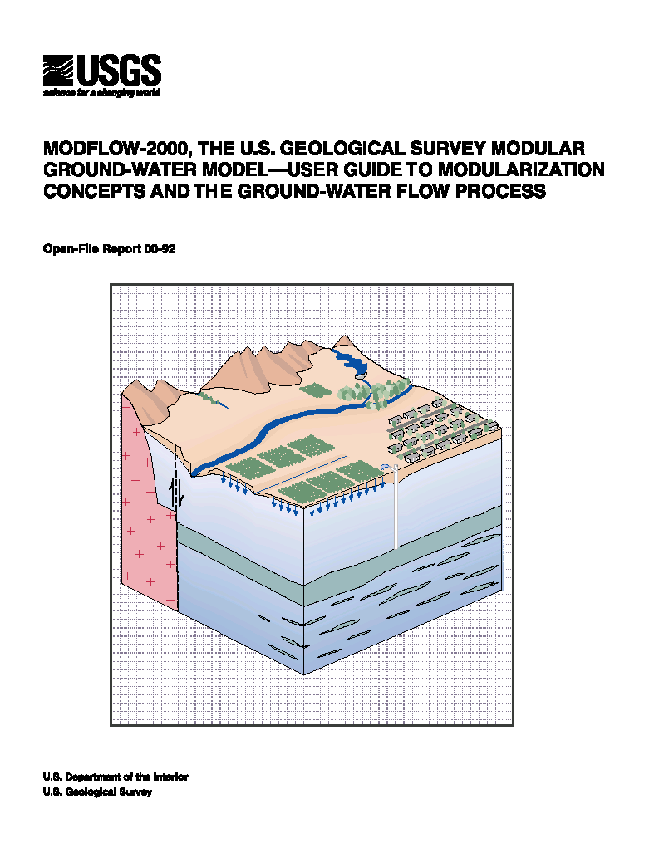
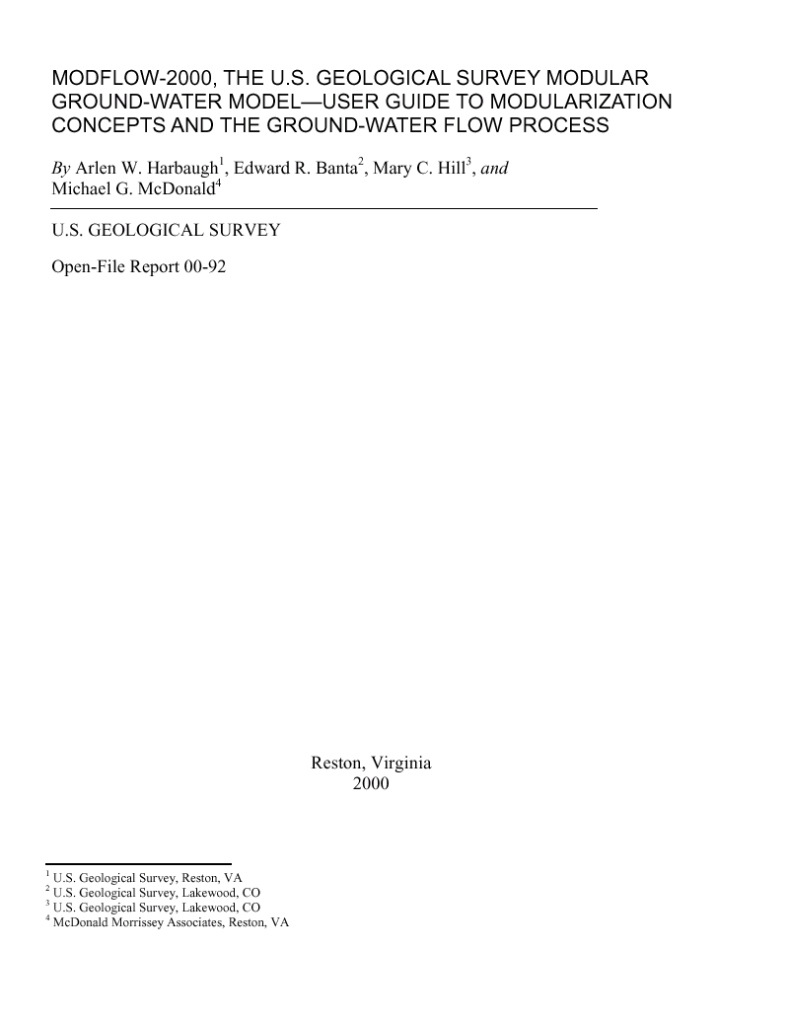
MODFLOW-2000
http://water.usgs.gov/software/modflow.html

Slide 30
List of Packages (included with MF2K version 1.17)
BAS6 -- Basic Package
BCF6 -- Block-Centered Flow Package
LPF1 -- Layer-Property Flow Package
RIV6 -- River Package
DRN6 -- Drain Package
WEL6 -- Well Package
GHB6 -- General Head Boundary Package
RCH6 -- Recharge Package
EVT6 -- Evapotranspiration Package
CHD6 -- Time-Variant Specified-Head Package
HFB6 -- Horizontal Flow Barrier Package
SIP5 -- Strongly Implicit Procedure Package
SOR5 -- Slice Successive Over-Relaxation Package
PCG2 -- Version 2 of Preconditioned Conjugate Gradient Package
DE45 -- Direct solver
LMG1 -- Multigrid solver (for USGS use only)
STR6 -- Streamflow-Routing Package
ADV2 -- Advective-Transport Observation Package
RES1 -- Reservoir Package (RES is the file type in the MODFLOW name file)
FHB1 -- Flow and Head Boundary Package (FHB is the file type in the MODFLOW name file)
IBS6 -- Interbed Storage (subsidence) Package (IBS is the file type in the name file)
HUF2 -- Hydrogeologic-Unit Flow Package
LAK3 -- Lake Package
ETS1 -- Evapotranspiration with a Segmented Function Package
DRT1 -- Drains with Return Flow Package
LMT6 -- Link to MT3DMS contaminant-transport model
MNW1 -- Multi-Node Well Package
DAF1 -- Diffusion Analogy Surface-Water Flow Package
SUB1 -- Subsidence and Aquifer-System Compaction Package
SFR2 -- Stream-Flow Routing Package, version 2
GMG1 -- Geometric MultiGrid Solver Package
Bold indicates package not compatible with SEAWAT-2000

Slide 31
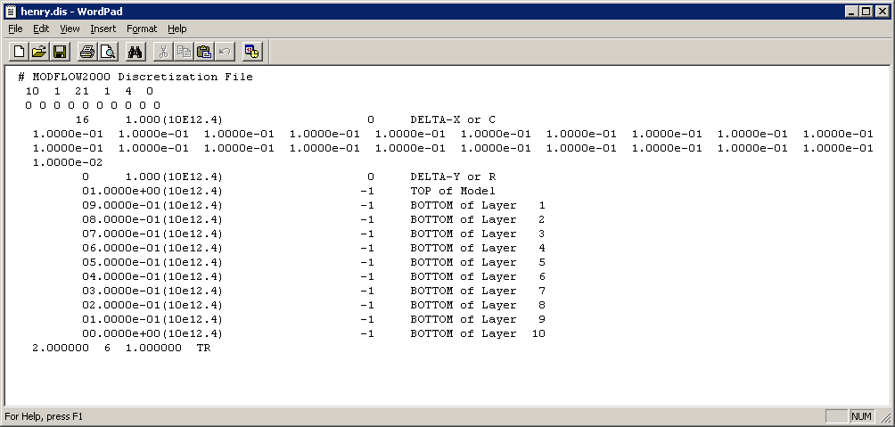
Discretization File
NLAY, NROW, NCOL, NPER, ITMUNI, LENUNI
Existence of Quasi-3D Confining Units
DELR
DELC
TOP elevation of system
Bottom elevation of each model layer and Quasi-3D Confining Unit
PERLEN, NSTP, TSMULT, SS/TR for each stress period
Mixed steady-state and transient simulations
Courtesy Arlen Harbaugh

Slide 32
Temporal Discretization
Stress periods
Time steps
In MODFLOW2000, stress periods may be either steady-state or transient
ts1
ts1
ts2
ts3
ts1
ts2
ts3
ts4
ts5
time
STRESS PERIOD 1
(SS)
STRESS PERIOD 2
(TR)
STRESS PERIOD 3
(TR)

Slide 33
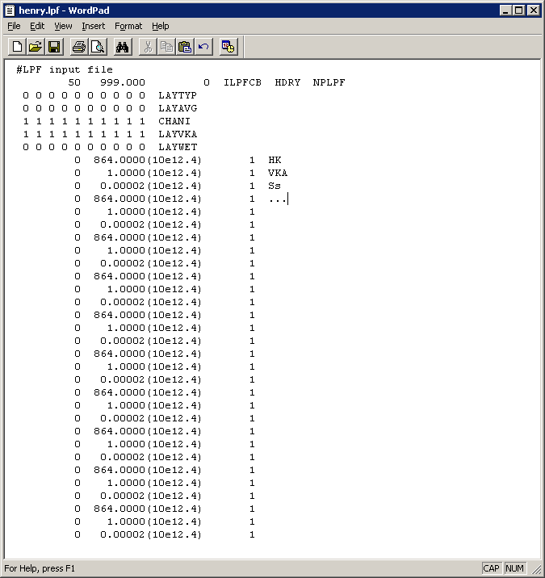
LPF Package
Substitute for Block-Centered Flow (BCF)
Internally LPF works like BCF
Layers are confined or convertible
Transmissivity, storage, and vertical leakage are based on saturation for convertible layers
Wetting and drying
Grid independent hydraulic properties
Specific storage when confined
Horizontal K even for confined layers
Vertical K or horizontal to vertical anisotropy ratio
Vertical K of quasi 3-D confining beds
NO MORE VCONT

Slide 34
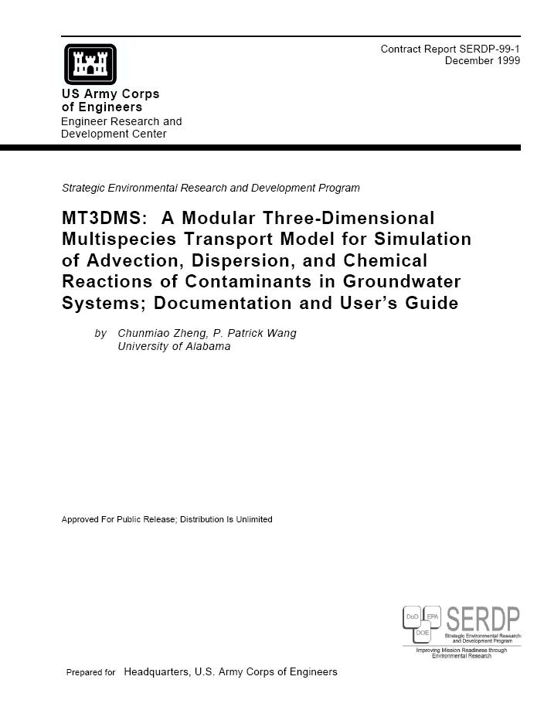
MT3DMS User Manual
http://hydro.geo.ua.edu/mt3d/mt3dmanual.pdf

Slide 35
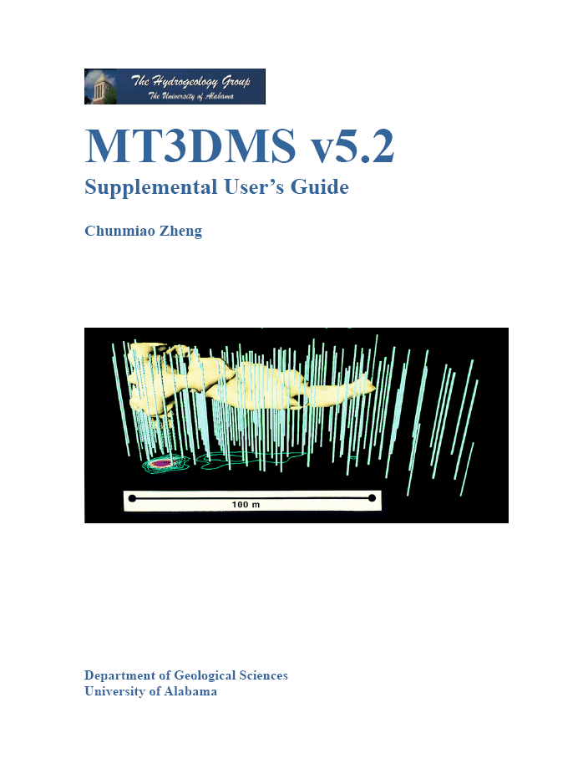
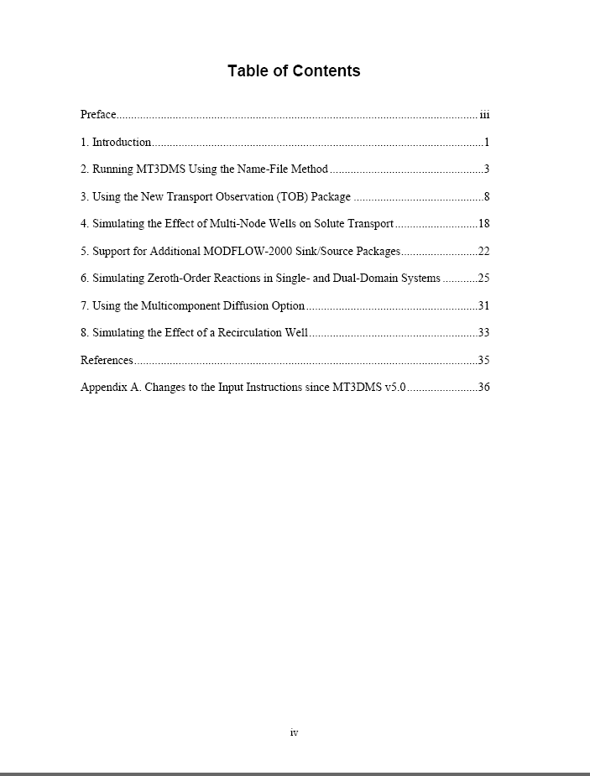
MT3DMS Supplemental Guide

Slide 36
Solution of the Transport Equation
ADV
DSP
SSM
RCT
Fundamental difficulty: the need to treat simultaneously the first-order (hyperbolic) advection term and the second-order (parabolic) dispersion term
first order
second order
Courtesy Chunmiao Zheng

Slide 37
Solution Methods
Eulerian
Fixed grid (standard finite difference or finite element)
Lagrangian
Deforming grid or deforming coordinate in a fixed grid (particle based)
Mixed Eulerian-Lagrangian
Combination of Eulerian and Langrangian methods

Slide 38
Solution Schemes (advection term)
Standard finite difference
Upstream weighting
Central-in-space weighting
Method of characteristics
Modified method of characteristics
Hybrid method of characteristics
3rd-order total-variation diminishing (TVD) [ultimate]
Courtesy Chunmiao Zheng

Slide 39
Courant Number
Number of cells, or fractional cell distance, that a particle is advected in one timestep

Slide 40
Method of Characteristics (MOC)
Each particle carries a volume and a concentration
Courtesy Chunmiao Zheng

Slide 41
Advantages and Limitation of Particle Methods
Advantages
Virtually eliminate numerical dispersion
Computationally efficient for highly advection-dominated problems
Disadvantages
May have mass balance discrepancy problems, particularly when model grid is highly irregular
Calculated concentration breakthrough curves may be “rough”
Computer memory intensive, particularly for multi-species simulations, with a set of particles for each species
Courtesy Chunmiao Zheng

Slide 42
Third-Order TVD (ULTIMATE)
Also referred to as higher-order finite-difference or finite-volume method.
TVD—Total Variation Diminishing
ULTIMATE—Universal Limiter for Transient Interpolation Modeling of the Advective Transport Equations
Courtesy Chunmiao Zheng

Slide 43
Advantages and Disadvantages of TVD
Advantages
Mass conservative
Minimal numerical dispersion and artificial oscillation for advection dominated problems
No numerical difficulty for distorted model grids or in the presence of many sinks/sources
Disadvantages
Could be computationally demanding
May not be as effective as MOC in eliminating numerical dispersion for purely advective problems
Courtesy Chunmiao Zheng

Slide 44
MT3DMS File Structure
INPUT
OUTPUT
Basic Transport Package
Basic Output File
Advection Package
Model Configuration File [mt3d.cnf]
Dispersion Package
Hydrocarbon Spill Source – v. 5.3
MT3DMS
Unformatted Concentration File [mt3d001.ucn]
Sink/Source Mixing Package
Transport Observations Package
Observation File [mt3d001.obs]
Reaction Package
GCG Solver Package
Mass Summary File [mt3d001.mas]
MODFLOW to MT3DMS link file
Courtesy Chunmiao Zheng

Slide 45
BTN Package
Purpose: to specify
Basic information
Spatial discretization
Boundary and initial conditions
Printing and saving options
Temporal discretization
Courtesy Chunmiao Zheng

Slide 46
Temporal Discretization
Stress periods
Flow timesteps
Transport timesteps
Transport timesteps
1
2
3
4
5
1
2
3
4
1
2
3
4
1
2
3
4
1
1
2
1
1
2
1
2
3
ts1
ts1
ts2
ts3
ts1
ts2
ts3
ts4
ts5
time
STRESS PERIOD 1
STRESS PERIOD 2
STRESS PERIOD 3

Slide 47
Basic Transport (cont.)
For each stress period
PERLEN (same as in MODFLOW)
NSTP (same as in MODFLOW)
TSMULT (same as in MODFLOW)
TSLNGTH(NSTP) (only for flow model other than MODFLOW)
DT0: maximum allowable transport stepsize
MXSTRN: maximum number of transport steps within one flow timestep
TTSMULT: transport stepsize multiplier within a flow-model timestep
TTSMAX: maximum transport stepsize within a flow model timestep (set to zero for no limit)
Courtesy Chunmiao Zheng

Slide 48
ADV Package
Purpose
To solve the advection components of the transport equation using one of the following options (through input variable MIXELM)
Finite Difference
Upstream weighting
Central-in-space weighting
Particle-Based Methods
MOC
MMOC
HMOC
TVD
Courtesy Chunmiao Zheng

Slide 49
DSP Package
Purpose: to solve the dispersion component of the transport equation, using the finite-difference technique
Courtesy Chunmiao Zheng

Slide 50
DSP Package (cont.)
AL (longitudinal dispersivity, unit L)
Cell-by-cell
2D array for each model layer
TRPT (ratio of horizontal transverse dispersivity to longitudinal dispersivity)
One value per model layer
Input as 1D array for all layers
TRPV
One value per model layer
Input as 1D array for all layers
DMCOEF
One value per model layer
Input as 1D array for all layers
D*=τD₀
Can now enter different DMCOEFF for each species (starting in version 5.2)
Courtesy Chunmiao Zheng

Slide 51
Generalized Conjugate Gradient (GCG) Solver
General purpose iterative solver
Three preconditioning options
Jacobi
Symmetric Successive Over Relaxation
Modified Incomplete Cholesky (MIC) (fewer iterations, more memory)
Lanczos/ORTHOMIN acceleration scheme
Two iteration loops (outer loop only required if matrix coefficients are a function of concentration: non-linear sorption)

Slide 52
SSM Package
Purpose: to solve the source and sink components of the transport equation
Courtesy Chunmiao Zheng

Slide 53
SSM Package (cont.)
Specify hydraulic sinks/sources
Point sinks/sources
Constant-head cells (ITYPE=1)
Wells (ITYPE=2)
Drains (ITYPE=3)
Rivers (ITYPE=4)
General-head boundaries (ITYPE=5)
…
Mass loading (ITYPE=15)
Distributed sinks/sources
Recharge
Evapotranspiration
Courtesy Chunmiao Zheng

Slide 54
SSM Package (cont.)
What is MXSS?
The maximum number of POINT sink/source cells (including constant-head cells) used in the flow model. It is only used for memory allocation purposes
How does MT3D know about the cell locations and flow rates of sinks/sources
Through the flow-transport link file saved by the LMT package in MODFLOW
Courtesy Chunmiao Zheng

Slide 55
SSM Package (cont.)
Time-varying constant-concentration cell (ITYPE=-1)
This overrides constant-concentration condition as defined in the BTN input (ICBUND<0)
Once a cell is defined as ITYPE=-1 it remains a constant concentration cell, but a new concentration value can be specified in different stress periods
Mass-loading source cell (ITYPE=-15)
Users specify Q*C directly (MT⁻¹)
Courtesy Chunmiao Zheng

Slide 56
SSM Package (cont.)
Specify concentrations of sinks/sources
Sinks
By default, concentration of all sinks set equal to that of aquifer at sink/cell locations
Default concentration of all sinks cannot be changed except for evapotranspiration
Sources
By default, concentration of all sources set equal to ZERO unless specified by user
Courtesy Chunmiao Zheng

Slide 57
SSM Package
Constant-head vs. constant concentration
A constant-head cell in MODFLOW is treated as a regular fluid sink/source (like a well). The new inflow/outflow rate through the constant-head cell is determined internally by MODFLOW
If the constant-head cell acts as a source (inflow), the source concentration is zero unless specified by the user in SSM input. If it acts as a sink (outflow), the sink concentration is always equal to that of the aquifer
A constant-head cell can be specified as a constant-concentration if so desired
Courtesy Chunmiao Zheng

Slide 58
SEAWAT Concept
Combine MODFLOW and MT3DMS into a single program
Insert MT3DMS into MODFLOW main program
Modify MODFLOW routines to solve the variable-density groundwater flow equation

Slide 59
SEAWAT Processes
Global (GLO) Process
Ground-Water Flow (GWF) Process
Variable-Density Flow (VDF) Process
Viscosity (VSC) Package
Integrated MT3DMS Transport (IMT) Process
Observation (OBS) Process
Sensitivity (SEN) Process
Parameters Estimation (PES) Process

Slide 60
Simulation Modes
 | Transport Excluded | Transport Included
Constant Density | GWF | GWF + IMT
Variable Density | VDF | VDF + IMT (uncoupled) VDF + IMT (coupled)

Slide 61
Optional Simulation Mode: VDF without Transport
User enters 3D array of fluid density
Caution—assumption is that fluid density will not change during the simulation period
Advantage: simulations run quickly because not limited by stability requirements for transport equation

Slide 62
Spatial Discretization
Information must be consistent between MODFLOW and MT3D
Higher level of vertical discretization required for variable-density groundwater flow (rule of thumb—~10 layers per aquifer)

Slide 63
Temporal Discretization
Stress periods
Flow timesteps
Transport timesteps
Flow and transport equations solved for each transport timestep
Transport timesteps
1
2
3
4
5
1
2
3
4
1
2
3
4
1
2
3
4
1
1
2
1
1
2
1
2
3
ts1
ts1
ts2
ts3
ts1
ts2
ts3
ts4
ts5
time
STRESS PERIOD 1
STRESS PERIOD 2
STRESS PERIOD 3

Slide 64
Options for Coupling Flow and Transport
Explicit—one timestep lag
Works well for most problems
Iterative—repeat solutions until convergence on fluid density
Can only be used if transport is solved using implicit finite difference
Can be time consuming and doesn’t seem to help with accuracy for problems tested thus far

Slide 65
Time-Variant Constant-Head Package
Constant heads read as h and converted to h_{f} for use in the flow equation
Works same as for constant-density MODFLOW simulations

Slide 66
Options for Specifying Constant Head Boundaries
Set in BAS6
h_{f} calculated from h and starting concentrations. h_{f} held constant for simulation
Can’t change h during simulation
Set in CHD Package
h_{f} calculated from temporally interpolated h and simulated concentration
Issue with MT3DMS boundary (ITYPE=1)

Slide 67
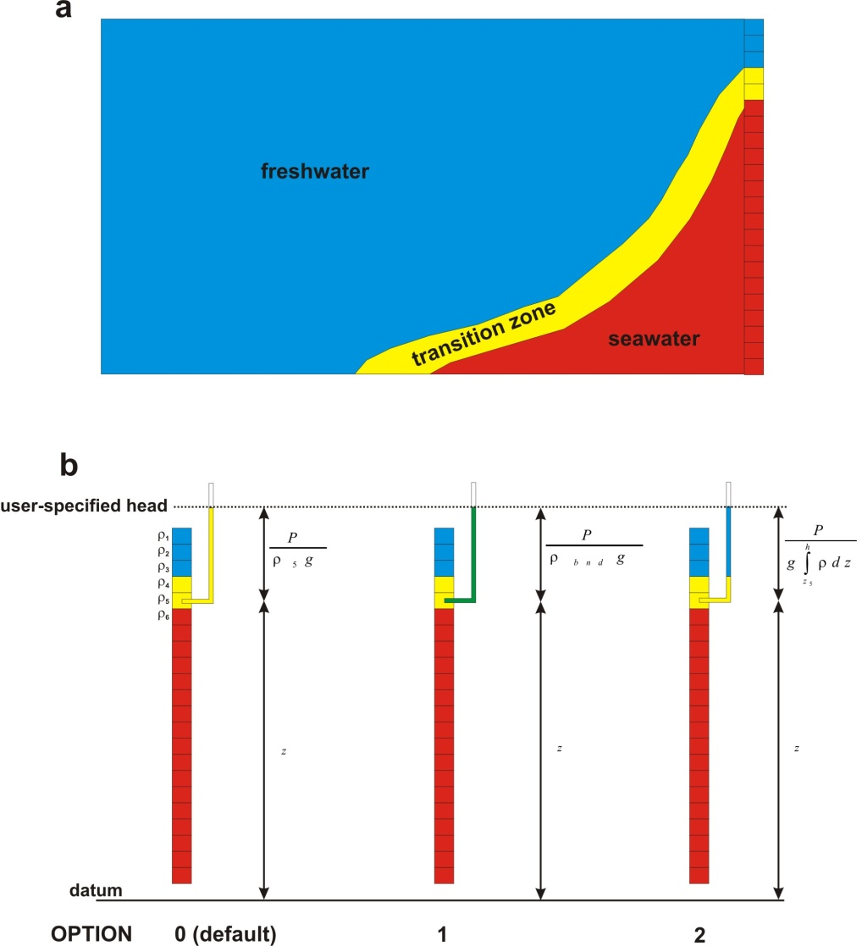
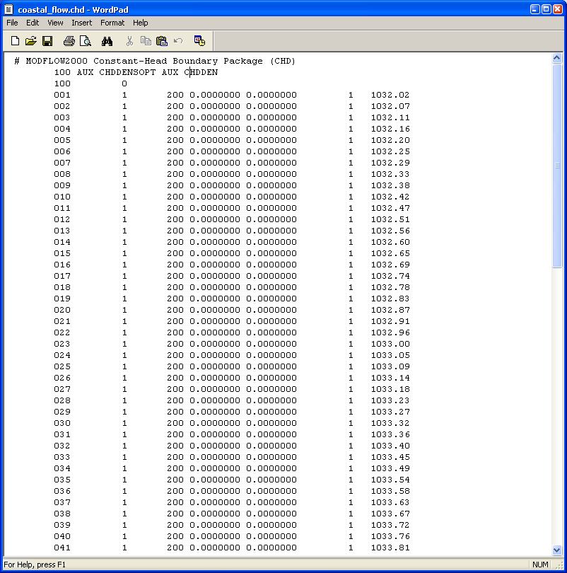
Options for CHD Boundaries

Slide 68
Name File
Name file is requested when SEAWAT Version 4 runs
Contains filetype, unit number, filename
Contains file information for:
MODFLOW-2000 files
MT3DMS files
Variable-Density Flow (VDF) input file
Viscosity Package (VSC) input file [optional]
FloPy creates valid SEAWAT Version 4 name file

Slide 69
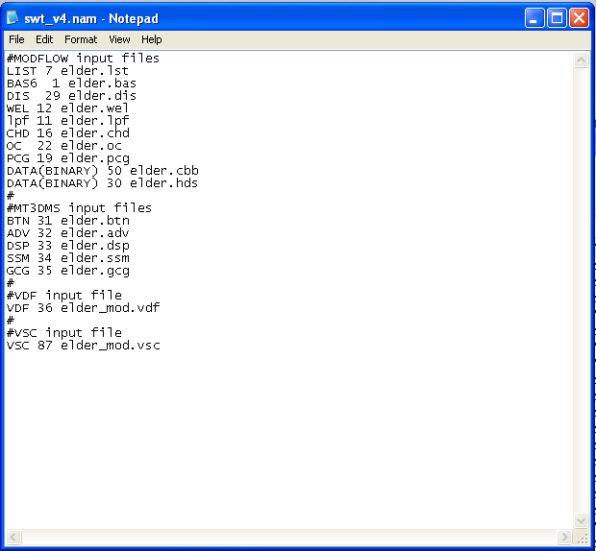
Example Name File

Slide 70
VDF File (cont.)
FOR EACH SIMULATION
0. [#Text]
Item 0 is optional and the symbol # must be in column 1. Item 0 can be repeated multiple times, but it cannot be used in the file after the first data record.
1. MT3DRHOFLG MFNADVFD NSWTCPL IWTABLE
2. DENSEMIN DENSEMAX
Read Item 3 if NSWTCPL > 1 or NSWTCPL = -1
3. DNSCRIT
Read Item 4 if MT3DRHOFLG ≥ 0
4. DENSEREF DRHODC(1)
Read Item 4a through 4c if MT3DRHOFLG = -1
4a. DENSEREF DRHODPRHD PRHDREF
4b. NSRHOEOS
4c. MTRHOSPEC(NSRHOEOS) DRHODC(NSRHOEOS) CRHOREF(NSRHOEOS)
Item 4c is read as a table, with one row representing each MT3DMS species to be included in the equation of state for fluid density. There is no requirement that this table be sorted by MTRHOSPEC.
5. FIRSTDT
FOR EACH STRESS PERIOD
Read Items 6 and 7 only if MT3DRHOFLG = 0
6. INDENSE
Read Item 7 only if INDENSE is greater than zero
7. [DENSE(NCOL,NROW)] – U2DREL
Item 7 is read for each layer in the grid.

Slide 71
DENSEREF and DENSESLP
Concentration
units | freshwater | seawater
mg/L | 0 | 35,000
g/L | 0 | 35
lbs/ft³ | 0 | 2.188
relative | 0 | 1
Density
units | Freshwater (DENSEREF) | seawater
g/cm³ | 1 | 1.025
kg/m³ | 1000 | 1025
lbs/ft³ | 62.42 | 63.98
Example:
use concentration in mg/L and density in kg/m³
Density length units must be same as length units used for model grid, hydraulic conductivity, etc.

Slide 72
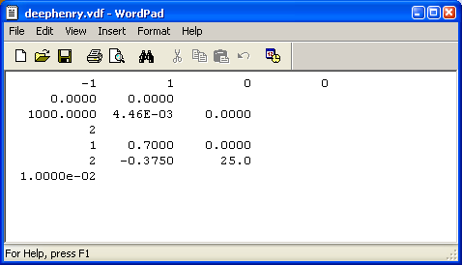
Density Equation of State
Multiple-species
Temperature
Water Compressibility

Slide 73
VSC Input File
By including in name file will activate the VSC option
VSC file is created by FloPy
Have multiple options from manual
Concentration
Temperature

Slide 74
VSC File
FOR EACH SIMULATION
0. [#Text]
Item 0 is optional and the symbol # must be in column 1. Item 0 can be repeated multiple times.
1. MT3DMUFLG
2. VISCMIN VISCMAX
Read item 3 if MT3DMUFLG ≥ 0
3. VISCREF DMUDC(1) CMUREF(1)
Read item 3a through 3c if MT3DMUFLG = -1
3a. VISCREF
3b. NSMUEOS MUTEMPOPT
3c. MTMUSPEC(NSMUEOS) DMUDC(NSMUEOS) CMUREF(NSMUEOS)
Item 3c is read NSMUEOS times, once for each MT3DMS species to be included in the viscosity equation.
3d. MTMUTEMPSPEC AMUCOEFF(MUNCOEFF)
Item 3d is read if MUTEMPOPT > 0. The size of the AMUCOEFF coefficient array depends on the selected equation for viscosity.
FOR EACH STRESS PERIOD
Read items 4 and 5 only if MT3DMUFLG = 0
4. INVISC
Read item 5 only if INVISC is greater than zero
5. [VISC(NCOL,NROW)] – U2DREL
Item 5 is read for each layer in the grid.

Slide 75
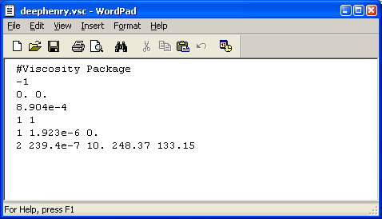
Constitutive Relation for Viscosity
or
MUTEMPOPT
1
2
3
e.g. SUTRA

Slide 76
Special Considerations for Packages
All input and output is expressed in terms of head (not equivalent freshwater head)
All storage and hydraulic properties must be represented in terms of equivalent freshwater values (or relative to the reference density)

Slide 77
Model Results of Interest
Listing Files
Flow budget
Solute mass budget
Heads
Flows
Concentrations
Unformatted concentration file
Concentration observations
Solute mass budget

Slide 78
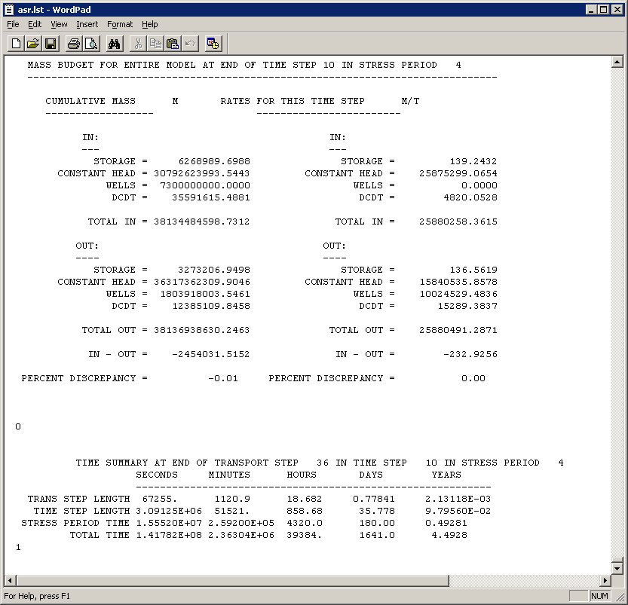
Flow Budget

Slide 79
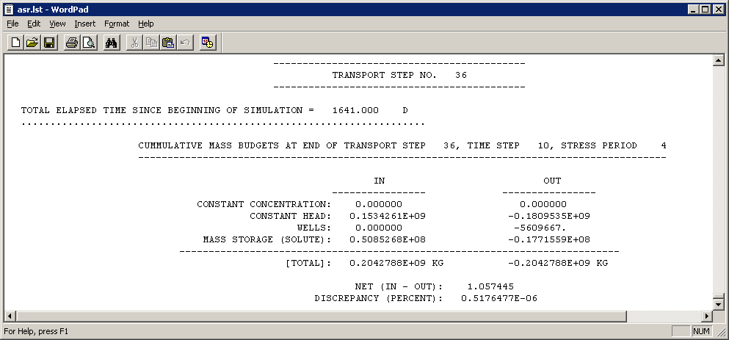
Solute Budget

