Slide 1
Old Technology – Windows’ Batch Files
I told some friends I was giving a presentation on batch files and they laughed. I guess because they thought it was such old tech or unworthy of discussion?
I like batch files and think they are still relevant because you can create self-documenting scripts that you can evolve and perfect over time.
Does anybody use Windows' batch files?
On a previous job I had I was the build master. It was then I had to get serious about writing reliable batch files which forced me to refactor many of my batch files and became the foundation for this talk.

Slide 2
Table of Contents
Part I – The Problem: Many batch files have spaghetti code.
Part II – The Answer in my opinion is functionalization.
Part III – How customization can increase your productivity.
Part IV – Live Demo.
Part V – Setting Up the Repository.

Slide 3
Part I of V - The Problem: Most Batch Files Are A Mess
Most batch files I've seen in the wild are pretty messy. They are often quite long and not well structured. I know this partly because I've written hundreds of them over the years that were a mess. I like to think I'm a little better now.
For Example, I googled "typical batch file" and this was the first hit:
https://www.instructables.com/id/5-Cool-Batch-Files/

Slide 4
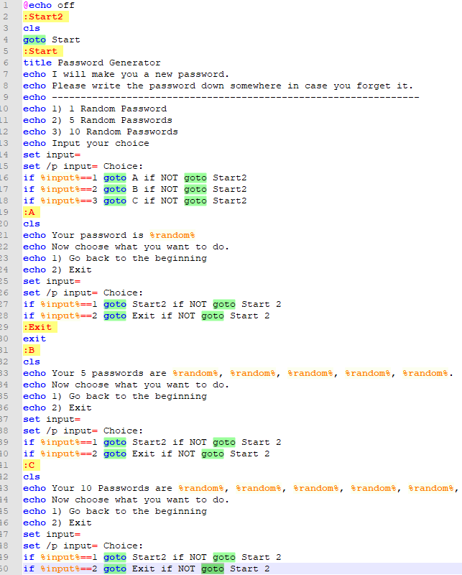
This small file has 19 goto statements! Makes my head hurt looking at it.
The lack of a standard structure is a problem and leads to code that is hard to follow and understand.

Slide 5
Part II of V - How to Modularize?
So let's impose some structure. In most programming languages there's a concept of a function. At the heart of Composable Batch Files is the enforcing the use of traditional functions or decoupled code blocks.
Anatomy of a function. Here are the basic structural elements:
* [label] = function name (which must be unique within the file).
* call :[label] = function call to another function in this batch file.
* goto [label] = also a function call, which does not return to the caller. Use judiciously.
* call [batch2] [label] = call to another batch file function.
* exit/b = end of function. The lack of exit/b is the most common culprit. Without ending functions, you have spaghetti code.

Slide 6
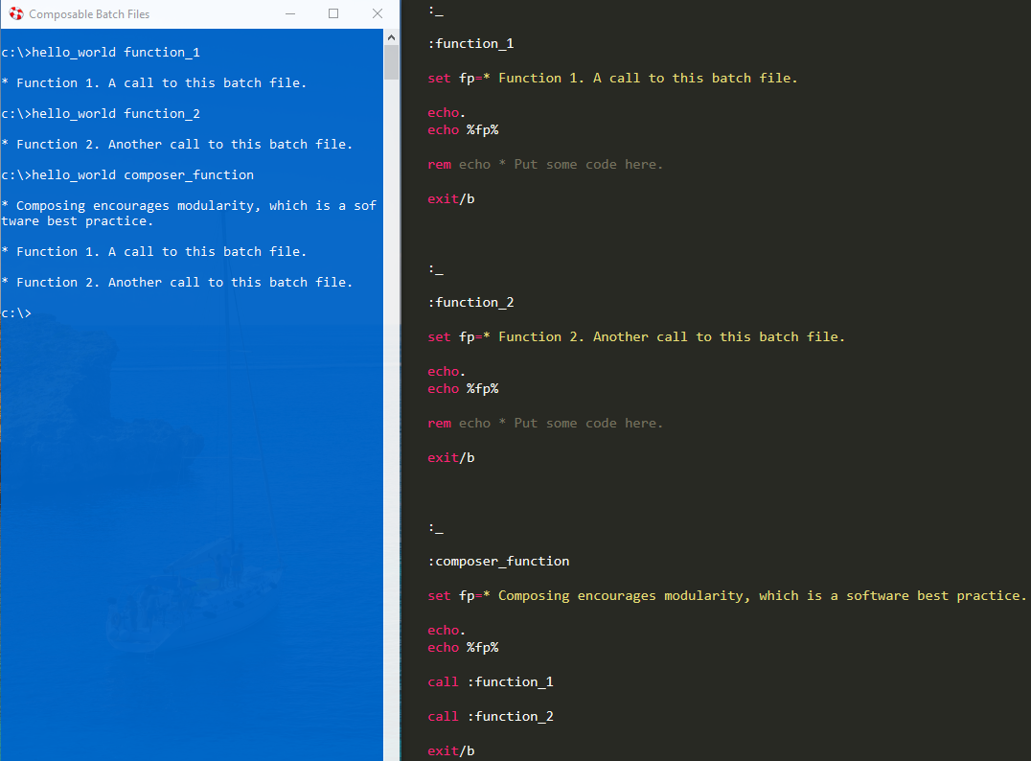
Hello World - A Functionalized Approach
Building the batch file around the a set of functions can turn a normally disorganized environment into a structured and organized one.

Slide 7
Part III of V: Customize CBF by Leveraging Environment Variables
Besides functionalization, another feature CBF promotes is leveraging environment variables in order to customize your CBF user experience. This is achieved by mapping nicknames/function names to environment variables. There is a CBF file named n.bat (Nicknames Dictionary) whose sole purpose is to do this mapping. For example, in n.bat, you could add a function with the nickname/function name of "docs" which maps the Documents folder to the cbf_path environment variable. Then because another batch file td.bat (Transform Directory) makes use of this mapping, typing "td docs" would navigate to the documents folder.
This is like creating a bookmark for a folder.

Slide 8
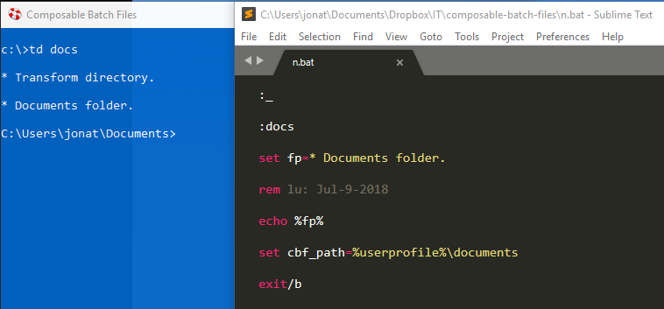
TD is probably my favorite CBF because it speeds up navigating the file system.

Slide 9
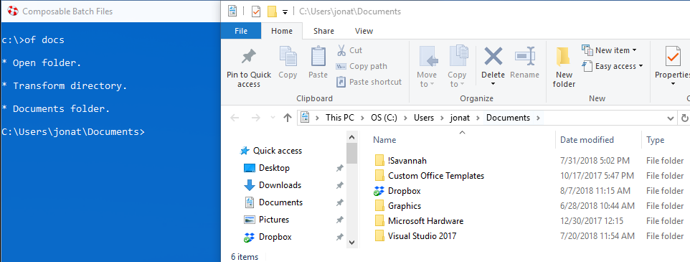
Leverages the same environment variable.
Since of.bat (Open Folder) also leverages the "cbf_path" environment variable, typing "of docs" would open the documents folder in Windows Explorer.

Slide 10
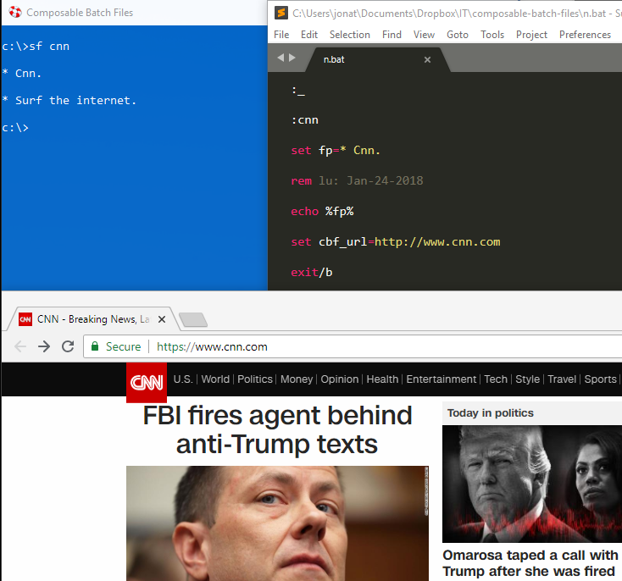
Sf.bat (Surf) leverages the "cbf_url" environment variable. Acts a like a text-based bookmark.

Slide 11
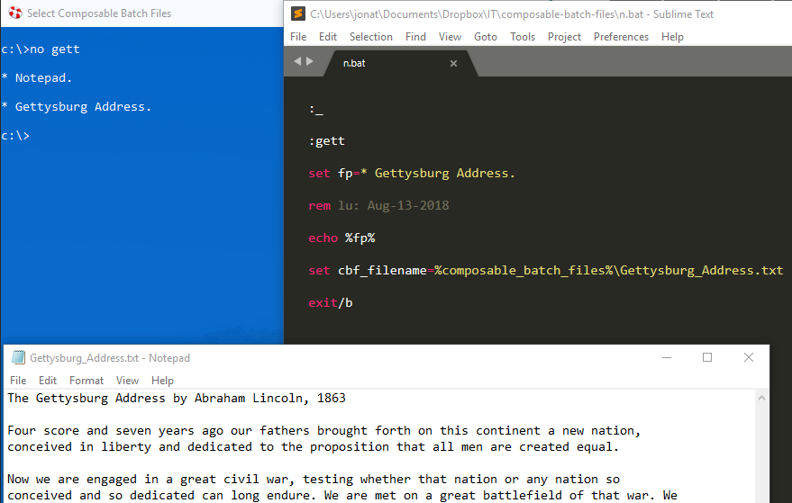
No.bat (Notepad) leverages the "cbf_filename" environment variable. Like a bookmark for a filename.

Slide 12
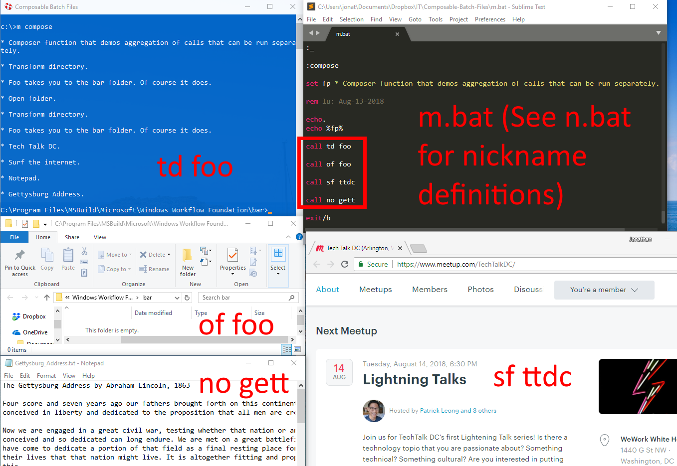
Composer Method – Run them all together.

Slide 13
Part IV of V: Live Demo
Hello_World, function_1, function_2, composer
Just to prove it works, run: m compose
1 of my favorite out-of-the-box batch files I use on a regular basis.
Run cs.bat, td ux (Entire Xamarin University Catalog),
cs UriImageSource *.cs

Slide 14
Part V – Repo Setup Instructions
Add %COMPOSABLE_BATCH_FILES% as an environment variable or, at least, add it to your path to where you installed the repository.
If you so choose, also add these environment variables for the following:
* %CBF_DEFAULT_BROWSER%
* %CBF_DEFAULT_TEXT_EDITOR%

Slide 15
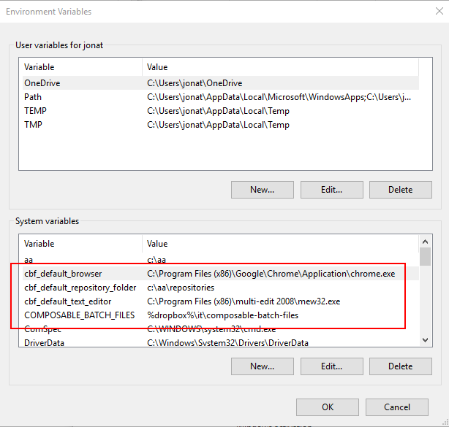
Here's an example of how to set some CBF default environment variables:

Slide 16
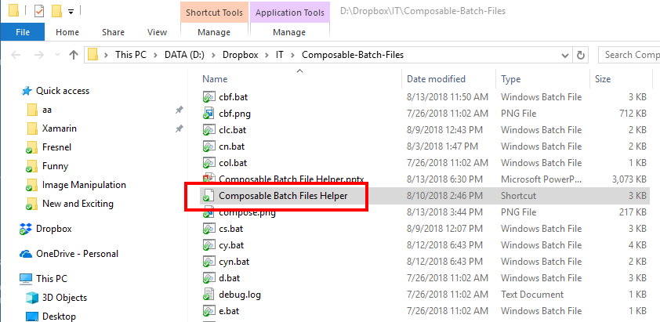
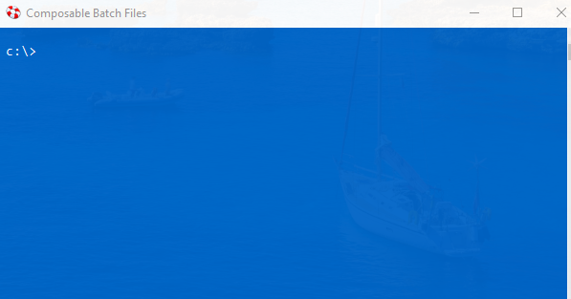
Blue Command Prompt
After you have cloned or downloaded the CBF repository, double click the shortcut titled "Composable Batch Files Helper" to open up a blue command prompt, which will initialize your environment.

Slide 17
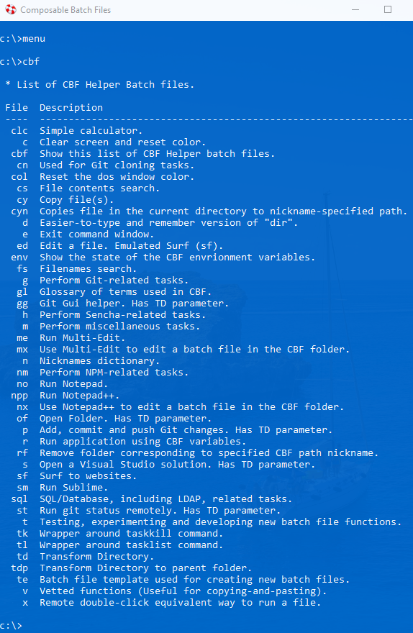
Menu
To see a menu of all of the out-of-the-box available CBFs type "menu" or "cbf" at the prompt.
All of the batch files in CBF use a functionalized, modular approach.

Slide 18
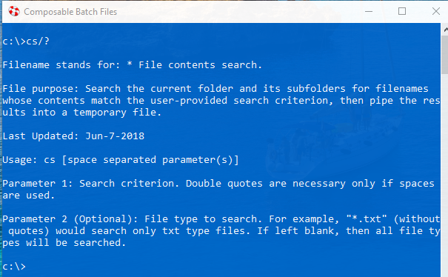
Getting Help
To get help with a particular batch file, at the prompt type "[batch file name]/?". For example:

Slide 19

Questions? To download and for more info., see:

