Slide 1
Data is the new gold? Then why don’t we have quality checks?

Slide 2
Base case: Data Dimensions available
Synthetic data can be generated accordingly if data dimensions/ variables are known
Through the use of unbiased data, any model bias is revealed by analyzing the model output on the unbiased dataset
This way, the actual dataset as well as the model itself does not have to be made public by the audited corporation
Must also closely mirror the data pre-processing steps as feature extraction/ generation is highly adopted

Slide 3
Reliance on Disparate Impact: Protected Groups
Model bias analysis currently relies on having pre-defined protected group
US law describes this as “Disparate Impact”, where a particular protected group is negatively affected by practices in employment, housing etc
Protected groups include race, color, religion, national origin, and sex
The protected group needs to be known in advance in order to control for that in the model analysis
Without the knowledge of a protected group or for a newly emerging protected group, current techniques do not detect bias properly
In some cases, traditional views on disparate impact might be out-of-date e.g. women in education

Slide 4
Removal of Protected Group from Data
In many instances, the protected group is simply removed from the data, e.g. omitting the column indicating sex or race
There might be other correlated data dimensions that closely mirror this protected group
If these columns are not removed at the same time, bias can still appear; though bias will not be detected with existing bias detection tools
Example: Health services company ‘Optum’ removed protected group (race) from dataset but racial information was still reflected by other columns, leading to undetected bias
Notes:
https://www.washingtonpost.com/health/2019/10/24/racial-bias-medical-algorithm-favors-white-patients-over-sicker-black-patients/

Slide 5
Realistic Case: Dimensions not available
Not only do companies not want to disclose their models and data, they most likely also do not want to disclose the data dimensions used
With the variables used being public, competitors can easily replicate the data acquisition and modeling process
Without knowing the data dimensions, how can we
closely mirror the true data generative process for dataset simulation?
identify model bias without information of a protected group?

Slide 6
Existing Solutions - IBM
IBM developed the product AI Fairness 360, targeting data scientists that want to actively remove bias from their modeling process
Several functions during pre-processing including
Adversarial debiasing
Disparate Impact Remover using protected group
Functions for post processing bias removal
(Calibrated) Equality of Odds
Reject Option Classification giving favorable outcome to protected/ unprivileged group
Notes:
https://github.com/IBM/AIF360/blob/master/examples/demo_disparate_impact_remover.ipynb
https://aif360.readthedocs.io/en/latest/modules/postprocessing.html

Slide 7
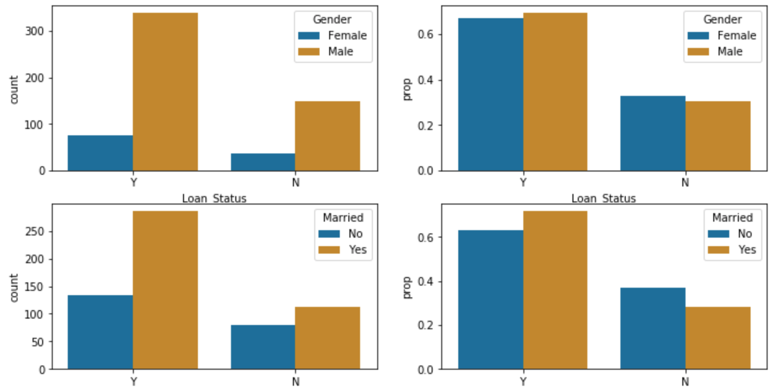
Case Study: Loan Application
Dataset includes 12 variables and the binary decision variable
Gender amongst the 12 variables, making it the protected group; there also several other dimensions with the potential of a protected group e.g. Married and Education
Significantly more data on male applicants and also a higher chance of male applicants being granted the loan, although not as significant as the total difference in training examples
High absolute difference in granted loans between married and not married though smaller difference in the not-granted section. Probabilities also much larger for married cases

